Slide 1
A
Project Proposal
On
“English to Sign Language Translation using Python”
Presented By:-
Sujit Adhikari( NCE078BCT044 )
Sarishma Neupane ( NCE078BCT038 )
Prayash Niraula ( NCE078BCT029 )
Ranjit Adhikari( NCE078BCT031 )

Slide 2
Overview
Introduction
Literature Review
Literature Review
Literature Review
Problem Statement
Objectives
Scope
Proposed Methodology
Proposed Methodology
Proposed Methodology
Expected Output
References

Slide 3
Introduction
Background
Transforms the voice or text inputs in the form of Sign language animation or video.
Development of comprehensive dataset of sign language gestures.
Natural Language Processing (NLP) and pyaudio for real-time interpretation for text and voice input respectively.
Aims to provide minimum delay with maximum efficiency.

Slide 4
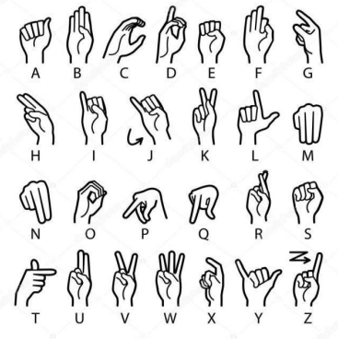
Literature Review
P. Chaudhari, P. Pathrabe, U. Ghatbandhe, S. Mondal, and S. Parmar, "Sign Language Detection System," 2022.

Slide 5
Literature Review
T. Petkar, T. Patil, A. Wadhankar, V. Chandore, V. Umate, and D. Hingnekar, "Real Time Sign Language Recognition System for Hearing and Speech Impaired People," 2022
- Uses American Sign Language letters
- Takes voice or text as input and provide sign language
animation as output using computer avatars.

Slide 6
Literature Review
E. P., R. K. M., R. A. S., V. V., and Y. A., "Speech To Sign Language Translator For Hearing Impaired," 2021
- Takes audio input from user
- If the word is not found locally, the system searches the "Indian Sign Language Portal."
- Uses web scraping to play the corresponding sign language video sequence.

Slide 7
Problem Statement
Communication between normal people and the hearing and speaking impaired is challenging due to lack of system implemented.
Existing sign language recognition systems have limitations:
i. Low accuracy.
ii. Difficult interfaces.
No sign language recognition system exists in industry.

Slide 8
Objective
Aim:-
The aim of this project is to develop an AI-based English to sign language translation system to enhance communication accessibility for individuals with hearing impairments.
Objectives:
To comprehend the daily challenges encountered by individuals with disabilities and to devise a solution that is:
Cost-effective
Widely adaptable
User-friendly
Understanding the needs of the impaired community, we aim to create a solution that makes a meaningful impact.
To enhance the physical and mental well-being of people with disabilities, ultimately improving their overall quality of life.
To provide a Universal Sign Language Recognition System.

Slide 9
Scope
Enhances learning tools for deaf students, improving educational opportunities.
Improves communication between healthcare providers and deaf patients, addressing critical needs in the healthcare sector.
Provides training programs in the workplace, promoting employment opportunities for the deaf and hard-of-hearing community.
Advances accessibility and inclusivity in digital content, offering subtitles and real-time sign language translations.
Fosters social integration, raises awareness, and promotes inclusivity, helping bridge communication gaps in various sectors, including public services, customer service, retail, and e-commerce.

Slide 10
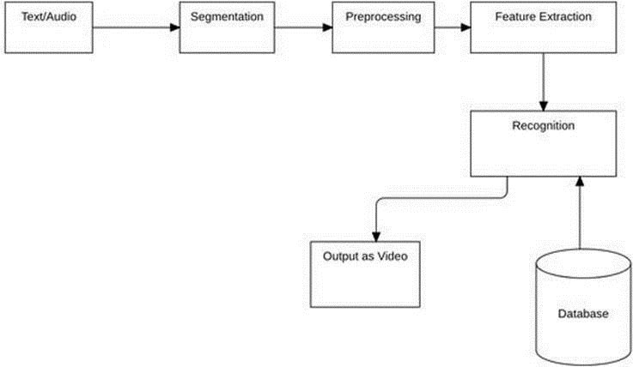
Proposed Methodology
Figure1: System block diagram

Slide 11
Proposed Methodology
Text/Audio Input: User provides text or audio input to generate a sign language video.
Segmentation: System classifies and isolates words and letters from the text.
Preprocessing: Text undergoes preprocessing to ensure clarity and accuracy.
Feature Extraction: Extracts relevant features for mapping text to sign gestures.
Recognition: NLP algorithm converts features to tokens and matches sign gestures.
Output as Video: Sign language gestures and corresponding text are displayed in sync.

Slide 12
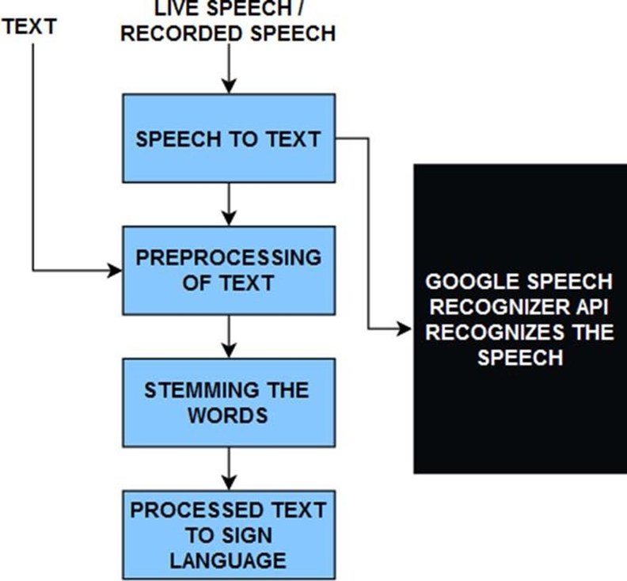
Proposed Methodology
Algorithm to be used:
Fig2: Porter Stemming Algorithm Flowchart

Slide 13
Proposed Methodology
Porter Stemming Algorithm
Removing Suffixes: Cuts off endings like "ing," "ed," and "ly" to find the base word.
CVC Rules: Adjusts short words that end in consonant-vowel-consonant patterns.
Doubling Final Consonants: Simplifies words with doubled last consonants, changing "hopping" to "hop".
Handling Plurals: Turns plural words into their singular form, like "cars" to "car."
Changing Y to I: Changes "y" to "i" in words where "y" follows a consonant, such as "happy" to "happi."
Managing Irregular Words: Correctly stems words that don't follow regular patterns.

Slide 14
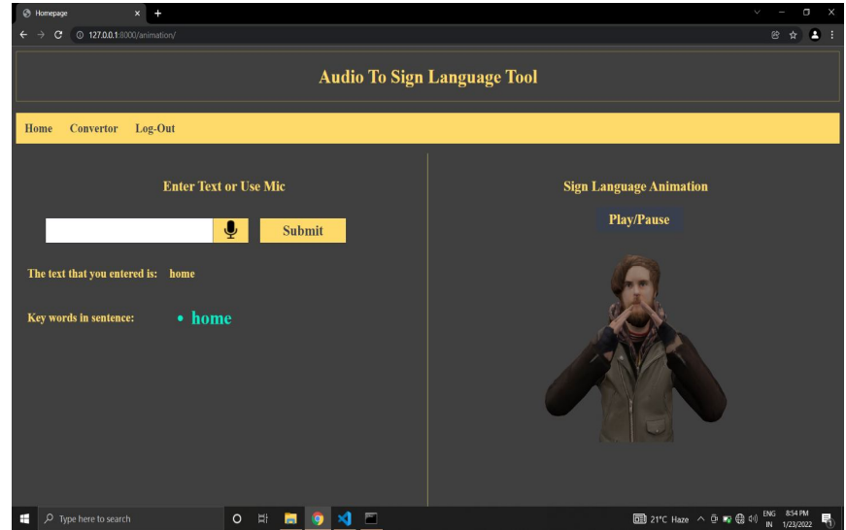
Expected Output
Sign language videos corresponding to the input text or voice, displaying the appropriate gestures.

Slide 15
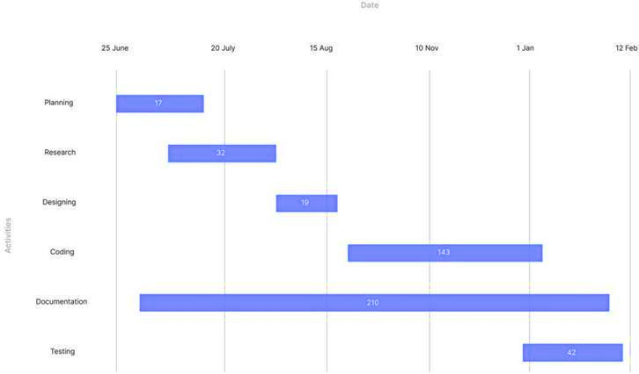
Project Timeline
Figure3 :Gantt chart

Slide 16
References
S. Prabhu, S. Shetty, S. P. Suvarna, V. Sanil, and J. N., "Sign language Recognition Using machine learning," 2022.
E. P., R. K. M., R. A. S., V. V., and Y. A., "Speech To Sign Language Translator For Hearing Impaired," 2021.
P. Chaudhari, P. Pathrabe, U. Ghatbandhe, S. Mondal, and S. Parmar, "Sign Language Detection System," 2022.
T. Petkar, T. Patil, A. Wadhankar, V. Chandore, V. Umate, and D. Hingnekar, "Real Time Sign Language Recognition System for Hearing and Speech Impaired People," 2022.
B. S. Parton, "Sign Language Recognition and Translation: A Multidisciplinary Approach from the Field of Artificial Intelligence," 2022.
"Deep Sign: Sign Language Detection and Recognition Using Deep Learning," 2022.

Slide 17
Thank You

