Slide 1
Assignment 1
CPS 584 - Advanced Intelligent Systems and Deep Learning
Prof - Dr. Tam Nguyen
Team Members
Connar Hite
Ranjita Piratla
Sean Saud
Monika Somu
T.Shiva Harshith Varma

Slide 2



Extracting Haar like features
Implemented a function for calculating integral image pixel values from the given image.
For the first pixel
For the pixels in the first row and first column
For the rest of the pixels

Slide 3
Extracting Haar like features cont
We then created a matrix of 30 dimensions of estimated coordinates of white regions of the given 30 rectangles.
For eg: Below are the coordinates of 5 rectangle’s white regions
[3, 3, 45, 45, -1, -1, -1, -1; % rec feature 1
4, 3, 18, 7, -1, -1, -1, -1; % rec feature 2
15, 18, 19, 45, -1, -1, -1, -1; % rec feature 3
4, 28, 7, 40, -1, -1, -1, -1; % ... 4
4, 25, 40, 36, -1, -1, -1, -1; ] % ... 5

Slide 4
Extracting Haar like features cont
Using this, we found the sum of white and black regions of each of the testing and training data.
We then extracted the haar-like features using the given formula for the rectangle sum given an integral image.

Slide 5
K-Nearest Neighbors (KNN) Algorithm
Two machine learning models are trained and tested on Haar features of rose and tulip images.
One of the models is K-nearest neighbor (KNN), during the training phase, the Euclidean distance between each testing and training feature is calculated and stored in a 2D array called knn.
The K array is used to set the number of nearest neighbors for the KNN model to 1, 3, 5, and 7.

Slide 6
K-Nearest Neighbors (KNN) Algorithm Cont.
The labels of the nearest neighbors are retrieved and the label that appears most frequently is chosen as the predicted label for the testing image.
The accuracy of the KNN model is computed for each number of nearest neighbors and the results are stored in the accuracy_knn array.

Slide 7
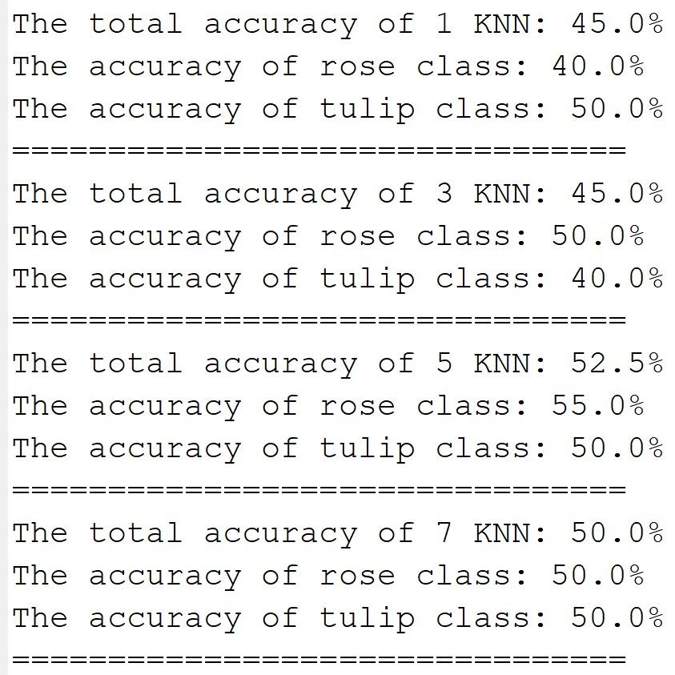
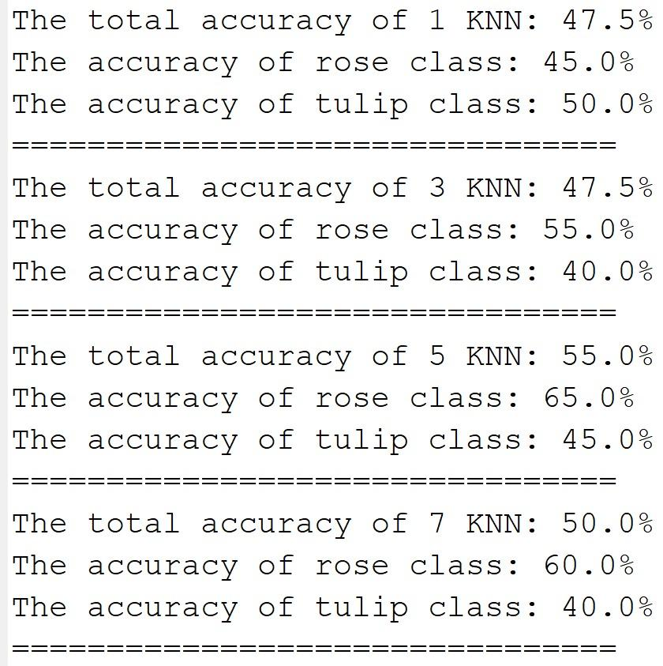
K-Nearest Neighbors (KNN) Algorithm Cont.
The percentage of correctly classified images is calculated and shown in the figure below

Slide 8
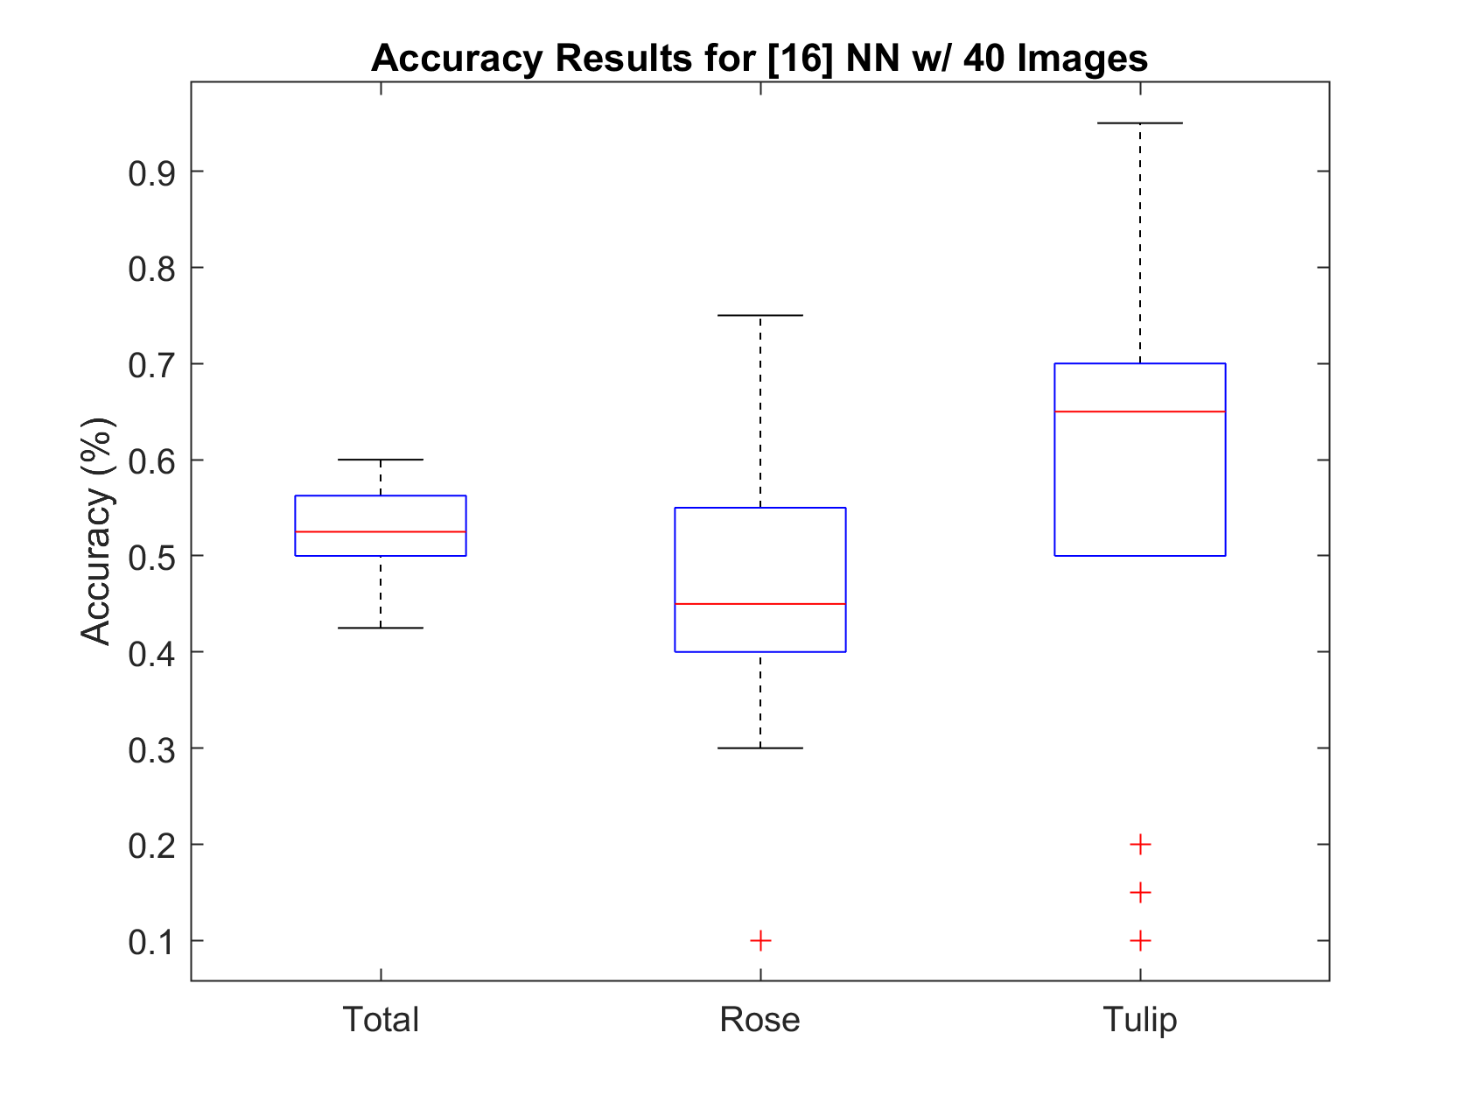
Neural Networks (NN)
Total: 52.5%
Rose: 47.7%
Tulip: 57.25%

Slide 9
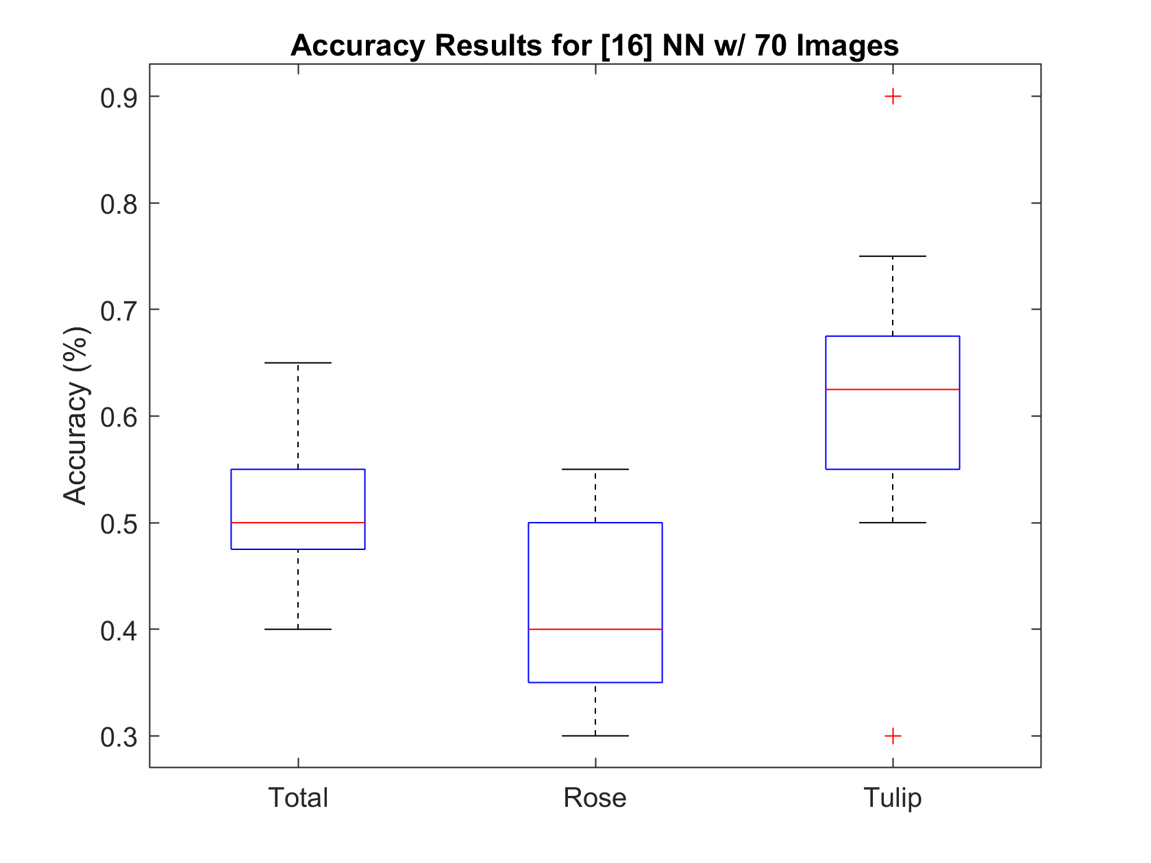
Neural Networks (NN) Cont.
Total: 51.125%
Rose: 41.75%
Tulip: 60.5%

Slide 10
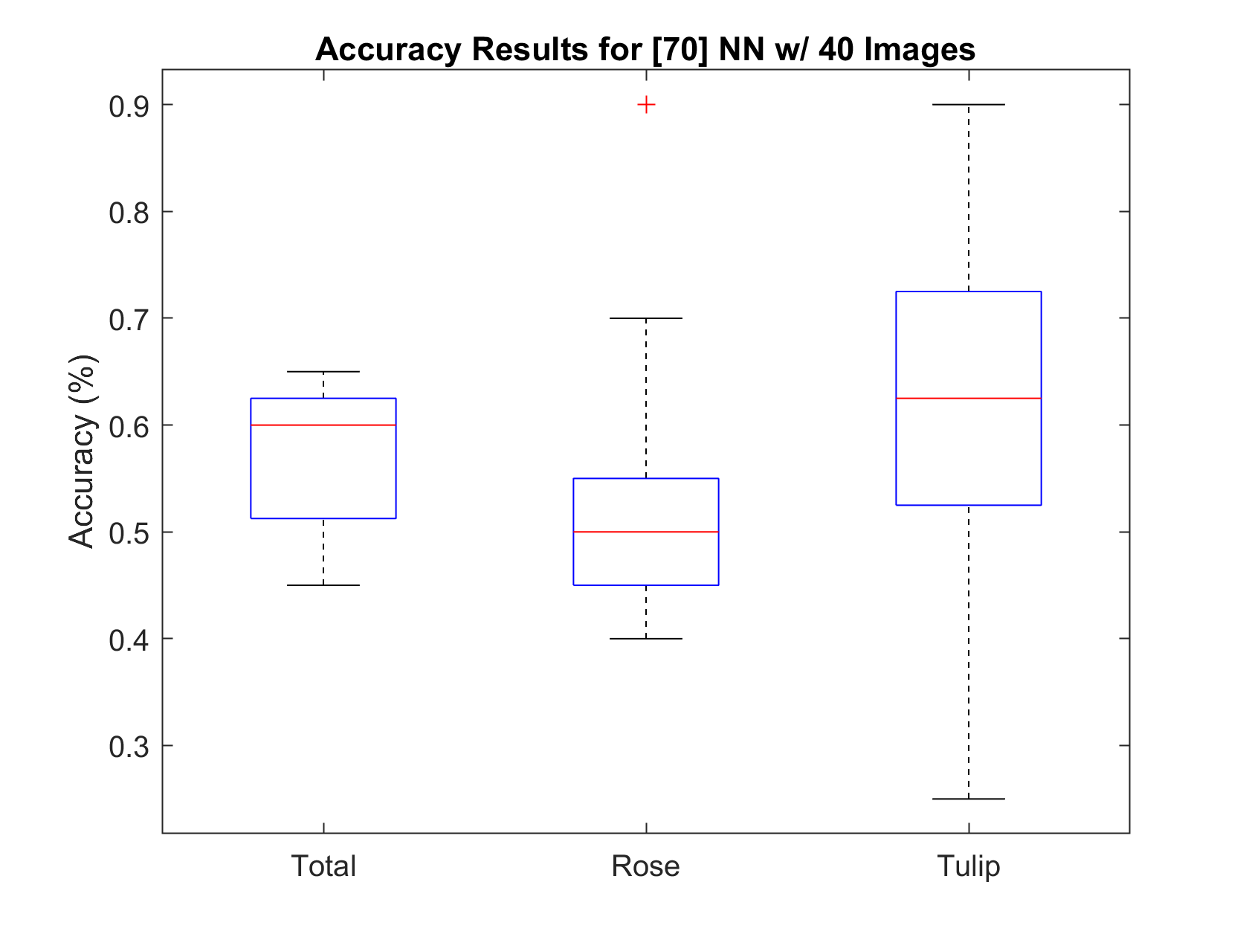
Neural Networks (NN) Cont.
Total: 57.25%
Rose: 53.5%
Tulip: 61%

Slide 11
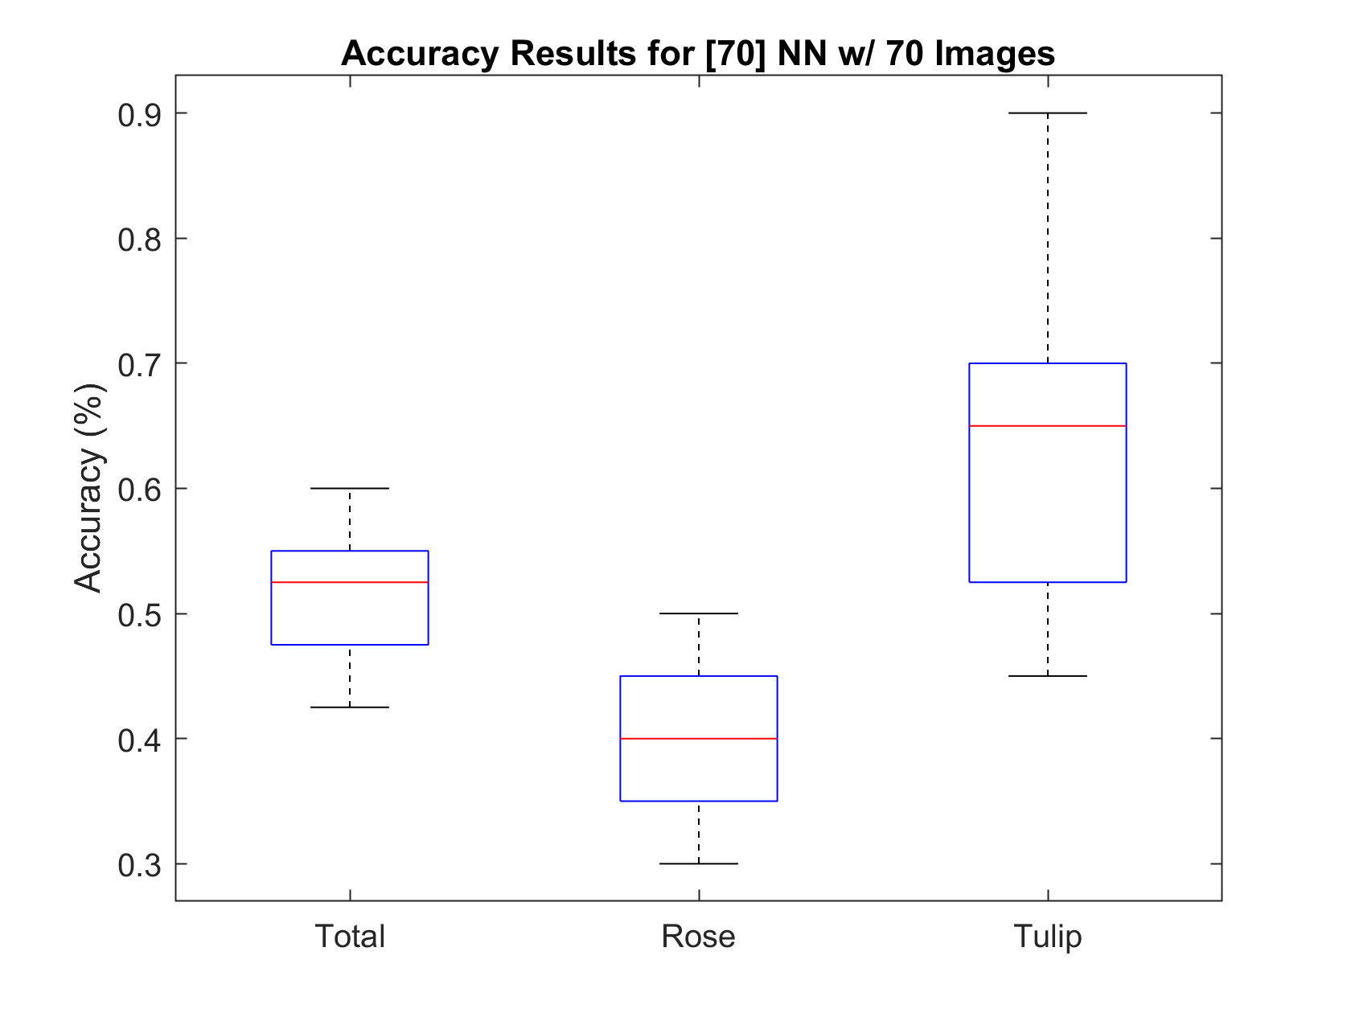
Neural Networks (NN) Cont.
Total: 51.875%
Rose: 41.25%
Tulip: 62.5%

Slide 12
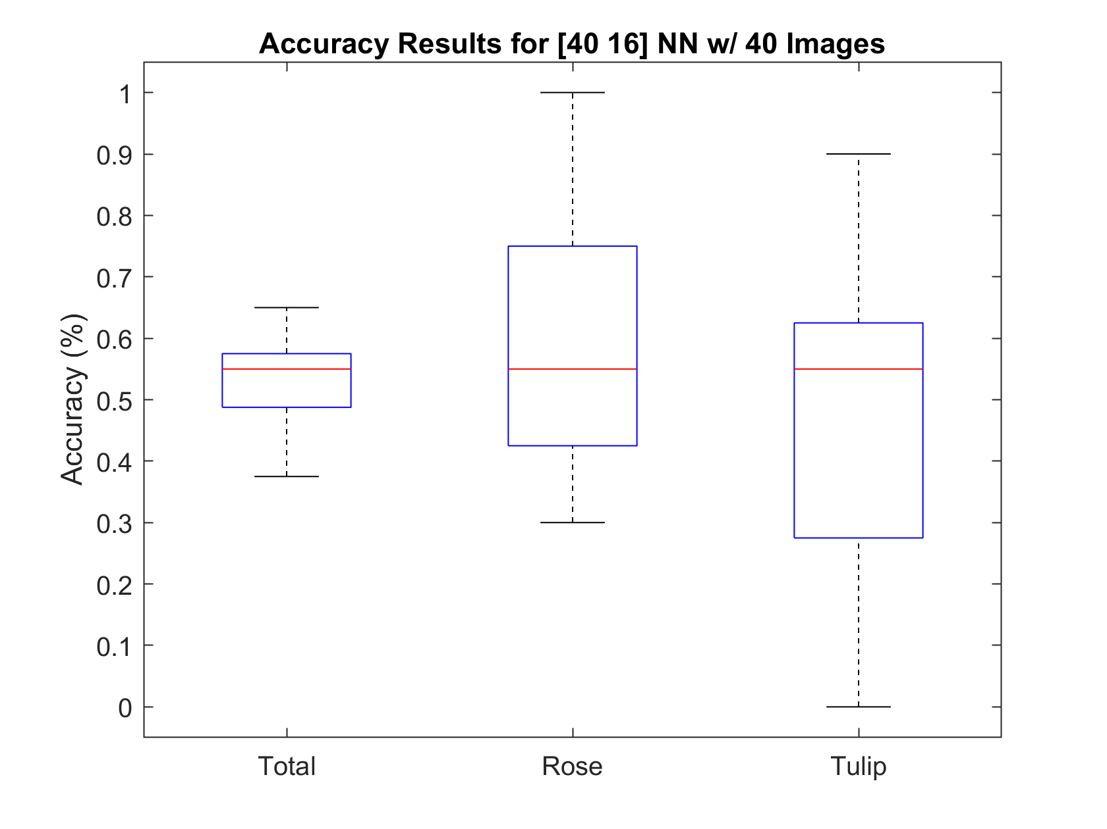
Neural Networks (NN) Cont.
Total: 53.125%
Rose: 60.25%
Tulip: 46%

Slide 13
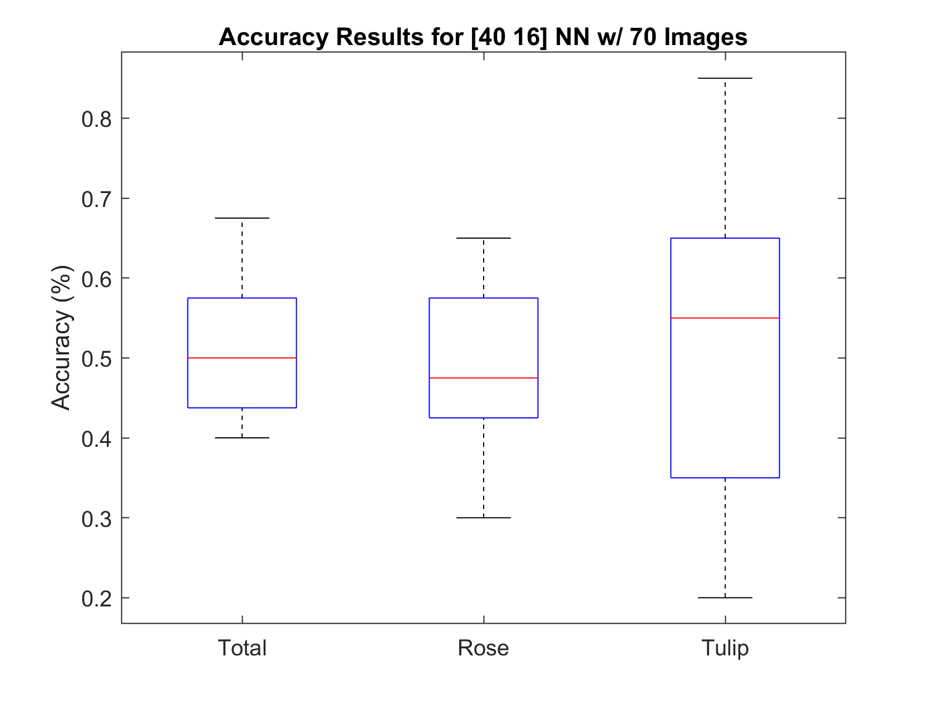
Neural Networks (NN) Cont.
Total: 50.5%
Rose: 48.75%
Tulip: 52.25%

Slide 14
Issues Encountered & Solutions
Calculating the integral image values in the third case mentioned above.
We did not know we have to subtract the repeated pixel values once to get the right values. A deep conceptual dive and a pen and paper interaction helped us achieve the expected result.
Getting the correct values for the rectangle sums was another issue. When comparing results, there were slight variations between members. To solve this issue, we went step by step until we found the point where the difference had occurred. The causes included how the Haar-like features were calculated and an issue when formatting the images (resize and gray scale).

Slide 15
Issues Encountered & Solutions cont
Another issue was that the Neural Network was not providing great results. One thing that helped improve the accuracy involved normalizing the inputs. This was not done at first because the function used does this automatically. However, it was found that performing the normalization beforehand slightly improved the accuracy.

Slide 16
Conclusions - Results
KNN has an accuracy of around 50%
NN performed similarly, but would generally perform better (52%~57%)
The NN results can vary greatly based on the architecture and number of images used
This is also due to the degree of randomness involved in the model
The best results for KNN came from utilizing 70 images and a K = 5

Slide 17
Conclusions - Trends
Increased number of training images improved KNN
Around K = 5 provided the best results
On average, NN is more accurate than KNN
Randomness means this can vary
Increasing the hidden layer size minorly improved accuracy
More testing to be done
More hidden layers did not noticeably increase accuracy, but did decrease spread

Slide 18
Conclusions - Further Improvements
It's possible that additional features could be extracted from integral images to boost classification precision.
Other improvements could possibly be brought on by increasing the number of training images and experimenting with more NN architectures.

Slide 19
Thank you

