Slide 1
Assignment 2
CPS 584 - Advanced Intelligent Systems and Deep Learning
Prof - Dr. Tam Nguyen
Team Members
Connar Hite
Ranjita Piratla
Sean Saud
Monika Somu
T.Shiva Harshith Varma

Slide 2
Feature Extraction
30 Haar-like features are extracted using the rectangle sum given an integral image, as done in Assignment 1
4096 Deep Learned features are extracted from the fc7 layer of AlexNet

Slide 3
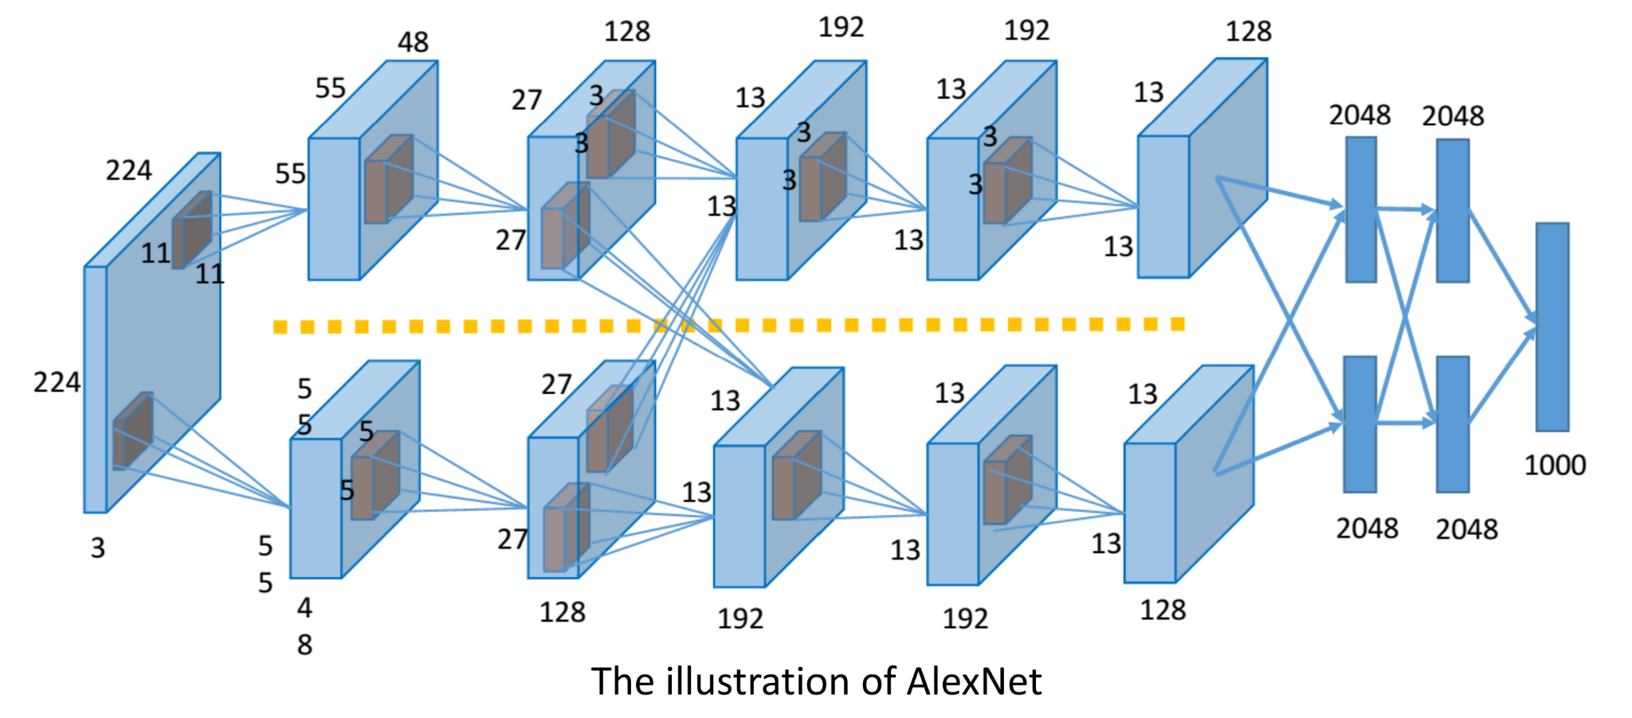
AlexNet (Deep Learned Features)

Slide 4
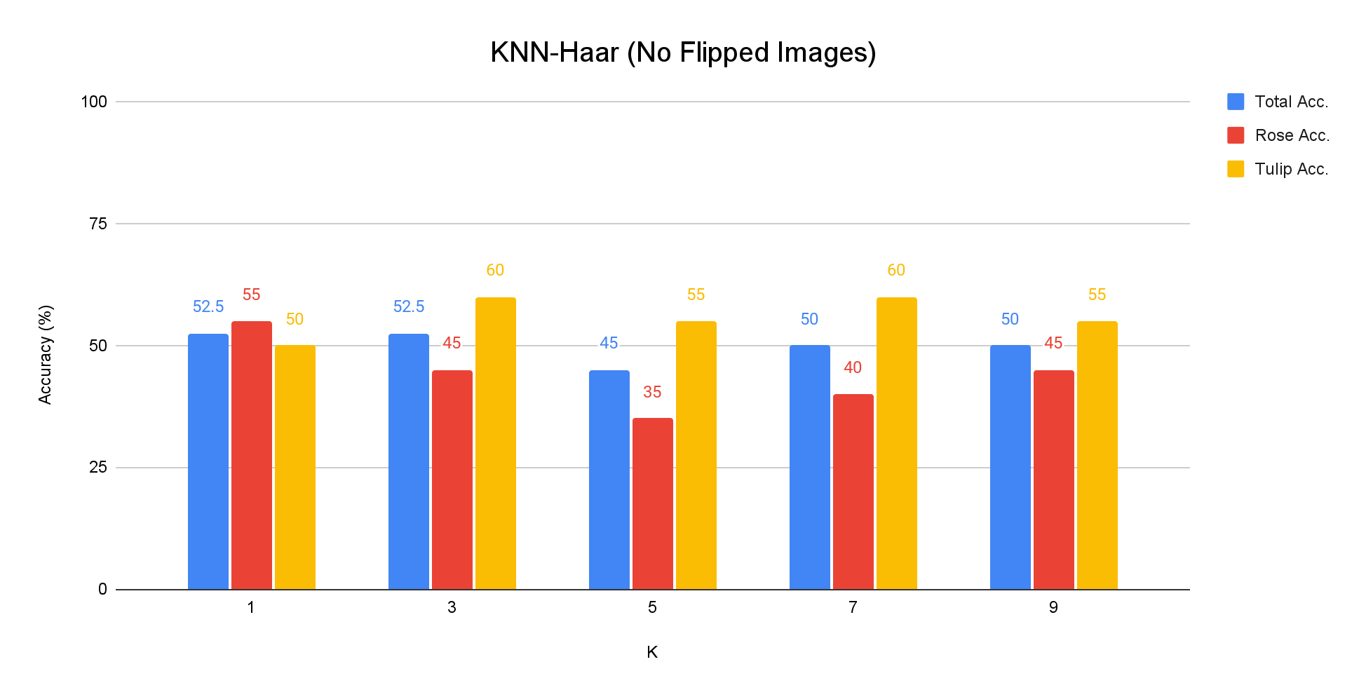
K-Nearest Neighbors (KNN) - Haar-like Features

Slide 5
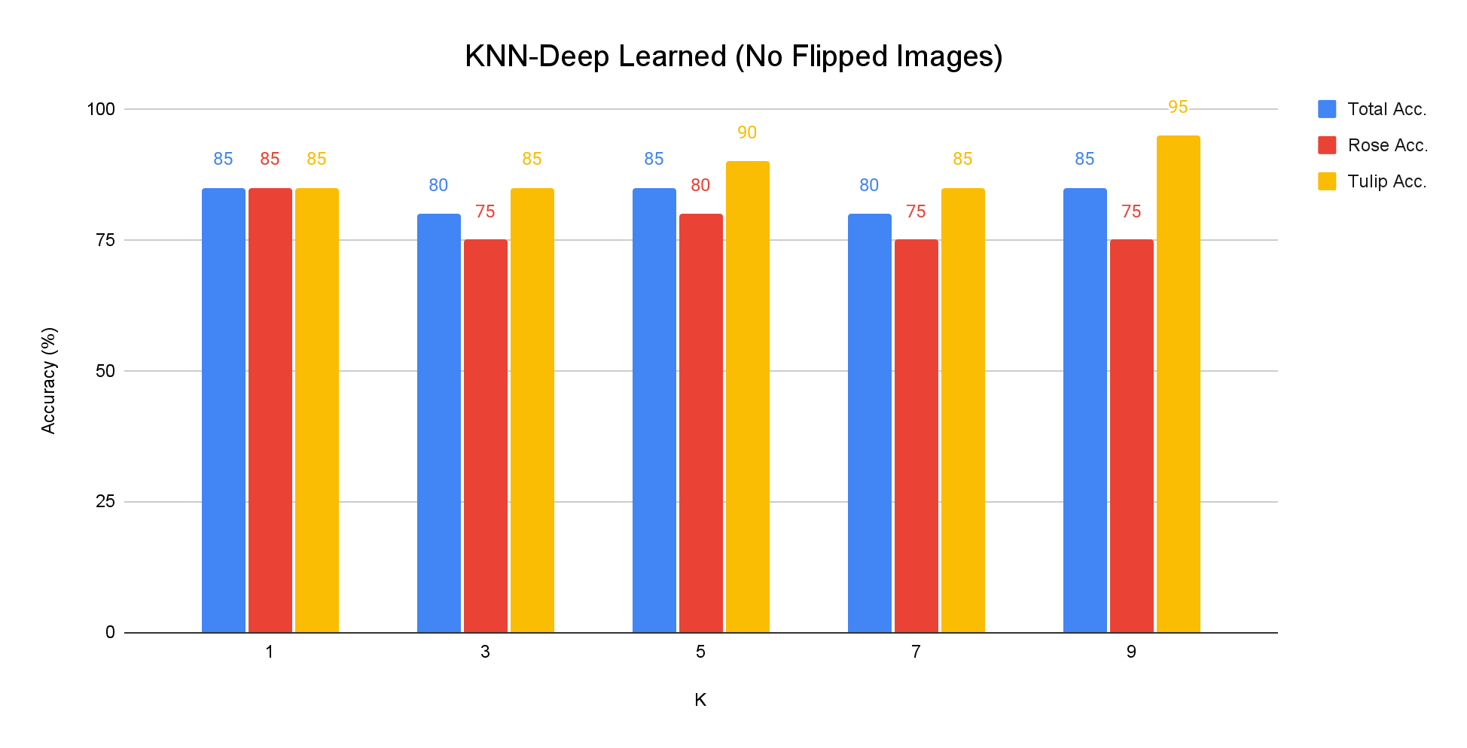
K-Nearest Neighbors (KNN) - Deep Learned Features

Slide 6
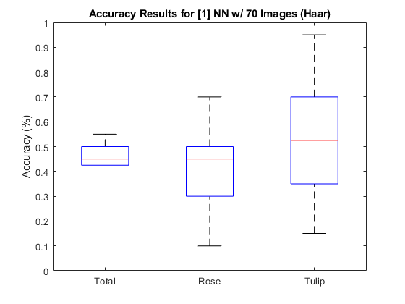
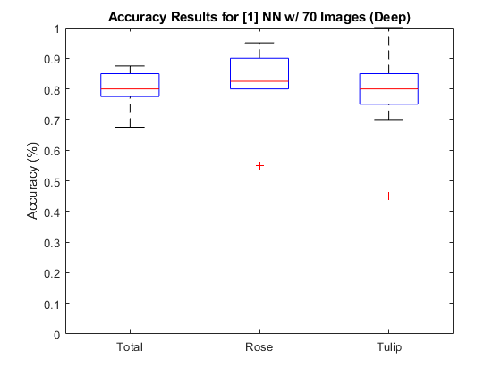
Neural Networks (NN)
Total: 45% Rose: 45% Tulip: 55%
Total: 80% Rose: 83% Tulip: 80%

Slide 7
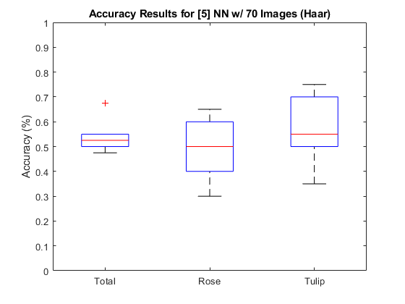
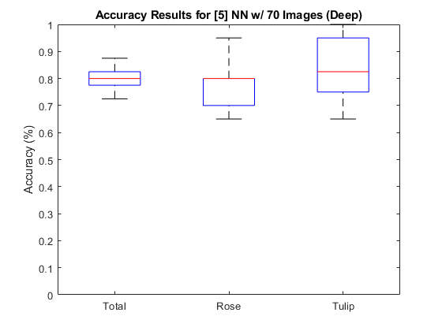
Neural Networks (NN)
Total: 53% Rose: 50% Tulip: 55%
Total: 80% Rose: 80% Tulip: 83%

Slide 8
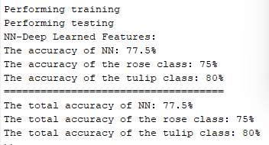
Neural Networks (NN)

Slide 9
Additional, Flipped Images
Every training image is flipped horizontally in order to have 70 more training images per class
The KNN algorithm (with K ϵ{1, 3, 5, 7, 9}) is then performed with the additional training data

Slide 10
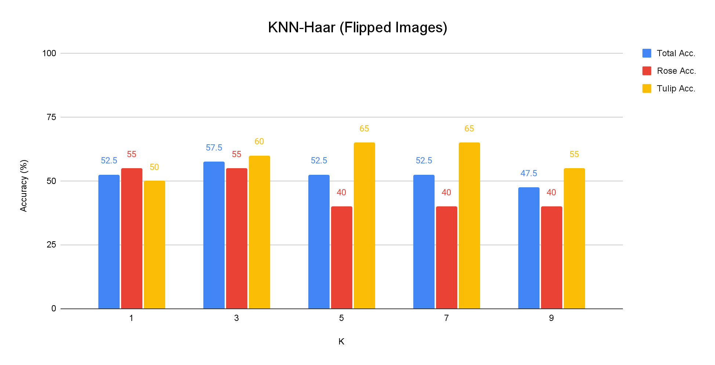
Additional, Flipped Images (KNN) - Haar-like Features

Slide 11
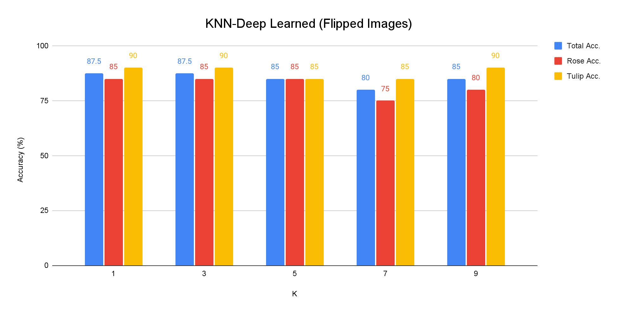
Additional, Flipped Images (KNN) - Deep Learned Features

Slide 12
Additional, Flipped Images (KNN) - Concatenated Features

Slide 13
Conclusions
Using Deep Learned features resulted in significantly higher accuracy (around 30%) than using Haar-like features for both KNN and NN.
Smaller values of K tended to result in higher accuracy (with some exceptions).
Increasing the number of training images by flipping the images increased accuracy
Concatenating both features decreased accuracy compared to using only the Deep Learned features.
The best results came from the KNN system training with additional images using Deep Learned Features when K = 1 and K = 3.

Slide 14
Conclusions - Further Improvements
Max memory issue could be further investigated and fixed
Possibility: implement Feature Selection method to reduce dimensionality
If the max memory issue is fixed, more complex hidden layer structures could be tested
Investigate different deep feature extraction methods

Slide 15
Member Contributions
Connar Hite: Wrote the K-Nearest Neighbors (KNN) and Neural Networks (NN) section and
edited paper/powerpoint
Ranjita Piratla: Wrote Additional, Flipped Images (KNN) section
Sean Saud: Wrote the Introduction and Conclusion in report, Results and Conclusion slides in
presentation, edited report/powerpoint
Monika Somu: Wrote Extracting Deep Learned Features using AlexNet section
T.Shiva Harshith Varma: Wrote Concatenated Features (KNN) section

Slide 16
Thank you

Slide 17
References
Parts of this assignment reference “Assignment 1” and “Lab 5” in Dr. Tam Nguyen’s Advanced Intelligent Systems and Deep Learning class (CPS 584).
Krizhevsky, A., Sutskever, I., & Hinton, G. E. (2017). Imagenet classification with deep convolutional neural networks. Communications of the ACM, 60(6), 84-90

