Slide 1
Assignment 3
CPS 584 - Advanced Intelligent Systems and Deep Learning
Prof - Dr. Tam Nguyen
Team Members
Connar Hite
Ranjita Piratla
Sean Saud
Monika Somu
T.Shiva Harshith Varma

Slide 2
S2: Max Pooling
64x64x64
S4: Max Pooling
32x32x96
S6: Max Pooling
16x16x128
S8: Max Pooling
8x8x164
S10: Max Pooling
4x4x256
Input:
128x128x3
C1:
128x128x64
C3:
64x64x96
C5:
32x32x128
C7:
16x16x164
C9:
8x8x256
Softmax
Dense
Dense
Dense
Dense
Flatten:
4096
F11:
2048
F12:
2048
F13
32
Output:
4

Slide 3
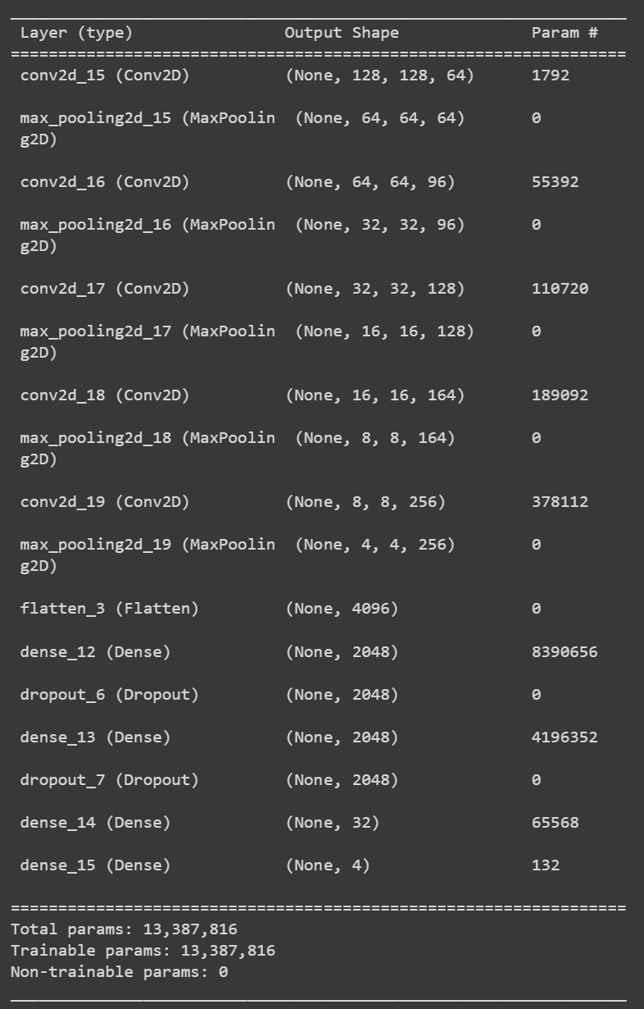
Model Structure

Slide 4
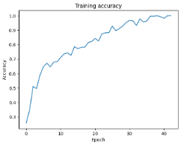
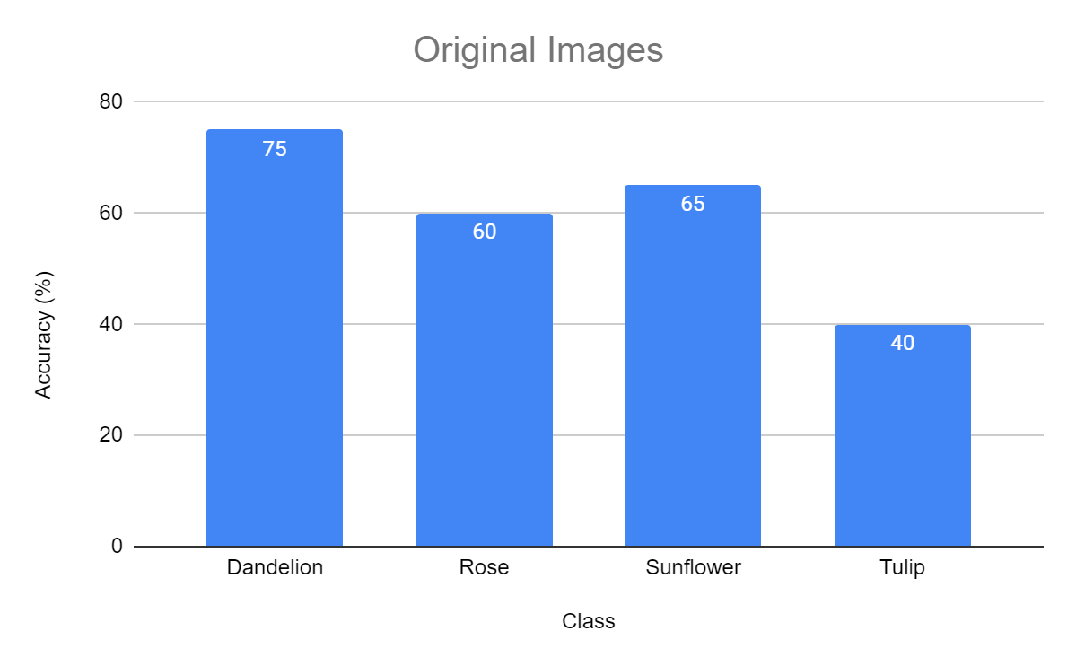
Original Images

Slide 5
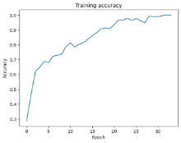
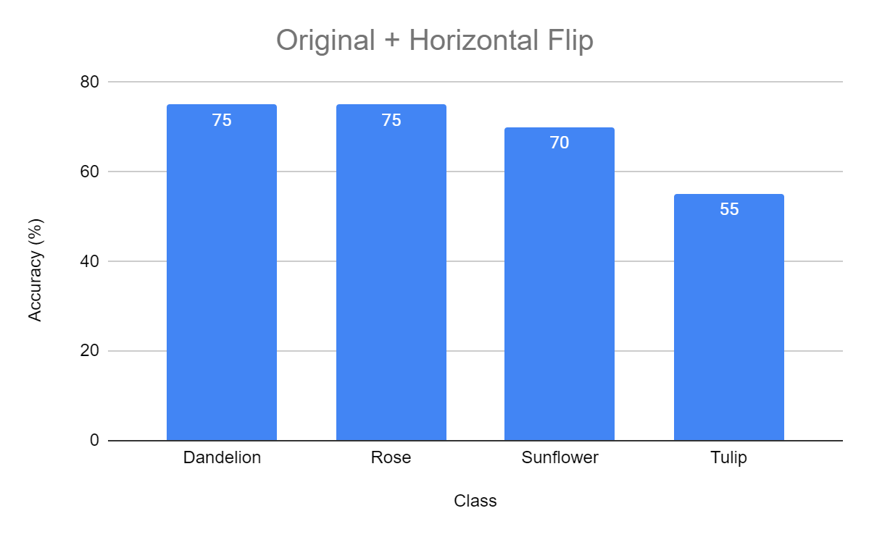
Original + Horizontal Flip

Slide 6
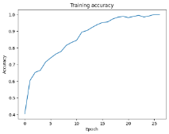
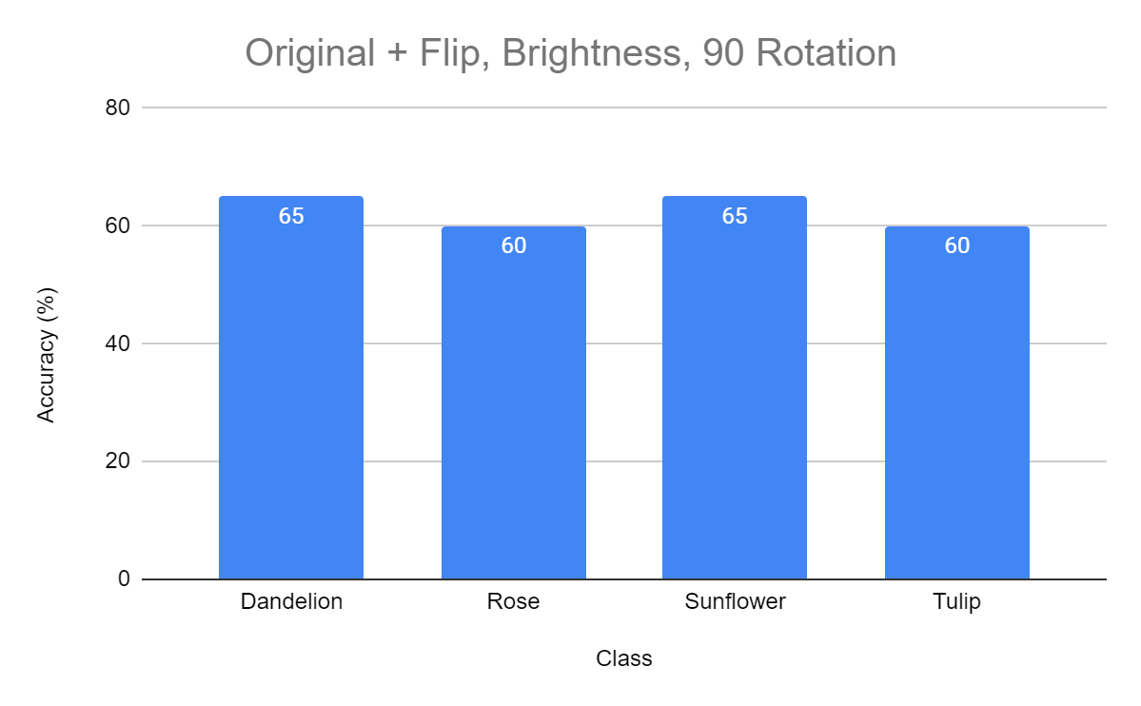
Original + Flip, Brightness, 90 Rotation

Slide 7
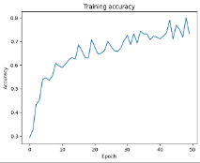
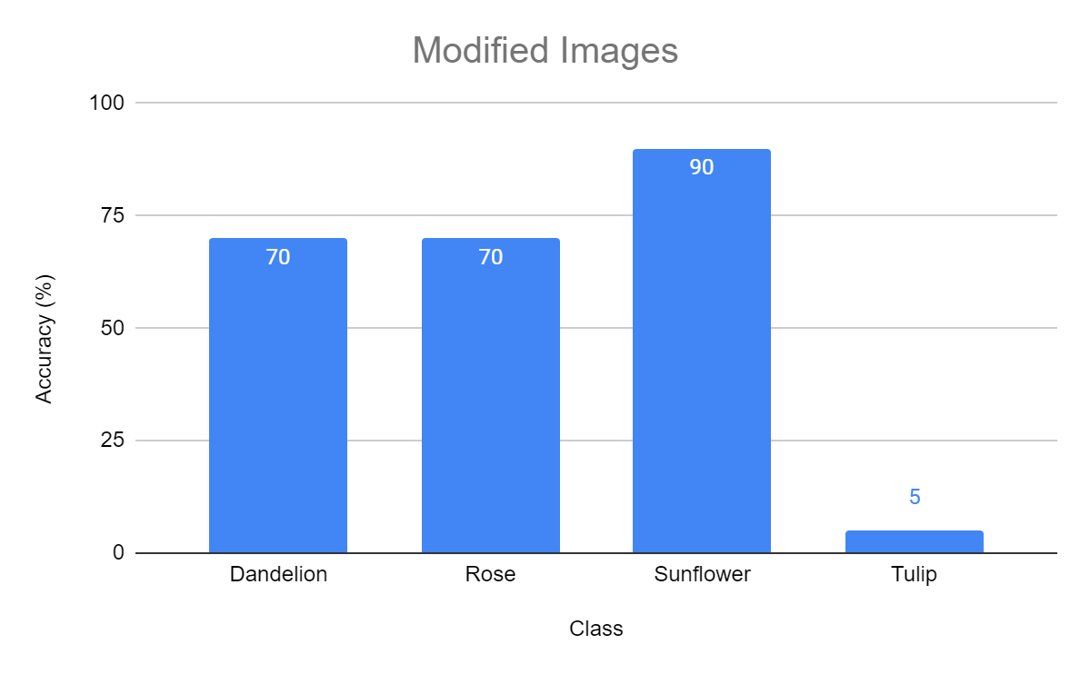
Modified Images

Slide 8
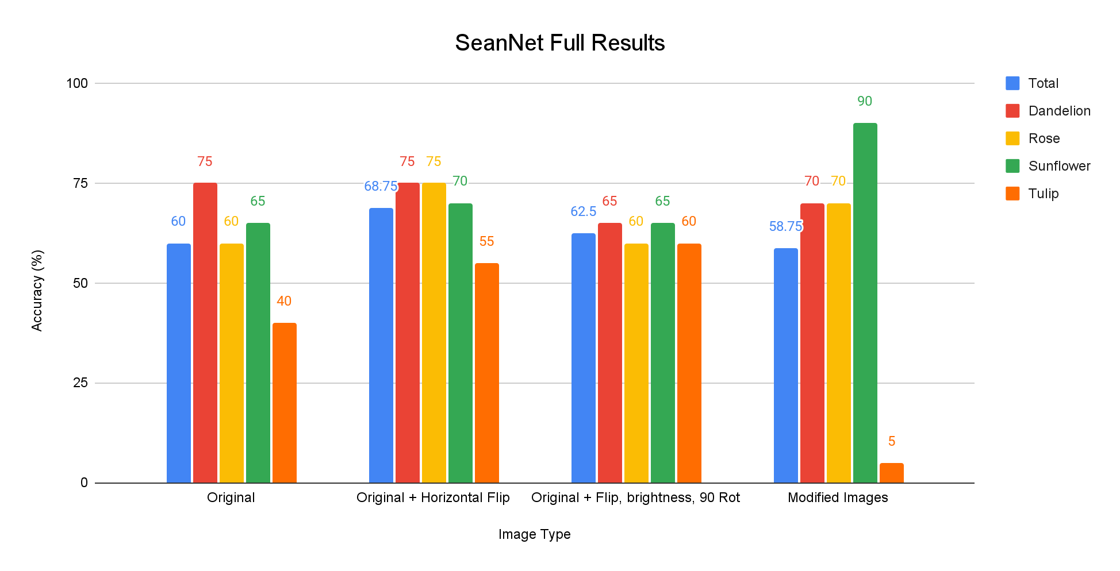
Total Results

Slide 9
Conclusions
A custom deep learning network was built to classify four different types of flowers.
Increase training data by flipping, rotating, and brightening images to avoid overfitting.
Increasing the number of training images and modifying them definitely increased accuracy.
To avoid overfitting, early stopping and dropout layers were used.
Through testing, accuracy was improved.

Slide 10
Member Contributions
Connar Hite:
Ranjita Piratla: Wrote Conclusion section
Sean Saud:
Monika Somu:
T.Shiva Harshith Varma:

Slide 11
Thank you

