Slide 1
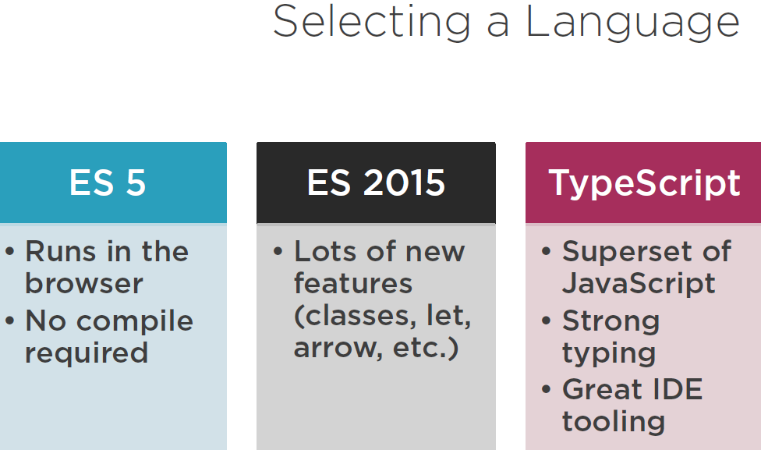

Slide 2
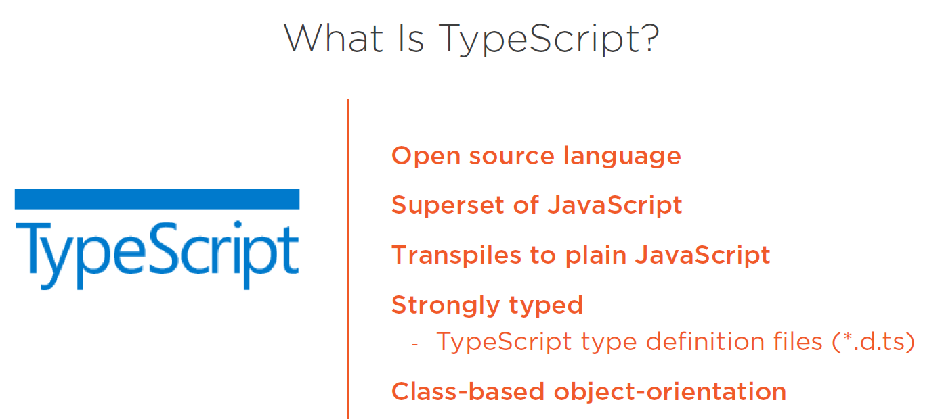
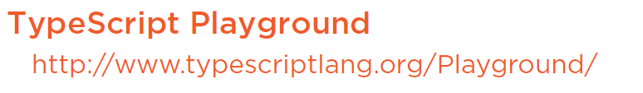

Slide 3
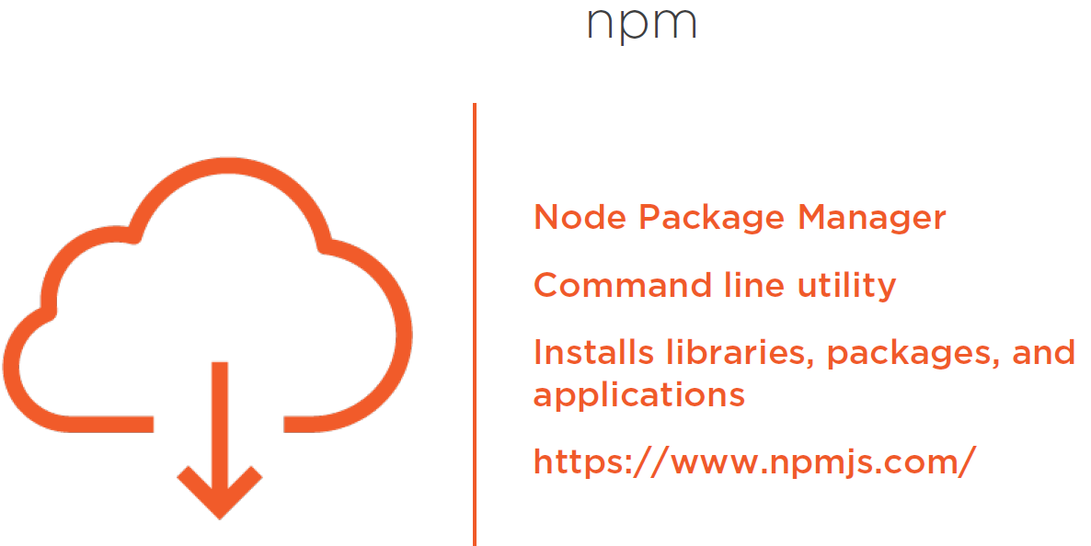
Notes:
NPM interacts with the repositories of open source projects and this has become the package manager for java script
Installs all of the dependencies required for an application.
We need NPM to install all of the libraries for angular and execute the scripts to transpile our code and launch our angular application.

Slide 4
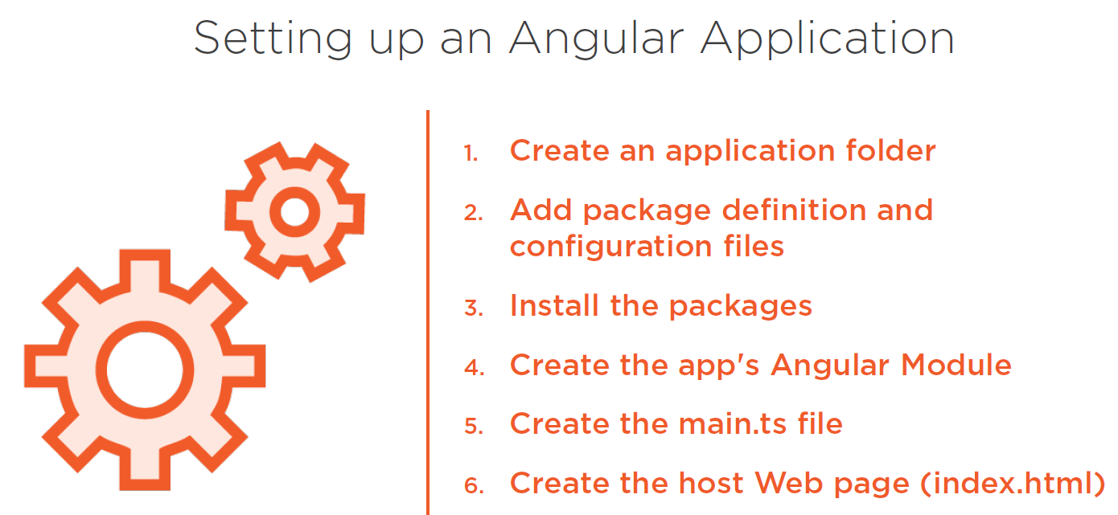
Notes:
Lucily, ANGULAR CLI does all of the above steps for us.
ANGULAR CLI
Is a command line tool to generate set of files and boiler plate code for angular application. It generates components, services etc. and it scaffolds and executes your unit and e2e tests and provides options to minimize package and prepare the files you need for deployment.

Slide 5
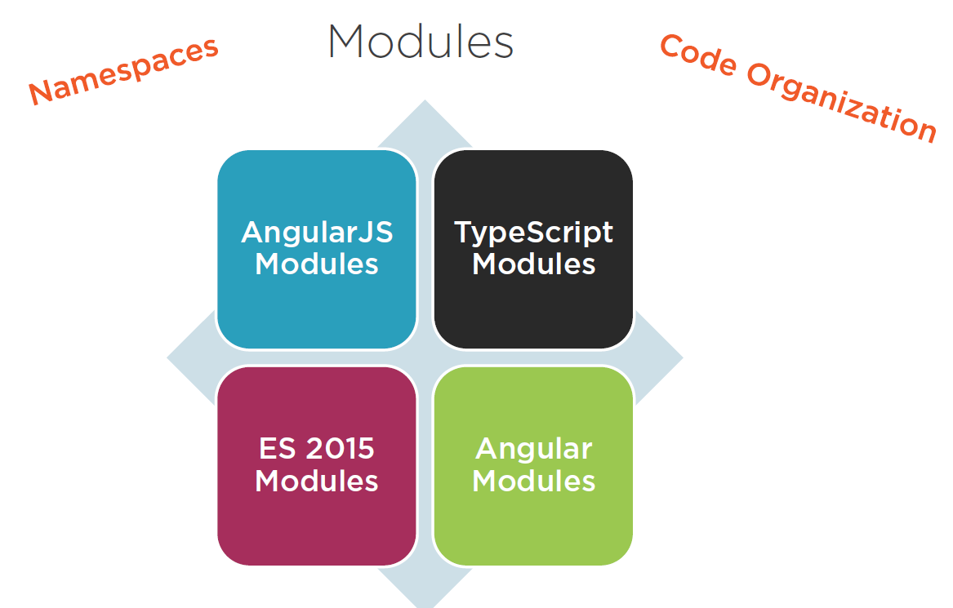
Notes:
With Javascript there is always problem with Namespaces, if we are not careful we will end up with VARIABLES and FUNCTIONS in the global namespace.
In addition Javascript didn’t provide features for our Code Organization.
To resolve these issues, ANGULARJS has MODULES – to help us organize our code and resolve SOME NAMESPACE issues.
TYPESCRIPT also have MODULES that help keep things out of global namespace.
ES2015 set us standard for defining a MODULE, In ES2015 – A MODULE is a FILE and a FILE is a MODULE, so when coding in ES2015 we don’t need to define OR name MODULEs. Just create a file and write some code, EXPORT or IMPORT something BANG the file becomes a MODULE.
ANGULAR leverages ES2015 MODULES, As we create code files and IMPORT (or) EXPORT something then we create MODULES for our application. BUT NOTE, ANGULAR have another concept of MODULES this is different from ES2015 MODULES.
As ANGULAR uses both ES2015 MODULES and Angular itself have ANGULAR MODULES.
NOTE
ES2015 MODULES is to resolve global namespace issue
ANGULAR MODULES is for modularization (Code Organization)
Lets see ES2015 MODULES first

Slide 6
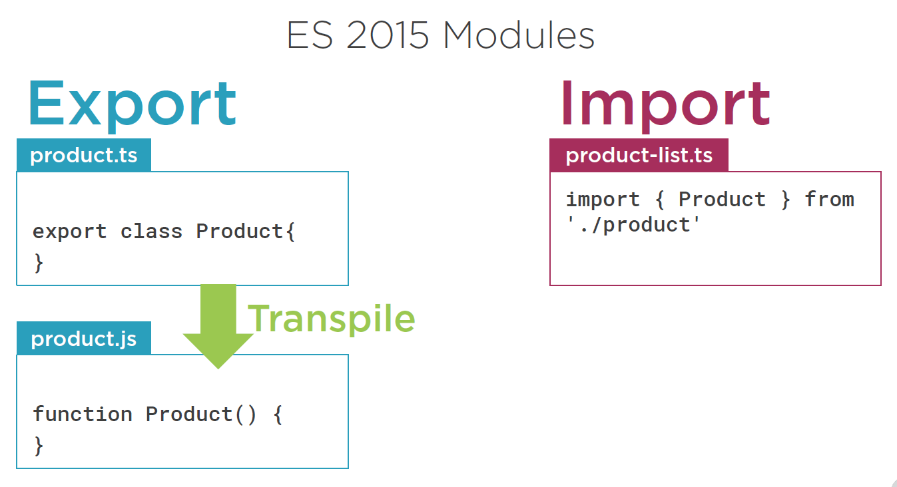
Notes:
In the above screenshot, Product class is exported so the file “product.ts” will become a MODULE.
So we can use that class in another module(FILE) by Importing it
Also note that file “product-list.ts” also will become a MODULE as we have imported something.

Slide 7
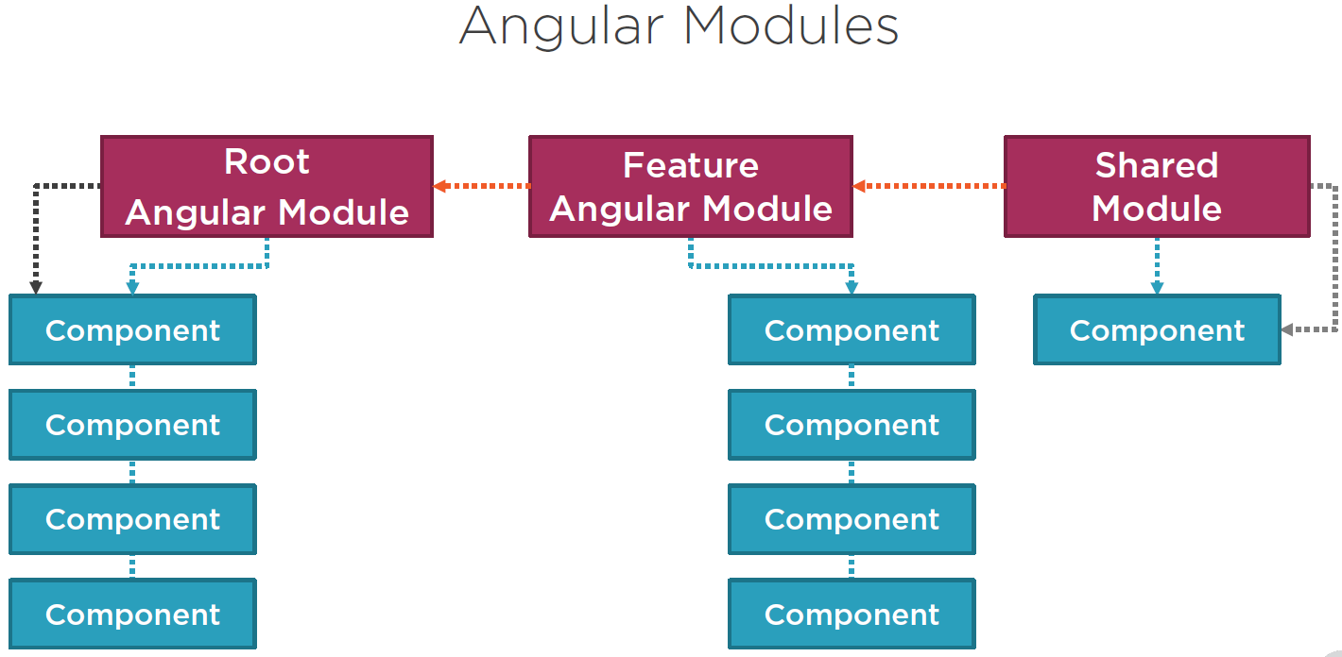
Notes:
Lets look at ANGULAR MODULES NOW
Angular MODULES helps to organize an application into COHESIVE blocks of functionality.

Slide 8
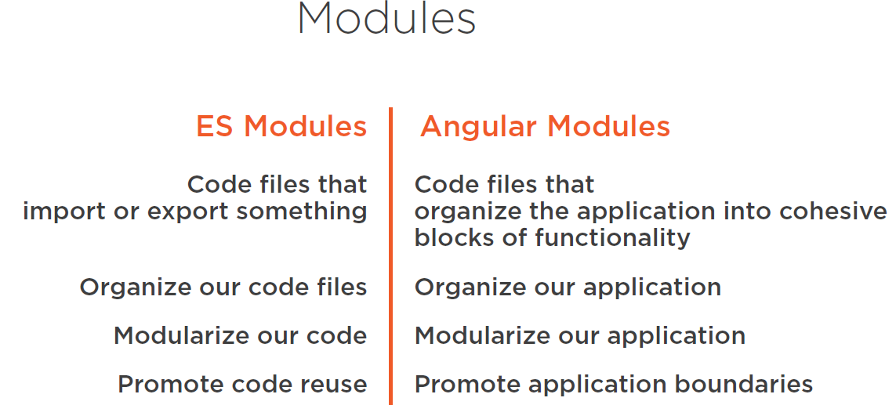

Slide 9
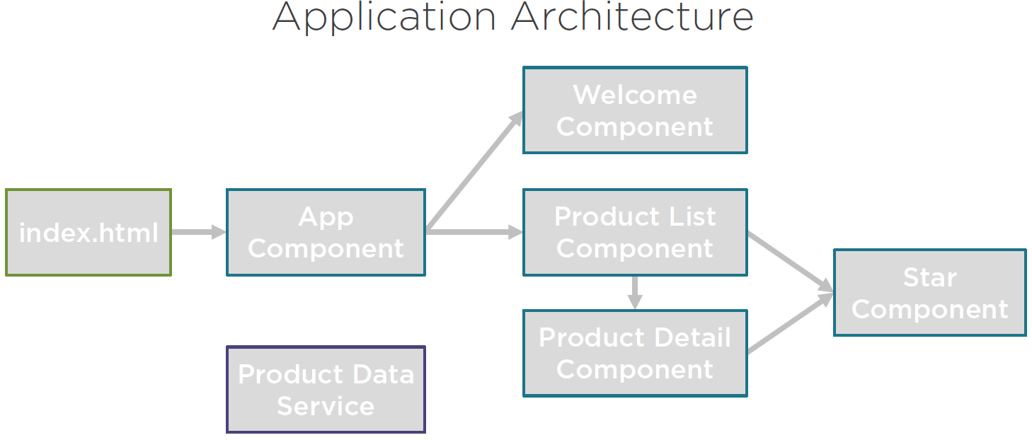

Slide 10
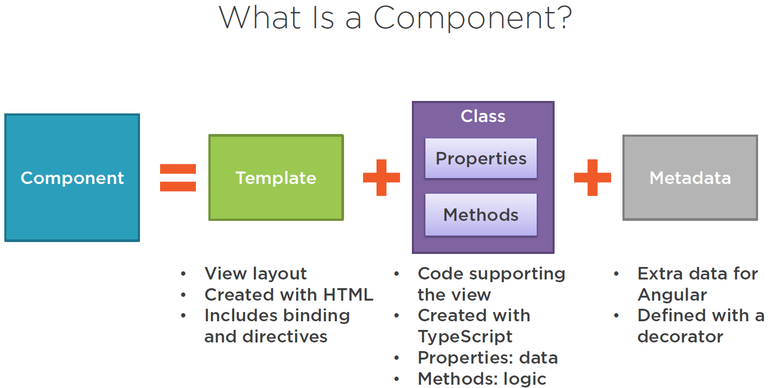

Slide 11
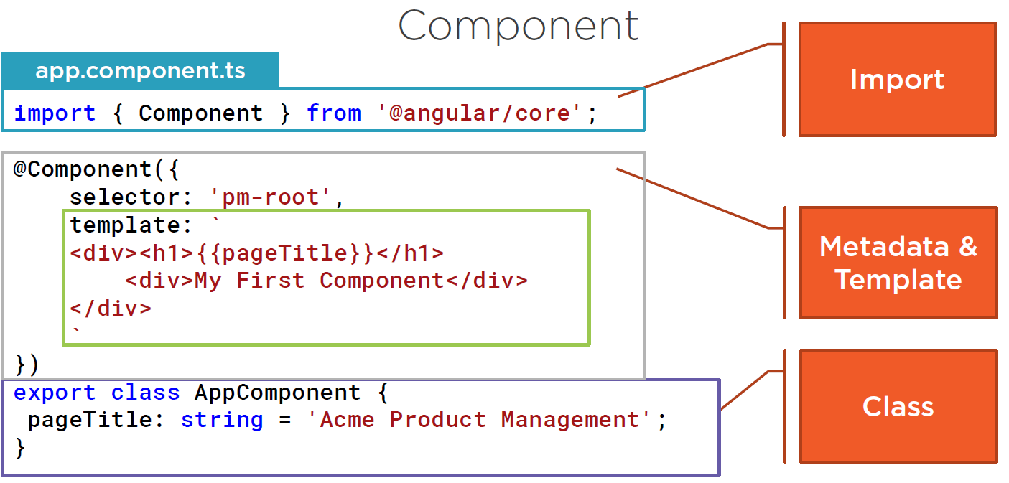

Slide 12
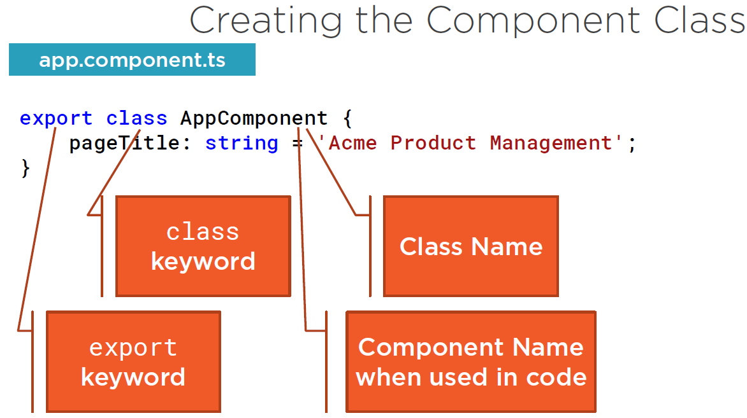
Notes:
A class is a construct that allows us to create a TYPE with properties that define the data elements and with methods that define the functionality.

Slide 13
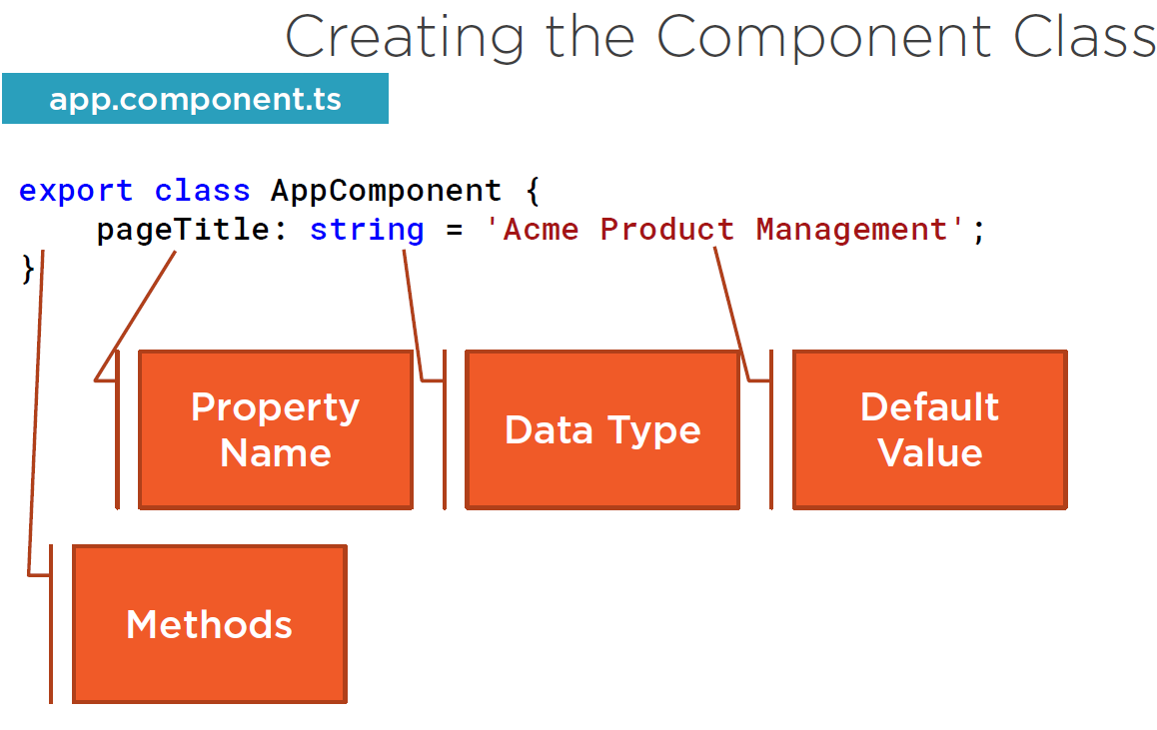

Slide 14
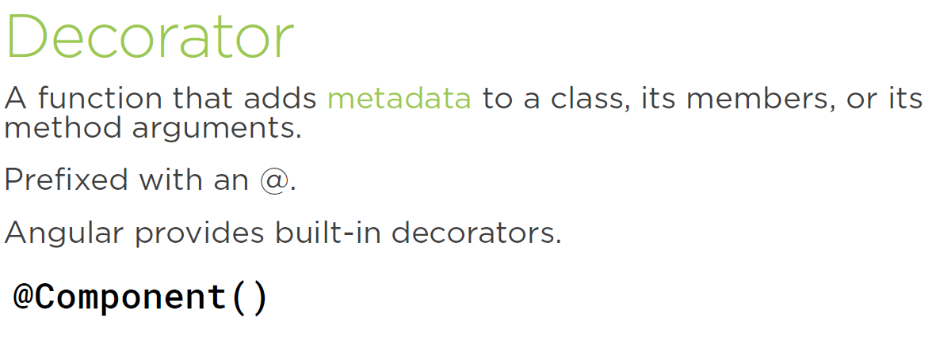
Notes:
A class becomes an Angular component when we give it component metadata. Angular needs that metadata to understand how to instantiate the component, construct the view, and interact with the component. We define a component's metadata with the Angular component function. In TypeScript we attach that function to the class as a decorator.
A decorator is a function that adds metadata to a class, its members, or its method arguments.
A decorator is a JavaScript language feature that is implemented in TypeScript. The scope of the decorator is limited to the feature that it decorates.
We apply a decorator by positioning it immediately in front of the feature we are decorating.
This syntax is similar to attributes used in other programming languages.
Since the decorator is a function, we always add parentheses. We pass an object to the component function as indicated with the curly braces. The object we pass in has many properties.

Slide 15
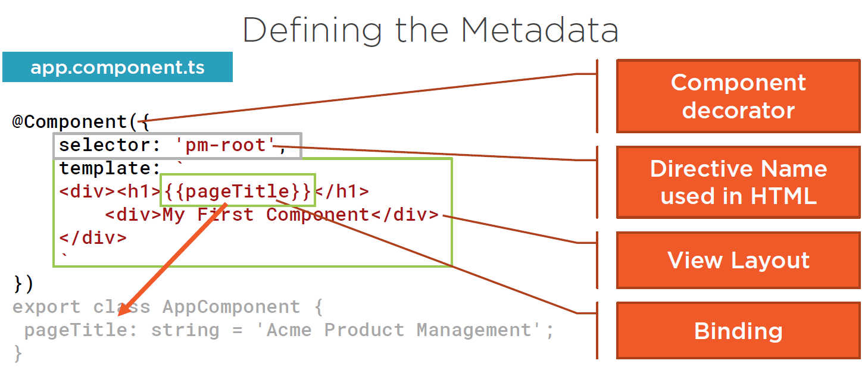
Notes:
A directive is simply a custom HTML tag.

Slide 16
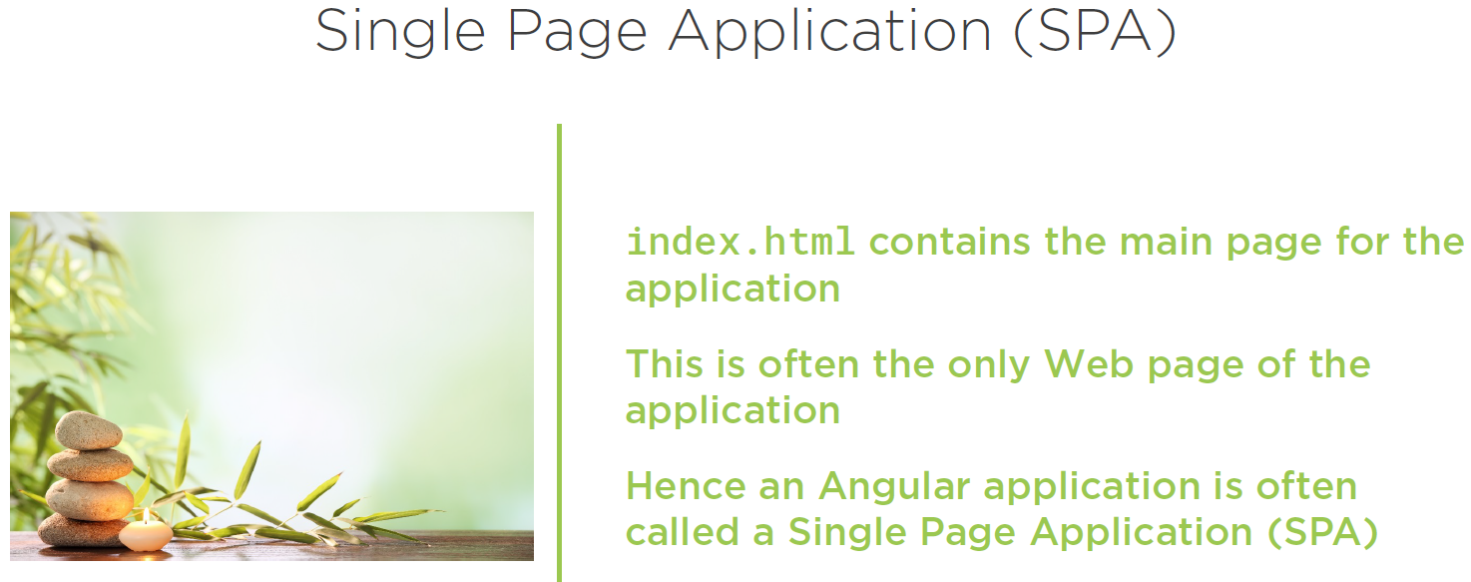
Notes:
We need to tell Angular to load our root component through a process that is called Bootstrapping. We first set up the index.html file to host our application. Then we define our root Angular module to Bootstrap our root component.
This index.html file is often the one true web page of the application. Hence an application is often called a single-page application or SPA, but don't worry. It will look to the user like we have lots of pages as we saw in the demo at the beginning of this course. What we do is insert bits of HTML into the one HTML page defined in index.html.

Slide 17
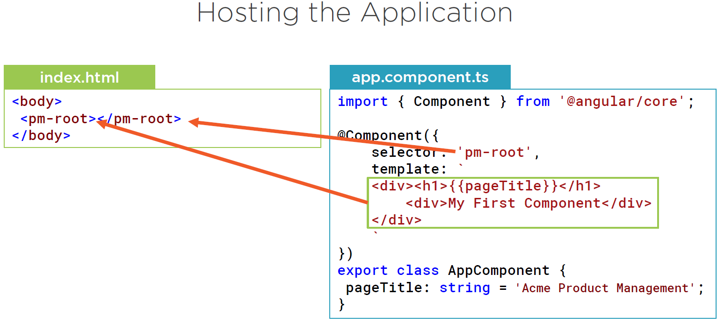

Slide 18
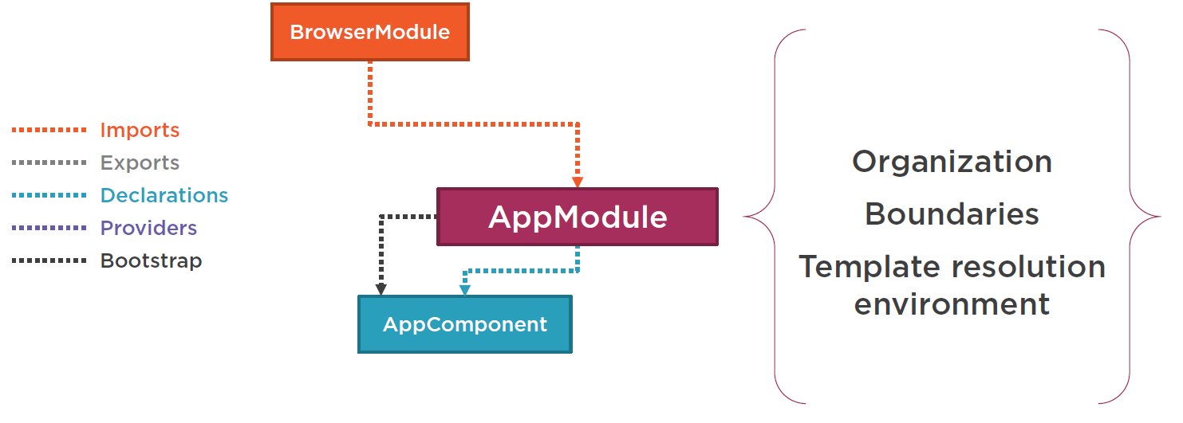
Notes:
template resolution environment. What does that mean? When the Angular compiler sees a directive in a template, it looks to the Angular module for the definition so we declare the AppComponent in an Angular module so the compiler can find it.
We also use the module to Bootstrap our startup component, which is our AppComponent and we want our application to work correctly in the browser so we add Angular's browser module to our Angular module's imports.

Slide 19
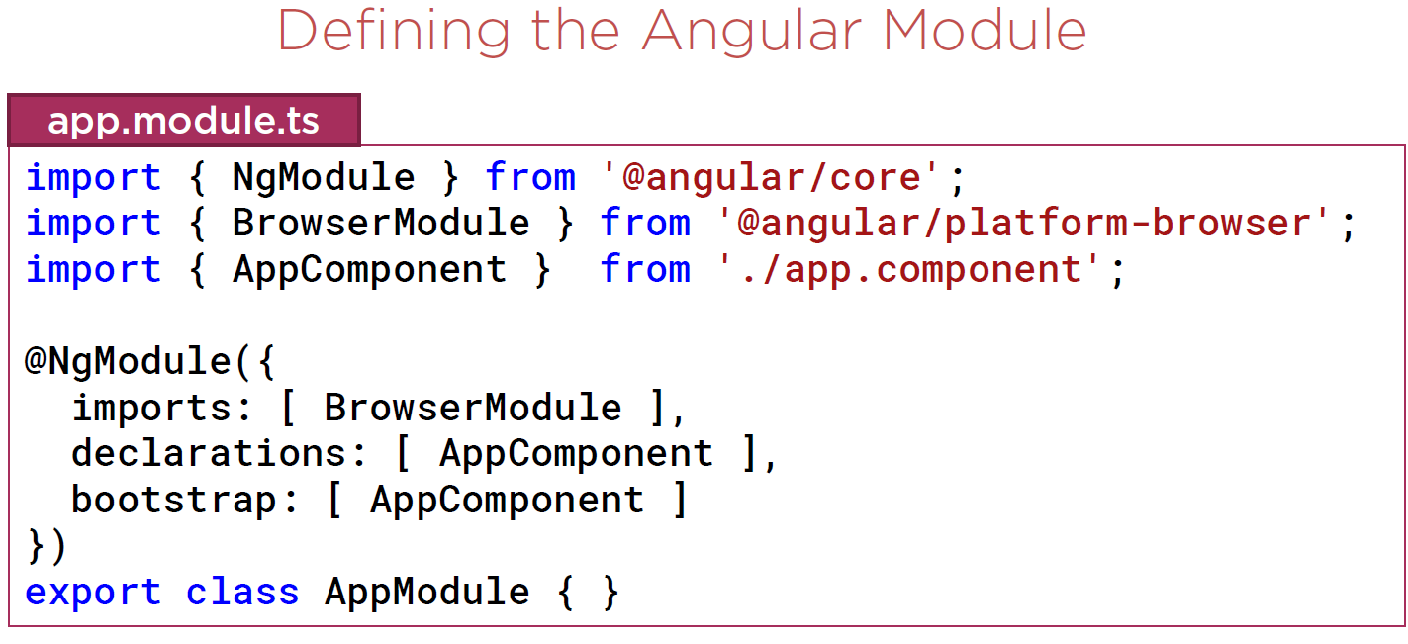
Notes:
For the NgModule decorator, the properties are arrays. In the declarations array we define which of our components belong to this module.
By convention, our root application component, AppComponent, belongs to the application's root Angular module, AppModule, so we declare it here. We can add other components here as well.
In the imports array we define the external modules that we want to have available to all of the components that belong to this Angular module. External modules could be modules provided by Angular, a third party, or our own Angular modules. Here we import browser module, which every browser application must import. Browser module register is important to application service providers such as error handling.
The Bootstrap array defines the startup component of the application, which is our AppComponent. The startup component should contain the selector we use in the index.html file, which in this case it does.
In any BROWSER, if you look at DEVELOPER TOOLS. Say in CHROME browser, Use the elements tab or DOM explorer to view the HTML displayed in the page.
This is a depiction of the DOM or document object model. The document object model is a document model loaded into the browser and represents our HTML as a node tree where each node is a part of our HTML.

Slide 20
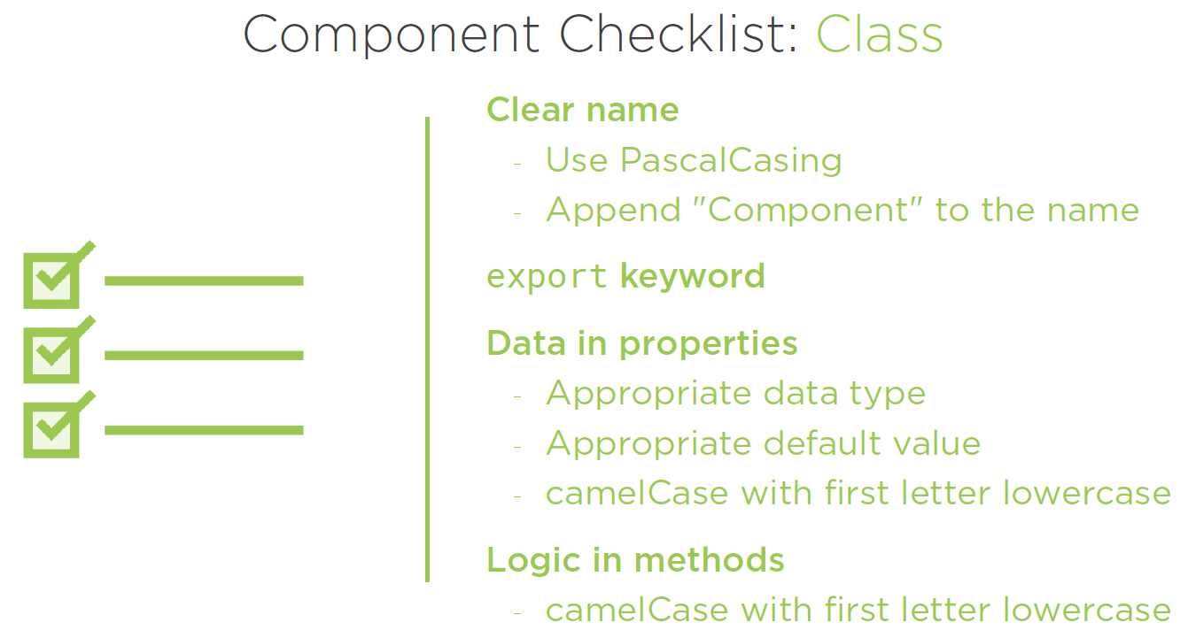

Slide 21
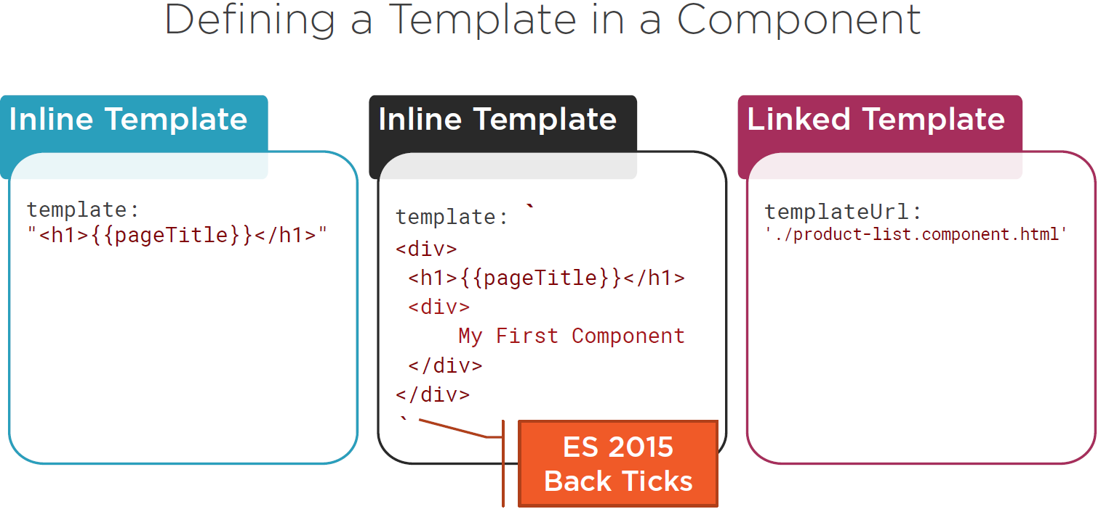
Notes:
Web applications are all about the user interface and Angular makes it easier to build rich and powerful user interfaces. Angular gives us data binding so we can easily display information and respond to user actions. With Angular directives we add logic to our HTML such as if statements and for loops and with Angular components, we build nested user interface fragments such as an image rotator or rating stars.
To know more about the bootstrap check below
http://getbootstrap.com/

Slide 22

Notes:
When a new HTML tag is being processed, Angular looks for a component that has a selector with this name. We could have hundreds of components in our application. How does our application know where to look for this selector? The application looks to the Angular module that owns this component defined all of the directives that are visible to this component.
So when a component contains a directive, Angular looks to the component's module to determine which directives are visible to that component.
We need to ensure that the directive is visible to any component that uses it.
INTERPOLATION is one way binding

Slide 23
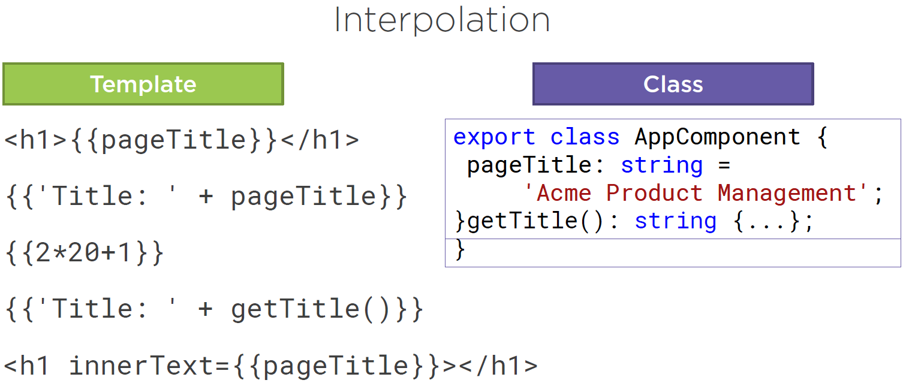
Notes:
Expression between the 2 flower braces is called as TEMPLATE EXPRESSION

Slide 24
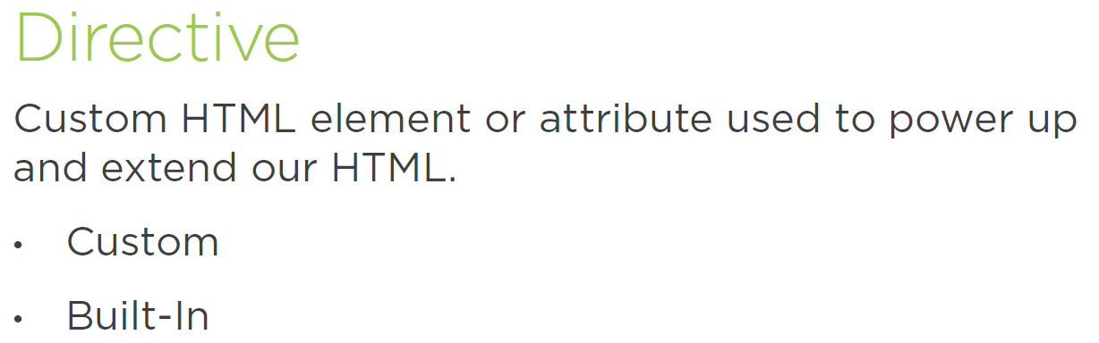

Slide 25
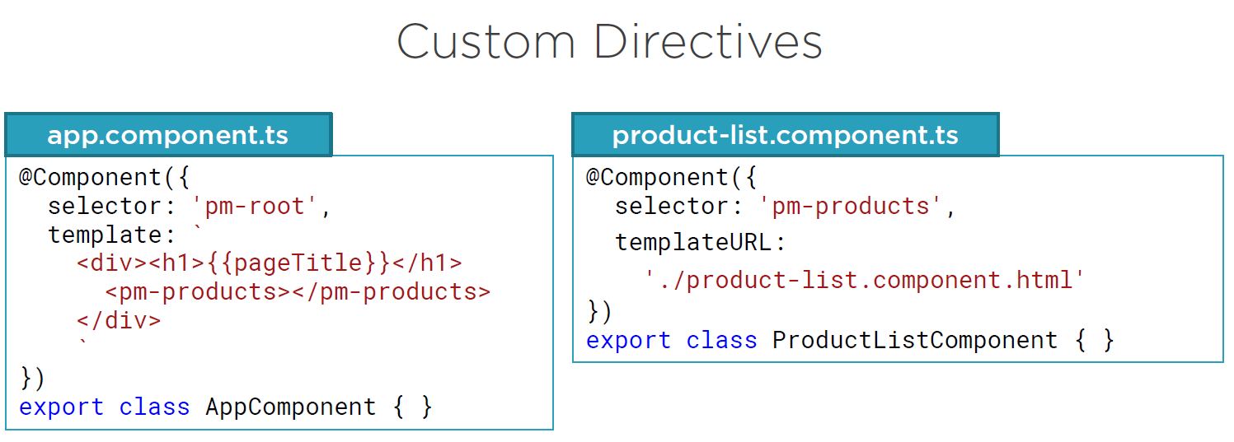

Slide 26
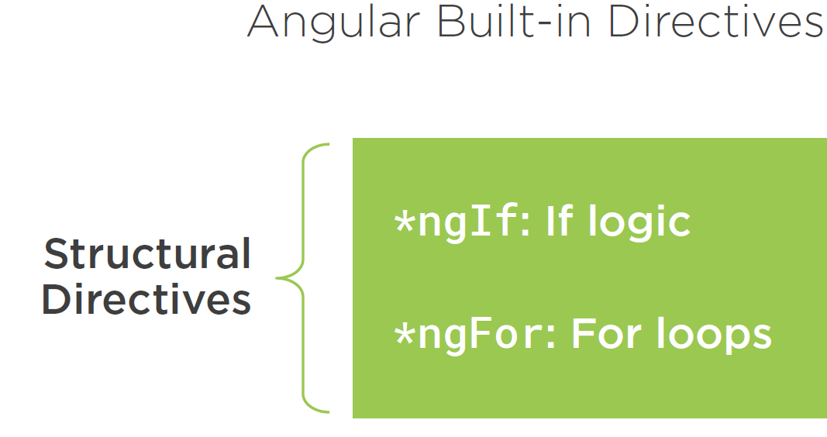

Slide 27
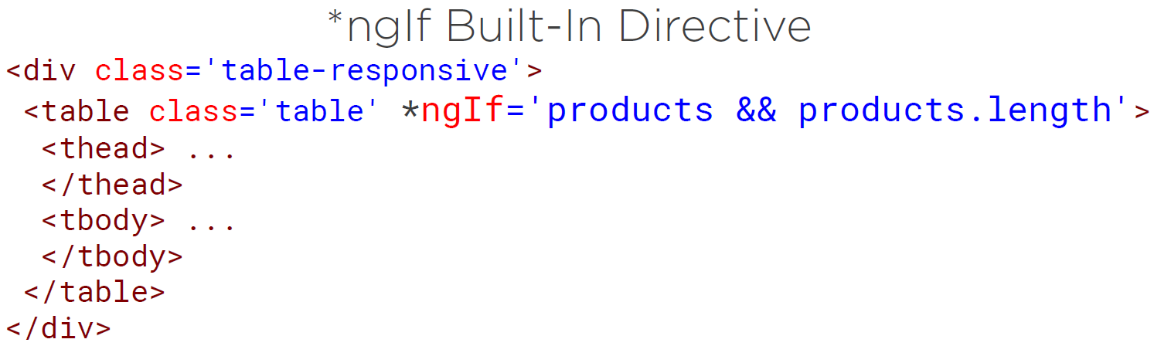

Slide 28
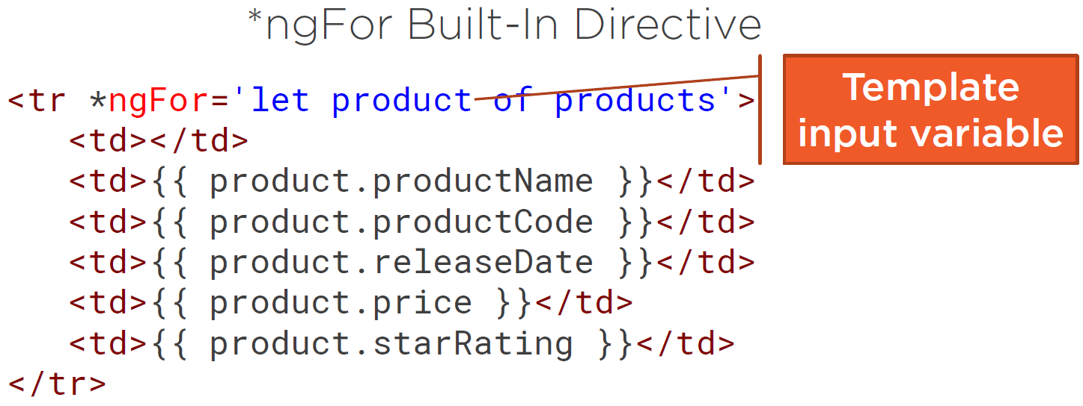

Slide 29
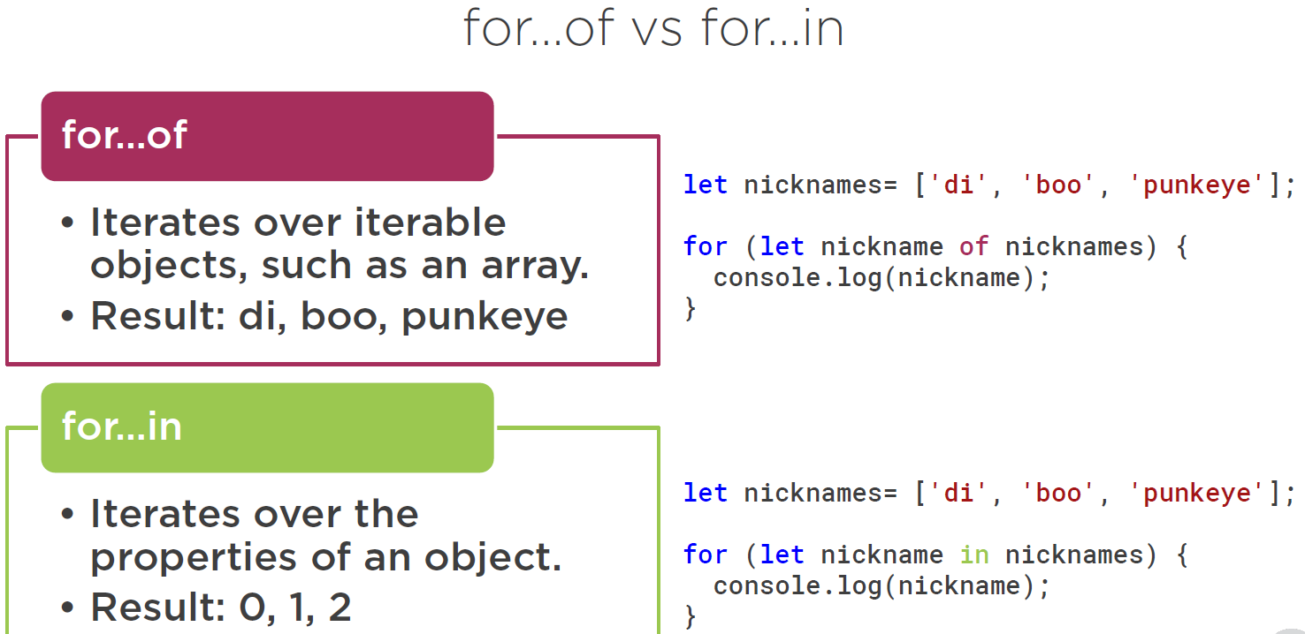
Notes:
FOR EASY REMEMBERENCE
IN ==== Iterating the INDEX

Slide 30
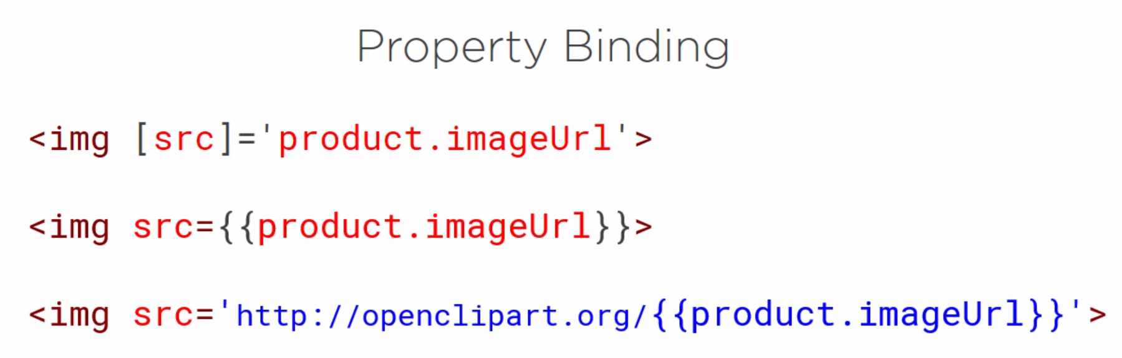

Notes:
Different ways of PROPERTY BIINDINDS
Angular Property Binding
This is always preferrable
Interpolation
But if part value is replaced then its better to have interpolation

Slide 31
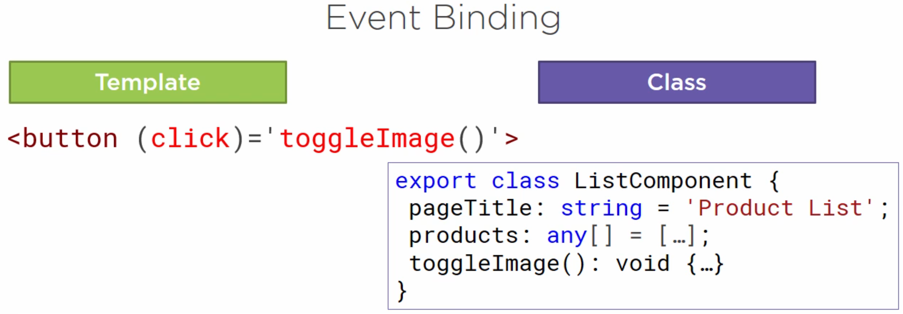
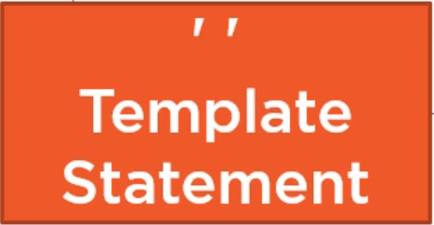


Slide 32
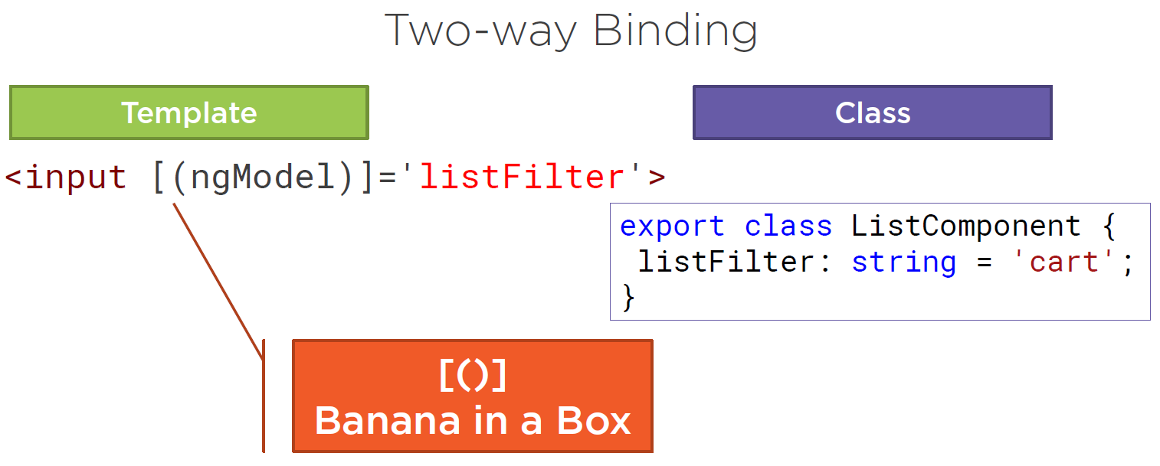
Notes:
To indicate two way binding, we use ngModel directive
[ ] = indicate property binding - from the class property to the input element
( ) = indicate event binding – to send a notification of the event entered data to the class property

Slide 33
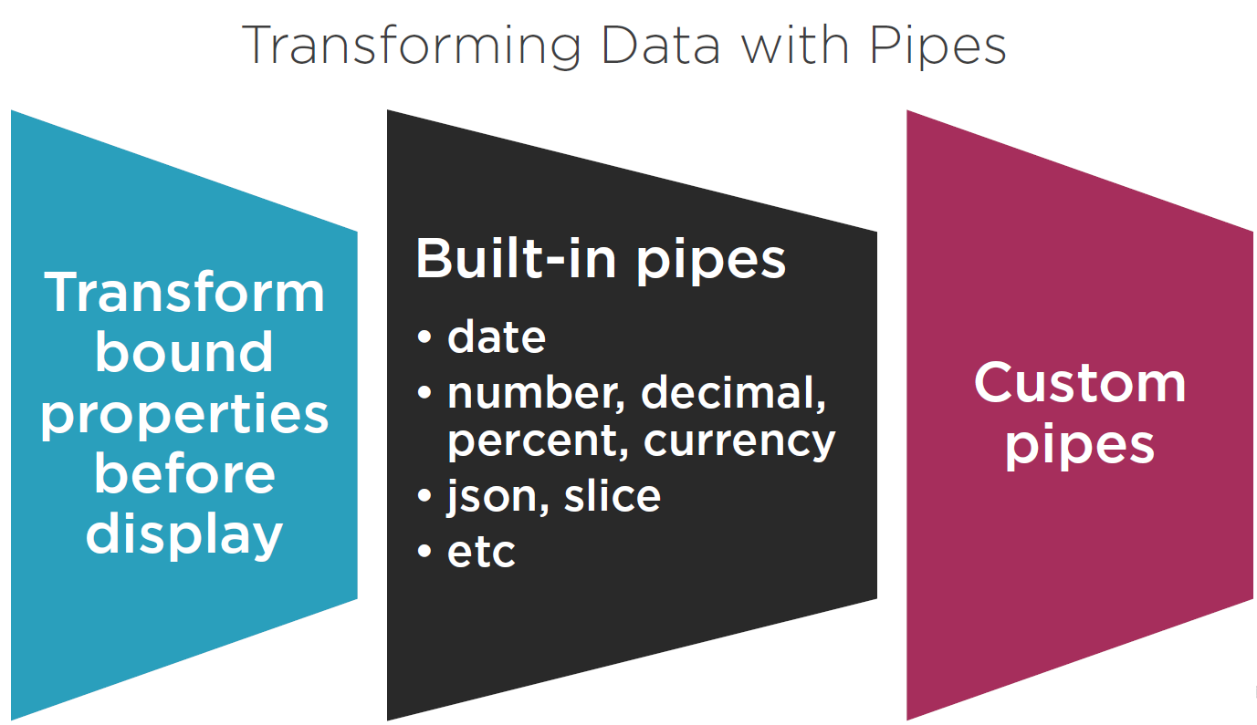


Slide 34
