Slide 1
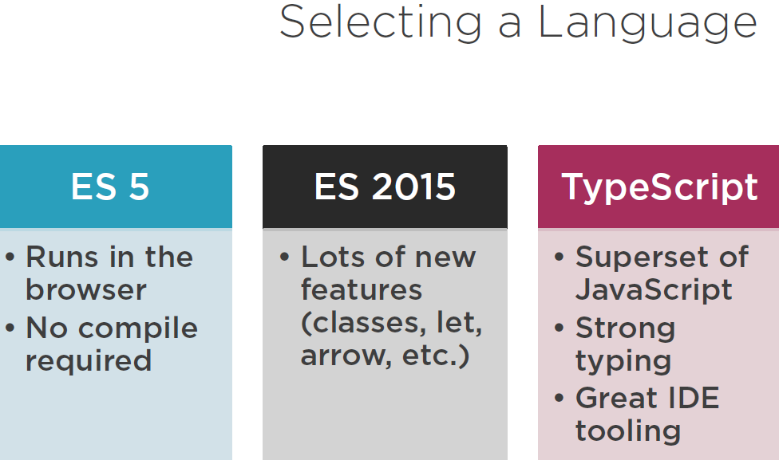

Slide 2
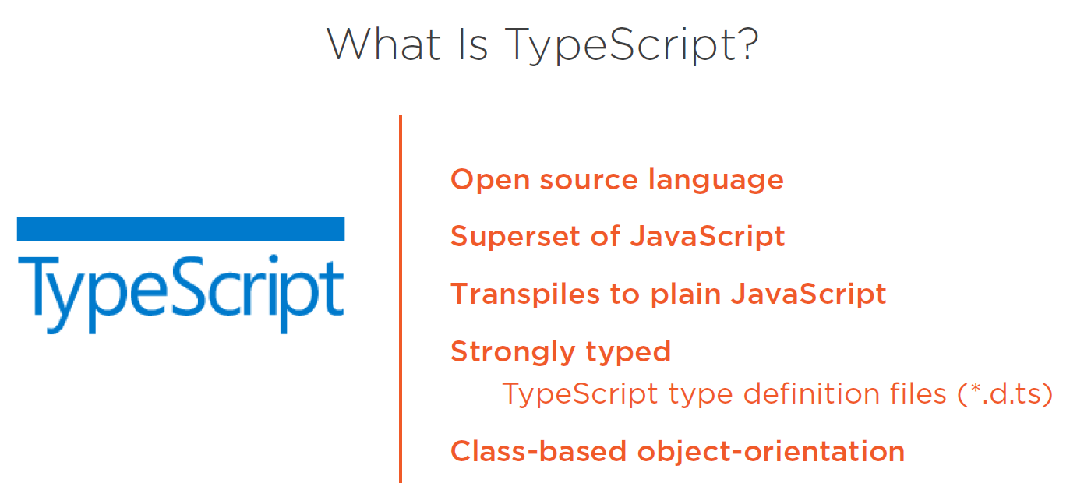
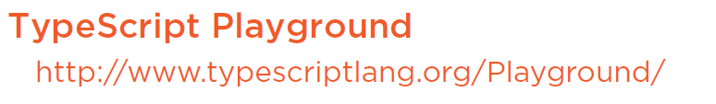

Slide 3
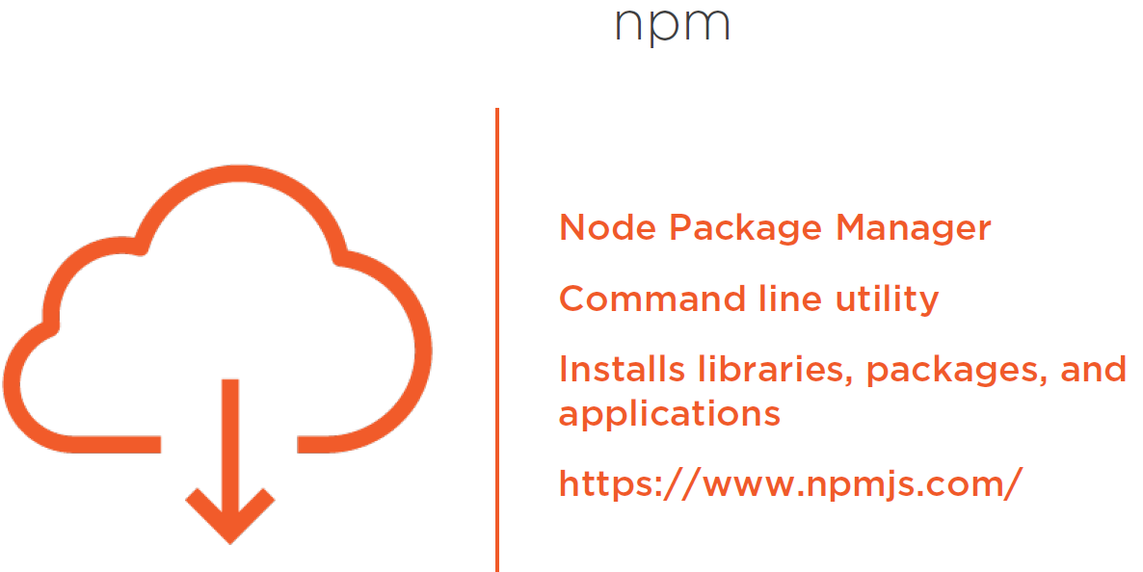
Notes:
NPM interacts with the repositories of open source projects and this has become the package manager for java script
Installs all of the dependencies required for an application.
We need NPM to install all of the libraries for angular and execute the scripts to transpile our code and launch our angular application.

Slide 4
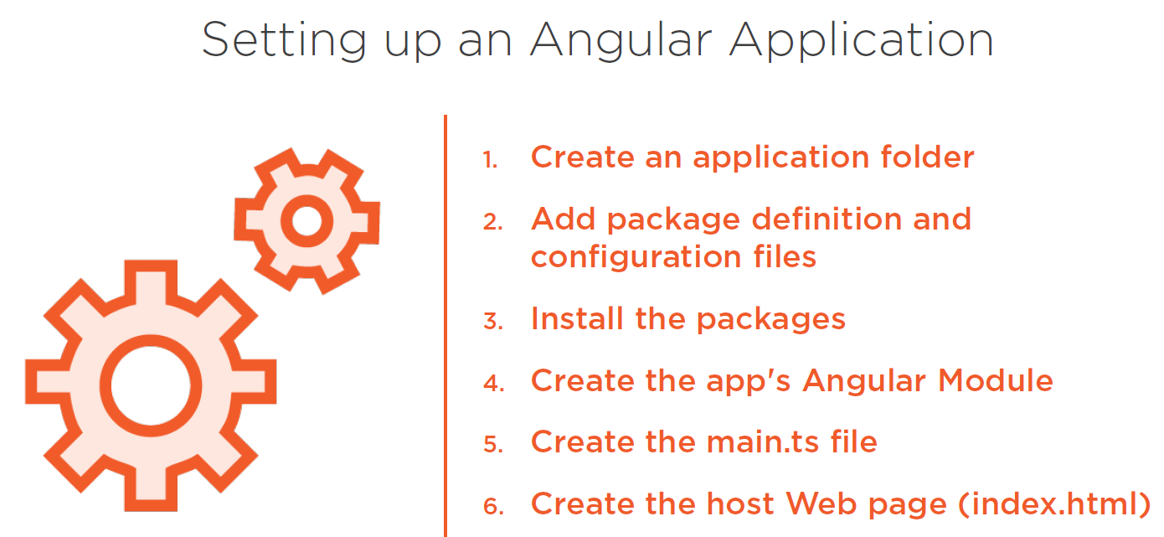
Notes:
Lucily, ANGULAR CLI does all of the above steps for us.
ANGULAR CLI
Is a command line tool to generate set of files and boiler plate code for angular application. It generates components, services etc. and it scaffolds and executes your unit and e2e tests and provides options to minimize package and prepare the files you need for deployment.

Slide 5
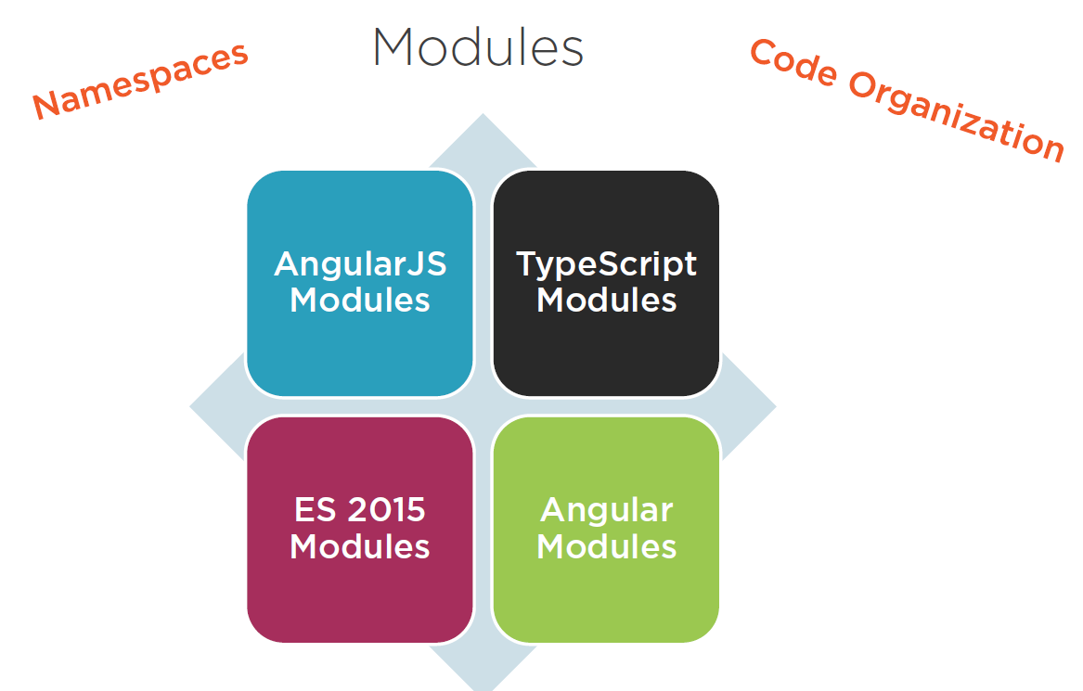
Notes:
With Javascript there is always problem with Namespaces, if we are not careful we will end up with VARIABLES and FUNCTIONS in the global namespace.
In addition Javascript didn’t provide features for our Code Organization.
To resolve these issues, ANGULARJS has MODULES – to help us organize our code and resolve SOME NAMESPACE issues.
TYPESCRIPT also have MODULES that help keep things out of global namespace.
ES2015 set us standard for defining a MODULE, In ES2015 – A MODULE is a FILE and a FILE is a MODULE, so when coding in ES2015 we don’t need to define OR name MODULEs. Just create a file and write some code, EXPORT or IMPORT something BANG the file becomes a MODULE.
ANGULAR leverages ES2015 MODULES, As we create code files and IMPORT (or) EXPORT something then we create MODULES for our application. BUT NOTE, ANGULAR have another concept of MODULES this is different from ES2015 MODULES.
As ANGULAR uses both ES2015 MODULES and Angular itself have ANGULAR MODULES.
NOTE
ES2015 MODULES is to resolve global namespace issue
ANGULAR MODULES is for modularization (Code Organization)
Lets see ES2015 MODULES first

Slide 6
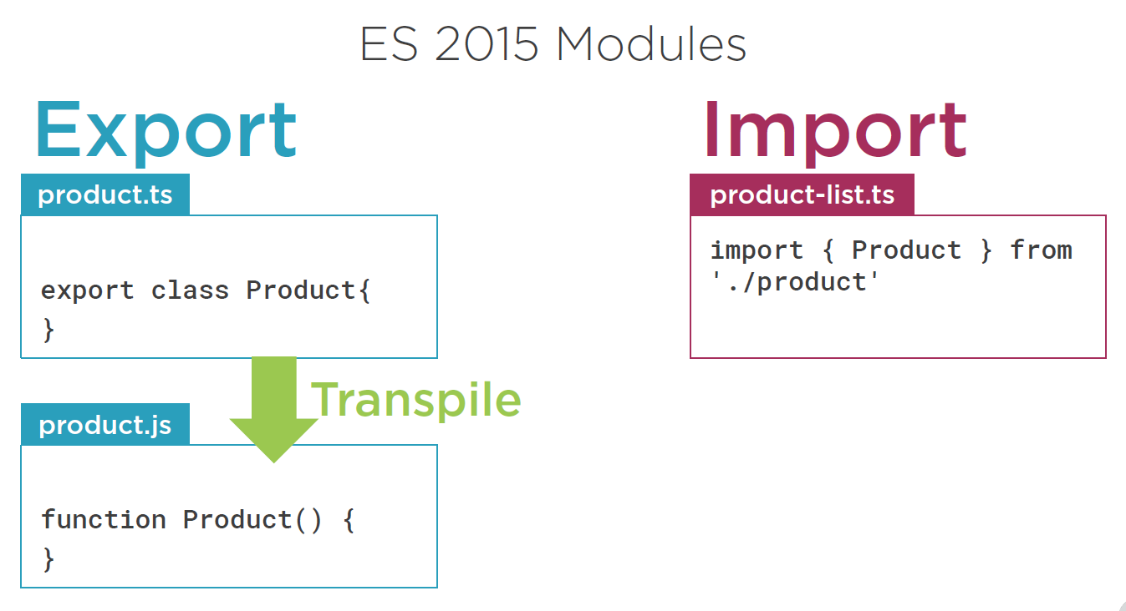
Notes:
In the above screenshot, Product class is exported so the file “product.ts” will become a MODULE.
So we can use that class in another module(FILE) by Importing it
Also note that file “product-list.ts” also will become a MODULE as we have imported something.

Slide 7
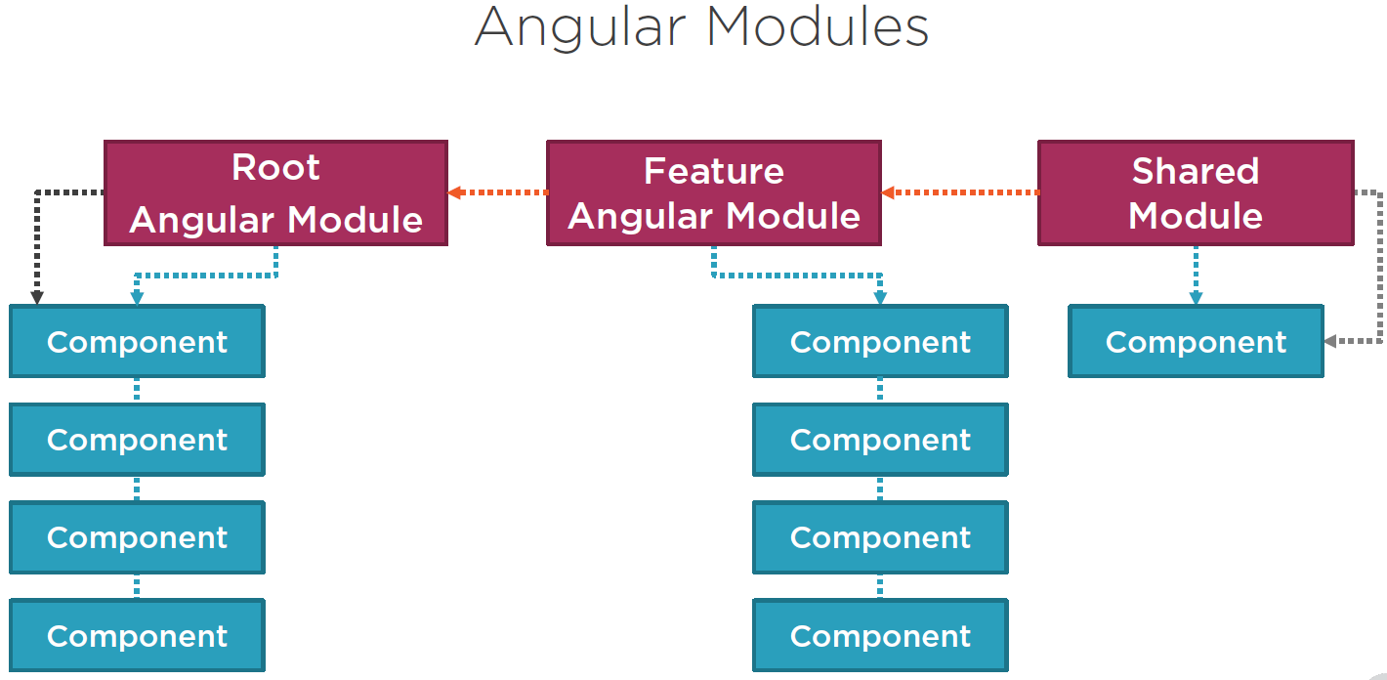
Notes:
Lets look at ANGULAR MODULES NOW
Angular MODULES helps to organize an application into COHESIVE blocks of functionality.

Slide 8
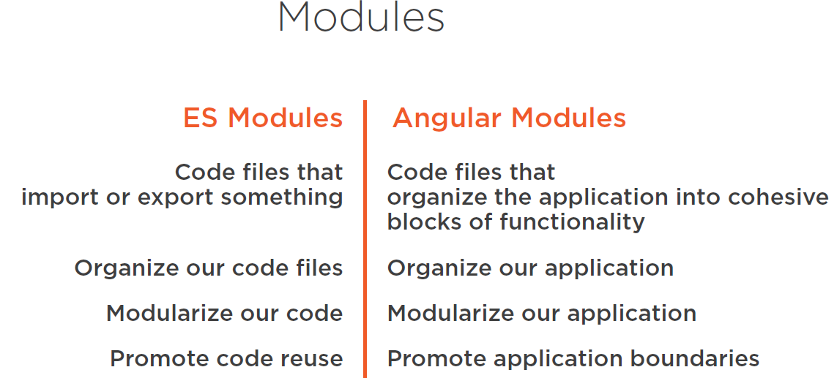

Slide 9
