Slide 1

Basic Details of the Team and Problem Statement
Ministry/Organization Name/Student Innovation:
Ministry of Social Justice and Empowerment
PS Code:
SIH1366 Problem Statement Title:
Centralised Nasha Mukti Database Team Name:
FE TEAM VIKRAM Team Leader Name:
RANJIT CHANDRASHEKHAR JAGTAP Institute Code (AISHE):
C-44585 Institute Name: TSSM BSCOER
Theme Name: INTEGRATED INFORMATION MANAGEMENT SYSTEM

Slide 2
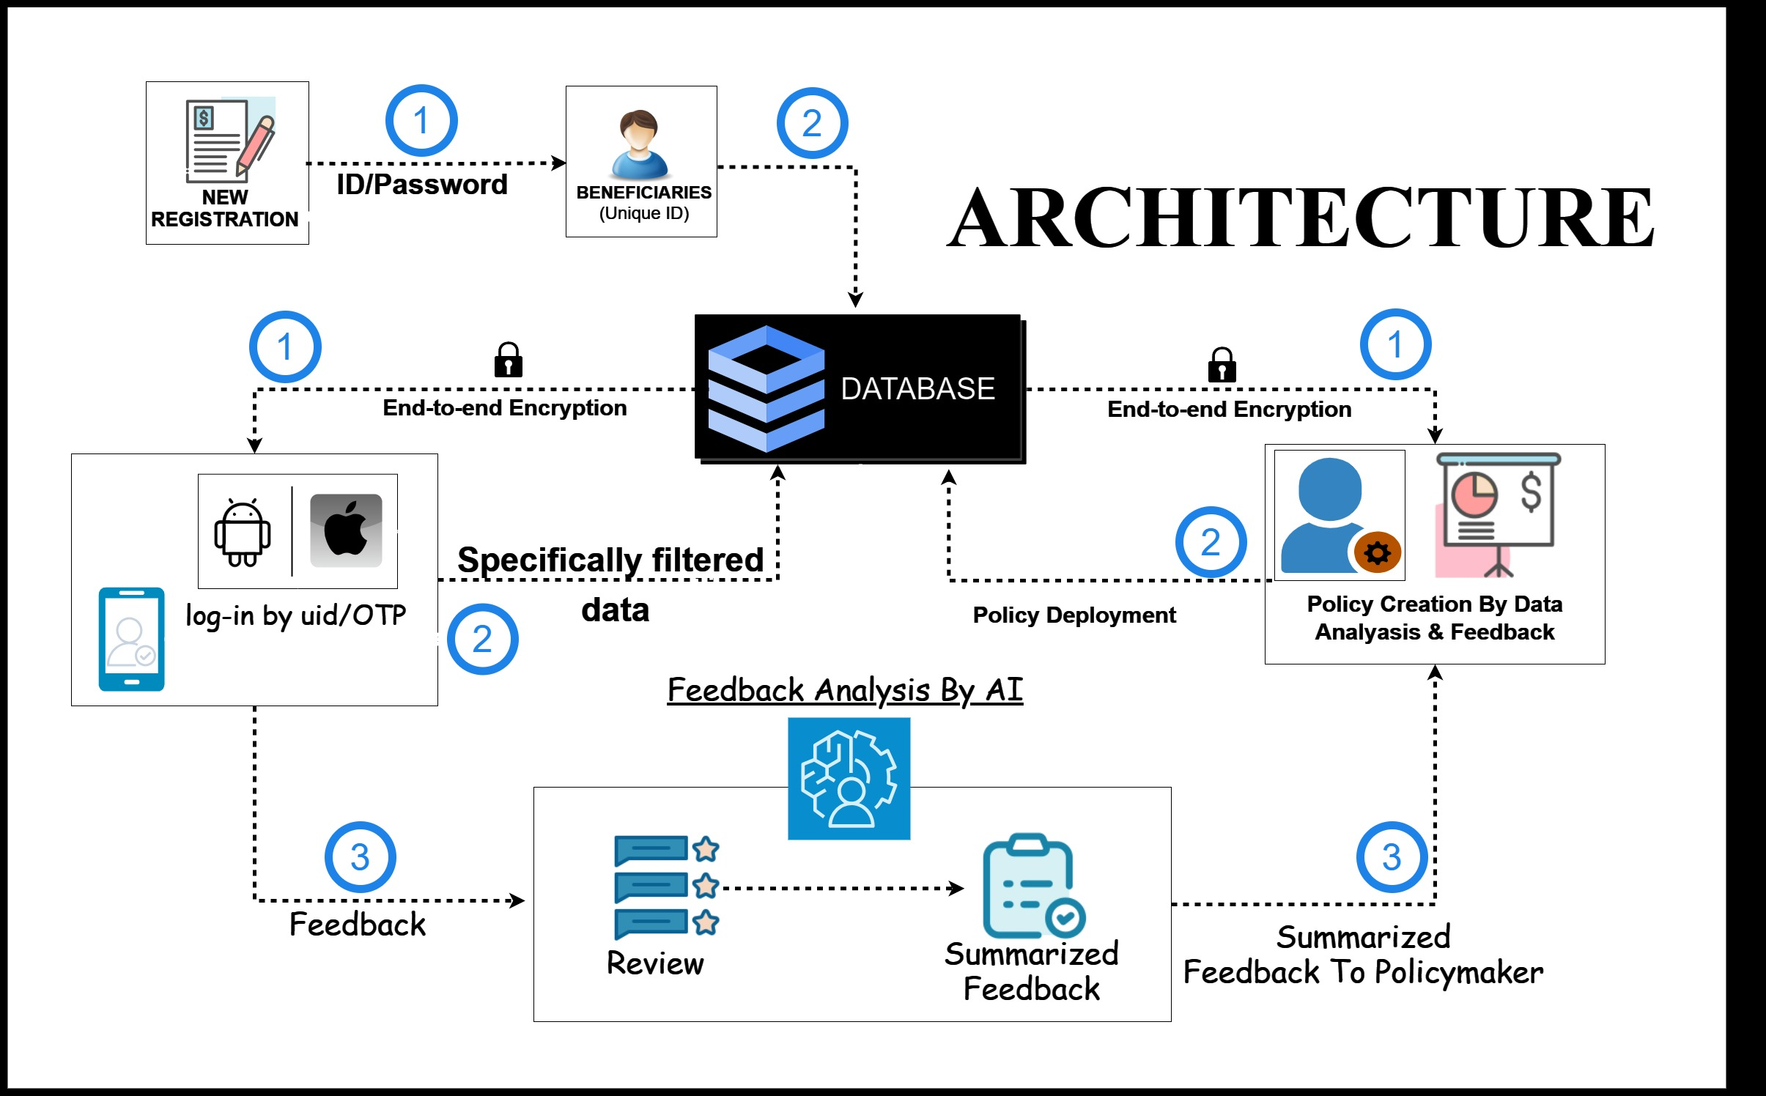
Idea/Approach Details
IDEA/SOLUTION
Use of Unique ID for identification of clients for sign-up process.
End-to-end encryption ensures the highest level of data security.
Using AI, the most frequent term in beneficiaries' feedback shall be delivered to the policymaker.
Analysis of patient-wise, center-wise or State- wise details.
Technology Stack
FrontEnd- React, Boostrap, HTML, CSS, JS
BackEnd- ExpressJS
DataBase- SQL
PRODUCT STATUS :
65% product built completed and further build is on progress. Testing and validation process are next to be undergone.

Slide 3
Idea/Approach Details
USE CASES:
SHOW STOPPER:
Can be used in hospital, clinic to view patients medical history.
Online prescription can be used in drug stores & pharmacist.
Provide accurate and comprehensive data to the Ministry of Social Justice and Empowerment, enabling the formulation of robust and effective policies.
Using confidential data of patients of rehabilitation centre to provide policymakers.
Anti Breach System- Uncompromisable innovation.
Revenue Streams:
Service Based Model.

Slide 4
Team Member Details
Team Leader Name: RANJIT CHANDRASHEKHAR JAGTAP
Branch: BE Stream: COMPUTER ENGINEERING Year : FIRST
Team Member 1 Name: SARTHAK VINAYAK SHINDE
Branch: BE Stream: COMPUTER ENGINEERING Year : FIRST
Team Member 2 Name: SHWET VIJAY KHADATKAR
Branch: BE Stream: COMPUTER ENGINEERING Year : FIRST
Team Member 3 Name: SAMRADNYI DATTATRAY MACHALE
Branch: BE Stream: COMPUTER ENGINEERING Year : FIRST
Team Member 4 Name: ROHIT ABHIMAN THORAT
Branch: BE Stream: ENTC Year : FIRST
Team Member 5 Name: SHRADDHA SANTOSH YEREKAR
Branch: BE Stream: ENTC Year : FIRST
Team Mentor 1 Name: N. B. POKALE
Category: Academic Expertise: COMPUTER ENGINEERING Domain Experience: 20 Years
Team Mentor 2 Name: V. V. ANKOLEKAR
Category: Academic Expertise: MECHANICAL ENGINEERING Domain Experience: 24 Years

