Slide 1
SketchRAG
Approximate streaming summaries as retrieval memory for agentic LLMs
Ranjith Kumar (2023BCD0030) · Bhuvan S M (2023BCS0198) · Nooh K (2023BCD0003) · Hariprashanth M (2023BCS0036)
Indian Institute of Information Technology Kottayam
64 memory cells: the agent's whole searchable memory
Notes:
SketchRAG is our streaming-data project. The question: an agent reads a stream that never ends. Can it keep a small, fixed-size summary of everything it has read, use that summary to answer questions, and know when the summary is not good enough and it must go back to the original text? The grid on the right is the idea in one picture: a fixed number of memory cells, a few of them picked by a question.

Slide 2



Agents reading a stream cannot keep re-reading all of it
THE PROBLEM
14,232
61.5 s
146 MB
LLM tokens per question
LLM time per question
dense index at 8.5M words
to send the whole document (full context). SketchRAG sends 1,213.
and still only 16.7 on PassKey: truncating the middle loses the needle.
a vector store grows with every chunk it ever sees.
Numbers from our own runs: 350 test questions, qwen2.5:7b-instruct; long stream = 8.5M words of LongBench documents.
Notes:
Three costs of not summarising. Full context sends 14,232 tokens per question and takes 61.5 seconds of LLM time, and it still scores only 16.7 on PassKey because the document has to be cut in the middle to fit the window. A dense vector index does not have that problem, but its size grows with every chunk: 146 MB after 8.5 million words in our stress test.

Slide 3



Keep a fixed-size summary, and know when not to trust it
OUR IDEA
Bounded hot memory
In one line
Streaming sketches summarise everything read so far in a fixed budget of cells: clustering, Count-Min Sketch, Misra-Gries, short digests.
Search a small summary. Read the original only where a sketch's error bound says the summary may have dropped the fact.
Cold storage
Every raw chunk is kept on disk behind pointers. It is never searched, only read when needed.
Error-bound gate
Memory stays bounded; context stays small; exact facts are still recoverable.
At question time, each cell's Count-Min Sketch says whether its digest can vouch for the rare words in the question. If not, read the raw chunks.
Notes:
Three parts. A hot memory that is bounded no matter how long the stream gets. A cold store that keeps every raw chunk but is never searched. And the error-bound gate, which is the part we contribute: it uses the Count-Min Sketch guarantee to decide, per memory cell and per question, whether the summary is safe to use.

Slide 4
From a stream of chunks to an answer
ARCHITECTURE
Hot memory (bounded)
Stream
≤ 64 cells: centroid + exemplars, Count-Min Sketch, 120-word digest
Global: Misra-Gries topics, streaming IDF
Rank cells
Error-bound gate
documents arrive as 150-word chunks
question embedding vs centroids and exemplars; top 4 + 1 neighbour
per cell: can the Count-Min Sketch vouch for the rare question terms?
trusted → digest
Cold storage (grows)
LLM answers
escalate → read raw chunks
raw chunks + embeddings, reached through cell pointers
one call, with digests + raw evidence for escalated cells
Single pass over the stream; ingest costs 2–26 ms per chunk on CPU.
Notes:
The data flow. Each chunk updates the hot memory in one pass and is written to cold storage. A question is embedded and compared with the cells; we keep the top four plus the cell that is next to the best one in time. The gate then checks each selected cell. Trusted cells contribute their digest; escalated cells are replaced by their two most relevant raw chunks from cold storage. The LLM is called once with that context.

Slide 5





A cell is a compact box for one topic in the stream
ONE MEMORY CELL
Centroid + 8 exemplars
Count-Min Sketch 3 × 512
≈ 14 KB
where the topic sits in embedding space
how often every word occurs in the cell
per cell, mostly sketch and exemplars
Digest ≤ 120 words
Span + radius
1.0 MB
hot memory with 64 cells after 8.5M words
3.7 MB
with 256 cells
the most informative sentences, read by the LLM
where in the stream; how spread out (loose > 0.75)
Raw-chunk pointers
Merge when full
the way back to the original text in cold storage
over budget: merge the two closest cells (Ward)
Notes:
What one cell stores. The centroid and up to eight exemplar embeddings are used to find cells. The Count-Min Sketch counts every word in the cell in a fixed 3 by 512 table; this is what the gate checks. The digest is up to 120 words of the best sentences. Pointers lead back to the raw chunks. A chunk joins a cell if its cosine similarity is at least 0.9, otherwise it opens a new cell; when the budget is exceeded, the two closest cells are merged. About 14 KB per cell, which is why memory stays at about 1 MB for 64 cells however long the stream gets.

Slide 6

Read raw text only where the sketch can't vouch for it
THE ERROR-BOUND GATE
Lossy
A rare query term is in the cell (Count-Min above its noise floor) but missing from the digest: the summary dropped the fact.
Exact-key lookup (∞-Bench KV)
6.7 → 96.7
Unresolved
No retrieved cell holds the rare terms above the guaranteed εN bound: the sketch cannot locate them, so read the top two cells raw.
score with digest only → with the gate. A UUID key never survives summarisation; the sketch knows it cannot vouch for it.
Loose
The cell's radius is above 0.75: it mixes too much for its digest to be faithful.
Questions with no rare terms (summaries) are answered from the digests.
Notes:
The gate is deterministic, no LLM involved. It looks at the rare terms in the question, by streaming IDF. For each retrieved cell: if the sketch says a rare term occurs in the cell but the digest does not contain it, the digest lost the fact. If no cell has the rare terms above the guaranteed error bound epsilon times N, the sketch cannot locate them at all, so the top cells are read raw. Very loose cells are always escalated. On key-value retrieval this takes the score from 6.7 to 96.7.

Slide 7




One model, one prompt; only the context changes
EXPERIMENTAL SETUP
350 test questions
qwen2.5:7b-instruct
12 tasks: 9 from LongBench (single- and multi-doc QA, summaries, passage retrieval) and 3 from ∞-Bench (PassKey, KV, En.QA)
through Ollama on Kaggle GPUs; greedy decoding, fixed seed, same prompt for every system
9 compared systems
Honest protocol
full context, BM25 RAG, dense RAG, SARA-lite, AMBER-lite, SketchRAG digest only / always raw / LLM agent / gate + agent
settings tuned only on a dev split (seed 1000); test split (seed 0) frozen; EM-LLM run from its official code
Notes:
Setup. 350 test questions over 12 tasks. Every system uses the same 7B model, the same prompt and greedy decoding, so differences come only from the context each system builds. We compare against full context, BM25 and dense retrieval, our simplified versions of SARA and AMBER, and several SketchRAG variants. Tuning used a separate dev split; the test split was frozen before tuning.

Slide 8
The gate beats full context and dense RAG; BM25 is still best
ANSWER QUALITY
41.7
SketchRAG + gate
beats full context (38.1), dense RAG (35.8), SARA-lite (38.2), AMBER-lite (32.0)
46.0
BM25 RAG
the best system overall, mostly on exact-match tasks
29.9
digest only
summaries alone lose exact facts; the gate adds 11.8 points
Notes:
Answer quality. SketchRAG with the gate scores 41.7, ahead of full context, dense RAG, SARA-lite and AMBER-lite. We report honestly that plain BM25 retrieval is the best system at 46, mostly because several tasks reward exact string matching. The digest alone scores 29.9; the gate is worth almost 12 points.

Slide 9
1,213 tokens per question: the cheapest context
CONTEXT COST
8.5%
of full context's tokens
5.8 s
LLM time per question, vs 61.5 s for full context
1 call
per question; AMBER-lite needs 3.0
Notes:
Cost. The gated system sends 1,213 tokens per question, the fewest of any system and 8.5 percent of full context, and needs 5.8 seconds of LLM time against 61.5. It makes one LLM call per question; AMBER-lite, which lets the LLM manage memory, makes about three.

Slide 10
It escalates exactly where raw evidence matters
IS THE GATE CALIBRATED?
54%
of questions escalated
190 of 350; there raw text lifts the score 30.0 → 51.5
94%
of the always-raw gain
with 22% fewer tokens than always reading raw
30 / 350
tool calls by an LLM agent
left to decide itself, a 7B model rarely fetches raw text and scores 30.1
Notes:
Calibration. The gate fires on 190 of 350 questions. On those, reading raw evidence lifts the score from 30 to 51.5. On the 160 questions it trusts, always reading raw would add less than one point. So it recovers 94 percent of the always-raw gain with 22 percent fewer tokens. When we let the LLM decide instead, through tool calls, it fetched raw text on only 30 questions and scored 30.1: the useful signal is the sketch's error bound, not the model's self-assessment.

Slide 11
Raw pointers matter most; cell budget barely does
ABLATIONS AND MEMORY BUDGET
Fewer cells → coarser digests → the gate escalates more (fire rate 0.45 → 0.77) and holds the score at 40.3–45.5. Hot memory: 178–507 KB.
Notes:
Ablations on 110 questions. Capping each cell's raw pointers at a 16-item reservoir drops the score from 42.4 to 28.9: the chunk with the answer is often no longer reachable. Removing the temporal neighbour costs about 1.7 points; the rest is within run-to-run noise of about 1 point. On the right, shrinking memory from 256 to 8 cells: the digest-only score falls, but the gate compensates by escalating more often, so the gated score stays between 40.3 and 45.5.

Slide 12

8.5M words: memory stays flat, but recall drops
LONG-STREAM STRESS TEST
1.0 MB vs 146 MB
SketchRAG hot memory (64 cells) vs a dense index after 8.5M words
Main limitation
Answer recall: dense RAG 0.44, BM25 0.38, SketchRAG gate 0.23 (256 cells). With thousands of unrelated documents sharing a few hundred cells, a centroid is too blunt a key.
Dense index size estimated as raw text + one 384-d float32 vector per chunk (same accounting as the stress-test script).
Notes:
The stress test streams all English LongBench documents, 8,488,204 words, through the system. Hot memory stays at about 1.0 MB with 64 cells, while a dense index grows to about 146 MB. But we have to be honest about recall: at this scale SketchRAG finds the evidence for 0.23 of probe questions against 0.44 for dense retrieval. Every probe escalates, so it behaves like a two-level router over cold storage. This is the main limitation we report.

Slide 13
Same model, same 120 questions: within a point of EM-LLM
AGAINST EM-LLM
34.8 vs 34.5
SketchRAG gate vs EM-LLM's official code. SketchRAG needs one generation per question instead of streaming the whole document through the model.
Caveats
EM-LLM ran in fp16; our Phi-3.5 is Ollama's quantised build
Reduced scale on Kaggle 2×T4: 6 of 9 planned tasks
Full context is highest here (37.7)
Notes:
We reproduced EM-LLM, an episodic-memory method, from its official repository, at reduced scale on Kaggle's two T4 GPUs. With the same base model and the same 120 questions, SketchRAG with the gate scores 34.8 and EM-LLM 34.5. The caveats: EM-LLM ran in fp16 while our Phi-3.5 is a quantised build, so it is the same questions but not an identical model, and only six tasks finished within the hardware limits.

Slide 14
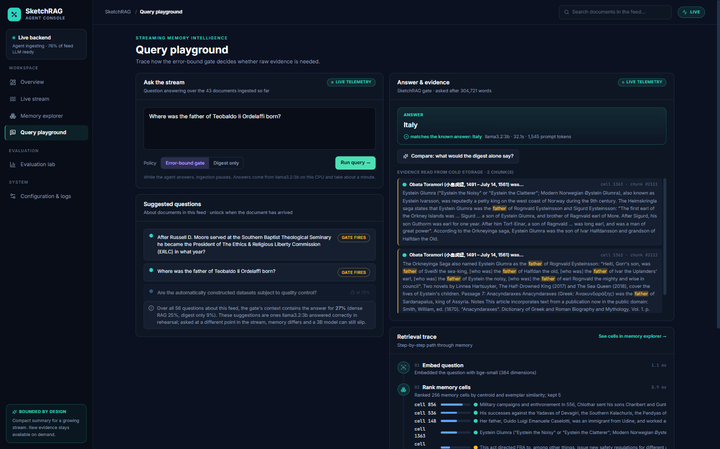



An agent monitoring a feed, answering live on a laptop
LIVE DEMO
Feed
58 LongBench documents (≈ 400k words) stream into a 256-cell memory
Ask
the trace shows ranking, the gate's verdict per cell and the raw chunks it read
Answer
llama3.2:3b via Ollama on the CPU, streamed in ≈ 30–60 s, checked against the known answer
Live run shown: "Where was the father of Teobaldo II Ordelaffi born?" → Italy (matches the known answer). Feed-wide, the gate's context holds the answer for 27% of questions (dense 25%).
Notes:
Live demo: python demo/agent/server.py, then open localhost:8600. Show the Live stream page filling, the Memory explorer grid, then ask the Teobaldo question in the Query playground and click Compare to show the digest-only answer. Note: the demo answers with a 3B model on this laptop, not the 7B model used for the benchmark numbers.

Slide 15


What SketchRAG does not solve yet
LIMITATIONS
BM25 is still stronger
Multi-hop questions
A plain lexical baseline scores 46.0 vs 41.7; these benchmarks reward exact string matches.
On 2WikiMQA the gate scores 33.3 vs 51.9 (SARA-lite) and 58.7 (full context): evidence spread over many chunks does not fit in 4 cells.
Recall at stream scale
Reduced-scale baselines
At 8.5M words recall falls to 0.23 vs 0.44 for dense RAG; cell centroids are too coarse.
SARA-lite and AMBER-lite are our re-implementations; EM-LLM ran on 6 of 9 tasks.
Notes:
Limitations, stated plainly. BM25 remains the strongest system. Multi-hop QA suffers because the evidence is spread across more chunks than four cells hold. At stream scale, recall drops well below dense retrieval. And two of our baselines are simplified re-implementations, while EM-LLM ran at reduced scale.

Slide 16
Bounded memory, with a sketch deciding what to re-read
CONCLUSION
Bounded
Cheap
Calibrated
Hot memory stays ≈ 1.0 MB at 8.5M words, against a 146 MB dense index.
1,213 tokens and 5.8 s per question; a score of 41.7, ahead of full context, dense RAG, SARA-lite and AMBER-lite.
The Count-Min bound picks where raw text matters (30.0 → 51.5); an LLM left to decide does not.
Possible next steps: finer-grained keys for long streams (sub-cell exemplars or a small lexical index over digests), and a multi-hop-aware gate.
Thank you · Questions?
Notes:
Three takeaways: memory is bounded, context is cheap, and the gate is calibrated because it comes from the sketch's error bound. The obvious next steps target the stream-scale recall problem and multi-hop questions. Thank you; happy to take questions or show the demo again.

