Slide 1
MINI PROJECT-FINAL REVIEW

Slide 2

AESTHETIC ANALYSIS
PROJECT TITLE

Slide 3
TEAM MEMBERS
MENTOR AND DESIGNATION:
DR.HEMALATHA B -- AP/IT
ANUSUYA G 711719205006
MANOJ N 711719205030
RANJITH B 711719205041
SAKTHI SUDHARSINI S 711719205043

Slide 4
INTRODUCTION
AESTHETIC ANALYSIS:
Aesthetic analysis is a careful investigation , Aesthetic means the pleasant , positive or artful appearance of person or a thing and events that evoke an Aesthetic response. Aesthetic analysis app is used to control mood induction enables us to know better, to understand and manage our emotions. Effort has been made in emotion research to create a system that artificially elicit emotional changes. Numerous mood induction procedures have been developed to generate positive , negative and neutral mood states.

Slide 5
ABSTRACT:
Aesthetic analysis is used to control mood induction enables us to know better, to understand and manage our emotions. Effort has been made in emotion research to create a system that artificially elicit emotional changes. Numerous mood induction procedures have been developed to generate positive, negative and neutral mood states. Emotions are a big part of human communication. Most of the communication takes place through emotion. The main aim of our project is to develop a robust system which can detect as well as recognize human emotion from live using face detection. There are some emotions which are universal to all human beings like HAPPY, SAD, SUPRISE, FEAR, NEUTRAL and ANGRY.

Slide 6
EXISTING SYSTEM
Aesthetic analysis is a natural language processing (NLP) technique used to determine whether data is SAD, HAPPY, NEUTRAL, FEAR, ANGRY, SURPRISE. Sentiment analysis is often performed on textual data to help businesses monitor brand and product sentiment in customer feedback, and understand customer needs

Slide 7
PROPOSED SYSTEM
Aesthetic analysis , it aids in the analysis of our emotions. It displays our emotions in text form and also displays quotes based on the detected emotions.

Slide 8
The main problem of face recognition is its high dimension space, which is to be reduced by any dimension reduction techniques. The pattern recognition approach then tries to match the facial features, which are extracted from all the images present in the database.
PROBLEM STATEMENT

Slide 9
The entire project mainly consists of 2 modules, which are 1. TRAINING module 2. TESTING module
MODULES

Slide 10
TRAINING MODULE: A training module is a segment of an overall eLearning course that focuses on a specific topic or objective. Think of it like a chapter of a book. Each training module acts as a step in a learner's journey, each time edging closer to completing the overall course. TESTING MODULE: Module testing is defined as a software testing type, which checks individual subprograms, subroutines, classes, or procedures in a program. Instead of testing whole software program at once, module testing recommends testing the smaller building blocks of the program. Module testing is largely a white box oriented.

Slide 11
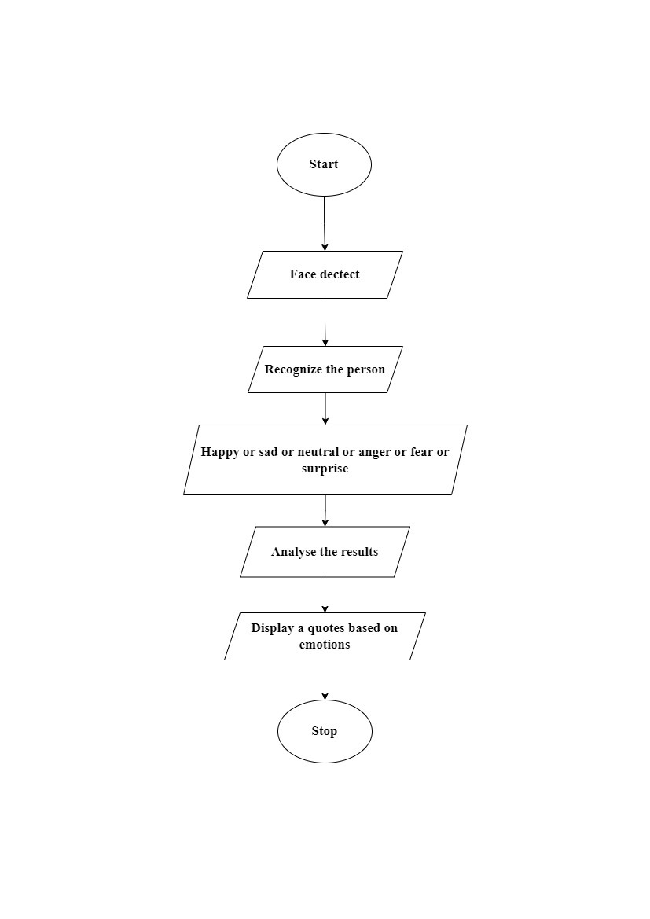
WORK FLOW

Slide 12
SYSTEM REQUIREMENTS
SOFTWARE REQUIREMENTS: PROCESSOR: Intel core i3 CAPACITY:80 GB RAM:4GB | HARDWARE REQUIREMENTS : OPERATING SYSTEM: Windows 10

Slide 13
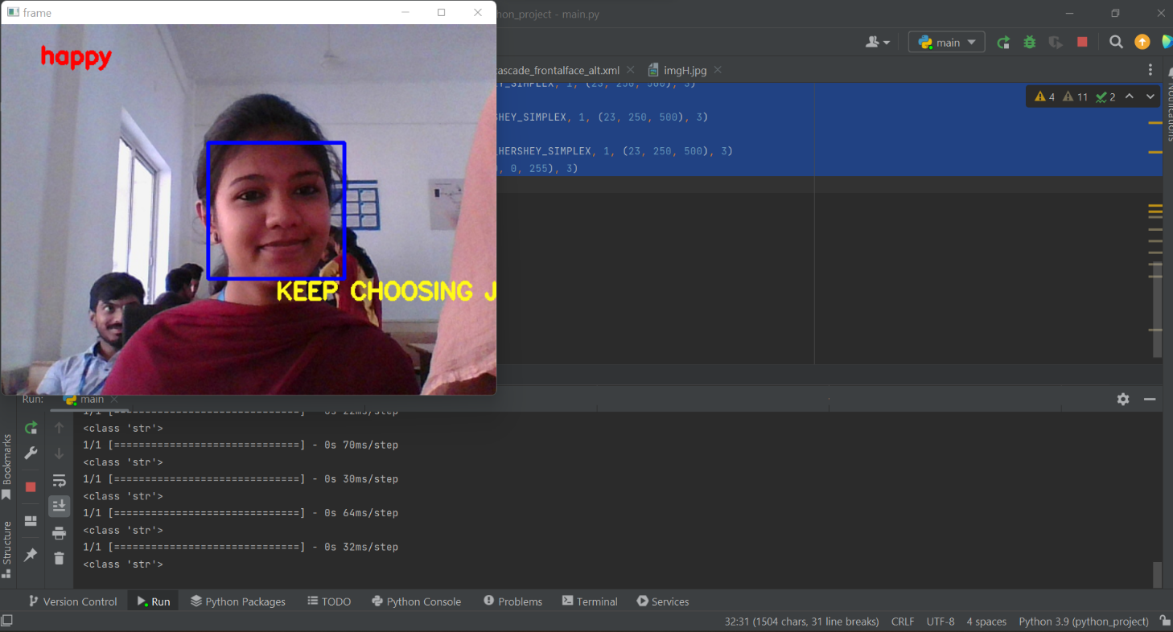
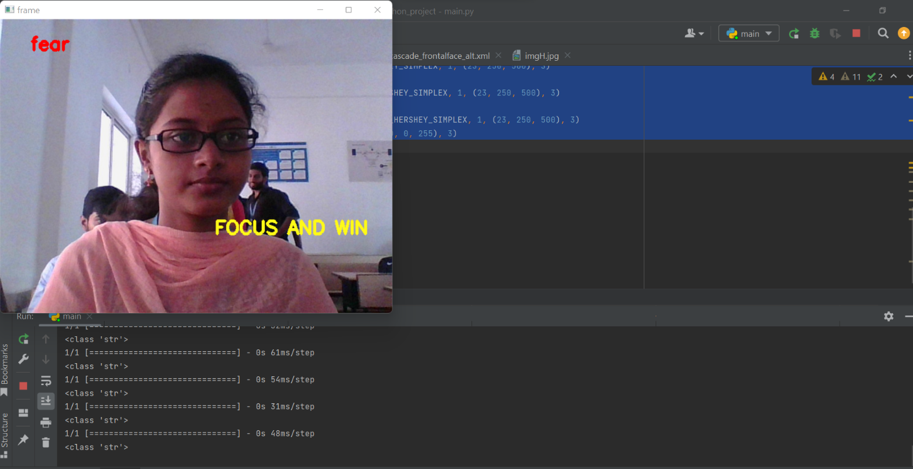
RESULT

Slide 14
In this mini project, we presented a model for recommending quotes on the basis of facial expression mood detection and recommending appropriate quotes to the user. This project proposes designing and developing a quotes recommendation system on the basis of emotion captured through face recognition. Quotes has the ability to heal any type of stress or anxiety. Recent advancements suggest that establishing an emotion-based motivational quotes recommendation system has a lot of potential. As a result, the suggested system includes a face-based emotion identification system that can detect emotions and display a quote based on those emotions
CONCLUSION

Slide 15
FUTURE WORK
In our future model user can select their regional language for better understand and a list of music and motivational speech will be displayed according to users emotion where user can select any of these options and it will be played in their regional language

Slide 16
THANK YOU

