Slide 1





Codebasics Resume Project Challenge 2026
2026 RESHAPED TAMIL NADU’S POLITICAL LANDSCAPE
Vote Share • Voter Participation • Constituency Representation
Analysis based on Official Election commission of India (ECI) Data
The 2026 Tamil Nadu Assembly Election marked a major political realignment, with TVK emerging as the dominant force across the state and reshaping regional electoral dynamics.
The 2026 Tamil Nadu Assembly Election marked a major political realignment, with TVK emerging as the dominant force across the state and reshaping regional electoral dynamics.
145 M +
Total Votes Polled
234
Constituencies
13K+
Candidates Contested
73.04%
Overall Voter Turnout
Prepared by
- Ranjith A R
Resume Project Challenge 2026
@Codebasics

Slide 2

Codebasics Resume Project Challenge 2026
THE CHALLENGE
Problem Statement
AtliQ Media wanted a fact-based analysis of the 2026 Tamil Nadu Assembly Election using only official Election Commission of India (ECI) data.
MAIN OBJECTIVE
The goal was to identify meaningful stories from the election results using official ECI data and present them through clear, fact-based storytelling.
Datasets & Sources
• tn_2021_results.csv
• tn_2026_results.csv
• constituency_master.csv
• Election Commission of India (ECI)

Slide 3

RESEARCH QUESTIONS SELECTED
Building a Connected Election Story
From the six research questions provided in the challenge, three were selected to build a connected story of the 2026 Tamil Nadu Assembly Election.
01
02
03
CONSTITUENCY REPRESENTATION STORY
VOTE SHARE STORY
TURNOUT STORY
How was voter support distributed among major political parties in the 2026 elections?
How engaged were voters across Tamil Nadu regions?
How did constituency-level outcomes shape Assembly representation?

Slide 4
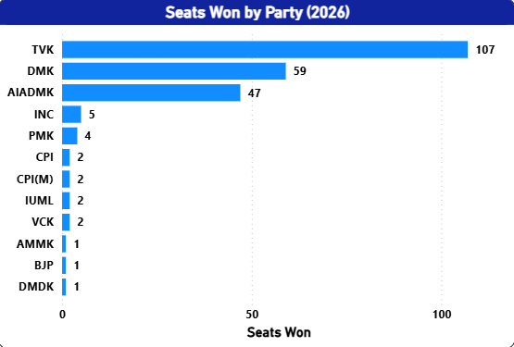
THE ELECTION AT A GLANCE
Understanding the scale and outcome of the 2026 Tamil Nadu Assembly Election.
145 M +
Total Votes Polled
234
Constituencies
13K+
Candidates Contested
73.04%
Overall Voter Turnout
ELECTION HIGHLIGHT
TVK emerged as the largest political force in 2026 Tamil Nadu Election.
TVK secured 107 seats and recorded the highest vote count, emerging as the largest party in the 2026 Tamil Nadu Assembly Election.
Source: Election Commission of India (2026)

Slide 5
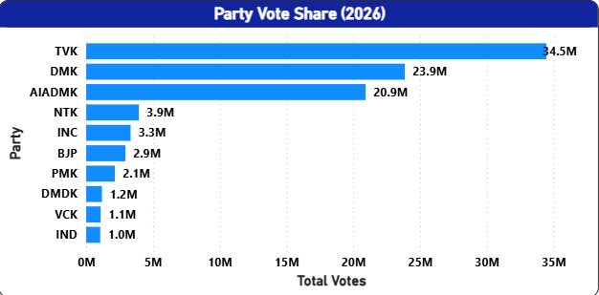
PARTY PERFORMANCE DEEP DIVE
Analysing vote share, seat share and electoral efficiency across major political parties.
MAIN FINDING
TVK recorded the Highest Vote Count and converted voter Support into the largest seat share in the Assembly.
TVK’s strong vote base translated into a clear legislative majority, establishing it as the dominant political force in the 2026 Tamil Nadu Assembly Election.
VOTE SHARE LEADER
ELECTORAL EFFICIENCY
MULTI PARTY COMPETITION
TVK recorded the highest vote count (34.5M), leading all parties in voter support during the 2026 election.
Vote share and seat share were not always proportional, highlighting differences in constituency- level conversion efficiency among parties.
Multiple parties maintained legislative representation despite differences in vote share.

Slide 6
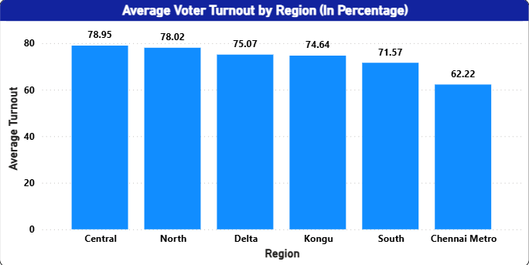


VOTER PARTICIPATION & TURNOUT
Analysing voter engagement and turnout patterns across Tamil Nadu
AVERAGE TURNOUT
HIGHEST TURNOUT REGION
73.04%
Central Region
78.95%
MAIN FINDING
Tamil Nadu recorded an average voter turnout of 73.04% with most regions exceeding 70% participation, reflecting strong electoral engagement across the state.
HIGH PARTICIPATION
REGIONAL VARIATION
DEMOCRATIC ENGAGEMENT
Central Region recorded the highest voter turnout (78.95%), leading all regions in electoral participation.
Chennai Metro reported lowest turnout at 62.22% showing variation in voter participation across regions.
Five out of Six Regions recorded turnout levels above 70% demonstrating widespread electoral participation.

Slide 7
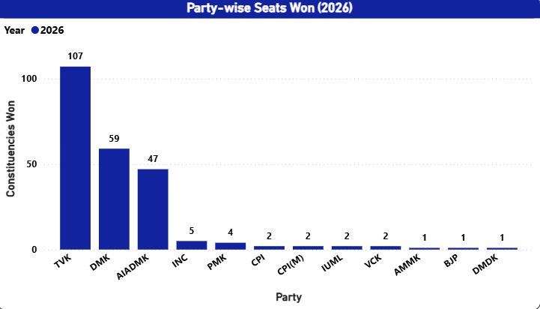
THE CONSTITUENCY REVOLUTION
Examining how constituency-level outcomes reshaped Assembly representation across Tamil Nadu.
MAIN FINDING
TVK secured 107 constituencies, becoming the largest party in the Assembly and recording the highest constituency representation in 2026.
SHIFT IN REPRESENTATION
CHANGING ELECTORAL LANDSCAPE
MULTI-PARTY COMPETITION
TVK recorded the highest constituency count, securing representation across a large share of Tamil Nadu's Assembly seats.
Constituency-level results indicate notable changes in political representation across Tamil Nadu.
Despite one party securing a clear lead, multiple parties continued to maintain representation in the Assembly.

Slide 8
KEY FINDINGS & FINAL VERDICT
Summarizing the major insights from the 2026 Tamil Nadu Assembly Election Analysis.
ELECTION WINNER
VOTE SHARE LEADER
HIGHEST TURNOUT
AVERAGE TURNOUT
TVK
107 Seats
TVK
34.5M Votes
CENTRAL REGION
78.95%
73.04%
KEY FINDINGS
FINAL VERDICT
TVK recorded the highest vote count and emerged as the largest party in the Assembly.
Tamil Nadu recorded strong voter participation, with average turnout exceeding 73%.
Constituency-level outcomes resulted in significant changes in political representation.
Multiple parties retained Assembly representation, reflecting continued electoral competition.
Vote share and constituency representation were not always proportional across parties.
The 2026 Tamil Nadu Assembly Election was characterized by strong voter participation, notable constituency-level shifts, and the emergence of TVK as the largest political force in the state.
This analysis is based solely on publicly available Election Commission of India data and focuses on describing electoral outcomes without making causal interpretations.

Slide 9
DATA LIMITATIONS & SOURCES
Understanding the scope and constraints of the analysis.
LIMITATIONS
DATA SOURCES
Analysis is based solely on publicly available Election Commission of India (ECI) data.
The analysis describes electoral outcomes and voting patterns but does not explain why parties won or lost.
No exit polls, opinion polls, demographic datasets, or survey data were used.
Findings should be interpreted as descriptive rather than causal.
Regional and constituency-level patterns are based only on officially reported election results.
Election Commission of India (ECI) - results.eci.gov.in
Chief Electoral Officer, Tamil Nadu - elections.tn.gov.in
Codebasics Resume Project Challenge Dataset
Constituency Master Dataset
Tamil Nadu Assembly Election Results
(2021 & 2026)
THANK YOU
Presented by
RANJITH A R
Resume Project Challenge 2026 | CODEBASICS

