Slide 1
Data Ingestion
- Ranjith. R

Slide 2
Index
Project Requirement
Technologies
Data Architecture
Data Model Diagram
Future Engineering
Conclusion

Slide 3
Project Requirement
The requirement is to create a robust Data Pipeline to ingest the data from PostgreSQL to Snowflake using Kafka, and Python in Real-time.
Kafka acts as a streaming system to capture data change (CDC) from PostgreSQL and store them in AWS S3 stage in Json format. Python scripts will leverage the upstream data from S3, and ingest the into Snowflake data warehouse.

Slide 4
Technologies
PostgreSQL
Kafka (Kafka Connect, Debezium)
AWS S3
Python (Boto3, Snowflake connector)
Snowflake

Slide 5


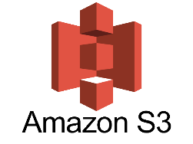

Data Ingestion Architecture
Applications
Source
Stage Layer
Data Warehouse
BI Tools
Streaming process
Python Script
Kafka Connect
ML Tools
Snowflake Connector
Data Analytics
PostgreSQL
Debezium

Slide 6
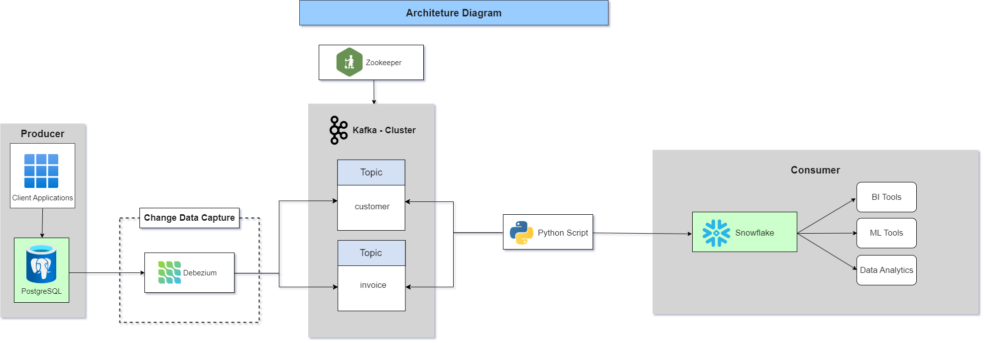

Slide 7
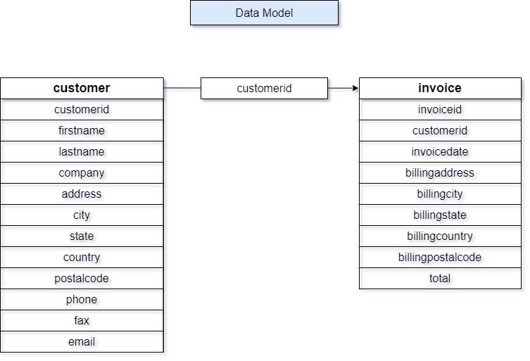

Slide 8
Deployment Strategy

Slide 9
Conclusion

