Slide 1















Data Structures
Presented by Sathiyan R

Slide 2
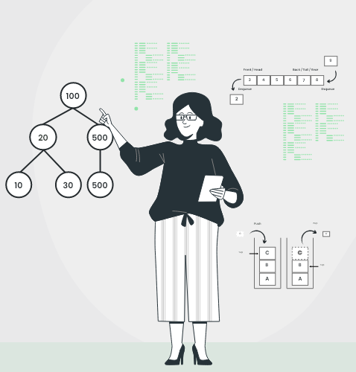
What is Data Structure?
A data structure is a way of organizing, managing, and storing data so it can be accessed and modified efficiently. Data structures define the layout and strategy for storing different types of data, and each data structure is suited to specific types of operations and tasks.

Slide 3
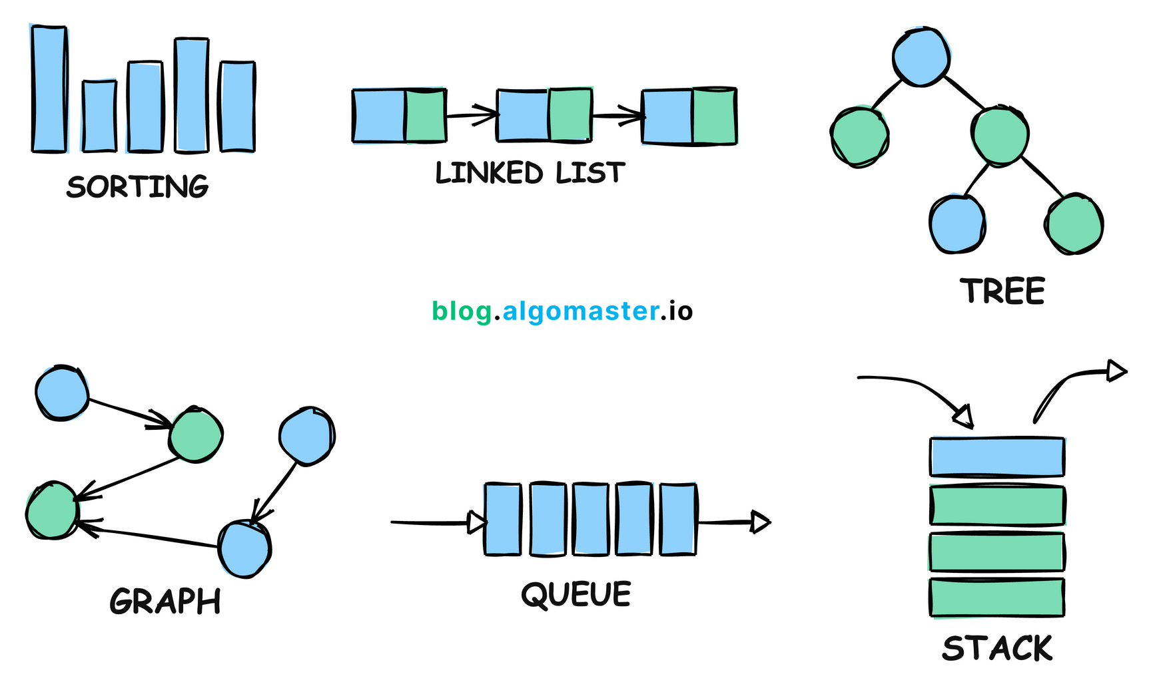
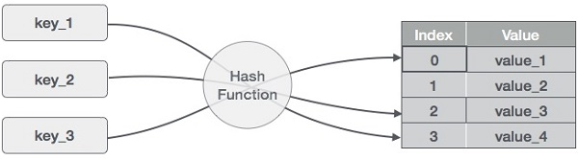
Classification of Data Structures
01.
Linear
02.
Non-Linear
03.
Hash Based

Slide 4
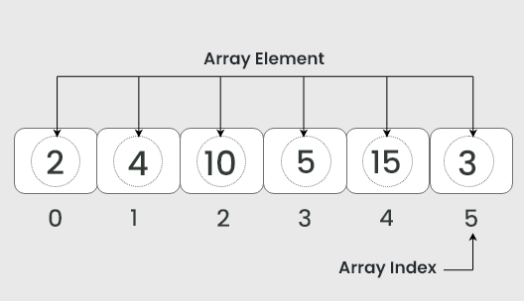
Array
Characteristics: 1) Fixed Size
2) Indexed Access 3) Homogenous Elements 4)Contiguous Memory Allocation
Operations: Access – constant time O(1)
Insertion – costly (if shifting needed) O(n) Deletion – requires shifting O(n)
Advantages
Disadvantages
Faster Access
Fixed Size in most languages
Stores multiple values of same type
Insertion and deletion can be costly

Slide 5
Stack
Characteristics: 1) Last In First Out
2) Single Access Point 3) Fixed or Dynamic Size
Operations: Push, Pop, Peek, isEmpty and isFull all operations are of constant time O(1)
Applications: Expression Evaluation Function calls Backtracking algorithms
Advantages
Disadvantages
Simple and Efficient
Limited Access

Slide 6
Queue
Characteristics: 1) First In First Out
2) Single Access Point(back for enque and front for deque 3) Fixed or Dynamic Size
Operations: Enque, Deque, Peek, isEmpty and isFull all operations are of constant time O(1)
Applications: Process Scheduling Breadth-first search
Advantages
Types: Simple Queue Circular Queue Priority Queue Double Ended Queue
Orderly Processing
Disadvantages
Limited Access

Slide 7
Linked List
Characteristics: 1) Sequential Access
2) Non-Contiguous Memory Allocation 3) Dynamic Size
Operations: Insertion, deletion, search all are sequential so based on the position, time complexity varies.
Advantages
Dynamic size
No memory wastage
Efficient Insertions and deletions
Applications: Implementing data structures like stacks and queues. Maintaining a list of items where frequent insertions and deletions are required.
Disadvantages
Memory Overhead
Sequential Access
Less Cache friendly

Slide 8
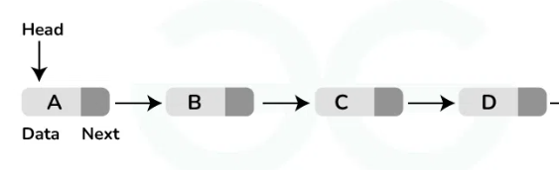
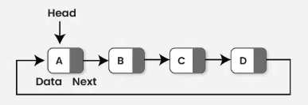
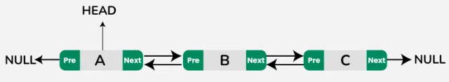
Types of Linked List
NULL
01
02
03
Singly Linked List
Doubly Linked List
Circular Linked List

Slide 9
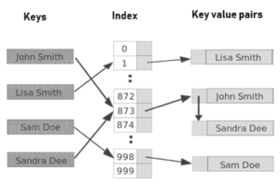
Map
Characteristics: 1) Key-value pairs
2) Efficient Lookup
Operations: Insertion- O(1) for HashMap, O(logn) for TreeMap Deletion- O(1) for HashMap, O(logn) for TreeMap Lookup- O(1) for HashMap, O(logn) for TreeMap
Applications: Counting and Frequency Analysis Request Headers
Advantages
Types: HashMap TreeMap Linked HashMap
Fast Data Retrieval
Disadvantages
Slower Than Arrays for Indexed Access

Slide 10
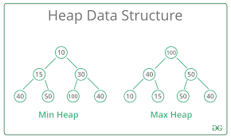
Heap
Characteristics: 1) Shape Property: Heaps are complete binary trees, meaning all levels are fully filled except possibly the last level, which is filled from left to right.
2) Heap Property: Every parent node in a max-heap is greater than or equal to its children, while in a min-heap, every parent node is smaller than or equal to its children.
Operations: Insertion and Deletion – O(logn) Peek – O(1)
Advantages
Good for dynamic data
Efficient priority access
Applications: Priority Queue Job Scheduling
Disadvantages
Lack of random access

Slide 11
Tree
Characteristics: 1) Acyclic
2) Efficient Lookup 3) Hierarchical Structure
Traversals: Preorder Inorder
Postorder Level Order
Applications: Decision Trees Expression Trees
File System Structure
Advantages
Hierarchical Organization:
Types: Binary Trees Binary Search Trees AVL Tree
Red-Black Trees B-Tree Trie
Disadvantages
Complexity in Balancing

Slide 12

Conclusion
Arrays offer contiguous memory storage for fast indexing.
Linked lists allow dynamic memory allocation and efficient insertion/deletion.
Stacks and queues provide last-in-first-out and first-in-first-out management, respectively.
Maps (including hash maps) are highly useful for key-value pairs, enabling efficient data lookup.
Trees and heaps support hierarchical data organization and prioritization.

Slide 13
Thank you very much!
sathiyanr2003@gmail.com

