Slide 1
Smart Investing Decision Making using ANN, Machine Learning, Indicators and Oscillators
Presented by
Mr. Mohit Sehgal (Regn. No. 1031330056)
Mr. Pranav Puri (Regn. No. 1031330008)
Mr. Umesh Verma (Regn. No. 1031330047)
Mr. Toyaz Pareek (Regn No. 1031330130)
Under the Guidance of
Mr. Partha Sarathi Chakraborty
Assistant Professor
Department of Computer Science and Engineering
SRM University, Delhi – NCR Campus, Modinagar, Ghaziabad, U.P., Pin – 201 204

Slide 2
TABLE OF CONTENT
S.No | Topic | Slide No.
1. | Project Time Management | 3
2. | Introduction | 4
3. | Literature Survey | 5-8
4. | Proposed Methodology | 9-14
5. | Screen-shots | 15-18
6. | Conclusion | 19
7. | Future Work | 20
8. | References | 21

Slide 3
Review 3
Review 1
Implementation
Review 2
Literature Survey
Final Review
Design
Result

Slide 4

Introduction
Prevailing business environment is full of complexities and confusion which leads to investors in a great dilemma while making strategic decision pertaining to buying and selling of securities.
With this project, an attempt has been made that facilitate investors in taking decision.
An attempt to predict future price is also made.

Slide 5

Literature Survey

Slide 6
Paper-I
Title: Investment Strategy optimization Using Technical Analysis and Predictive Modeling in Emerging Markets[Ref:5]
Authors: Jelena Stankovic, Ivana Markovic, Milos Stojenovic
Objectives:
The aim of this paper is the study of profitability of technical trading rules implemented on specific group of emerging market of South-East European Countries.
The technical indicators which are used to form the most profitable strategies are used as input vectors for LS-SVM which is then evaluated.
Results:
In case of BELEX15, best performing strategies are based on EMA and MACD
In case of CORBEX10, strategies show no significant consistency.
In case of SOFIX and BET, best performing strategies are EMA and MACD
In none of the cases, the strategies based on RSI performed well. This is due to the fact that RSI strategies works in a non-trending environments.(Wong et Al.,2010)

Slide 7
Paper-2
Title: Research on the effectiveness of technical indicators with the Volume[Ref:7]
Authors: Gang LI, Jin Zhu
Objectives:
Effectiveness of technical indicators with the volume on the basis of conclusion about relationship between price and volume
Results:
After taking into account the volume, it can be found :
sensitivity of indicators improved, reliability enhanced,
investment risks and losses reduced, the investment
returned increased.
Thus, the application of technical indicators which takes into account the volume is more effective than pure price index in stock market.

Slide 8
Paper-3
Title: Stock Price Prediction using Artificial Neural Network[Ref:6]
Authors: Mayankkumar B Patel, Sunil R Yalamalle
Objectives:
To study the current stock market trend and collect trend data.
To build perceptron model for companies listed under LIX15 index of NSE using Multi layer Perceptron Neural Network Technique.
To compare model with real data for its accuracy
Results:
It was concluded that MLP NN technique gives satisfactory output with:
Median Normalized Error: 0.05995
Median Correct Direction %: 51.06
Median Standard Deviation: 6.39825

Slide 9
Proposed Methodology
Step 1: Data Collection
User provides the TICKER for the stock of interest.
Quandl API is used to fetch the past stock data in JSON format.
It returns Closing Price, Volume, Open, High, Low etc. as a data-frame.
Close Price series is formed which is used as the data for further process.
Step 2: Implementation of Indicators and oscillators
SMA, EMA, MACD, RSI, Bollinger Band, Statistical Linear Regression for
trend-line are implemented.

Slide 10
Proposed Methodology
Step 3: Determining Buy/Sell Signals
If previous SMA is lower than the previous Close Price and current SMA is greater than current Close Price
then Buy Signal is generated.
if previous SMA is greater than the previous Close Price and current SMA is lower than current Close Price
then Sell Signal is generated.
If previous EMA-20 is lower than the previous EMA-50 and current EMA-20 is greater than current EMA-50
then Buy Signal is generated.
if previous EMA-20 is greater than the previous EMA-50 and current EMA-20 is lower than current EMA-50
then Sell Signal is generated.
if previous MACD value is less than previous EMA-9 and current MACD value is greater than current EMA9
then Buy Signal is generated.
if previous MACD value is greater than previous EMA-9 and current MACD value is lower than current
EMA-9 then Sell Signal is generated.
if [Close Price - lower band]<[Upper Band - Close Price] and both the differences are greater than 0 then
buy Signal is generated
if [Upper band – Close Price]<[Close Price – Lower Band] and both the differences are greater than 0 then
Sell signal is generated

Slide 11
Proposed Methodology
Step 4: Predicting Stock Price
Past 30 days stock price and the index is used as training data for Radial Basis Function Network.
Next Day price is predicted and displayed as an output data.
Step 5: Calculating Trend Line Equation
Past 20 days prices are taken as ‘y’ and index is taken as ‘x’
Relation between ‘x’ and ‘y’ is determined using statistical regression
Its slope will determine bullish and bearish market

Slide 12
Proposed Methodology
Calculation Of Simple Moving Average (SMA):
SMA(n+1)=(a+b+c+……+n)/n
SMA(n+2)=(b+c+…..+(n+1))/n
and so on.
where
a,b,c, are a^{th},b^{th} and c^{th} stock prices and
n is time period, n=20 days
Determining Trend:
if Closing price curve is above the SMA curve , it is uptrend
if Closing price curve is below the SMA curve , it is downtrend

Slide 13
Proposed Methodology
Calculation of n-period-EMA(Exponential Moving Average):
SMA: n-period-sum/n
Multiplier: 2/(n+1)
EMA: {close – EMA(previous day)}*multiplier + EMA(previous day)
Calculation of MACD(Moving Average Divergence Convergence):
MACD : 12 day EMA - 26 day EMA
Signal Line: EMA-9
Calculation of RSI(Relative Strength Index):
RSI: (100 – (100/(1+RS)))
RS : 14-day-EMA of up-day closing gains/14-day-EMA of down-day closing losses
Determination of overbought and oversold:
if RSI is 70 then overbought and oversold when below 30.

Slide 14
Proposed Methodology
Calculation of Statistical Regression:
y = mx + c
where y = closing price ,
x = nth number
m = (sum(x*y)-sum(y)*sum(x))/sum((x-mean(x))^2)
c = y – mx
Determination of Trend:
if m > 0 then trend is uptrend
if m < 0 then trend is downtrend
Calculation of Bollinger Band:
Upper-Band: SMA-20 + 2 * standard deviation of 20 day closing
Lower-Band: SMA-20 + 2 * standard deviation of 20 day closing

Slide 15
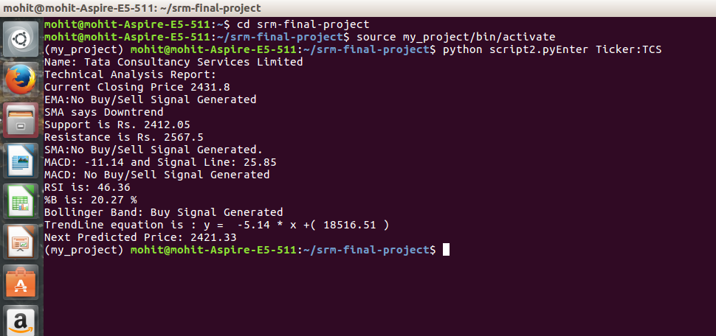
Screen-Shots

Slide 16
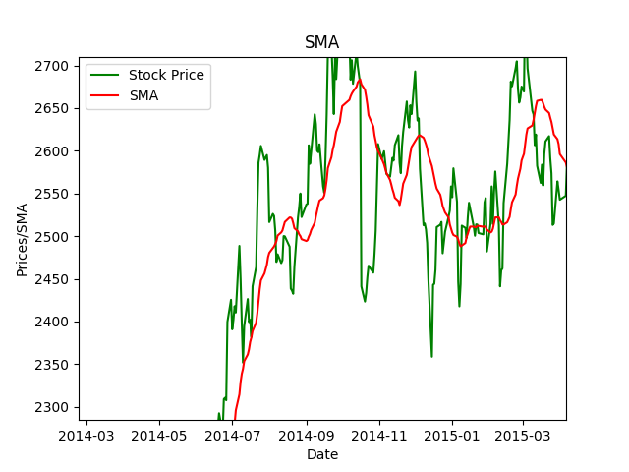
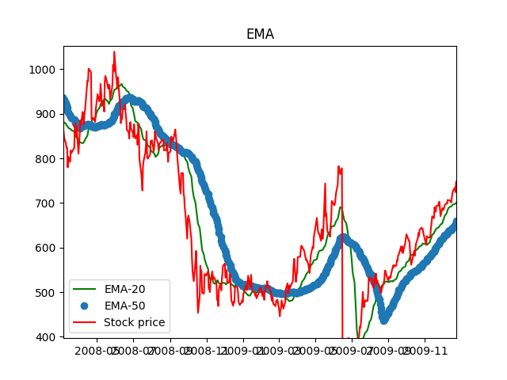
Screen-Shots

Slide 17
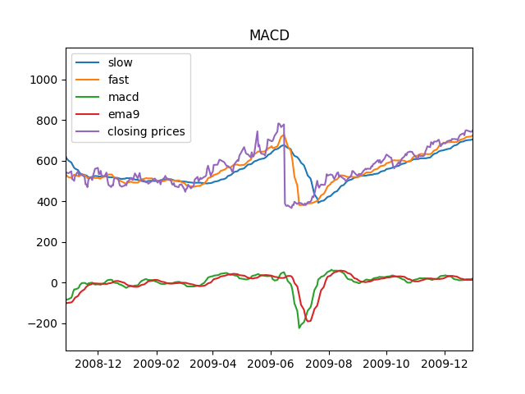
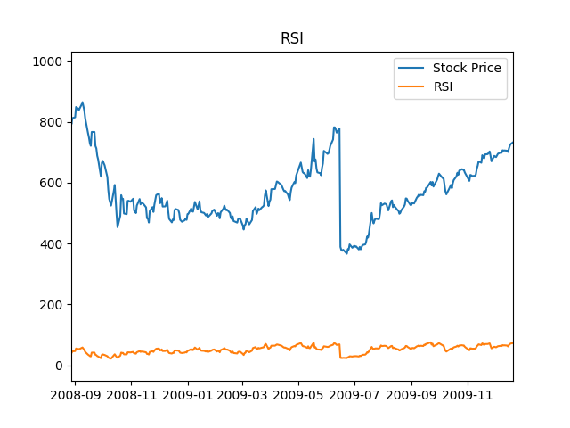
Screen-Shots

Slide 18
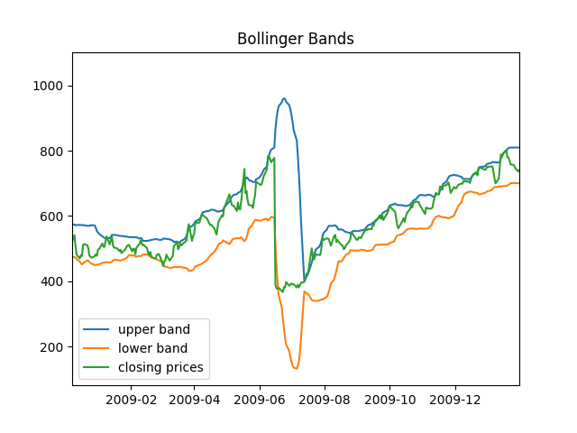
Screen-Shots

Slide 19
Conclusion
Technical Analysis of stock market is a method of evaluating securities by analyzing statistics generated by market activity. Chartist uses these data to determine whether they are going to invest in that stock. They look for the buy and sell signals. This project has also performed technical analysis over stock prices by using some of the mostly used indicators and oscillators. We have also tried to predict stock price for the next day.
Stock price is influenced by many factors including –internal information, news, speeches of ministers etc. So this does not give accurate results all the time. But it is better than blindly investing.
Hence, it can be concluded that a smart investing decision can be made if one uses technical indicators and oscillators and other sorts of information like news etc. before making an investment.

Slide 20
Future Work
More Indicators and oscillators will be added.
Sentiment Analysis will be performed on the data fetched from twitter.
Buy/Sell Signals will be generated according to the sentiments with combined results of indicators and oscillators.

Slide 21
References
Appel, Gerald (2005). Technical Analysis Power Tools for Active Investors. Financial Times Prentice Hall. p. 166. ISBN 0-13-147902-4.
J. Welles Wilder, New Concepts in Technical Trading Systems, ISBN 0-89459-027-8
Bollinger, John. Bollinger on Bollinger Bands. McGraw Hill, 2002. ISBN 978-0-07-137368-5
NIST/SEMATECH e-Handbook of Statistical Methods: Single Exponential Smoothing at the National Institute of Standards and Technology
Jelena Stankovic, Ivana Markovic , Milos Stojanovic ,”Investment Strategy Optimization Using Technical Analysis and Predictive Modeling in Emerging Markets”, The Economies of Balkan and Eastern Europe Countries in the changed world, EBEEC 2014 ,Nis, Serbia
Mayankkumar B Patel, Sunil R Yalamalle, “Stock Price Prediction Using Artificial Neural Network”, International Journal of Innovative Research in Science, Engineering and Technology 2014, (volume :3), 6-June-2014
Gang LI, Jin Zhu, ”Research on Effectiveness of Technical Indicators with the Volume”, International Conference on Education, Management and Computing Technology(ICEMCT 2014)
Darmadi Komo, Chein-I Chang, Hanseok KO , “Neural Network Technology for Stock Market Index
Prediction”, International Symposium on Speech, Image Processing and Neural Networks, 13-16 April
1994

Slide 22
Thank You

