Slide 1
Phishing Website Detection by Machine Learning Techniques
Team Members:
S.Shathvaran (211423104618)
K.Sri RanjithKumar (211423104643)
Guide: Mrs.Monica
Department of Computer Science and Engineering
Panimalar Engineering College
October 2025

Slide 2
Agenda
Introduction
Objective
Literature Survey
Problem Statement
Architecture Diagram
Use Case Diagram
Modules
Algorithms / Methodology
Testing
Test Cases & Validation
Performance Analysis
Screenshots
Conclusion
Future Work
References

Slide 3
Introduction
Phishing websites mimic legitimate sites.
Goal: steal user credentials and financial info.
Traditional methods: manual and blacklist-based.
Machine Learning offers automated detection.
Enhances security and browsing safety.

Slide 4
Objective
Detect phishing websites using ML algorithms.
Extract multiple URL-based and HTML features.
Train models and compare performance.
Choose best-performing model (XGBoost).
Enable real-time phishing detection.

Slide 5
Literature Survey
Author & Year | Approach | Algorithm | Accuracy
Mohammad et al., 2012 | Phishing website detection | Decision Tree | 84%
Jain & Gupta, 2018 | ML classification | Random Forest | 89%
Marchal et al., 2017 | URL feature analysis | Naïve Bayes | 80%
Aburrous et al., 2020 | Hybrid ML technique | SVM | 85%
Moghimi et al., 2021 | Deep learning approach | CNN | 92%
AlMousa, 2019 | Feature selection-based | XGBoost | 88%
Dey et al., 2020 | Ensemble ML detection | RF + XGB | 90%
Ramesh et al., 2021 | Real-time URL classification | Logistic Regression | 83%
Patel & Desai, 2022 | Web content analysis | Random Forest | 87%
Sharma et al., 2023 | Hybrid multi-feature model | DNN | 94%

Slide 6
Problem Statement
Phishing websites increase cybercrime rates.
Manual detection is inefficient.
Need automated ML-based real-time detection.
Objective: classify URLs as legitimate or phishing.

Slide 7
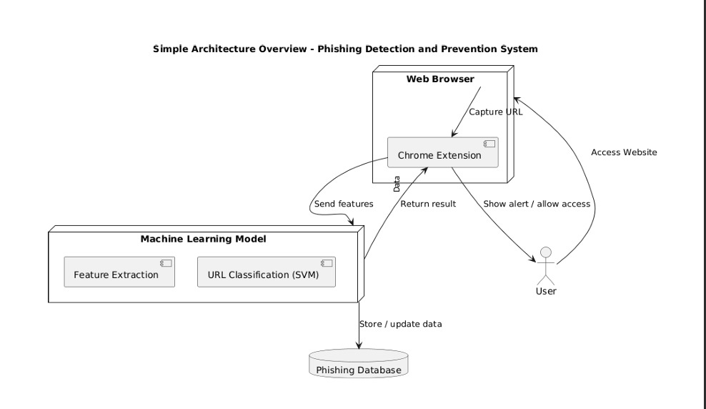
Architecture Diagram

Slide 8
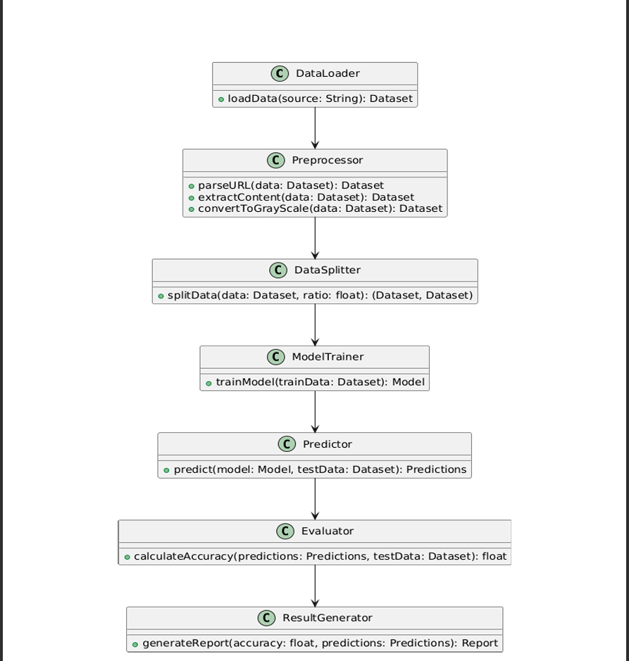
Use Case Diagram

Slide 9
Modules
Data Collection Module
Feature Extraction Module
Model Training Module
Testing Module
Prediction Module

Slide 10
Algorithms / Methodology
Supervised Learning Classification Approach
Models: Decision Tree, Random Forest, SVM, XGBoost, MLP
Feature Extraction: URL, Domain, HTML/JS-based
Train-Test Split: 80%-20%

Slide 11
Testing
Functional Testing
Unit Testing
Integration Testing
Validation Testing

Slide 12
Test Cases & Validation
Test ID | Input URL | Expected Output | Result
TC1 | google.com | Legitimate | Pass
TC2 | paypal-secure.xyz | Phishing | Pass
TC3 | facebook.com | Legitimate | Pass
TC4 | icicibank-security.net | Phishing | Pass

Slide 13
Performance Analysis
Decision Tree – 79%
Random Forest – 83%
SVM – 80%
XGBoost – 86.4% (Best)
Evaluated using Accuracy, Precision, Recall, F1-score

Slide 14
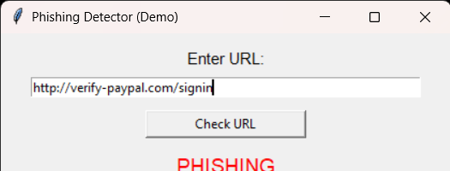
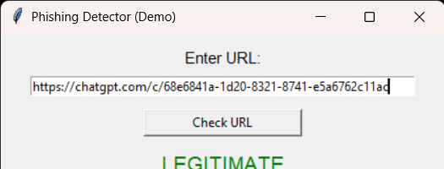
Screenshots

Slide 15
Conclusion
Phishing website detection system implemented.
XGBoost model performed best with 86% accuracy.
System enables secure and real-time predictions.

Slide 16
Future Work
Integrate browser extension.
Develop GUI for end-users.
Adopt CNN-based deep learning.
Deploy cloud-based live system.

Slide 17
References
IEEE & Springer papers (2012–2024)
PhishTank Dataset
UNB Dataset
Research on ML-based phishing detection

