Slide 1
Intelligent Traffic Management System using YOLOv8
BATCH-A10:
A. RANJITH KRISHNA (Y20ACS402)
B. BALA SUBRAMANYAM (Y20ACS418)
CH. GOPI (Y20ACS426)
B. VENKATA NAGA GANESH (Y20ACS417)
PROJECT GUIDE:
THOKALA SRIVALLI (Assistant Professor),
Dept. of CSE, BEC

Slide 2
CONTENTS
Abstract
Objective
Existing System
Proposed System
Design Methodology
Hardware and Software Requirements
Result
Conclusion

Slide 3
ABSTRACT
Traffic congestion is becoming one of the critical issues with increasing population and automobiles in cities.
The current traffic control methods, such as manual controlling by traffic police, fixed-timer traffic lights and electronic sensors, have their limitations.
The system uses a deep learning technique called Yolov8, a trained model, to accurately detect vehicle objects, count vehicles, and allocate timer to communicate this data to the traffic signals.
By adjusting the traffic lights based on traffic density, we can control the flow of vehicles on the road smoothly, thus avoiding any further traffic jams.

Slide 4
OBJECTIVE
To develop a more efficient and adaptive system for managing traffic flow at junctions in urban areas.
Using CCTV camera images and an object detection algorithm, we can identify the number of vehicles present in an image.
To accurately measure real-time traffic density, the system will adjust traffic signal timings as necessary, ensuring each lane receives a fair allocation of green light time based on traffic demand.
This will help in reducing congestion, minimizing delays for drivers, and improving overall traffic flow efficiency.

Slide 5
EXISTING SYSTEM
Existing Methodologies:
Drawbacks of conventional systems:
Fixed Signal Timers: Conventional traffic lights uses a timer for every phase, which is fixed and does not adapt according to the real-time traffic on that road.
Sensor-Based Systems: Electronic sensors can only detect things within a short distance, you need to use many of them to effectively cover all the places you want to monitor.
Intelligent Traffic Systems:YOLOv4 and MobileNet V2 pre-trained model which is trained over 10 epochs with final validation accuracy of 95.49%

Slide 6
PROPOSED SYSTEM
Our proposed system takes an image from the CCTV cameras at traffic junctions as input for real-time traffic density calculation using image processing and object detection.
A image is passed on to the vehicle detection algorithm, which uses YOLOv8. The number of vehicles of each class, such as car, bike, bus, and truck, is detected, which is to calculate the density of traffic.
The signal switching algorithm uses this density, among some other factors, to set the green signal timer for each lane.
The green signal time is restricted to a maximum and minimum value in order to avoid starvation of a particular lane.

Slide 7
PROPOSED SYSTEM
Vehicle Detection Module:
The proposed system uses YOLOv8 (You only look once) for vehicle detection, which provides the desired accuracy and processing time. A custom YOLOv8 model was trained for vehicle detection, which can detect vehicles of different classes like cars, bikes, heavy vehicles (buses and trucks), and rickshaws.
Signal Switching Module:
The Signal Switching Algorithm sets the green signal timer according to traffic density returned by the vehicle detection module, and updates the red signal timers of other signals accordingly. It also switches between the signals cyclically according to the timers.

Slide 8
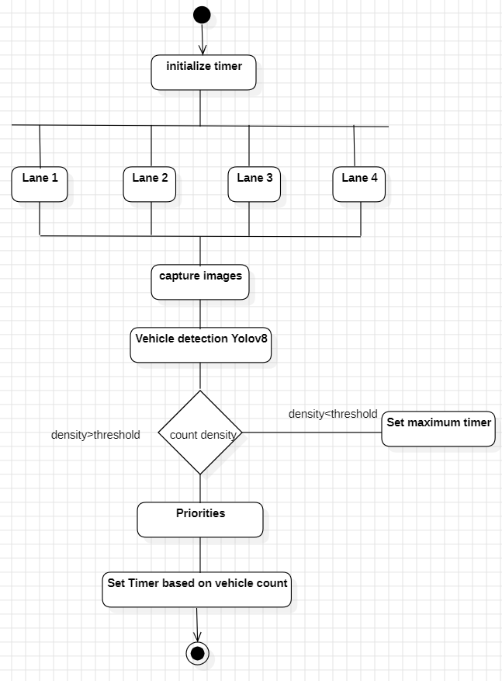
DESIGN METHODOLOGY

Slide 9
STEPS …
Step 1: Capturing Traffic Images:
Traffic images are taken using CCTV cameras installed at traffic signals.
Step 2: Vehicle Detection and Traffic Density Calculation:
We use the YOLOv8 algorithm to detect the vehicles present in the images. We need to calculate the traffic density by determining the number of vehicles in an image.
Step 3: Sending Traffic Density Data to Server:
The calculated traffic density information is sent to a central server.
Step 4: Calculating Green Signal Time:
The server processes the traffic density data to calculate the timing for green signals.
Step 5: Updating Traffic Signal Timers :
The green signal time is set for the traffic signal and updating signal to other lanes of road .

Slide 10
IMPLEMENTATION
!pip install ultralytics # Install Ultralytics library
model = YOLO('yolov8n.pt’) # Load a pretrained YOLOv8n model from Ultralytics
dataset_path = '/kaggle/input/Vehicle_Detection_Image_Dataset’
os.path.join(dataset_path, 'data.yaml’) # Set the path to the YAML file
!yolo task=detect mode=train model=yolov8n.pt imgsz=640
data='/kaggle/input/trafficcongestiondataset/vehicledatasetyolov8/data.yaml'
epochs=100 batch=32 name=yolov8n optimizer='auto' patience=50 dropout=0.1 seed=0 device=0,1 # Train the model on our custom dataset
best_model.predict(source=image_path, imgsz=640, conf=0.5)
# Perform inference on each selected image and display it
best_model.predict(source=video_path, save=True)
# Initiate vehicle detection on the sample video using the best performing model

Slide 11
SOFTWARE & HARDWARE REQUIREMENTS
SOFTWARE COMPONENTS
Operating system : Windows ,macbook
Coding Language : Python 3.10.9, HTML,CSS,JS
Web Framework : Flask
HARDWARE COMPONENTS
System : Pentium i3 Processor,AMD ryzen.
Hard Disk : 500 GB.
Ram : 4 GB

Slide 12
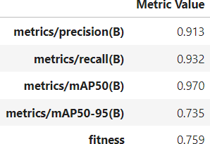
RESULTS
The YOLOv8 model achieves an impressive precision of 91.3% on the validation set, indicating a high percentage of correct predictions.
It demonstrates a recall score of 93.2%, showcasing its ability to identify most relevant cases in the dataset.
With a mean Average Precision (mAP) of 97.0% at 50% Intersection over Union (IoU), the model shows high accuracy in detecting objects with significant overlap with the ground truth.
The fitness score of 75.9% highlights a good balance between precision, recall, and IoU, affirming the model's effectiveness in object detection tasks.

Slide 13
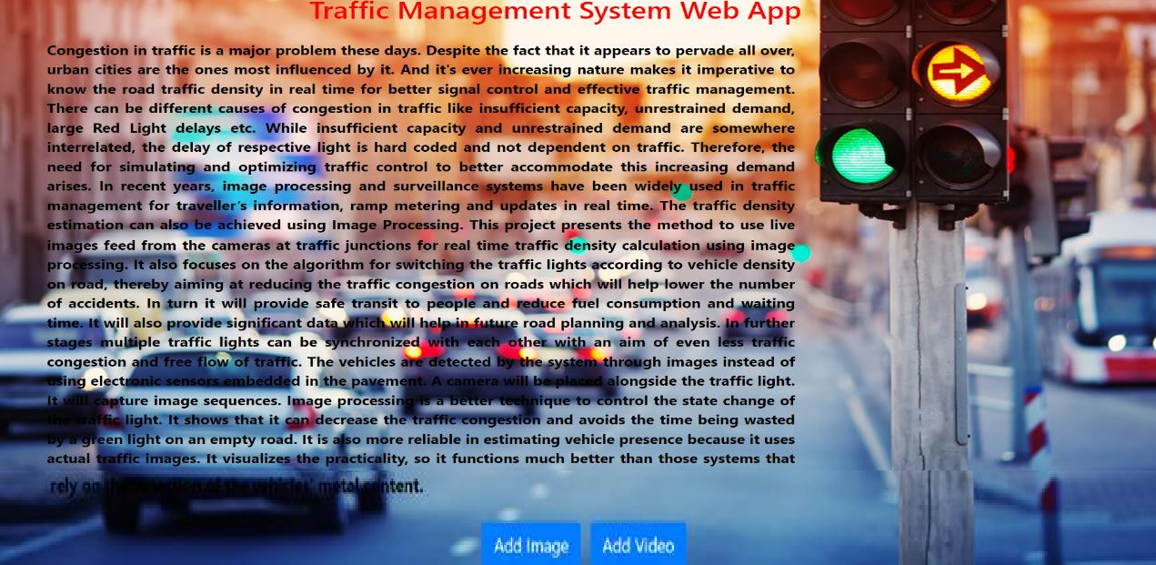
After Opening the Website:

Slide 14
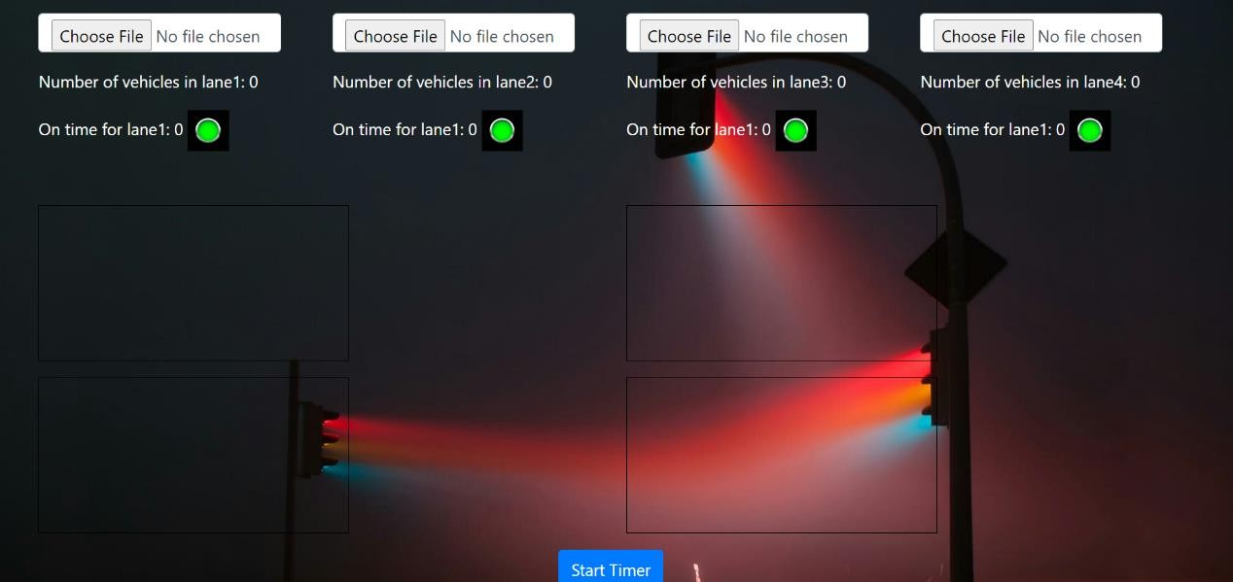
Vehicle Object Detection Page:

Slide 15
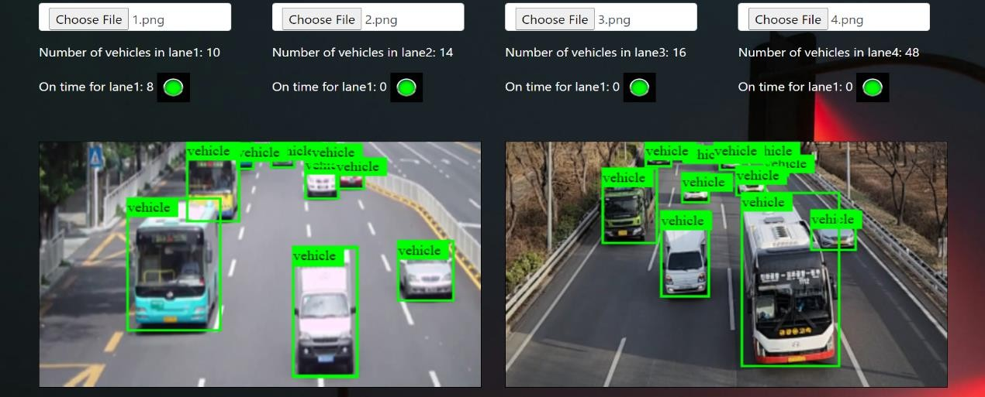
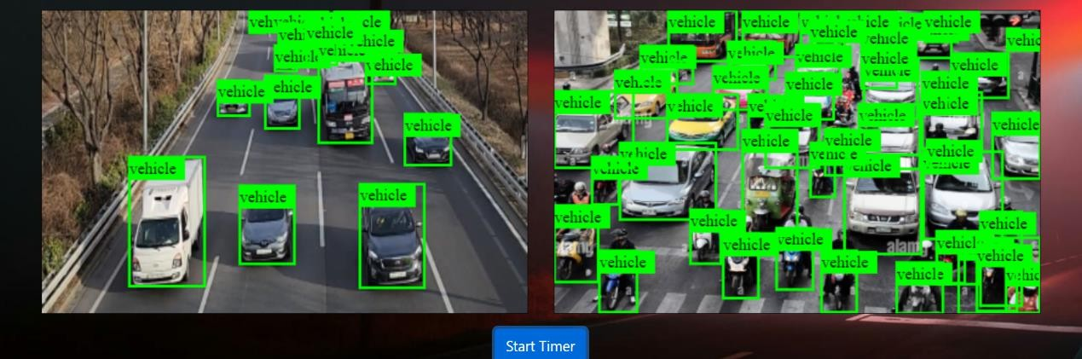
Results:

Slide 16
CONCLUSION
In conclusion, the proposed system sets the green signal time adaptively according to the traffic density at the signal and ensures that the direction with more traffic is allotted a green signal for a longer duration of time as compared to the direction with lesser traffic. This will lower the unwanted delays and reduce congestion and waiting time, which in turn will reduce fuel consumption and pollution.
YOLOv8 is a state-of-the-art deep learning model renowned for ITMS speed and accuracy(97%) in real-time object detection tasks, making it well-suited for the dynamic nature of traffic monitoring and management.

Slide 17
Thank You!!

