Slide 1
CS415 – Operating Systems Laboratory
Spring 2026

Slide 2
Introductions

Slide 3
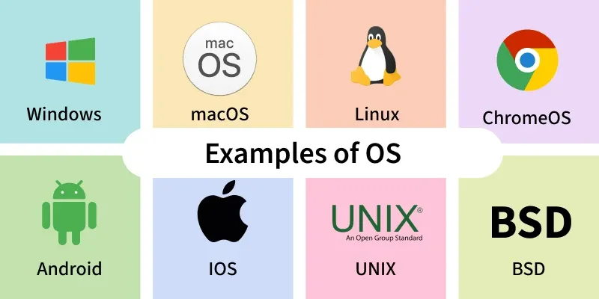
Operating Systems
Acts as an interface between the user and the computer hardware
Manages system resources like CPU, memory, storage, and devices
Provides services so applications (Chrome, VS Code, etc.) can run smoothly and efficiently

Slide 4
Lab Logistics
Lab website - https://ranjitha-rani.github.io/cs415-operating-systems-lab/
Lab timings: Friday – 12:00 – 12:50 pm – KLAMATH B026
Lab distribution
Lab attendance – 10%
Lab submissions – 10%

