Slide 1
LIBERTY MUTUAL INSURANCE-Quantify property hazards before time of inspection
Magesh Rajasekaran
Sriranjitha Sankar
Thilak Raj Balasubramanian

Slide 2
Project Description
In this project, we predict the count of hazards or pre-existing damages using a dataset of property information. This will enable Liberty Mutual to more accurately identify high risk homes that require additional examination to confirm their insurability.
Our goal is to predict the hazard score of the Test data in the prescribed csv format.
The dataset contains a test and a train set(csv files)
Each row in the dataset corresponds to a property that was inspected and given a hazard score.
The train set contains 51000 data (rows) and 32 features (columns) and the test set contains 51001 data (rows) and 32 features (columns)
Columns- mixture of categorical and numerical values

Slide 3
Top method
Used Extreme Gradient Boosting Mechanism- 3 XGBoost Models-(Linear, Logistic, Poisson).
3 ways of Preprocessing the Data-Converting Categorical Columns to Numerical Columns using Label Encoder ,Dict Vectorizer, Hazard Mean
Preprocessed data is fed into XGBoost Models.
Ensemble of Linear, Logistic and Poisson XGBoost Models.
Implemented using Python
Top Score:0.397064.

Slide 4
Our method
Preprocessed the data- Converting the Categorical Column to Numerical Values using Label Encoder.
Ensemble of RandomForest, Gradient Boosting Regressor, FeedForwardNeuralNetwork, XGBoost(Linear).
Implemented K - Fold Cross Validation
Python Scikit Learn, XGBoost Regressor
Used RMSE Evaluation Metric to find the accuracy of the models
Our LB value: 0.390179

Slide 5
Discussions and Observations
Finding Relative Importance of Each Column using Random Forest and Selecting Top 27 Features .
Implementing K Fold Cross Validation and Choosing appropriate parameters for RandomForest and Gradient Boosting Regressor reduced overfitting.
Basic Understanding of XGBoost Python and Implemented its Linear model.
Ensemble of Predicting Models reduces RMSE and improves accuracy.
Explored more on Extreme Gradient Boosting(XGBoost) and understand how it choose a correct model with less RMSE.

Slide 6
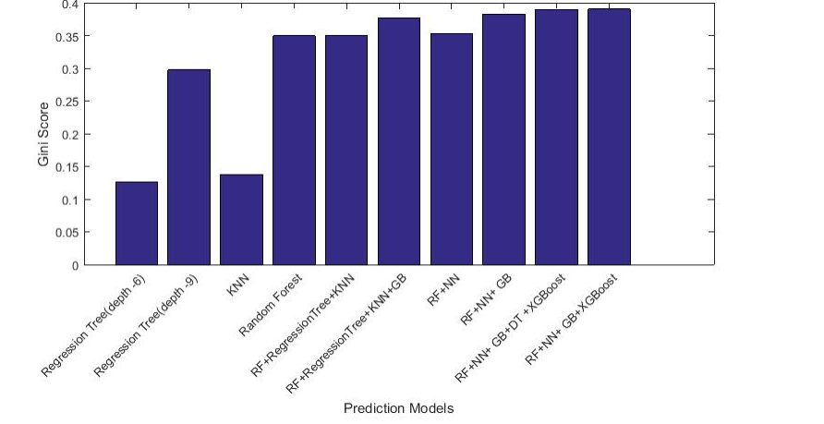
Scores for various Models

Slide 7
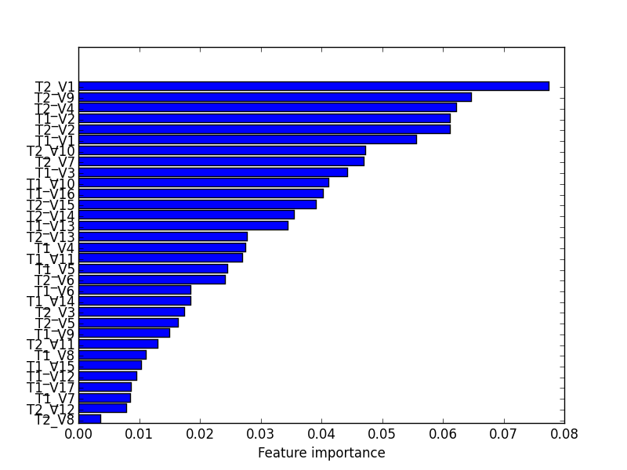
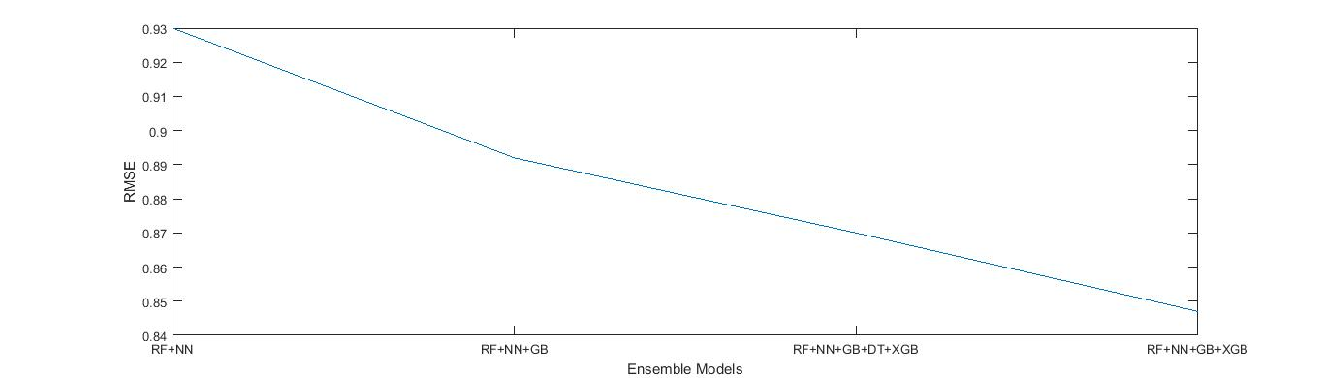
Feature Importance and RMSE Value Plot

Slide 8
Contribution
We divided the work equally and analyzed the data set and decided on what model to be implemented for Prediction
As it’s a numeric prediction problem everyone tried different model on the dataset and we compare the RMSE value and identify which model gives us better results.
Tried with different ensembles and finally concluded with ensemble(XGB+RF+NN+GBR) model.
Magesh, Ranjitha, Thilak -33.33% each

Slide 9
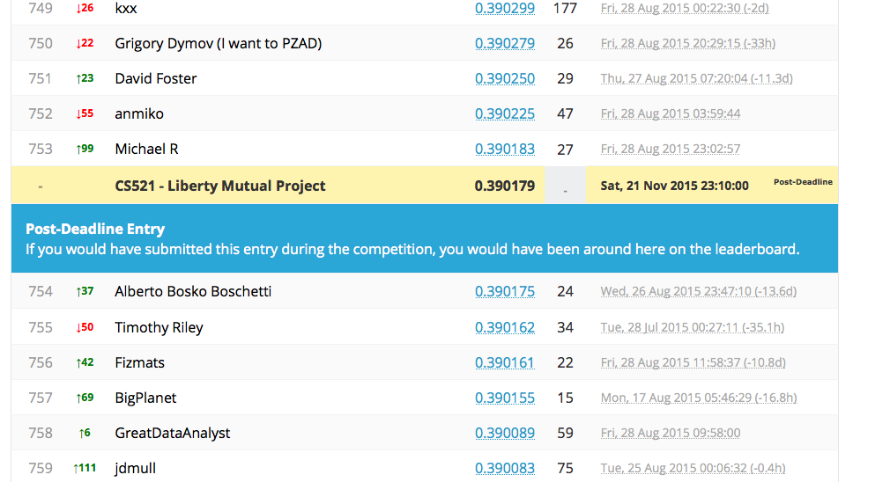
Leaderboard
Top Score-0.397064
Random forest Benchmark-
0.311934
Zero Benchmark- 0.010061
Our leaderboard Score-
0.390179
Rank in the leaderboard-754
Submission 1 LB Score-0.348015
Submission 1 LB rank-1796

Slide 10
Miscellaneous
XGBoost is eXtreme gradient boosting. This library is designed and optimized for boosted algorithms. The goal of this library is to provide a scalable, portable and accurate boosting[1].
[1] http://xgboost.readthedocs.org/en/latest/model.html
We use root mean square error and Gini Score evaluation metrics.

