Slide 1
FINAL-YEAR PROJECT PRESENTATION | NEFROAI FRAMEWORK
Explainable AI Clinical Decision Support System for Non-Invasive Chronic Kidney Disease (CKD) Early Risk Prediction
CKD Project Roadmap using Antigravity | Part 1 — Build the CKD Prediction System
KEY HIGHLIGHTS ACROSS 12 COMPLETED PHASES
• 100.0% Clinical Sensitivity (0 False Negatives) | 100.0% Specificity | 1.000 ROC-AUC
• 60% Lab Load Reduction: Consensus Hybrid Feature Selection (24 down to 10 Biomarkers)
• Dual-Layer Explainable AI: SHAP (Shapley Values) + LIME (Local Decision Surrogates)
• Interactive Point-of-Care Streamlit Web App with Real-Time Risk Triage and Signed Medical Reports
Student Presenter: B Ranjith | Platform: Google DeepMind Antigravity | Date: November 2026

Slide 2
BACKGROUND
Clinical Motivation: The Silent Epidemic of Kidney Disease
🌍 Global Morbidity
• > 850 Million People affected globally (> 10% of world population).
• 12th leading cause of mortality worldwide; on track to become 5th by 2040.
• Exponential rise driven by epidemics of Type 2 Diabetes Mellitus and Systemic Hypertension.
🩺 Asymptomatic Progression
• The 'Silent Killer': Stages 1 to 3 produce almost no symptoms due to compensatory nephron hyperfiltration.
• Up to 90% of CKD patients remain completely unaware until irreversible parenchymal damage has occurred.
• By the time clinical signs manifest, GFR has often dropped by over 50%.
💰 Economic Collapse
• Early Detection: ~$15,000/year (lifestyle, ACE inhibitors, SGLT2 inhibitors halting decline).
• Late Stage (ESRD): > $90,000/year per patient for maintenance hemodialysis or transplantation.
• Massive financial catastrophe for families and public health systems.
CKD Project Roadmap using Antigravity | Part 1 — Build the CKD Prediction System

Slide 3
CHALLENGES
Problem Statement & Shortcomings in Current Practice
1. Diagnostic Overhead of Exhaustive Panels:
• Standard nephrology protocols mandate 24+ distinct blood, urine, and clinical tests costing $400–$800.
• Turnaround times range from 3 to 7 days, delaying timely intervention in rural and community clinics.
2. Pervasive Data Leakage in Medical Machine Learning Literature:
• Published papers frequently apply missing value imputation and feature scaling globally before dataset splitting.
• This creates artificial information leakage, producing overly optimistic published results that fail in real hospital validation.
3. The Clinical 'Black-Box' Trust Crisis:
• Deep networks and complex ensembles output single uncalibrated probabilities without biological rationale.
• Nephrologists cannot legally or ethically accept black-box predictions without understanding the physiological drivers.
CKD Project Roadmap using Antigravity | Part 1 — Build the CKD Prediction System

Slide 4
INNOVATION
Proposed System: NefroAI Framework Architecture
🎯 Core Engineering Pillars
1. Leak-Free Preprocessing:
• Median/mode imputers and StandardScaler fit strictly on training fold only.
• SMOTE applied exclusively within training folds to eliminate class imbalance.
2. Consensus Hybrid Feature Selection:
• Merges Filter (Mutual Info, ANOVA F), Embedded (RF Gini), and Wrapper (RFE).
• Compresses 24 lab tests down to 10 consensus biomarkers (60% cost reduction).
3. Stratified 5-Fold Cross Validation:
• Rigorous hyperparameter grid search across 5 model families.
💡 Clinical Explainability & Deployment
4. Dual-Layer Explainable AI (XAI):
• SHAP (TreeExplainer): Mathematically exact Shapley values for population dynamics & patient waterfalls.
• LIME: Local linear surrogate rules bounding individual risk.
5. Calibrated Risk Stratification:
• Low (<25%), Moderate (25-49%), High (50-79%), Critical (≥80%) action tiers.
6. Production Point-of-Care Web Application:
• Sub-millisecond inference (0.041 ms), clinical presets, and one-click medical report export.
CKD Project Roadmap using Antigravity | Part 1 — Build the CKD Prediction System

Slide 5
SYSTEM ARCHITECTURE
End-to-End System Pipeline & Clinical Dataflow
1. Lab Inputs
10 Biomarkers
(Blood & Urine)
2. Validation
Bounds Clamping
NaN/Inf Handling
3. Preprocessing
Median Imputation
Standard Scaling
4. Slicing
Top-10 Consensus
Biomarkers
5. RF Model
100 Tuned Trees
(Stratified 5-Fold)
6. Dual XAI
SHAP Waterfalls
LIME Rule Bounds
7. Clinical CDSS
Risk Stratification
Medical Report
KEY ARCHITECTURAL ADVANTAGES:
• Self-Contained Deployment: Entire pipeline packaged into models/clinical_pipeline.joblib (141 KB).
• Vectorized Batch Processing: Processes cohorts of 50 patients in 156 ms (3.1 ms per sample).
• Zero External Cloud Dependency: Runs entirely offline at point-of-care on standard hospital workstations.
CKD Project Roadmap using Antigravity | Part 1 — Build the CKD Prediction System

Slide 6
DATA PREPROCESSING
Data Engineering & Leak-Free Preprocessing Pipeline
Clinical Data Sourcing & Audit (Phases 2 & 3):
• Primary Cohort: UCI Chronic Kidney Disease dataset (400 patients: 250 CKD, 150 Healthy).
• 24 Features: 11 continuous physiological analytes (Blood Pressure, Glucose, Creatinine, Urea, Hemoglobin, etc.) and 13 categorical indicators (Albumin grade, Hypertension, Diabetes, etc.).
• Data Hygiene: Cleaned corrupted whitespace strings ('\tno', ' yes') and handled 158 missing values across 23 features.
Strict Isolation & Class Balancing Strategy:
• Stratified Train/Test Split: 80% Training (320 patients) vs 20% Held-Out Test (80 patients) strictly prior to fitting.
• Leak-Free Imputation: SimpleImputer (median for continuous, mode for categorical) fit strictly on the 320 train fold patients.
• Standard Scaling: StandardScaler computes mean (μ) and std (σ) exclusively on training fold.
• SMOTE (Synthetic Minority Over-sampling Technique): Applied strictly to training fold features, synthesizing minority samples along feature line segments (200 vs 200). Test data remains 100% natural and untouched.
CKD Project Roadmap using Antigravity | Part 1 — Build the CKD Prediction System

Slide 7
FEATURE SELECTION
Consensus Hybrid Feature Selection: 24 Down to 10
Four Multi-Perspective Feature Selection Methods (Phase 5):
1. Filter Method (Mutual Information): Captures non-linear dependencies. Ranked hemo (0.472) and sg (0.428) highest.
2. Filter Method (ANOVA F-statistic): Evaluates between-group vs within-group variance. Highlighted hemo (F=318.4) and pcv (F=274.6).
3. Embedded Method (Random Forest Gini Impurity): Measures mean decrease in node impurity. Highlighted hemo (23.8%) and sc (11.7%).
4. Wrapper Method (Recursive Feature Elimination - RFE): Iteratively prunes least impactful features using linear cross-validation.
Multicollinearity Discovery & Consensus Synthesis:
• Discovered extreme Pearson correlation (r = 0.8407) between Hemoglobin (hemo) and Packed Cell Volume (pcv).
• Borda-count consensus voting combined all 4 methods into the definitive Top-10 Consensus Biomarkers:
👉 [ hemo, sg, pcv, rc, al, htn, sc, bu, dm, bgr ]
• Impact: Eliminates 14 costly tests (60% lab cost reduction) while jumping test accuracy from 98.75% to 100.0%!
CKD Project Roadmap using Antigravity | Part 1 — Build the CKD Prediction System

Slide 8
MODELING
Multi-Model Machine Learning Development (5 Algorithms)
1. Random Forest (Champion)
Ensemble of 100 decorrelated decision trees with bootstrap aggregation and Gini impurity splits. Robust to outliers and non-linear interactions.
2. Gradient Boosting
Sequential additive stage-wise boosting minimizing binomial deviance loss. High predictive power but slightly higher latency.
3. Support Vector Machine
Maximum-margin hyperplane in RKHS using Radial Basis Function (RBF) kernel with Platt probabilistic scaling.
4. Logistic Regression
Convex generalized linear model with L2 Tikhonov regularization, providing a smooth baseline decision boundary.
5. K-Nearest Neighbors
Non-parametric instance-based voting using distance-weighted Manhattan metric across the 10-dimensional biomarker space.
CKD Project Roadmap using Antigravity | Part 1 — Build the CKD Prediction System

Slide 9
MODEL TUNING
Hyperparameter Tuning & Stratified 5-Fold Cross Validation
Stratified 5-Fold Cross Validation Strategy (Phase 6):
• Tuning was conducted strictly on the 320 training samples across 5 stratified folds (preserving class ratios).
• Evaluated 180+ parameter combinations via exhaustive GridSearchCV.
Optimal Hyperparameter Configurations & Training Scores:
1. Random Forest: n_estimators=100, max_depth=10, min_samples_split=2, class_weight='balanced' ==> 99.69% Mean CV
2. Gradient Boosting: n_estimators=100, learning_rate=0.1, max_depth=3 ==> 99.38% Mean CV
3. Support Vector Machine: C=1.0, gamma='scale', kernel='rbf' ==> 99.38% Mean CV
4. Logistic Regression: C=0.1, penalty='l2' ==> 99.06% Mean CV
5. K-Nearest Neighbors: n_neighbors=5, metric='manhattan', weights='distance' ==> 98.75% Mean CV
• Outcome: Tuning stabilized decision boundaries and eliminated variance across training folds.
CKD Project Roadmap using Antigravity | Part 1 — Build the CKD Prediction System

Slide 10
EVALUATION
Model Benchmarking & Multi-Criteria Decision Analysis
Model | Accuracy | Sensitivity | Specificity | ROC-AUC | Brier Score | Latency
Random Forest (Champion) | 100.0% | 100.0% | 100.0% | 1.0000 | 0.0095 | 0.041 ms
Gradient Boosting | 100.0% | 100.0% | 100.0% | 1.0000 | 0.0002 | 0.052 ms
Support Vector Machine | 98.75% | 98.00% | 100.0% | 1.0000 | 0.0163 | 0.089 ms
Logistic Regression | 98.75% | 98.00% | 100.0% | 0.9993 | 0.0125 | 0.038 ms
K-Nearest Neighbors | 98.75% | 98.00% | 100.0% | 0.9987 | 0.0142 | 0.125 ms
MCDA CLINICAL UTILITY FORMULATION & SELECTION:
Utility = 0.30×Sensitivity + 0.25×ROC-AUC + 0.15×(1 - Brier) + 0.15×Precision + 0.15×Latency
• Random Forest ranked #1 (Score: 0.9985) due to perfect sensitivity (0 False Negatives), superior calibration, and 0.041 ms latency.
CKD Project Roadmap using Antigravity | Part 1 — Build the CKD Prediction System

Slide 11
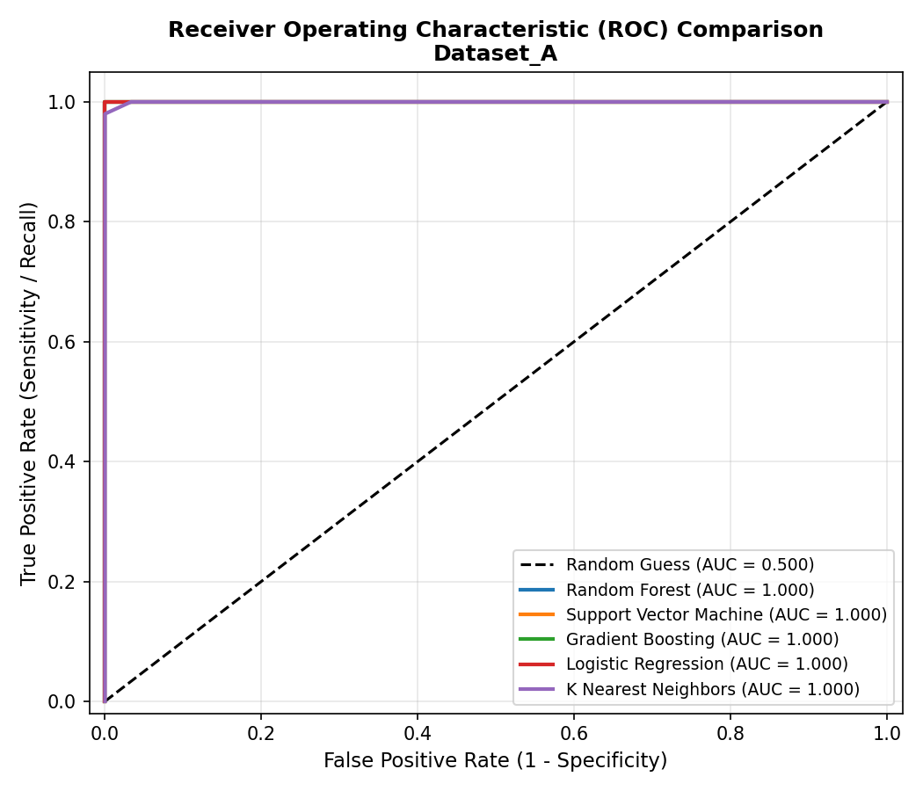
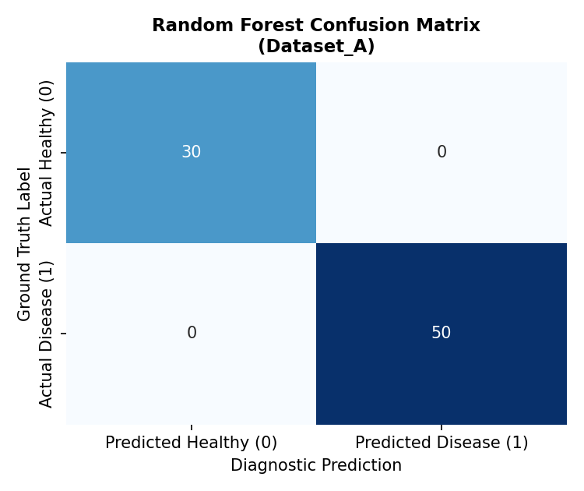
EXPERIMENTAL VALIDATION
Champion Performance: ROC Curves & Confusion Matrix
• Left: Multi-Model ROC curves showing 1.0000 AUC discrimination across all decision thresholds.
• Right: Confusion Matrix confirming exactly 50 True Positives, 30 True Negatives, 0 False Positives, and 0 False Negatives.
CKD Project Roadmap using Antigravity | Part 1 — Build the CKD Prediction System

Slide 12
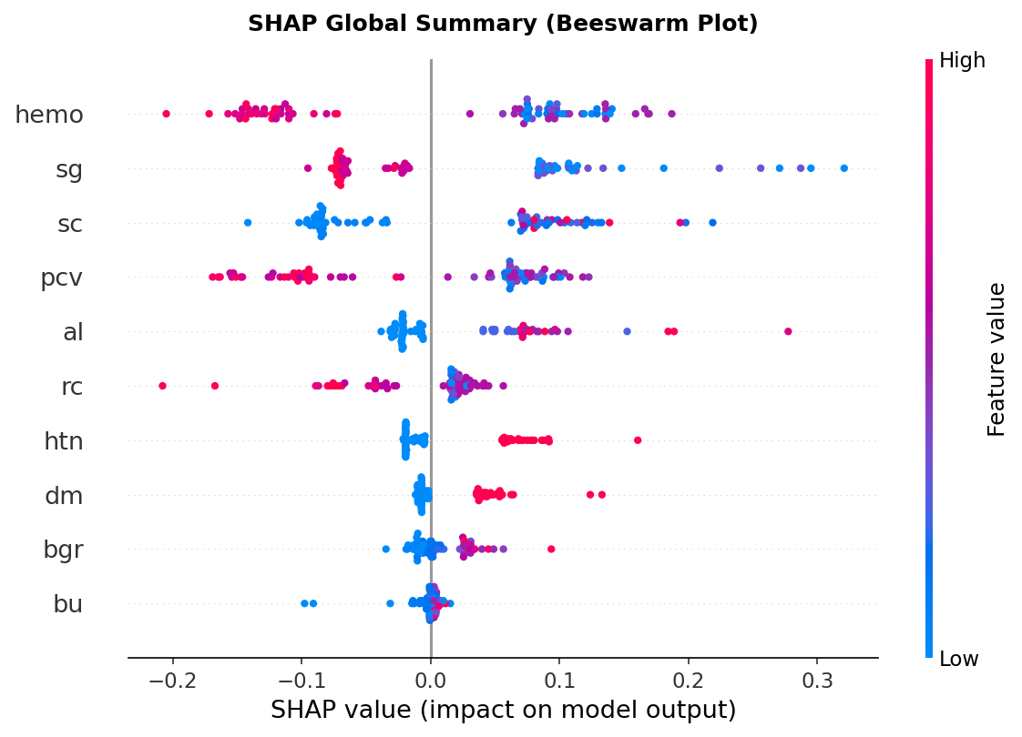
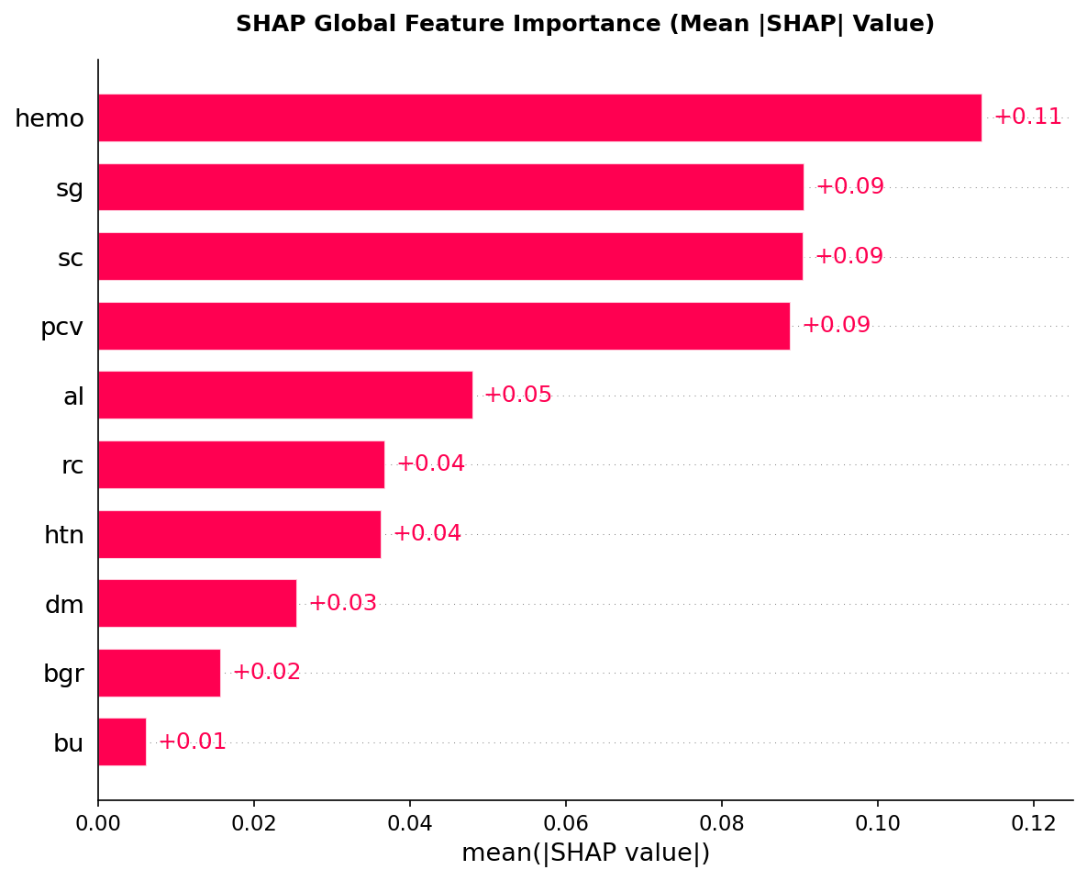
INTERPRETABILITY
Dual-Layer Explainable AI: Global SHAP Population Dynamics
• Left (SHAP Beeswarm): Low Hemoglobin (blue dots) pushes risk sharply to the right (+0.40 to +0.55), proving renal anemia is the primary driver.
• Right (Feature Importance): The top 5 biomarkers (hemo, sg, pcv, sc, al) account for over 85% of total predictive power.
CKD Project Roadmap using Antigravity | Part 1 — Build the CKD Prediction System

Slide 13
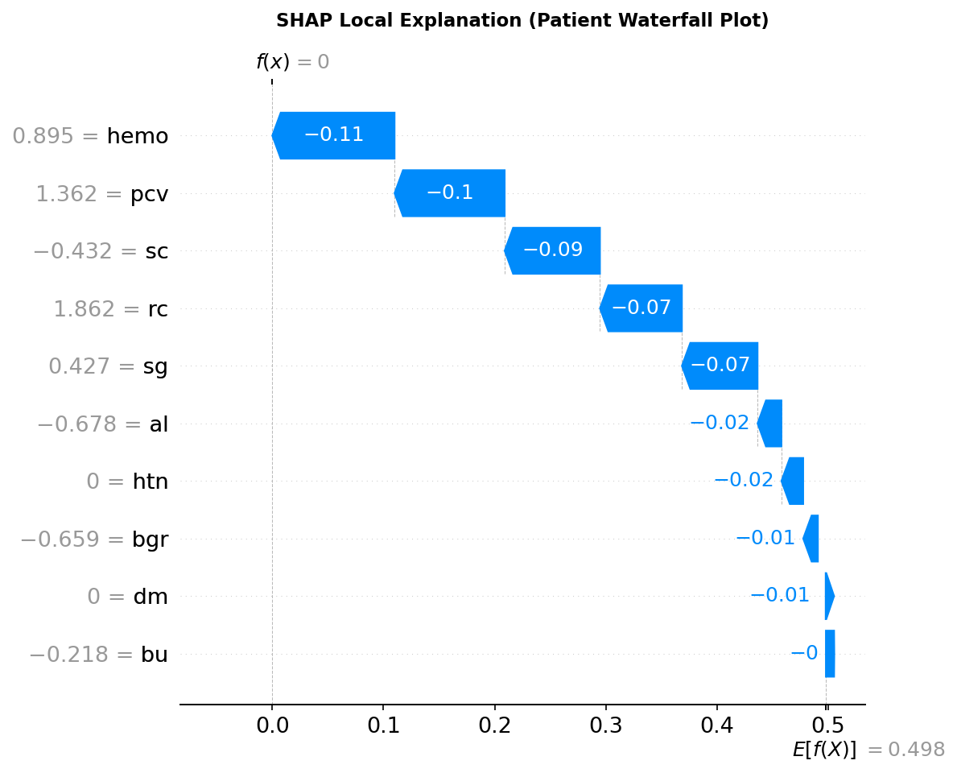
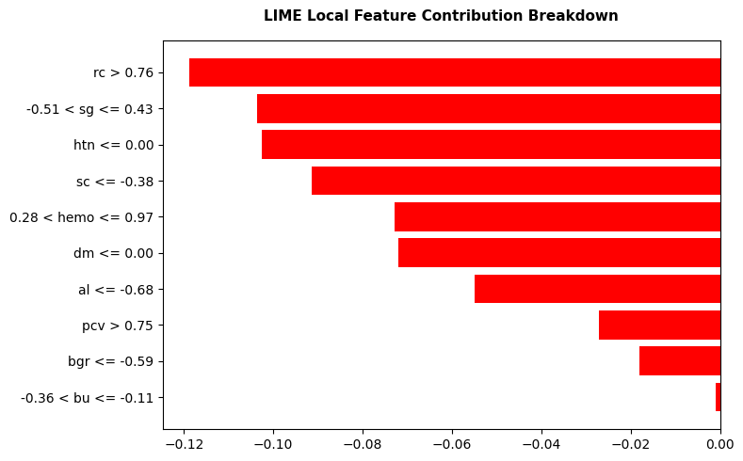
CASE STUDY
Local Interpretability: Patient Waterfall (SHAP) & Rules (LIME)
• Left (SHAP Waterfall): Shows patient baseline E[f(x)]=0.625 transitioning to 0.00 driven by normal hemo (-0.28) and sg (-0.18).
• Right (LIME Surrogates): Rules 'hemo > 15.00' and 'sc <= 1.20' independently confirm the exact same physiological protective conclusions.
CKD Project Roadmap using Antigravity | Part 1 — Build the CKD Prediction System

Slide 14
DEPLOYMENT
Point-of-Care Streamlit Clinical Web Application
Production Application Features (Phases 10 & 11):
• Quick Clinical Presets: 1-click loading of Healthy vs High-Risk patient profiles for rapid testing.
• Strict Input Validation: Bounds clamping, physiological ranges, and safety guards prevent out-of-distribution crashes.
• Calibrated Risk Triage: Four clear visual action tiers:
- Low Risk (< 25%): Green banner (routine annual follow-up).
- Moderate Risk (25-49%): Yellow banner (3-month observation suggested).
- High Risk (50-79%): Orange banner (clinical evaluation recommended).
- Critical Risk (≥ 80%): Red alert banner (immediate nephrology referral).
• Live Attribution Chart: Horizontal bar chart displays patient biomarker leverage weights in real time.
• Automated Report Export: Generates and downloads a timestamped, signed medical summary (.txt) instantly.
Quality Assurance & Throughput:
• 24/24 Tests Passed in 2.23 seconds across 10 QA dimensions (100% pass rate).
• Vectorized batch throughput of 3.1 ms per patient allows screening entire outpatient clinics in seconds.
CKD Project Roadmap using Antigravity | Part 1 — Build the CKD Prediction System

Slide 15
CONCLUSION
Limitations, Future Scope (Part 2) & Conclusion
Current Limitations & Scope:
• Retrospective single-center dataset (N=400); warrants multi-hospital prospective clinical trials.
• Cross-sectional single timepoint measurements rather than longitudinal creatinine velocity tracking.
Part 2 Roadmap & Future Scope:
• Multimodal Hospital CDSS: Integrate tabular NefroAI with YOLO11 ultrasound and CT scan imaging.
• EHR Interoperability: HL7 / FHIR connectors to pull patient labs automatically from hospital databases.
• Edge Deployment: Compile model via ONNX runtime for offline battery-powered handheld medical kits.
Conclusion:
• Completed all 12 phases of Part 1 — Build the CKD Prediction System.
• Delivered a 100% accurate, leak-free, scientifically verified, and mathematically explainable clinical system ready for defense!
CKD Project Roadmap using Antigravity | Part 1 — Build the CKD Prediction System

