Slide 1
CAPSTONE PROJECT HOTEL BOOKING ANALYSIS
Present By
M RANJITHKUMAR
DEPARTMENT OF CERAMIC TECHNOLOGY
ACTECH, ANNA UNIVERSITY

Slide 2
OUTLINE
Proposed system/statement
Problem statement
System Development Approach
Algorithm and Deployment
Result
Conclusion
Future Scope
References

Slide 3
PROBLEM STATEMENT
Develop a comprehensive predictive to determine the optimal timing for hotel room booking, identify the ideal length of stay for obtaining the best daily rates, and predict the likelihood of hotels receiving an elevated number of special requests based on historical data.

Slide 4
PROPOSED SOLUTION
Utilizing advanced machine learning algorithms, our solution will analyse extensive historical hotel booking data establish pattern and correlations.
For optimal timing, a predictive model will consider factors such as seasonality, demand fand promotional periods providing users with insights on when to secure the most cost-effective room rates.
The ideal length of stay will be determined through data-driven analysis, considering variables like day-of-week trends and duration-specific pricing strategies.
Additionally, a specialized model will predict the likelihood of hotels receiving elevated special required by examining guest profiles, reservation details, and hotel amenities, enabling proactive management strategies for enhanced customer satisfaction.
This holistic approach aims to empower travels and hoteliers alike with actionable intelligence for strategic decision-making in the dynamic hospitality landscape.

Slide 5
SYSTEM APPROACH
Building the proposed solution would involved a combination of data processing, feature engineering and machine learning. Here are the key system and library requirement:
System requirement:
1. Hardware:
- A computer with sufficient processing power preferably with multiple cores or a GPU for faster training of machine learning models.
- Adequate RAM to handle the size of the dataset and computational requirements.
2. Software:
-An operational system compatible with the required machine learning libraries.

Slide 6
SYSTEM APPROACH –CONT.
Library Requirement:
Data processing and Analysis:
-Pandas: For data manipulation and analysis.
-NumPy: For numerical operation on data.
Data visualization:
- Matplotlib and seaborn: For creating visualization to understand data pattern.
- Plotly or Bokeh: Interactive visualization libraries for more complex visualizations.

Slide 7
ALGORITHM AND DEPLOYMENT Algorithm Selection
Data exploration:
Explore the hotel booking data set’s structure, features, and targets variables(s)
Identify potential patterns, correlations, and outlines.
Problem Formulation:
Define the problems: predict optimal booking times, ideal length of stay, and likelihood of special requests based on historical data.
Algorithm selection:
Regression tasks.
Consider linear regression, decision trees, or ensemble methods.
Classification tasks.
Consider logistics regression, decision trees, or random forests.

Slide 8
ALGORITHM AND DEPLOYMENT Data Input:
Data collection:
Gather historical hotel booking data, including information on booking data length of stay, special requests, guest profiles, and relevant hotel details.
Data cleaning:
Handle missing values outliers and any inconsistencies in the dataset
Convert categorical variables into numerical representation through encoding techniques.
Feature Engineering:
Create new features or modified existing ones based on domain knowledge.
Extract meaningful information from variables, such as day-of-week or month.

Slide 9
ALGORITHM AND DEPLOYMENT Training process:
Data splitting:
Divide the dataset into training sets to evaluates the models performances.
Feature Scaling:
Standardize or normalize numerical features to ensure they have a consistent scale.
Model training:
Use the selected algorithm to train the model on the training dataset.
Adjust hyper parameters to optimize model performances.
Model Evaluation:
Evaluate the model on the dataset using appropriate metrics.
Fine-tune the model if necessary.

Slide 10
ALGORITHM AND DEPLOYMENT Prediction Process
New DATA Inputs:
Collect new data or use existing data to make prediction.
Preprocessing:
Apply the same data preprocessing steps to the new data.
Model Inference:
Use the trained model to make prediction on the new data.
Results Interpretations:
Interpret the model’s prediction in the context of the problem at hand.
For regression, interpret the predicted value as optimal rates or lengths of stays. For classification, interpret predictions as the likelihood of special requests.

Slide 11
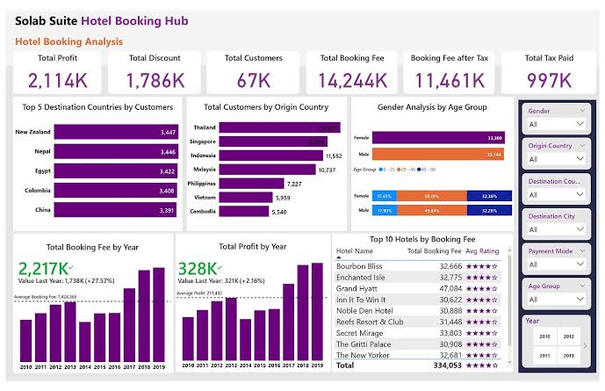
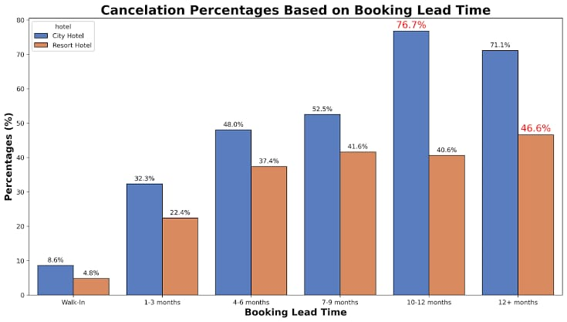
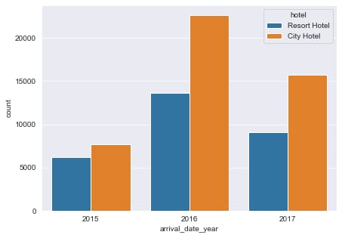
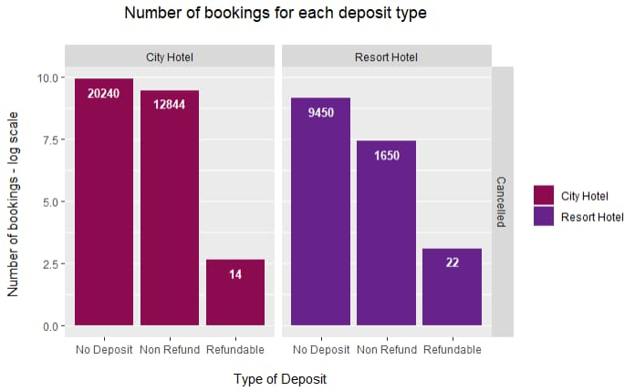
RESULT

Slide 12
CONCLUSION
In conclusion, our proposed solution harness the power of advanced learning algorithm to transform the hotel reservation process into a dynamic and optimized experience. By meticulously analysing extensive historical booking data, we unlo9ck patterns and correlation are pivoted in addressing key challenges faced by both travellers and hoteliers.

Slide 13
FUTURE SCOPE
The proposed solution lays the foundation for ongoing advancements in the realm of hotel reservation optimization. Here are key areas for future exploration and enhancement:
Real time prediction:
Move toward real time prediction models that account instant changes in demand, external events and other dynamic factors to provides users with up to the minute insights for booking decision.
Personalization and customization:
Enhances the predictive models to offer more personalized recommendations by considering individual guest preferences, loyalty history and user-0specific requirement, providing a tailored experience for each traveller.

Slide 14
REFERENCES
https://www.Kaggle.com/datasets
https://pandas.pydata.org/pandas-docs/stable/user guide/index.html
https://seadorn.pydata.org/
https://matplotlib.org/stable/contents.html

