Slide 1
OpenGE
&
TSG Deployer Tool

Slide 2
What is OpenGE?
OpenGE is a Source Code Management (SCM) service provided by GE Corporate.
Using this tool, application teams create projects and users to manage the projects. Technically speaking a CVS project repository is created.
What is CVS? CVS (Concurrent Versions System) is a tool used by many software developers to manage changes within their source code tree. CVS provides the means to store not only the current version of a piece of source code, but a record of all changes (and who made those changes) that have occurred to that source code.
Currently we have 2 CVS servers cvs1.openge.ge.com and cvs2.openge.ge.com. All the repositories are split between these 2 servers.
Developers use CVS client tool like Tortise to connect to OpenGE and upload their code changes. Only users with permission to access the code can perform this operation.
TSG does not operate or provide support for the GE Corporate OpenGE source code repository. Any issues or questions regarding the use of OpenGE, please consult their wiki documents or open a support case at http://openge.ge.com.
For more information on OpenGE, please visit http://openge.ge.com/help

Slide 3
What is TSG Deployer Tool?
TSG Deployer tool is used for building and deploying Java Enterprise Edition applications into the GE Infrastructure (TSG) Java application server environment.
This tool uses the following utilities:
  Sun Solaris CVS client to checkout files from GE Corporate OpenGE source code repository.
  Apache Ant to build and deploy to GE TSG application server deployment locations.
In order for the deployer tool to connect to OpenGE and checkout the code, application teams need to ensure that they add afngfor user to their project as Admin or Sr. Developer .
One more pre-requisite is to ensure that the GE TSG business applicaton profile cvsproject attribute (i.e. ep-art) must match your GE Corporate OpenGE cvsroot and GE TSG business application profile cn attribute (i.e. ep-art) must match your GE Corporate OpenGE module name (under your cvsroot).

Slide 4
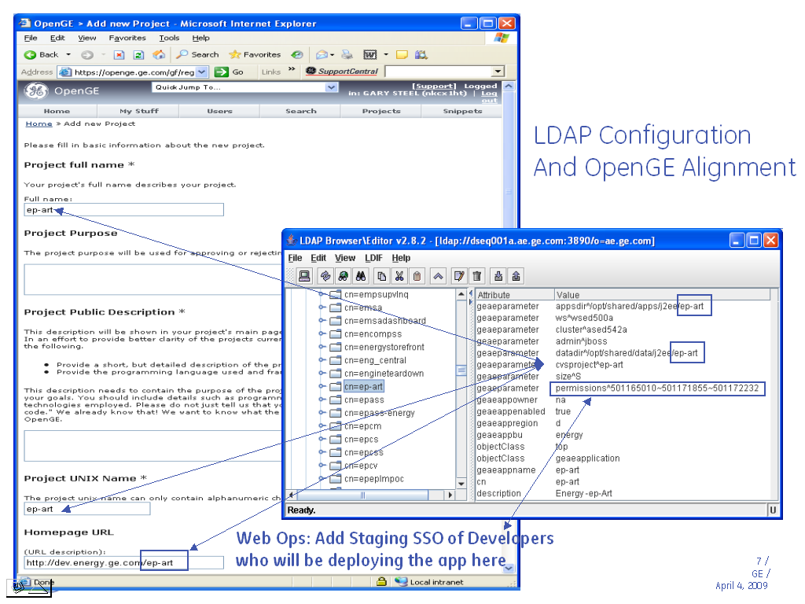
Relationship between OpenGE and App Profile

Slide 5
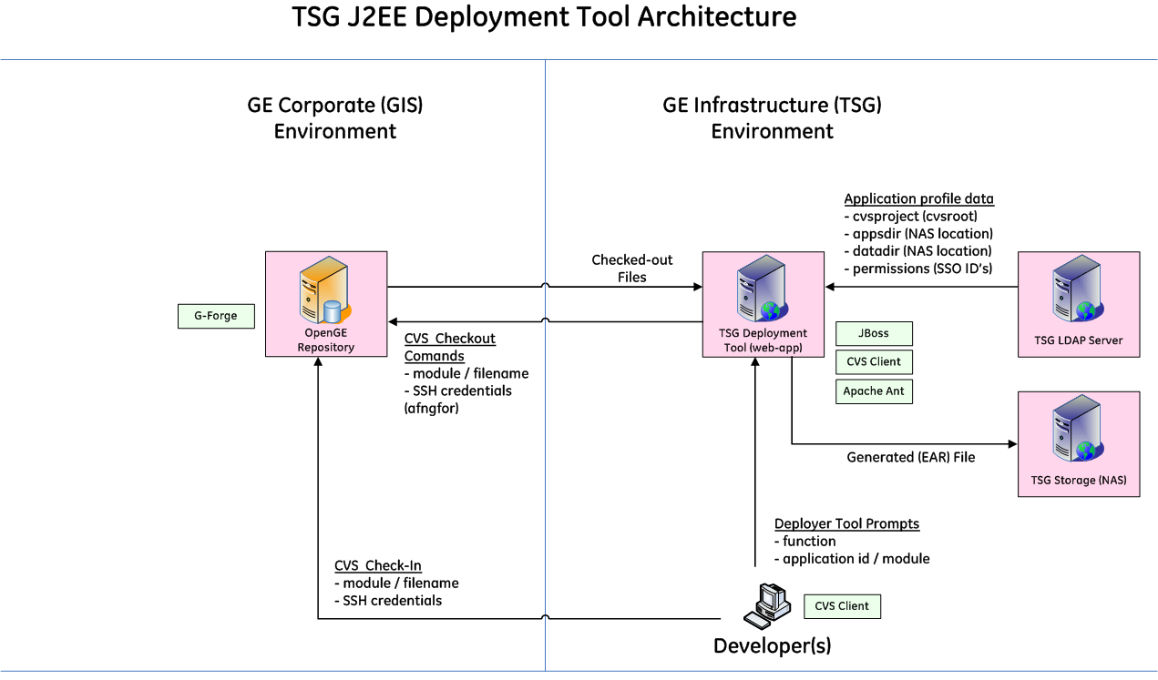
Deployment Tool Architecture

Slide 6
Deployment Tool Functions
Add Standard Folders in OpenGE:
This function will create an empty directory structure for your application in the OpenGE cvs repository. Using this function will create a deployment tool compliant directory structure for your application.
Build and Deploy J2EE Application (ear):
This function performs a full compile of source code in OpenGE, creates an application.ear file and copies it to your application server deployment directory. Below is the process
  Creates a temporary build directory on the deployer server: /tmp/deployer/<sso id>/<application id>
  Checks out OpenGE files to this location.
A single cvsroot (OpenGE project id) can be used to maintain source code for multiple J2EE applications as long as
the module names (under cvsroot) match your J2EE application identifier - /opt/shared/apps/j2ee/<application id>.
  Executes a full ant build (javac) and (ear, sar & har) for the application.
  Copies the generated application.ear file to the applications deployment directory using sftp: /opt/shared/apps/j2ee/<application id>
  Removes the temporary build directory.
    contd…

Slide 7
Deployment Tool Functions – contd.
This function only supports generating a single WAR per EAR!
Ant Target | OpenGE Project File (required)
ear (Enterprise Archive) | /<your app>/ear/conf/application.xml
war (Web Application) | /<your-app>/war/conf/web.xml
ejb (Enterprise Java Bean) | /<your-app>/ejb/conf/ejb-jar.xml
har (Hibernate Archive) | /<your-app>/har/conf/jboss-service.xml
sar (Services Archive- mbeans) | /<your-app>/sar/conf/jboss-service.xml
Build and Deploy Web Application (war):
This function performs a full compile of source code in OpenGE, creates an application.war file and copies it to your application server deployment directory. The process is similar to build and deploy J2EE application except that this function creates and deploys only a .war file.
Ant Target | OpenGE Project File (required)
war (Web Application) | /<your-app>/war/conf/web.xml
Deploy Module (ear, jar, har, sar, war):
This function deploys a pre-built file from the module /dist (distribution) directory in OpenGE to the application server. The module will be deployed directly to the following server location:
/opt/shared/apps/j2ee/<application id>/<module name>

Slide 8
Deployment Tool Functions – contd.
Deploy JBoss Configuration File (xml):
    This function deploys a pre-built XML configuration file (connection pools, jms topic & queue definitions etc.) from your module /dist (distribution) directory in OpenGE to the application server. The configuration file will be deployed directly to the following location: /opt/shared/apps/j2ee/<application id>/xml/<configuration file>.xml
Publish J2EE Data (Update):
    This function recursively copies all files under a module /data directory in OpenGE to the application server. All folders & files under /data will be deployed directly to the following location:
    /opt/shared/data/j2ee/<application id>
Publish J2EE Data (Replace):
    This function removes all application data files from the target application server before recursively copying all files under a module /data directory in OpenGE to the application server. All folders & files under /data will be deployed directly to the following location:
      /opt/shared/data/j2ee/<application id>

Slide 9
Deployment Tool Functions – contd.
Touch JBoss Application Deployment:
    This function simply issues a UNIX touch command on the J2EE application deployment (ear) and configuration (xml) files. This will cause JBoss to redeploy existing deployments.
View Audit Log:
    This function displays all the audit log of transactions performed using the OpenGE Deployment Utility. If an application identifier is entered, only the transactions associated with the particular application are displayed.

Slide 10
Special Configuration Files
The below configuration files are stored in /ear/conf directory of OpenGE. You can create 3 configuration files (one per environment) by prefixing the environment (dev, qa, prod) to the file name (ex. dev-ds.xml, qa-ejb-jar.xml, prod-jms-ds.xml).
  File Name - Deployed to
  environment.properties - /opt/shared/apps/j2ee/<app-id>/props
  ejb-jar.xml - /opt/shared/apps/j2ee/<app-id>/xml
  ds.xml - /opt/shared/apps/j2ee/<app-id>/xml
  jms-ds.xml - /opt/shared/apps/j2ee/<app-id>/xmll
*The above files can be deployed individually using Deploy JBoss Configuration File option.
The below configuration files are stored in /war/conf directory of OpenGE. You can create 3 configuration files (one per environment) by prefixing the environment (dev, qa, prod) to the file name (ex. dev-ds.xml, qa-ejb-jar.xml, prod-jms-ds.xml).
  File Name - Deployed to
  environment.xml - <app-id>/WEB-INF/
  web.xml - <app-id>/WEB-INF/
  spring-config.xml - <app-id>/WEB-INF/
  casper-config.xml - <app-id>/WEB-INF/

Slide 11
Automatic Password Injection
Database passwords will automatically be injected into JBoss datasource (e.g. dev-ds.xml) and Casper configuration (dev-casper-config.xml) files at time of deployment if the following conditions are met:
  The database type needs to be Oracle / Tearadata / IDMS / MS SQL Server / AS400 / MySQL
  The database details need be specified in ds.xml / casper-config.xml / web.xml
  The password field in the config file needs to be empty.
  The database user name or schema name is suffixed with _WEB (Ex: ICAM2_WEB)
  The DB password for the _WEB userid need is stored in DBM.DBM_WEB_DB_LOOKUP view

Slide 12
Known Issues
Below are the common errors and fixes.
Error:
cvs-ext:
[cvs] Using cvs passfile: /export/home1/jboss/.cvspass
[cvs] Cannot access /cvsroot/metruengine/CVSROOT
[cvs] No such file or directory
Fix:
Add afngfor id as Admin / Sr. Developer to the cvs project
Error:
No space left on device
Fix:
Clear /tmp folder on deployer servers

Slide 13
Known Issues – contd…
Error:
[cvs] cvs server: cannot open /cvsroot/esstbt/CVSROOT/config: Permission denied
[cvs] Cannot access /cvsroot/esstbt/CVSROOT
[cvs] Permission denied
Fix:
Verify the cvsproject mapped to the app profile. It should point to esstbt (case-sensitive) in this case.

Slide 14
Application Profiles
Attribute | Description
geaeparameter: antscripts | The indicator of controlling whether custom ant scripts should be executed during the build & deployment. Example: true | false Default: false
geaeparameter: appsdirownership | The UNIX user and group ownership for application binaries (ear / war files). Example: web:web
geaeparameter: appsdirpermissions | The UNIX permissions for application binaries (ear / war files). Example: 775
geaeparameter: cluster | The JBoss cluster where the application should be deployed. Example: ased300a
geaeparameter: datadirownership | The UNIX user and group ownership for application data. Example: web:web

Slide 15
Application Profiles – contd…
geaeparameter: deployorder | JBoss deployment order for a given filename suffix (i.e. .har, .sar, .ear, .war). This must be a integer values less than 99. Example: 1
geaeparamter:disdownload | The comma-delimited list of filename suffix strings which are not valid for download (i.e. –ds.xml because it contains passwords)
geaeparameter: dsusers | A tilde-delimited list of database usernames for which password injection is authorized. Example: myapp1_web~myapp2_web
geaeparameter: javahome | The Java compiler to use during application build & deployment. Example: /opt/shared/java/1.5.0_10/sparc Default: /opt/shared/java/1.4.2_13/sparc

Slide 16
Application Profiles – contd…
geaeparameter: permissions | A tilde-delimited list of SSO ID’s authorized to perform deployment functions for an application. Example: 210014410~210014420
geaeparameter: savedir | The NAS location for deployment backups. Specifying a savedir location will cause the appsdir location to be compressed (using zip) and stored in the savedir location. Zip files will be created for each deployment and named as follows: <appid>-<date>-<time>.zip Example: myapp1-20090112-100101.zip
geaeparameter: sshuser | The username to use for ssh/sftp activities. Example: nfnj691
geaeparameter:vcsserver | The version control server (OpenGE) hostname. By default, cvs2.openge.ge.com will be used. Examples: cvs1.openge.ge.com cvs2.openge.ge.com
geaeparameter: vcsuser | The username to use for version control system checkouts. Example: afngfor

Slide 17
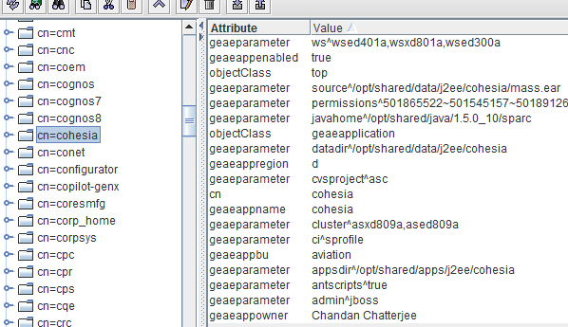
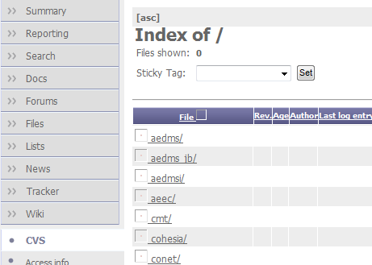
Miscellaneous
afngfor Vs. afn38x5
afngfor id is used by deployer tool to connect to the OpenGE servers and checkout the code to the server (tnsp01412/1413) where it is running.
afn38x5 id is used by the deployer tool to sftp the created ear / war / xml files from source servers (tnsp01412/1413) to the target server.
cvs project Vs. cvs module
Make sure that GE TSG business applicaton profile cvsproject attribute (i.e. ep-art) must match your GE Corporate OpenGE cvsroot and GE TSG business application profile cn attribute (i.e. ep-art) must match your GE Corporate OpenGE module name (under your cvsroot).
CVS Project
CVS Module

