Slide 1
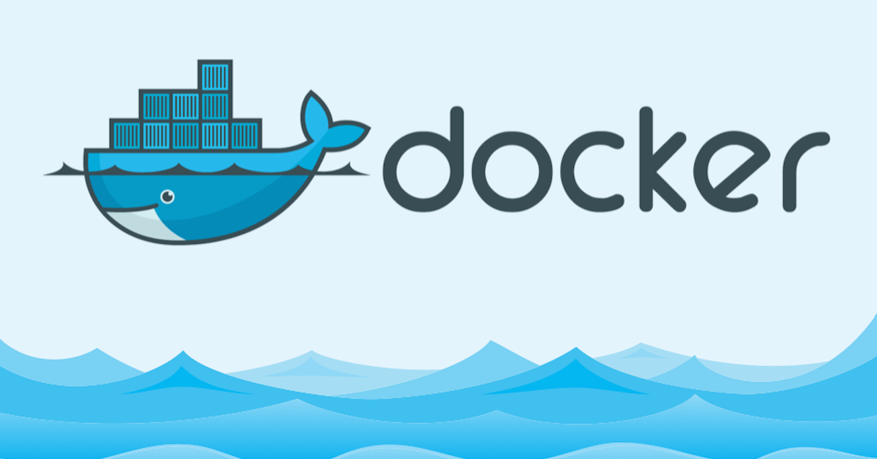

Slide 2
Introduction:
What is container? Containers are lightweight and portable execution environments that allow developers to package their applications and dependencies into a single container that can be run consistently across different environments.
Key Characteristics of Containers 1. Lightweight: Containers are much lighter than virtual machines, requiring fewer resources. 2. Portable: Containers can be run consistently across different environments, including development, testing, staging, and production. 3. Isolated: Containers provide a high level of isolation between applications, ensuring that they do not interfere with each other. 4. Efficient: Containers provide efficient resource utilization, allowing multiple containers to run on a single host.
What is Docker? Docker is a containerization platform that allows developers to package, ship, and run applications in containers. Containers are lightweight and portable, providing a consistent and reliable way to deploy applications across different environments.

Slide 3
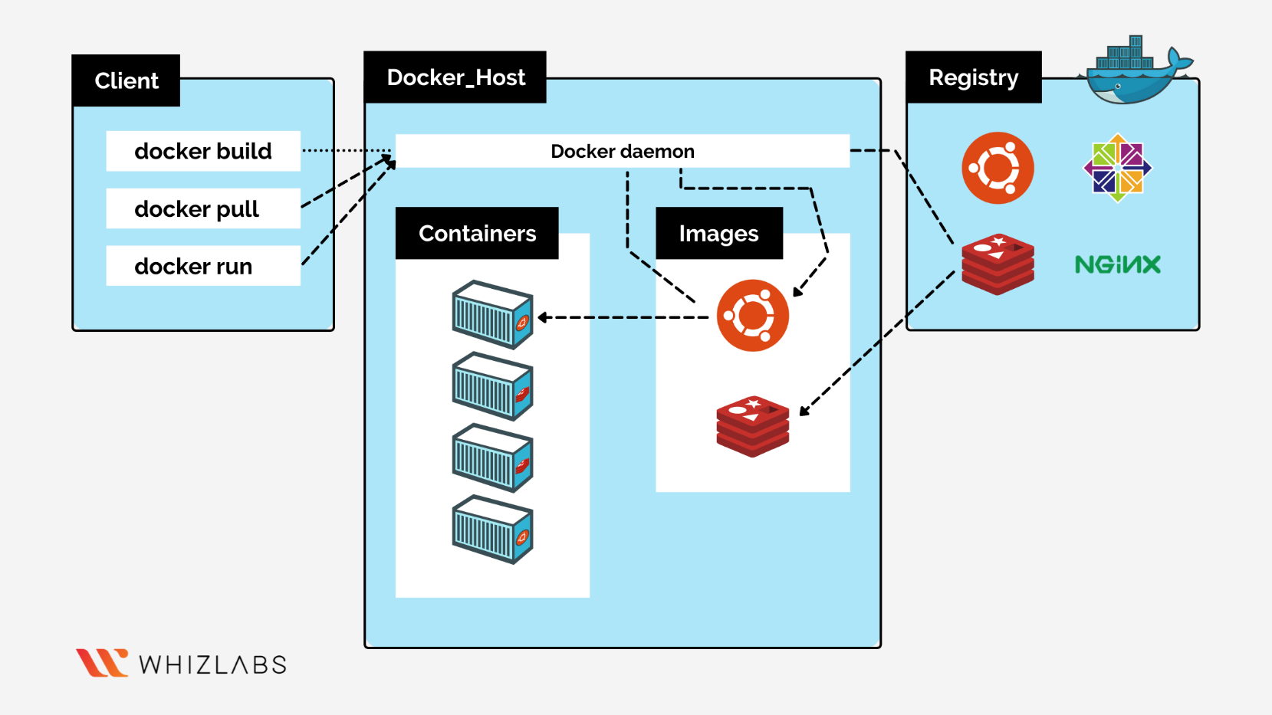
Docker Architecture

Slide 4
The Docker architecture consists of the following components: 1. Docker Client The Docker client is the primary interface for interacting with Docker. It provides a command-line interface for creating, managing, and deleting containers 2. Docker Daemon The Docker daemon is the background process that manages containers. It is responsible for creating, running, and managing containers. 3. Docker Images Docker images are templates that contain the application code and dependencies. They are used to create containers. 4. Docker Registry The Docker registry is a repository of Docker images. It provides a centralized location for storing and sharing images. 5. Docker Containers Docker containers are lightweight and portable execution environments that contain the application code and dependencies.

Slide 5
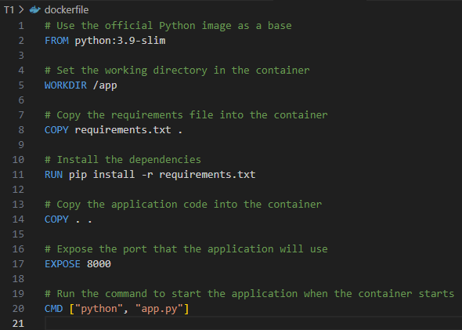
Docker File:
How the Dockerfile Works 1. Build the image: 2. Create a container: 3. Start the container: 4. Expose the port:

Slide 6
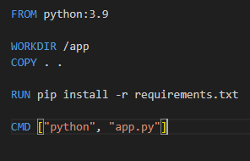
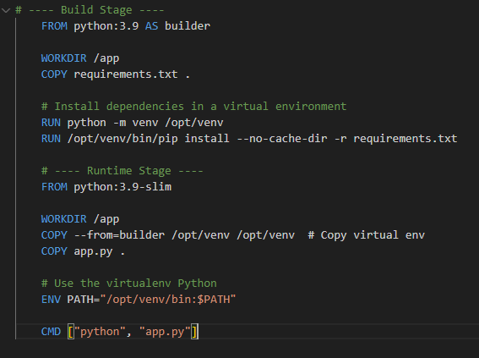
Multi-Stage Dockerization: Multi-stage Docker builds help optimize your Docker images by separating the build environment from the runtime environment. This reduces the final image size and improves security by excluding unnecessary build tools.
Single Stage
Multistage

Slide 7
Command | Description
docker network ls | List all networks
docker network inspect <network_name> | Show detailed network configuration
docker network create <network_name> | Create a custom network
docker network rm <network_name> | Remove a network
docker network prune | Remove all unused networks
docker run --network=<network_name> <image> | Start a container on a specific network
docker network connect <network> <container> | Connect a running container to a network
docker network disconnect <network> <container> | Disconnect a container from a network
Docker Networking: Docker networking allows containers to communicate with each other and with the host machine. Types of Docker Networks 1. Bridge network: A bridge network is the default network type in Docker. It allows containers to communicate with each other and with the host machine. 2. Host network: A host network allows containers to use the host machine's network stack. 3. None network: A none network disables networking for a container. 4. Overlay network: An overlay network allows containers to communicate with each other across multiple hosts.

Slide 8
Docker Volumes Docker volumes are directories or files that are shared between the host machine and a Docker container. They provide a way to persist data even after a container is deleted or restarted. Types of Docker Volumes 1. Named volumes: Named volumes are volumes that are created and managed by Docker. They are given a name and can be used by multiple containers 2. Anonymous volumes: Anonymous volumes are volumes that are created and managed by Docker, but are not given a name. 3. Bind mounts: Bind mounts are volumes that are mounted from the host machine into a container.
Command | Description
docker volume create <volume_name> | Create a named volume
docker volume ls | List all volumes
docker volume inspect <volume_name> | Show volume details (mount point, driver)
docker volume rm <volume_name> | Remove a volume
docker volume prune | Delete all unused volumes

Slide 9
Major Issues with Docker
Security Risks
Container breakouts, root privileges, and vulnerable base images.
Storage Complexity
Data persistence challenges and slow bind mounts on macOS/Windows.
Networking Problems
Port conflicts, DNS issues, and cross-host communication hurdles.
Resource Hogging
Uncontrolled CPU/memory usage and disk bloat from unused images.
Platform Limitations
Linux dependency, ARM compatibility issues, and poor GUI support.
Orchestration Overhead
Steep learning curve for Swarm/Kubernetes and stateful app management.

