Slide 1
Corona Virus Analysis Using SQL
Insights and Trends
RANJIT KUMAR NISHAD
Batch Name -MIP-DA-09

Slide 2
Introduction
The COVID-19 pandemic has had a profound impact on global public health, economies, and daily life.
As a data analyst, it is crucial to understand the spread of the virus through data-driven insights.
This analysis aims to provide a deeper understanding of COVID-19 trends and patterns.

Slide 3
Dataset Overview
Province: Geographic subdivision within a country/region.
Country/Region: Geographic entity where data is recorded.
Latitude: North-south position on Earth's surface.
Longitude: East-west position on Earth's surface.
Date: Recorded date of CORONA VIRUS data.
Confirmed cases: Number of diagnosed CORONA VIRUS cases.
Deaths: Number of CORONA VIRUS related deaths.
Recovered cases: Number of recovered CORONA VIRUS cases.

Slide 4
Data Cleaning
Check and handle NULL values
Update NULLs with zeros

Slide 5
Data Exploration
Total number of rows - 78386
Date range of the dataset – Start Date (22/01/2020)
End Date (13/06/2021)

Slide 6
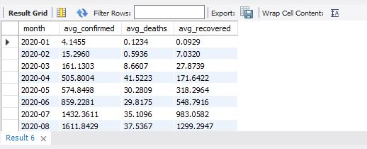
Monthly Data Analysis
Number of months in the dataset - 18
Monthly averages for confirmed, deaths, recovered

Slide 7
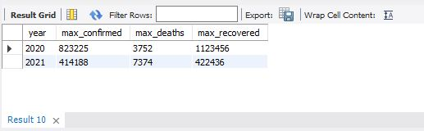
Most Frequent Values
Most frequent values for confirmed, deaths, recovered each month

Slide 8
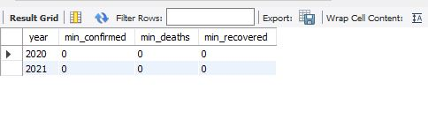
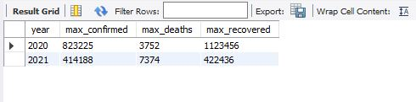
Yearly Data Analysis
Minimum and maximum values per year for confirmed, deaths, recovered

Slide 9
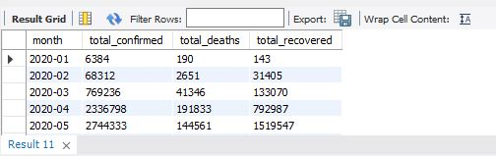
Total Cases Each Month
Monthly totals for confirmed, deaths, recovered

Slide 10
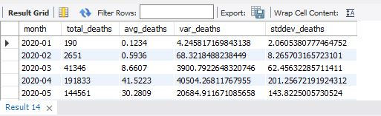
Statistical Analysis
Spread of confirmed, deaths, recovered cases (total, average, variance, standard deviation)

Slide 11
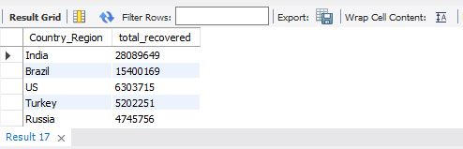
Country Analysis
Country with the highest confirmed cases – (US, 33461982)
Country with the lowest deaths -(Dominica, 0 death)
Top 5 countries with the highest recovered cases

Slide 12
Conclusion
In conclusion, this analysis provides a detailed overview of COVID-19 trends and patterns.
It highlights the importance of data-driven insights in understanding and combating the pandemic.
The findings can help inform public health decisions and strategies for managing future outbreaks

Slide 13
Acknowledgement
First and foremost, I would like to thank Mentorness for providing me with the opportunity and resources to conduct this analysis.
Thank you !!

