Slide 1
Salary Predictions of Data Professions
Machine Learning Internship Project
Ranjit Kumar Nishad
Batch Name – MIP-ML-12

Slide 2
Introduction
Project Objective
Predict the salaries of data professionals.
Provide actionable insights for job seekers and employers.

Slide 3
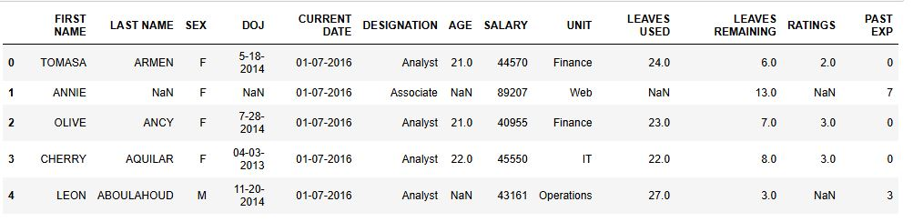
Dataset Overview
Columns in the Dataset

Slide 4
Exploratory Data Analysis (EDA)
Goals of EDA
Understand the data distribution.
Identify patterns and correlations.
Visualize key insights.

Slide 5
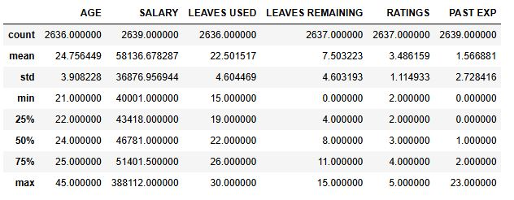
EDA Insights

Slide 6
EDA Insights
Age
Most employees are between 22 and 25 years old.
The age distribution indicates a young demographic, potentially early in their careers.

Slide 7
EDA Insights
Salary
Salary variance is significant, with high salaries possibly due to experienced or high-performing individuals.
The median salary is 46,781, with the majority earning between 43,418 and 51,401.50.

Slide 8
EDA Insights
Leaves Used
Leave usage is fairly consistent, with most employees using between 19 and 26 days.
The company may have a standardized leave policy that employees adhere to.

Slide 9
EDA Insights
Leaves Remaining
Variability in leaves remaining suggests differences in how employees manage their leave balance.
Some employees might not be using their leave, potentially due to workload or personal preference.

Slide 10
EDA Insights
Ratings
Ratings are generally positive, with most employees receiving between 2 and 4.
The performance rating system may be stringent, resulting in a lower overall rating average.

Slide 11
EDA Insights
Past Experience
Most employees have very little past experience, as shown by the 25th percentile at 0 years and the median at 1 year.
The workforce is predominantly junior, with many possibly starting their first job

Slide 12
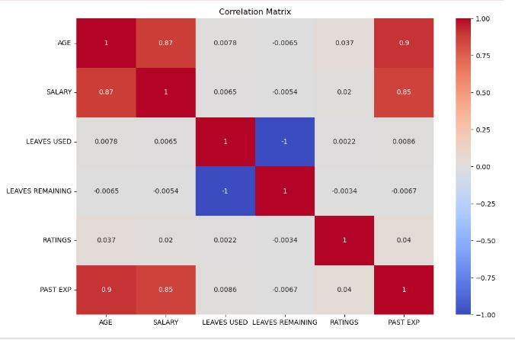
Correlation Matrix

Slide 13
Feature Engineering
New Features Created
Tenure (difference between DOJ and CURRENT DATE).
Total leaves (sum of LEAVES USED and LEAVES REMAINING)
Interaction terms between features like DESIGNATION and RATINGS.

Slide 14
Data Preprocessing
Steps in Preprocessing
Handling missing values.
Encoding categorical variables.
Scaling/normalizing numerical features.

Slide 15
Model Development
Models Used
Linear Regression
Decision Trees
Random Forest
Gradient Boosting

Slide 16
Model Evaluation
Evaluation Metrics
Mean Absolute Error (MAE)
Mean Squared Error (MSE)
Root Mean Squared Error (RMSE)
R-squared (R2) score

Slide 17
Model Performance Overview
1. Linear Regression Performance:
Mean Absolute Error (MAE): 4624.47
Mean Squared Error (MSE): 96520358.42
Root Mean Squared Error (RMSE): 9824.48
R-squared (R2): 0.9419

Slide 18
Model Performance Overview
2. Decision Tree:
Mean Absolute Error (MAE): (5067.61)
Mean Squared Error (MSE): (100,353,298.71)
Root Mean Squared Error (RMSE): (10017.65)
R-squared (R2): (0.9396)

Slide 19
Model Performance Overview
3. Random Forest:
Mean Absolute Error (MAE): 4697.04
Mean Squared Error (MSE):125,739,932.02
Root Mean Squared Error (RMSE): 11213.38
R-squared (R2): 0.9243

Slide 20
Model Performance Overview
4. Gradient Boosting:
Mean Absolute Error (MAE): 4698.53
Mean Squared Error (MSE): 135,102,559.37
Root Mean Squared Error (RMSE): 11623.36
R-squared (R2): 0.9186

Slide 21
Best Model Selection
Model Performance Comparison
Best Model: The Linear Regression model performed the best in terms of MAE, RMSE, and R2, indicating it has the most accurate and reliable predictions for salary.
Decision Tree: Slightly worse than Linear Regression but still a good model with high R2.
Random Forest: Slightly underperforms compared to Linear Regression and Decision Tree, indicating the model may be overfitting or less suitable for this dataset.
Gradient Boosting: Shows the worst performance in terms of error metrics and R2 value, suggesting it may not be the best choice for this specific problem.

Slide 22
Recommendations
Key Findings
Linear Regression provided the best balance of accuracy and simplicity for this dataset, with the lowest MAE, MSE, and RMSE, and the highest R2 score. Decision Tree also performed well but was slightly less accurate. Random Forest and Gradient Boosting, while powerful, require further tuning and feature engineering to potentially outperform Linear Regression

Slide 23
Conclusion
Project Summary
Linear Regression provided the best balance of accuracy and simplicity for this dataset, with the lowest MAE, MSE, and RMSE, and the highest R2 score. Decision Tree also performed well but was slightly less accurate. Random Forest and Gradient Boosting, while powerful, require further tuning and feature engineering to potentially outperform Linear Regression

Slide 24
Acknowledgements
Thank You

