Slide 1
Analyzing the Impact of NREGA A Data-Driven Approach Insights and Recommendations for Rural Employment Nrega Analysis with Tableau Ranjit Kumar Nishad MIP-DA-09

Slide 2
Introduction
NREGA is a game-changing government scheme that aims to provide rural households with guaranteed wage employment.
In this project, we'll be diving into different aspects of NREGA to better understand how effective and impactful it really is.

Slide 3
Problem Statement
Our analysis dives into a few important questions:
How well does NREGA actually provide employment?
Are there any differences in how it's implemented across different regions?
How exactly is the budget used, and what factors contribute to the completion of NREGA projects?

Slide 4
Dataset Information
The dataset used for this analysis is sourced from official government records and contains information related to NREGA implementation across various states and districts in India.
It comprises 28 columns, encompassing data on job cards, worker details, budget allocation, work completion statistics, expenditure, and more.
This dataset offers a comprehensive view of the progress and challenges faced by the NREGA program.

Slide 5
Variable Description
State_name | Total No. of Active Workers | ST persondays | Total Individuals Worked
District_name | SC workers against active workers | Women Persondays | Differently abled persons worked
Total No. of Job Cards issued | ST workers against active workers | Average days of employment provided per Household | Number of Ongoing Works
Net profit | Approved Labour Budget | Average Wage rate per day per person(Rs.) | Number of Completed Works
Total No. of Workers | Persondays of Central Liability so far | Total No of HHs completed 100 Days of Wage Employment | Total Exp(Rs. in Lakhs.)
Total No. of Active Job Cards | SC persondays | Total Households Worked | And more...

Slide 6
Data Cleaning and Preparation
Our first step was to clean and prepare the data.
Rename columns so they make more sense, and create new calculated fields.
These calculated fields were important to help us with our analysis.

Slide 7
Exploratory Data Analysis (EDA)
We created an overview dashboard to display key metrics such as the total number of job cards issued, total workers, and total expenditure.
This provided a high-level view of NREGA's implementation.

Slide 8
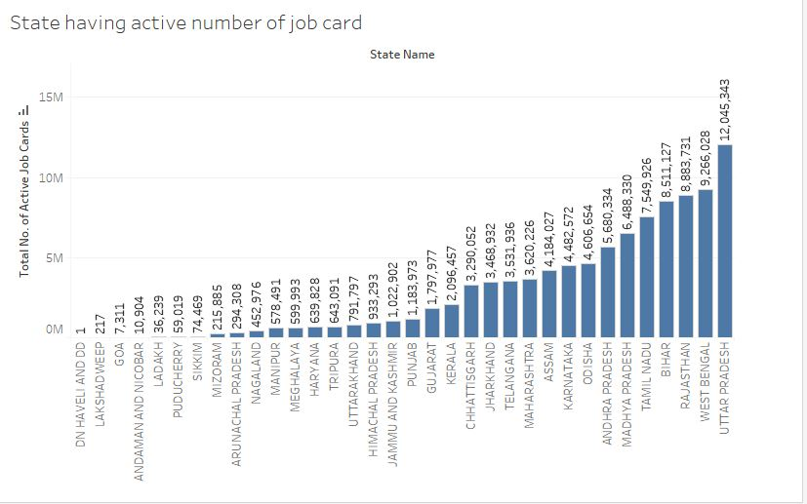
Employment Analysis

Slide 9
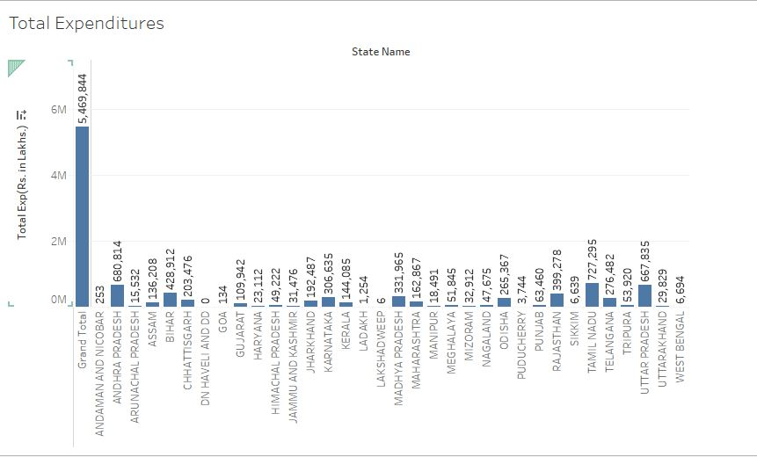
Budget Utilization Analysis

Slide 10
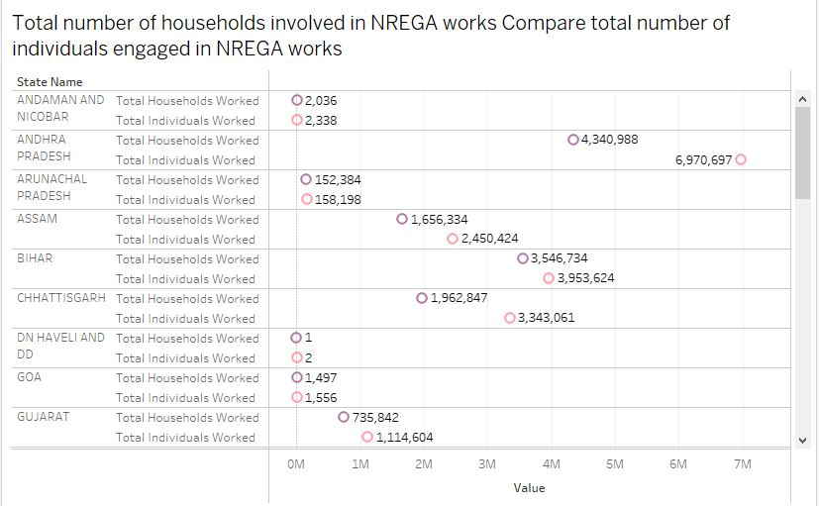
Work Completion Analysis

Slide 11
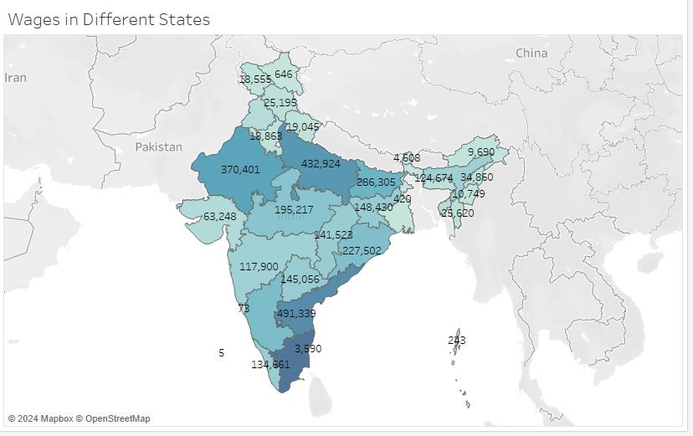
State-Level Analysis

Slide 12
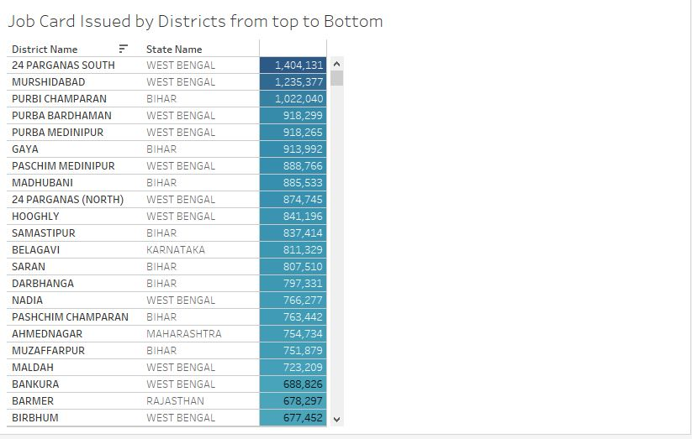
District-Level Analysis

Slide 13
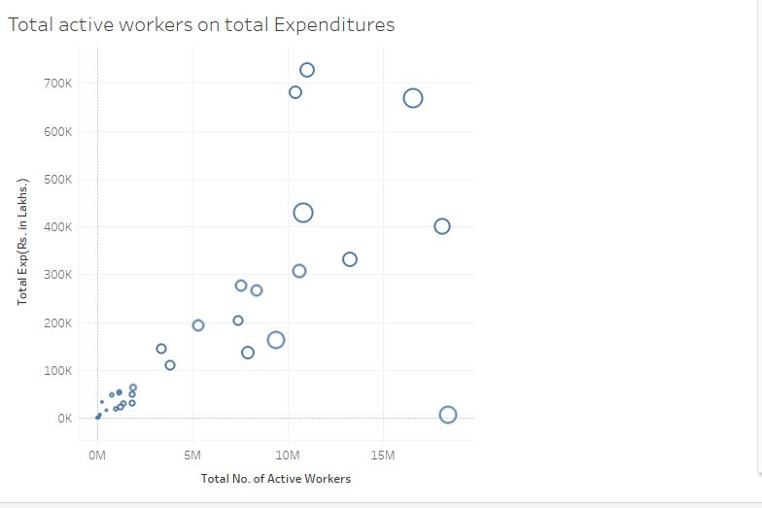
Time Series Analysis
Time Series Analysis

Slide 14
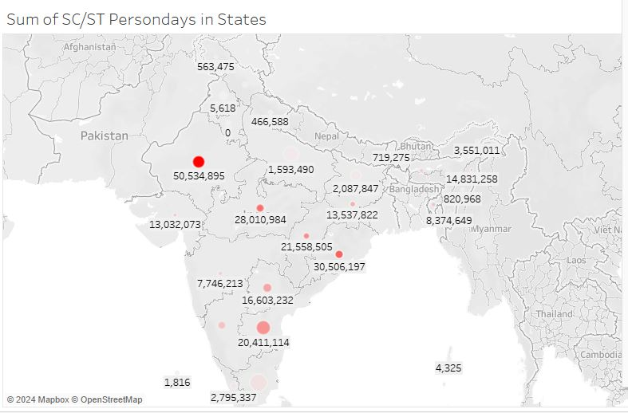
Demographic Analysis
Time Series Analysis

Slide 15
Insights
Employment Effectiveness:
High Employment Days: States like Maharashtra and Rajasthan show a high number of employment days provided, indicating effective implementation in these regions.
Low Employment Days: Some states, such as Bihar and Uttar Pradesh, have relatively low employment days provided, suggesting potential issues in scheme implementation.

Slide 16
Insights
Regional Disparities:
Disparities in Job Card Issuance: There is a noticeable disparity in the number of job cards issued across different states, with states like Tamil Nadu issuing more job cards compared to others.
Active Worker Discrepancies: The ratio of active workers to job cards issued varies significantly, indicating that not all issued job cards are being utilized effectively.

Slide 17
Insights
Budget Utilization:
Effective Utilization: States like Andhra Pradesh and Karnataka show high utilization rates of the allocated budget, correlating well with high employment generation.
Underutilization: States such as Bihar and Assam display underutilization of the allocated budget, which might contribute to lower employment generation in these regions.

Slide 18
Insights
Work Completion Rates:
High Completion Rates: States like Kerala and Gujarat have high rates of work completion, suggesting efficient project management and execution.
Low Completion Rates: Several states, including Odisha and Chhattisgarh, show lower work completion rates, indicating possible administrative or logistical challenges.

Slide 19
Insights
Demographic Participation:
Inclusivity: The data reveals that certain states have a higher participation of Scheduled Caste (SC) and Scheduled Tribe (ST) workers, such as Madhya Pradesh and Jharkhand.
Gender Participation: Women’s participation in NREGA is higher in states like Tamil Nadu and Kerala, reflecting better gender inclusivity

Slide 20
Recommendations
Regular Audits: Implement regular audits and monitoring mechanisms in states with low employment days and high discrepancies in active worker ratios to identify and address underlying issues.
Awareness Campaigns: Conduct awareness campaigns in low-performing states to educate rural households about the benefits and availability of NREGA
Financial Training: Provide financial management training to local administrators in states with budget underutilization to ensure efficient and effective use of allocated funds.

Slide 21
Recommendations
Project Management Training: Offer project management and execution training for local NREGA officials in states with low work completion rates.
Inclusive Policies: Formulate and implement policies to ensure higher participation of SC/ST workers and women in states where their participation is low.
Digital Monitoring Systems: Implement digital monitoring systems for real-time tracking of NREGA activities, fund utilization, and project completion.
Mobile Applications: Develop mobile applications for workers to easily register, report issues, and access information about their entitlements and payments.

Slide 22
Conclusion
In conclusion, this data-driven analysis of NREGA provides a comprehensive view of its implementation and impact.
By leveraging these insights, we can contribute to improving rural employment and livelihoods through more effective policymaking.
Thank you for your attention.

Slide 23
Thank you
Ranjit Kumar Nishad
ranjitnishad@gmail.com | +91- 8468085323

