Slide 1
Module Progress Dashboard

Slide 2

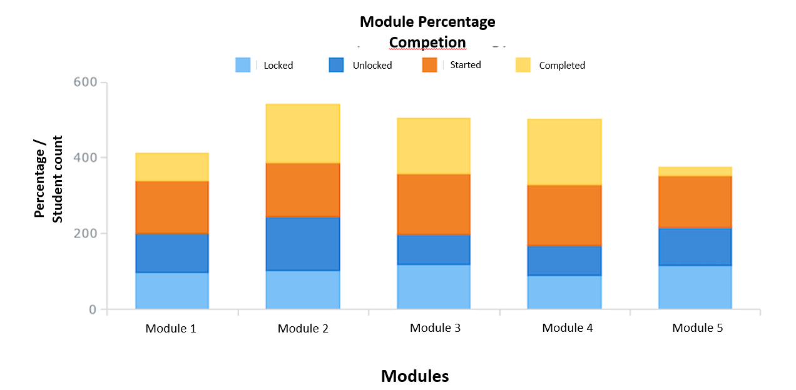

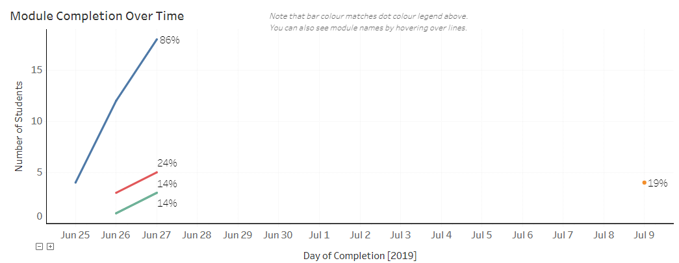

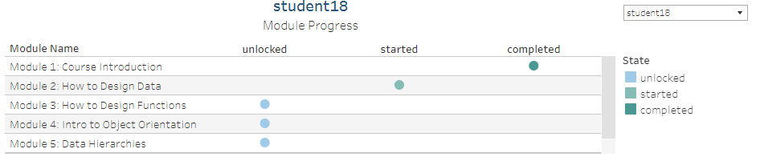
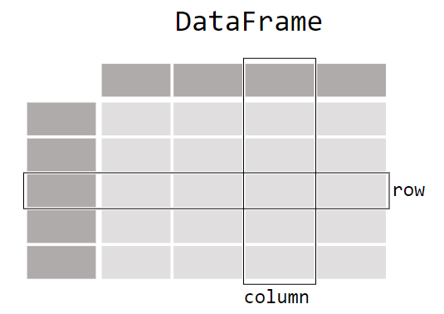

Module Progress Dashboard (Page 1)
Overall Dashboard filters
Export Overall PDF
Course filter
Course 1
Student filter
All (Default)
Export Report
Pick Modules
Line plot of Module completion over time
Bar or Stacked plot of module status for ALL students.
If one student is selected then displays a scatterplot as below
All (Default)
Module 1
Module 2
Module 3
Module 4
Module 8
Module 9
Module 10
Data Table as required , No of total Students,
Course or Module Metrics
Options:
Plot fo Avg. time to complete each module? – Bar plot, Box and Whiskers? (Diff between started to completed) [This might help identify the longest modules.]
Interactive box for user to ask questions to backend data. (Challenging)
Attributions:
Source:
Assumptions:
Summary:

Slide 3
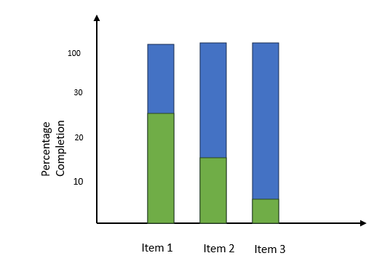
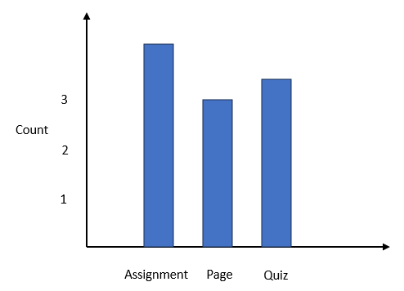
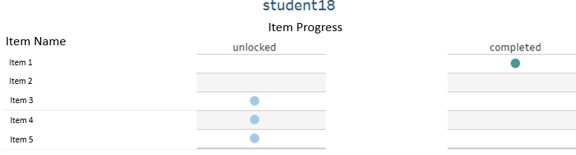
Module Progress Dashboard (Page 2)
Overall Dashboard filters
Course filter
Course 1
Student filter
All (Default)
Select Module
Bar plot of item type
Bar or Stacked plot of item status for ALL students.
If one student is selected then displays a scatterplot as below
Module 1
Pick Items
All (Default)
Item 1
Item 2
Item 3
Item 4
Select a
specific
module
Item 8
Item 9
Data Table with Items with insights.
Item 10
Attributions:
Source:
Assumptions:
Summary:

Slide 4
100
3
30
Count
Percentage Completion
2
20
1
10
Reference Images
Assignment
Page
Quiz
Item 1
Item 2
Item 3
Item Progress
Item Name
Item 1
Item 2
Item 3
Item 4
Item 5

