Slide 1
Learning Pose from Quadrotor Motion
CIS 680 – Final Project
Presented by:
Elijah Lee
Raymond Bjorkman
Ranjani Narayanan

Slide 2
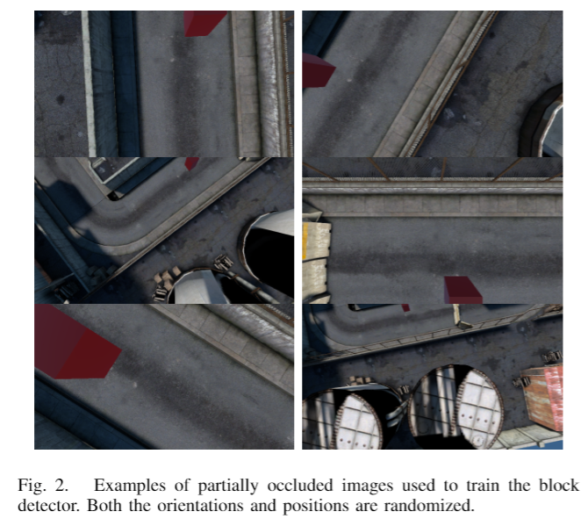
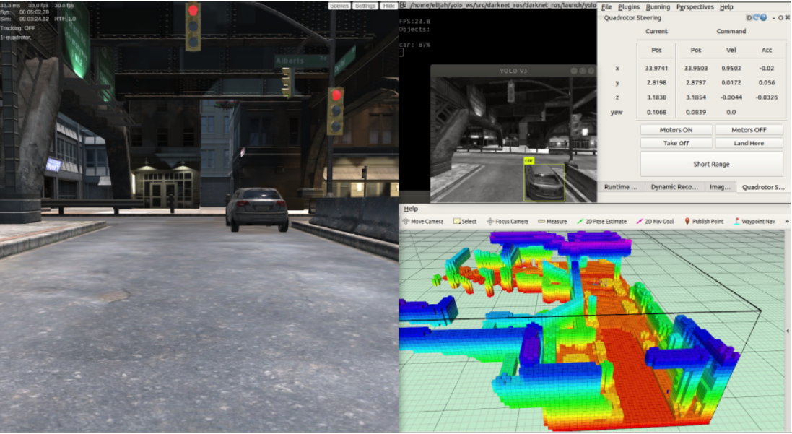
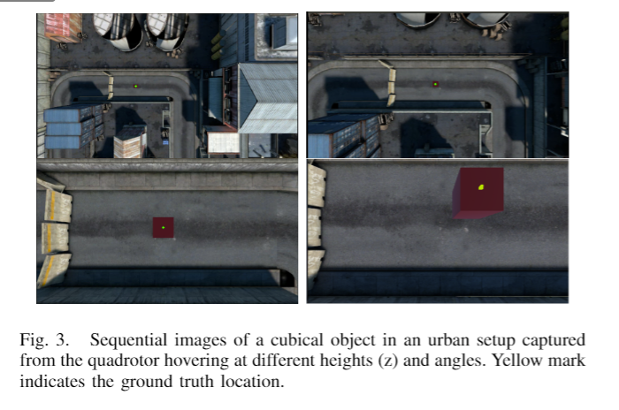

Data Generation and Pre-Processing
Data Generation
Simulator- Unity
Description
3002 non-rotation and 5236 images with rotation
Pre-processing
Normalization with mean and standard deviation
Labels are of the form: x, y, z, Ɵ (relative to camera)
All images of shape [360, 640] with RGB channels
Augmentation in the form of contrast variations

Slide 3
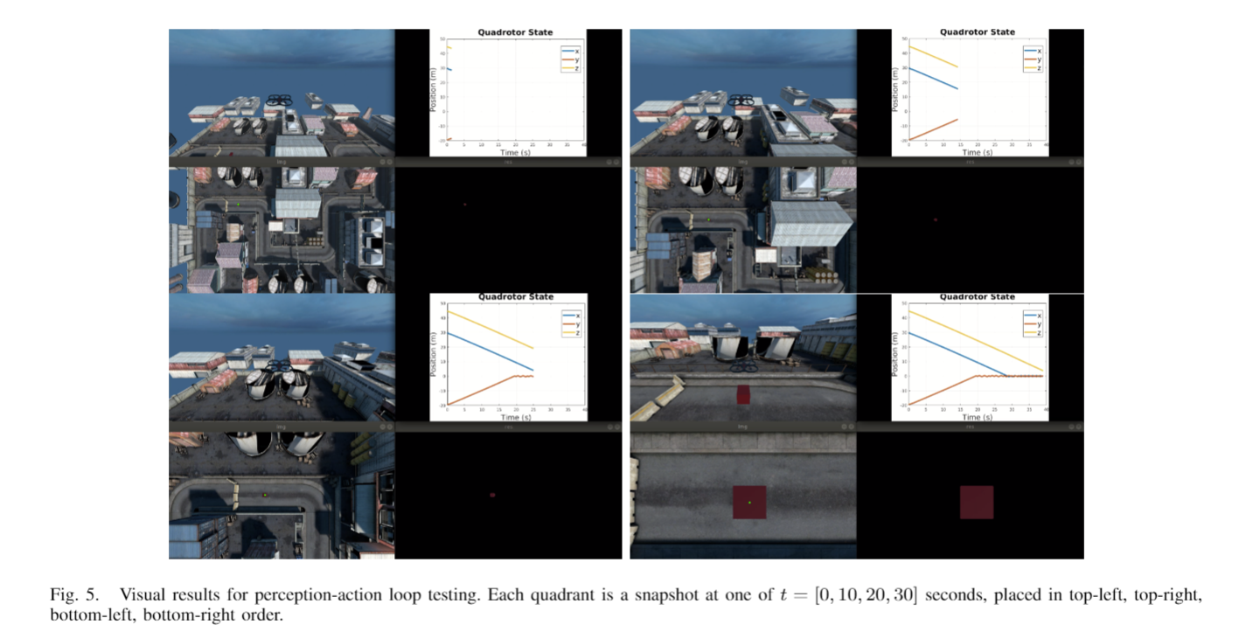
Data Generation Setup
Perception-action loop

Slide 4
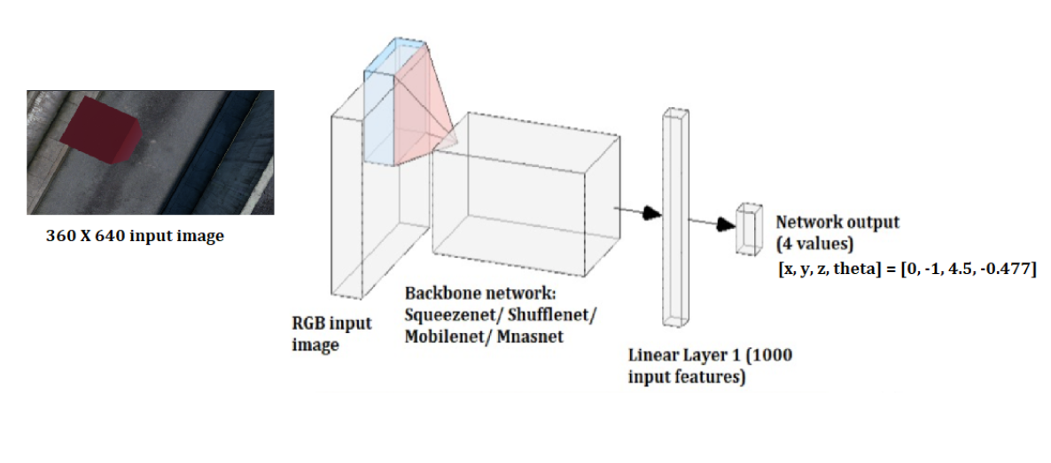
Model Architecture

Slide 5
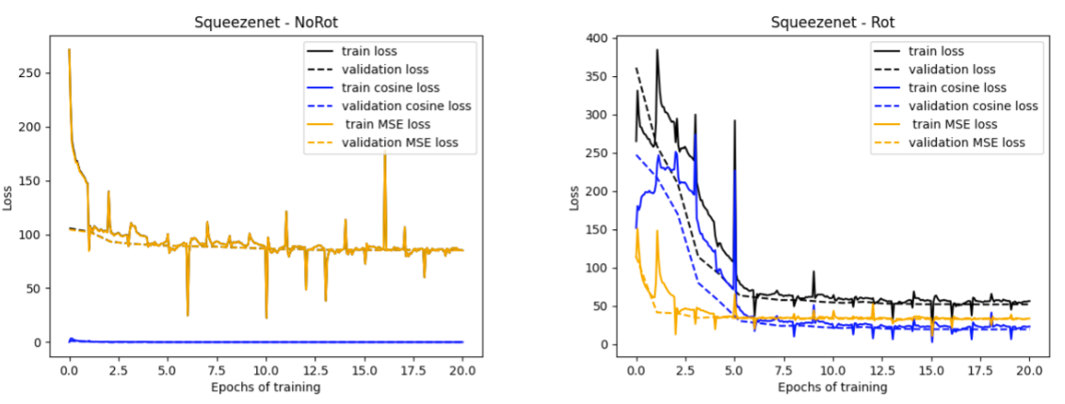
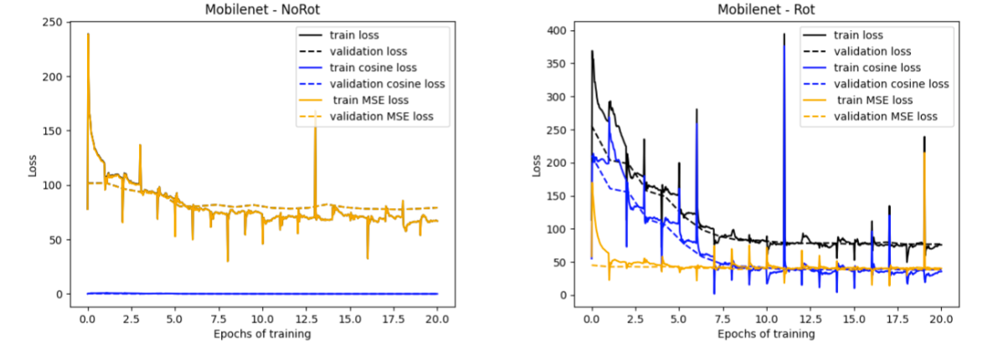
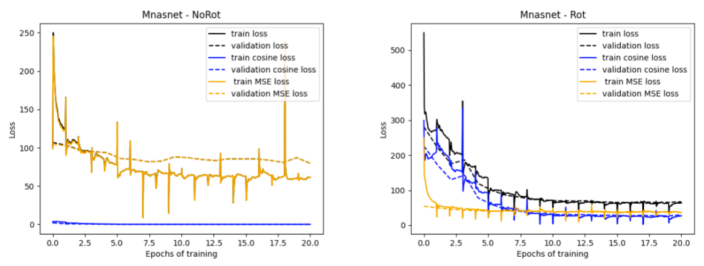

Training and Validation
Training Parameters:
Learning rate: 1e-4
Scheduler: 1/10th at 5th and 12th epochs
Epochs: 20
Optimizer: Adam
Batch Size: 4
Lambda: 250
Loss:

