Slide 1
REVA – REMOTE ELECTRONIC VIRTUAL ASSESSMENT
Ranjani Venkatesan (Summer 2025 intern)
1
FOR INTERNAL USE ONLY. DO NOT DUPLICATE, DISTRIBUTE, OR USE IN DETAILING.

Slide 2


Agenda/ I ntroduction
I N T E R N P R O G R A M O V E R V I E W
I N T E R N P R O G R A M O V E R V I E W
Current REVA Setup & Challenges
Overview of the existing on-prem setup using Node.js, MongoDB, and backup servers.
Pain points: lines of custom code, frequent backup server failures, and downtime during patches, production halts, and high maintenance costs.
AWS Serverless Transformation
How we migrated to a fully serverless AWS workflow using S3, Lambda, Rekognition, DynamoDB, and CloudWatch.
Eliminated backup servers, simplified infrastructure, and reduced dependency on large codebases.
Business Impact
Annual cost savings of approximately $100k by removing infrastructure overhead.
Zero downtime during deployments and improved production reliability.
A scalable architecture ready to support future clinical trial growth.
Lessons Learned & Next Steps
Key takeaways from implementing a serverless model for REVA.
Roadmap for expanding this AWS architecture to other clinical trial applications and broader use cases.
April 2024
01US24IUE0185

Slide 3
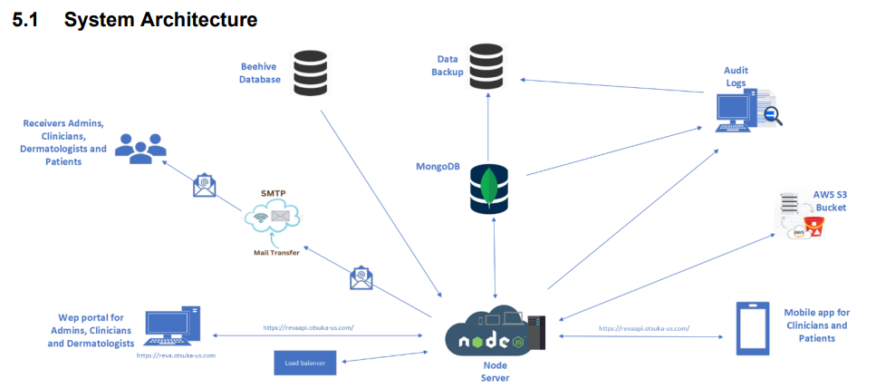
Proj ect( s) Overview
I N T E R N P R O G R A M O V E R V I E W
I N T E R N P R O G R A M O V E R V I E W
What is REVA?
A web & mobile platform to capture and review clinical trial rash reports and images.
Integrates with multiple user roles (Subjects, Clinicians, Dermatologists, CRAs, Monitors) and EMR systems.
Current Architecture
Node.js server, MongoDB database, backup/disaster-recovery servers, and on-prem integration with Beehive EMR.
Heavy reliance on thousands of lines of custom Python & Node.js code to handle core functions (register users, report rash, generate reports, sync backups).
Key Challenges
Backup servers frequently failed, halting production and impacting clinical trials.
Patching or updating requires manual intervention and downtime.
The codebase was large, complex, and costly to maintain.
Infrastructure & maintenance costs were escalating every year.
April 2024
01US24IUE0185

Slide 4
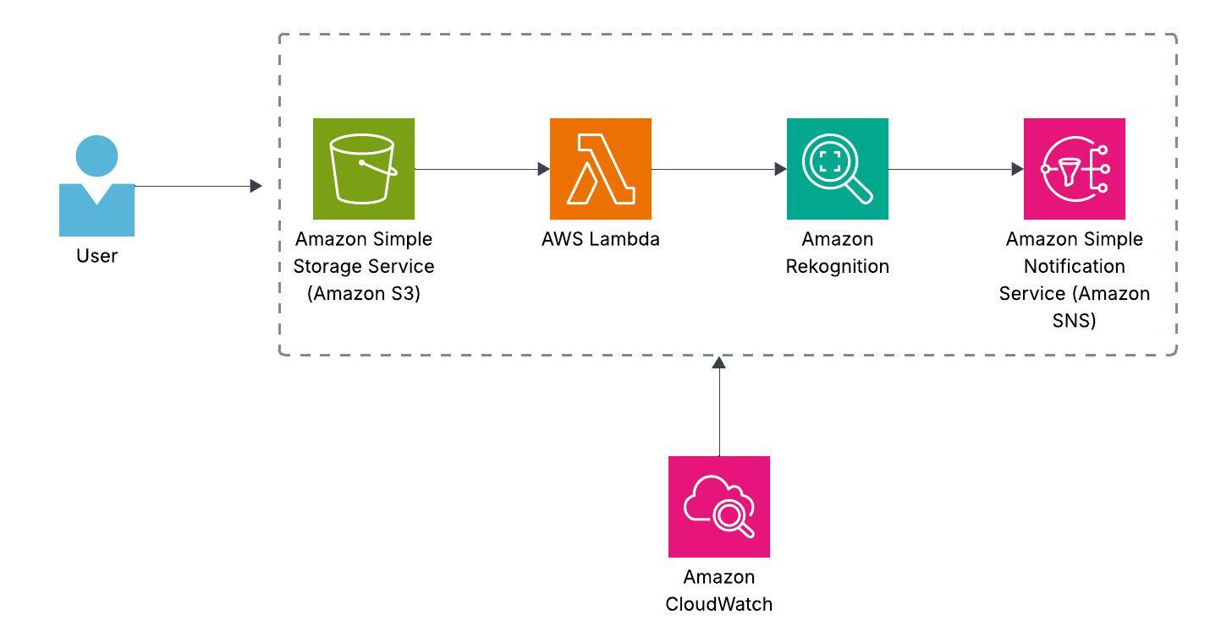
Detail s about project( s)
I N T E R N P R O G R A M O V E R V I E W
I N T E R N P R O G R A M O V E R V I E W
Current REVA Workflow User → Node.js App Server (thousands of lines of fragile custom code) MongoDB (data) Backup Servers (frequent sync failures, production stops) Manual patch scripts (downtime for every update) File Storage + SMTP Relay (emails) Beehive EMR + Audit Logs (manually integrated) ⚠ Complex, hard to maintain, multiple failure points. | New AWS Serverless Workflow User uploads image to S3 (secure presigned URL) S3 triggers Lambda (ProcessImage) Lambda uses Rekognition for analysis Results written back to S3 (results/) SNS sends notifications (optional) CloudWatch monitors everything (logs & alarms) ✅ Simple, automated, fault-tolerant, serverless.

Slide 5
Im pact of proj ect( s)
I N T E R N P R O G R A M O V E R V I E W
I N T E R N P R O G R A M O V E R V I E W
Why AWS Platform Integration is Good?
- Serverless: No servers to patch, scale, or monitor manually.
- Native integrations: S3 events trigger Lambda directly, Rekognition API plugs in seamlessly.
- High reliability: AWS managed services guarantee 99.9%+ uptime.
- Built-in security & compliance: IAM roles, S3 encryption, CloudWatch logs (critical for clinical trials).
Advantages of the New Workflow
- Zero downtime: Backup server failures and patch outages are fully eliminated.
- Operational simplicity:
- From thousands of lines of fragile code → 5-6 modular Lambdas.
- Automatic retries & failure handling.
- Automated monitoring & alerts: CloudWatch captures every error, metric, and log.
- Scalable by design: Can handle 10x more uploads without extra infra.
cost & Savings
- Infra cost: Eliminated backup servers & DR hardware. Only pay-per-use (Lambda/S3/Rekognition/SNS).
- Estimated savings: $100k/year in infrastructure + operational overhead.
- Reduced engineering hours: Faster feature rollouts, less time firefighting downtime.

Slide 6
Lessons Lear ned
I N T E R N P R O G R A M O V E R V I E W
I N T E R N P R O G R A M O V E R V I E W
Applying Data-Driven Thinking to Architecture
My background helped me design workflows that are modular and optimized for scale, like breaking monolithic code into Lambda functions.
Serverless Cloud Skills in Action
Leveraging AWS S3, Lambda, and Rekognition showed me how serverless tools can simplify complex systems and improve reliability.
Start Small, Then Evolve
I learned to avoid over‑engineering. Beginning with essential AWS services gave us quick wins and the confidence to expand the pipeline.
Automation Improves Quality
Event‑driven triggers (S3 → Lambda → SNS) helped me reduce manual interventions and remove downtime risks.
Monitoring = Long-Term Stability
Setting up CloudWatch logs and alarms strengthened my ability to maintain production reliability proactively.

