Slide 1

ISRO (Indian Space Research Organisation)
Presenting to:swetha uttarakar madam
By:Arindam Das

Slide 2
What is ISRO ?
ISRO stands for Indian Space Research Organization. It has different types of missions which are Chandrayaan 1, 2, and, 3 , Gaanganyaan, NISAR. India has produced more hundreds of satellites and rockets. Their current launch pad is Srihari Kota, Andhra Pradesh.
The ISRO was developed since
15 august,1969.It has types of
Like GSLV, PSLV, etc.

Slide 3
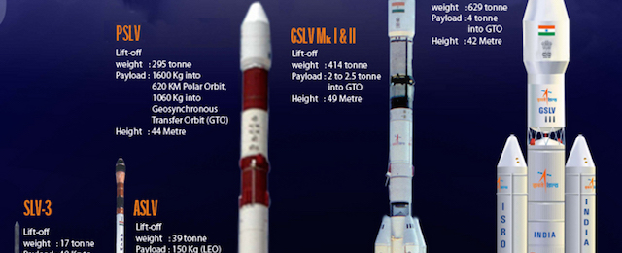
These are the types of rockets that are as follows:
GSLV
PSLV
ASLV
SLV-3
GSLV M I, II, and III.

Slide 4
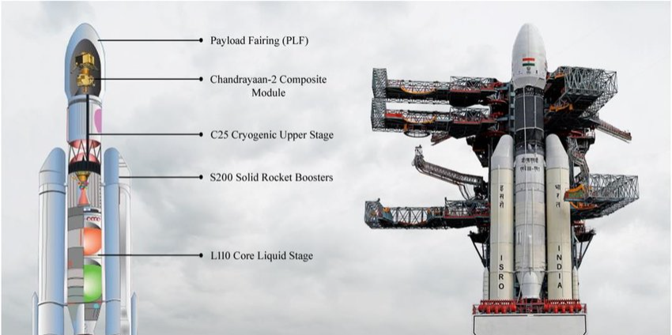
Parts of rocket.
For ex : This picture Fig.2

Slide 5

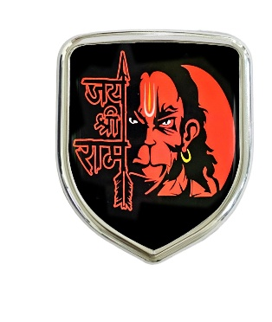

So that’s all for today’s presentation I am glad that you like it as I will be seeing you in next class in Diwali. So that’s all for today’s presentation I am glad that you like it as I will be seeing you in next class in Diwali sweta maam. And happy Diwali bring the divine to light for the ram who rescued seeta from sri lanka and the devil Ravana.
So happy Diwali!!!!
Notes:
So that’s all for today’s presentation I am glad that you like it as I will be seeing you in next class in Diwali swetha maam

Slide 7

Thank you
isro!!!
Notes:
Thank you

Slide 8

Thank you, Bright Champs!!!

