Slide 1
Operating System - I
Chapter -4
Linkers and Loaders

Slide 2
We will learn-
Concept of binding-static and dynamic
Concept of addresses- translated, linked and load time addresses
Relocation and linking concept- program relocation, performing relocation, public and external references, linking, binary program, object module
Types of loaders- compile and go, absolute relocating and direct-linking
Relocatability- nonrelocatable , relocatable and self relocating programs
Linking of overlays

Slide 3
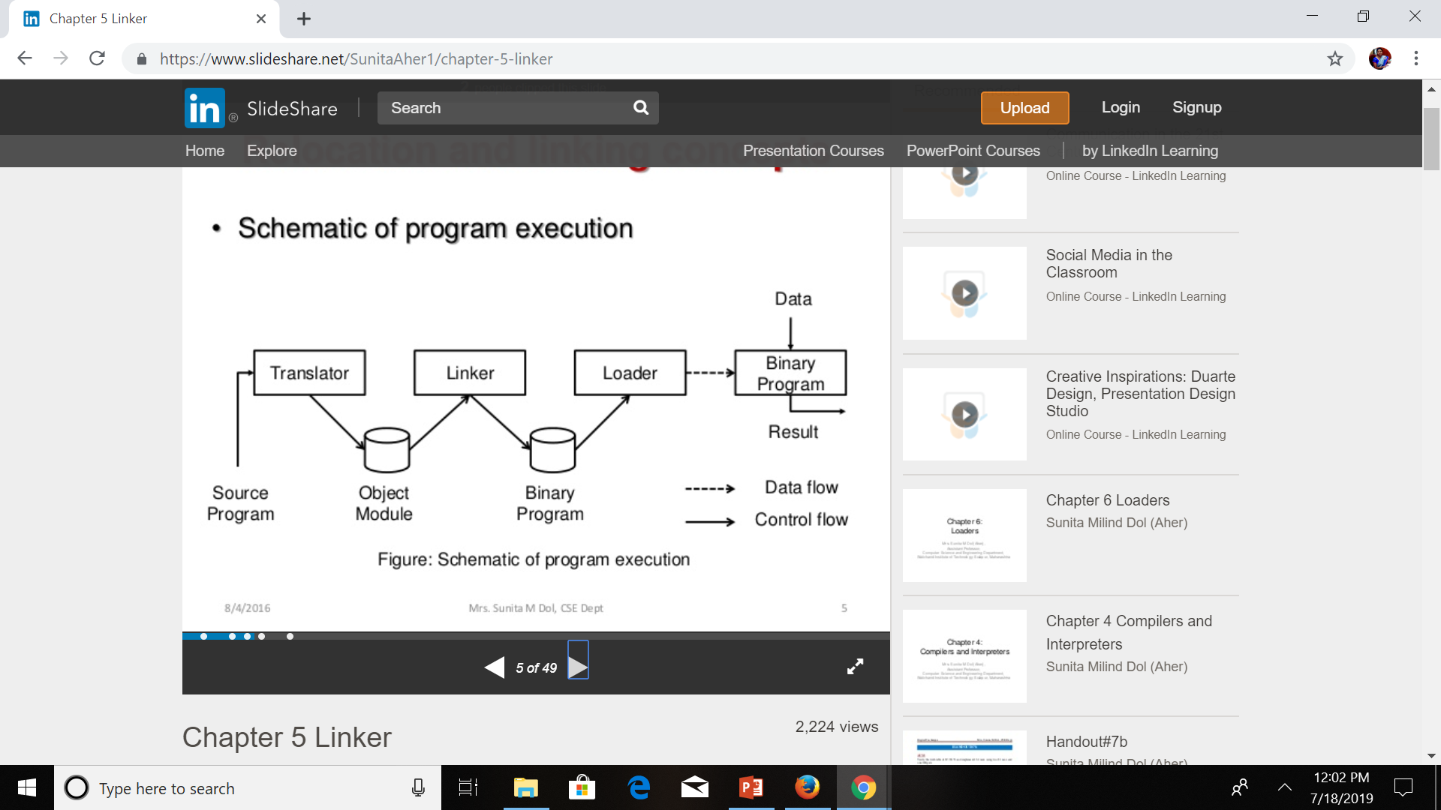
The steps involved in the execution of a program written in language L:-
Translation of the program (Translator)
Linking of the program with other programs needed for its execution (Linker)
Relocation of the program to execute from the specific memory area allocated to it. (Linker).
Loading of the program in the memory for the purpose of execution (Loader)
A schematic of program execution can be shown as below-
Source: “Systems Programming”, D.M.Dhamdhere, Tata McGrawHill Publication

Slide 4
Here,
The translator outputs -> a program form “Object Module”
The linker processes a set of object modules to produce a ready-to-execute program form, “binary program”
The loader loads this program into the memory for the purpose of execution.
Definition: Linking is a process of combining various pieces of code and data together to form a single executable that can be loaded into memory.
Linking can be done at compile time , at load time(by loader) and also at run time(by application program)

Slide 5
Concept of binding
Definition- Binding is the association of an attribute of a program entity with a value.
Binding time is the time at which a binding is performed.
Binding times-
1. Language definition time of L
2. Language implementation time of L
3. Compilation init time of proc
4. Link time of proc
5. Execution time of proc
Here, L is the language, P is the program and proc is the procedure

Slide 6
Static binding and Dynamic binding
Static Binding: is a binding performed before the execution of a program begins. It is also known as early binding
Dynamic binding: is a binding performed after the execution of a program begins. It is also known late binding.
Static Binding | Dynamic Binding
1. Binding between names and objects can be determined at compile time | 1. Binding between names and objects can be determined at runtime
2.Variable binding depends on where the procedure is written | 2. Binding depends on who calls the procedure
3. Output does not differ at runtime | 3. Output differs at runtime
4. Compiler is needed | 4. Interpreter is needed
5. Program is more efficient | 5. Program is more flexible.
6. Ex: a C language | 6. Ex: LISP

Slide 7
Translated , Linked and load time addresses
While compiling a program , the language translator needs to know what memory address the first memory word of the target program should have.
We call it the origin of the program
The origin should be either specified to the language translator, or it would have to be assumed. (In assembly program, the origin specified by START or ORIGIN statement)

Slide 8
Some important terminologies:
Translation time (or translated) address: Address assigned by the translator
Linked address: Address assigned by the linker
Load time (or load) address: Address assigned by the loader
4. Translated origin: Address of the origin used by the translator. It is either the address specified by the programmer in an ORIGIN or START statement, or a default value
5. Linked origin: Address of the origin assigned by the linker while producing a binary program
6. Load origin: Address of the origin assigned by the loader while loading the program in memory for execution.

Slide 9
Relocation and linking concepts-
Program Relocation
Let AA be the absolute addresses-instruction or data addresses-used in the instructions of a program P. AA would be a nonempty set if the program P expects some of its instructions and data to occupy memory words with specific addresses. Such a program is called an address sensitive program. It contains –
An address sensitive instruction: An instruction that uses an address a_{i} included in set AA
An address constant: A data word that contains an address a_{i} included in set AA
Definition: Program Relocation is the action of modifying the addresses used in the address sensitive instructions of a program such that the program can execute correctly from the designated area of memory.

Slide 10
If Linked origin ≠ Translated origin, relocation must be performed by the linker
If Linked origin ≠ Load origin, relocation must be performed by the loader
In general, a linker always performs relocation, whereas some loaders do not.
Loaders that do not perform relocation- i.e. Load origin = Linked origin, such loaders are called as absolute loaders. In this case, “Load origin” and Linked Origin” are termed interchangeably.
Loaders that perform relocation are called as relocating loaders.

Slide 11
Consider the following assembly program and its generated code:
 | Statement |  | Address | Code
 | ORIGIN | 500
 | ENTRY | TOTAL
 | EXTRN | MAX, ALPHA
 | READ | A | 500) | + 09 0 540
LOOP |  |  | 501)
 | :
 | :
 | MOVER | AREG, ALPHA | 518) | + 04 1 000
 | BC | ANY, MAX | 519) | + 06 6 000
 | :
 | :
 | BC | LT, LOOP | 538) | + 06 1 501
 | STOP |  | 539) | + 00 0 000
A | DS | 1 | 540)
TOTAL | DS | 1 | 541)
 | END

Slide 12
Example: correcting addresses used in address sensitive instructions:
The translated origin of the program in slide no. 11 is 500. The translated time address of symbol A is 540. The instruction corresponding to the statement READ A uses the address 540, hence it is an address sensitive instruction. If the linked origin is 900, A would have the linked address 940, hence the address in the READ instruction should be corrected to 940. similarly the instruction in translated memory word 538 uses the address 501, the address of LOOP. It should be corrected to 901.
Performing relocation
Let the translated and linked origins of program P be t_origin_{p} and l_origin_{p} respectively. consider a symbol symb in P. let its translation time address be t_{symb} and linked address be l_{symb} . The relocation factor of P is defined as follows:
relocation_factor_{p} = l_origin_{p} – t_origin_{p} (1)
relocation_factor_{p} can be positive, negative or zero

Slide 13
Consider a statement which uses symb as an operand. The translator puts the address t_{symb} in the instruction generated for it. Now,
t_{symb} = t_origin_{p} + d_{symb}
Where d_{symb} is the offset of symb in P. After program P has been relocated to the linked origin, i.e l_origin_{p} , we have
l_{symb} = l_origin_{p +} d_{symb}
Using (1),
l_{symb} = t_origin_{p} + relocation_factor_{p} + d_{symb}
= t_origin_{p} + d_{symb} + relocation_factor
= t_{symb} + relocation_factor_{p} (2)

Slide 14
Example: (Relocation of program) for the program in slide no. 11,
Relocation factor= 900-500
= 400
Relocation is performed as follows: IRR_{p} contains the instructions with translated addresses 500 and 538. The instruction with translated address 500 contains the address 540 in the operand field. This address is changed to (540+400)=940.
The instruction with translated address 538 contains address 501 in the operand field. Adding 400 to this address makes it 901.

Slide 15
Linking
A program unit is any program or routine that is to be linked with another program or routine.
Let an application consist of a set of program units SP={P_{i}}. Now consider a program unit P_{i} that requires the use of another program unit P_{j} during its execution- either it uses the address of some instruction in P_{j} in one of its instructions, possibly in a subroutine call instruction, or it uses the address of some data defined in P_{j} in one of its instruction.
To form a binary program by combining P_{i} and P_{j} linked addresses of relevant instructions. It is achieved by the following linking related concepts:
Public definition: A symbol defined in a program unit that may be referenced in other program units
External reference: A reference to a symbol that is not defined in the program unit containing the reference.

Slide 16
EXTRN and ENTRY statements
An ENTRY statement in a program unit lists the public definition of the program unit.
An EXTRN statement lists the symbols to which external references are made in the program unit.
Example: In the assembly program in slide No. 11, the ENTRY statement indicates that a public definition of TOTAL exists in the program.
LOOP and A are not public definitions even though they are defined in the program.
The EXTRN statement indicates that the program contains external references to MAX and ALPHA

Slide 17
Resolving external references
While assembling an external reference in a program unit, the assembler does not know the address of the referenced symbol. Hence it puts the zeroes in the address field of the instruction that contains the external reference.
Example: In slide no. 11 program, it would put zeroes in the address field of the instruction corresponding to the statements MOVER AREG, ALPHA and BC ANY, MAX. Before the program can be executed, the correct linked addresses should be put in every instruction that contains an external reference.
Definition: Linking: is the action of putting the correct linked addresses in those instructions of a program that contain external references.

Slide 18
Example: Resolving an external reference- consider following program code-
statement address code
START 200
ENTRY ALPHA
----
----
ALPHA DS 25 231) + 00 0 000
END
Program unit P on slide No. 11 contains an external reference to symbol ALPHA in the instruction with the translation time address 518. Let the linked origin of P be 900 and its size be 42 words. Hence the linked origin of Q is 942. and accordingly, the linked address of ALPHA is 973. The external reference in the instruction with the translation time address 518 in P is resolved by the linked address of ALPHAi.e.973 in it.

Slide 19
Constructing binary programs
Binary program:- a binary program is a machine language program comprising a set of program units SP such that for every P_{i} in SP
P_{i} has been relocated to the memory area whose starting address matches its linked origin , and
Each external reference in P_{i} has been resolved
To form a binary program from a set of object modules, the programmer invokes the linker by using the command
linker <link origin>, <object module names>[,<execution start address>]
Where <link origin> specified the memory address to be given to the first word of the binary program.
<external start address> is usually a pair(program unit name, offset in program unit). The linker converts it into the linked start address, and stores it along with the binary program for use when the program is to be executed.

Slide 20
If specification of <execution start address> is omitted the execution start address is assumed to be the same as the linked origin.
Since we have assumed the load origin of a program to be the same as its linked origin, the loader simply loads the binary program into the area of memory starting at its linked origin for execution.

Slide 21
Object Module
It is a program unit contains all the information that would be needed to relocate and link the program unit with other program units. The object module of a program unit P consists of the following four components:
Header: The header contains the translated origin, size and execution start address of P.
Program: This component contains the machine language program corresponding to P.
Relocation table (RELOCTAB): This table describes the instructions that require relocation, that is , it describes IRR_{P}. Each RELOCTAB entry contains a single field:
Translated address: Translated address of an address sensitive instruction
4. Linking Table (LINKTAB) : this table contains information concerning the public definitions and external references in P.

Slide 22
Each LINKTAB entry contains the following three fields:
symbol : Symbolic name
Type : The values PD and EXT indicate whether the entry pertains to a public definition or an external reference, respectively
Translated address : For a public definition, it is the translated address of the first memory word allocated to the symbol. For an external reference, it is the address of the memory word that is required to contain the address of the symbol.
Example: (Object Module)The object module of the program P on slide no. 11 contains the following information:
1. The header contains the information translated address=500, size=42, execution start address = 500
2. The program component contains the machine language instructions.
3. The relocation table is as follows:

Slide 23
Translated address
500 538
4. The linking table is follows:
Symbol | Type | Translated Address
ALPHA | EXT | 518
MAX | EXT | 519
TOTAL | PD | 541

Slide 24
Types of Loaders-
Compile and go-
is a link editor or program loader in which the assembler itself places the assembled instructions directly into the designated memory locations for execution
The instruction are read line by line, its machine code is obtained and it is directly put in the main memory at some known address
After completion of assembly process, it assigns the starting address of the program to the location counter
Ex: WATFOR, PL/C and Dartmouth BASIC
Here the assembler gets executed and when it is finished, causes a branch straight to the first instruction of the program
There is no stop between the compilation, link editing, loading, and execution of the program
It is also called as assemble and go or a load and go system

Slide 25
Advantages-
They are simple and easy to implement
No additional routines are required to load the compiled code into the memory
Disadvantages-
There is wastage of memory space due to the presence of the assembler
There is no production of .obj file, the source code is directly converted to executable form.
Hence , even though there is no modification in the source program , it needs to be assembled and executed each time.

Slide 26
Absolute loader-
An absolute loader does not perform any relocation while loading a program in memory, so its use is limited to only those programs that either have load origin=linked origin or are self-relocating.
It loads a binary program in memory for execution. We assume that the binary program is stored in a file that contains the following:
A header record showing load origin, length, and load time execution start address of the program
A sequence of binary image records containing the programs code.
Each binary image record contains a part of the programs code in the form of a sequence of bytes, the load address of the first byte of this code, and a count of the number of bytes of code.

Slide 27
Bootstrap loader
As soon as we turn on computer system, the operating system has to be loaded in memory.
It involves loading of several programs in memory. As the computer’s memory does not contain any programs or data at this time- a bootstrap loader (a tiny program that can fit into a single record on floppy or hard disk) loads the main operating system or runtime environment for the computer after completion of self-tests.

Slide 28
Relocating loaders
To avoid possible reassembling of all subroutines when a single subroutine is changed and to perform the tasks of allocation and linking for the programmer, the relocating loaders is introduced.
A relocating loader loads a program in a designated area of memory, relocates it so that it can execute correctly in that area of memory, and passes control to it for execution.
Ex: Binary Symbolic Subroutine(BSS) loader used in the IBM 7094, IBM1130, GE635
Direct linking loaders:
A direct linking loader is a relocatable loader.
It has the advantage of allowing programmer multiple procedure segments, and multiple data segments
Here complete freedom in referencing data or instructions obtained in other segments, provides flexible intersegment referencing

Slide 29
_{Program Relocatability:}
The manner in which a program can be modified, or to execute from a given load origin i.e how relocation can be carried out, classify programs into the following:
Non-relocatable program
Relocatable programs
Self-relocating programs
1. Non-relocatable program:
A non-relocatable program can not be executed in any memory area other than the area starting on its translated origin
It is the result of address-sensitivity of the code and lack of information regarding- the parts of the program are address sensitivity
Example: .com files in MS-DOS

Slide 30
Relocatable programs:
The program can be relocated by a linker or loader to have a linked address or load address that matches the start address of the specified area of memory.
It is the one which consists of a program and relevant information about its relocation. These programs contains information of address sensitive instructions.
using relocation information, the program can be loaded at different locations other than translation time origin. At relocation the relocation factor is added to the address part of address sensitive instruction
This process is generally done by operating system and the output which perform relocation is called linkage editor relocating loader.
Linkage editor is required to modify all the address sensitive instructions with the help of relocatable information present in the program.
Example: .exe files in MS-DOS
The size of the relocatable program is larger than the non-relocatable program because it contains relocation information

Slide 31
Self-Relocatable programs:
The program can be loaded in any area of memory for execution. At the start of execution it would perform its own relocation so that it can execute correctly in that memory area.
Self-relocating program contains-
A table of information about the address sensitive instructions
Code to perform the relocation of address sensitive instructions
Examples- TC, FORTRAN, COBOL
These programs are useful for operating system point of view in multiuser or time sharing environment

Slide 32
Program + Data |  | Program + Data |  | Relocation Logic
 |  | Relocation information |  | Program + Data
 |  |  |  | Relocation information
a) Non-Relocatable Program |  | b) Relocatable Program |  | c) Self- Relocatable Program

Slide 33
Linking for Overlays
A special kind of linkage editor called overlays is used to run the programs those large in size as compared to the available address space on the machines.
Some part of a program may be executed only briefly, or not at all, during an execution. Memory requirement of the program can be reduced by not keeping these parts in memory at all times.
It is achieved by: some parts of a program are given the same load address during linking. This way, only one of these parts can be in memory at any time because loading of another part that has the same load address would overwrite it.
An Overlay is a part of program that has the same load origin as some other part(s) of the program.
A program containing overlays is called an overlay structured program.
It consists of- a permanently resident part, called the root and a set of overlays that would be loaded in memory when needed

Slide 34
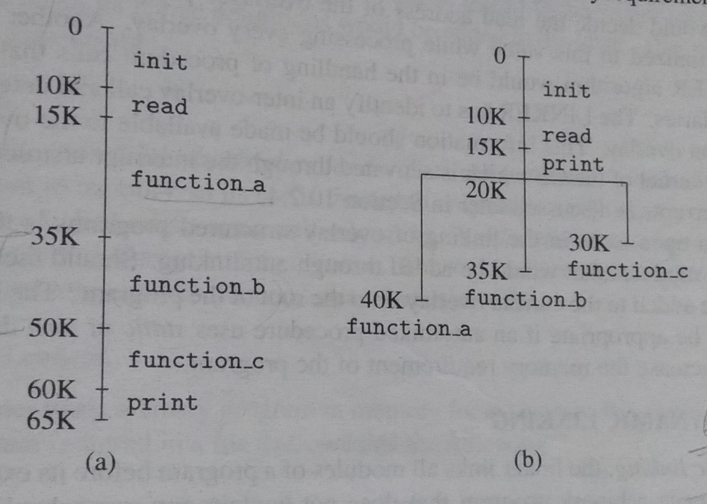
Example: Consider a program with 6 sections named init, read, function a, function b, function c and print. init performs initialization and passes control to read. read reads one set of data and invokes function a, function b or function c depending on the values of the data. Print is called to print the results.
function a, function b and function c are mutually exclusive. Hence they can be made into separate overlays. read and print are put in the root of the program since they are needed for each set of data. The overlay structure program can execute in 40k bytes though it has a total size of 65k bytes. The figure below shows an overlay tree:

Slide 35
References:
1. D.M.Dhamdere, “Systems Programming”, Tata McGrawHill Private Limited

