Slide 1
Unit – I Introduction
Types of Program – System program and Application program
Difference between system program and application program
Elements of Programming environment- Editor, Preprocessor, Assembler, Compiler, Interpreter, Linker and Loader, debugger, device drivers, operating system
1

Slide 2
Introduction
Computer: machine that obeys instructions
People communicated with computer by means of primitive set of instructions.
Wants to run features with more complex instructions.E.g. X=30 * Y; where Y=10. What is X.
Computers cannot understand such language.
Requires System Programs.

Slide 3
What is System Program?
System Programs: manage the hardware and coordinate the execution of different programs.
Developed to make computers better adapted to the needs of their users.
Efficiency, effectiveness and sophistication of system programs decides productivity of computer.
Examples: Operating Systems MS Windows and Linux also compilers, assembler, loader, macro preprocessors

Slide 4
What is Application Program?
Complete, self-contained computer program that performs a specific useful task, other than system maintenance functions. Called 'Apps' for short, application programs are the most familiar forms of software and come in a very wide variety of types. Also called application software.

Slide 5
Differences System Program and Application Program
In application programming programmers build applications. Application programs include websites, video games, iPhone applications, Microsoft Word, Microsoft Excel, Web browsers and other programs that people use for entertainment, communications, accessing information, organizing, and getting work done. Application software interacts with people or users.
Systems programming is creating technology that programmers use to build applications. In order for an applications programmer to build an application, he needs an operating system, a programming language, and other tools to get the application built, tested, and working.

Slide 6
Elements of Programming Environment
Editors
Preprocessor
Assembler
Compiler
Interpreter
Linker and Loaders
Debuggers
Device Driver
Operating System

Slide 7
Elements of Programming Environment
Editors
  A program that allows to change (edit) the contents of file (if exist or not exist).
  Various editors are available in windows as well as in Linux
  In Linux: VI, Text Editor etc
  In windows: DOS Editor, Notepad etc.

Slide 8
Elements of Programming Environment
Preprocessor (Macro – Preprocessor)
  To avoid repeated statements of program O.S. provide macro processing facility which permits to define abbreviation for part of program and use that abbreviation
  MPP treats abbreviation as macro definition and save it.
  MPP substitutes the definition for all occurrences of the abbreviations (macro call) in the program.
Assembler
  It is program that translate mnemonic instruction set into machine language.

Slide 9
Elements of Programming Environment
Compilers
  Area of Problems are categorized
  Need for specialized programming languages (high level languages)
  To processed high level program language need for system program – compiler
  Compiler is program that accepts program written in high level language and produces an object code
  C, COBOL, GCC, JAVAC etc.

Slide 10
Elements of Programming Environment
Linkers and Loaders
  The basic job of any linker or loader is simple: it binds more abstract names to more concrete names, which permits programmers to write code using the more abstract names. That is, it takes a name written by a programmer such as getline and binds it to ‘‘the location 612 bytes from the beginning of the executable code in module iosys.’’ Or it may take a more abstract numeric address such as ‘‘the location 450 bytes beyond the beginning of the static data for this module’’ and bind it to a numeric address.

Slide 11
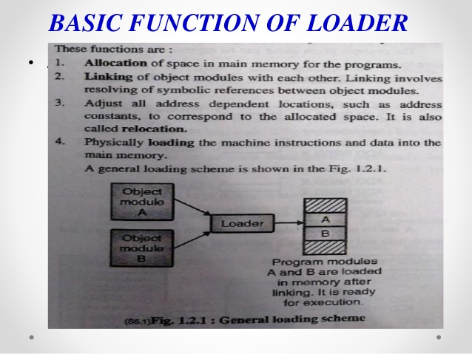
Loader

Slide 12
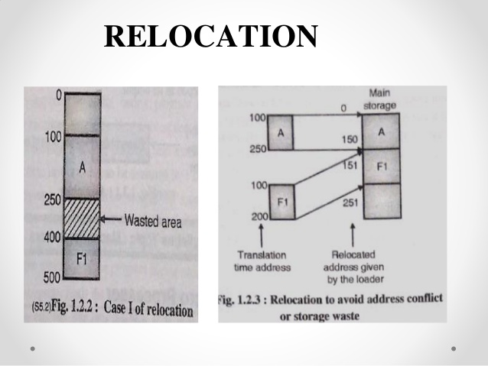
Relocation

Slide 13
Elements of Programming Environment
Debuggers
  A piece of software that enables you to run your program in debugging mode rather than in normal mode.
  Debuggers enables you to:
    See the source code of each statement as it executes
    Suspend or pause execution of program at place of your choice
    To resume (or continue) execution
  In pause, you can issue various commands to examine and change internal state of program
  Two types of debuggers
    Consol Mode
    Visual or graphical

Slide 14
Elements of Programming Environment
Console Debuggers
  Part of language itself
  User interface to a console debugger is keyword and console mode window
  While executing, the lines of source code stream past console window as they are executed
  Typical debuggers has way to specify exact places in the program where you want to pause
  In pause case, it waits for input from keyboard
  The input guides debugger what to do next
  You can display certain values of program variables or continue debugging

Slide 15
Elements of Programming Environment
Visual Debugger
  Typically looks like the interface of a graphical text editor.
  Source code is displayed on screen
  The debugger has its own menus with specialized debuggers features.
  It has debugger margin area on left to denote symbols for breakpoint, the current line pointer etc.
  As debugger starts visual pointer appears on screen indicating which statement is debugging

Slide 16
Elements of Programming Environment
Device Drivers
  A device driver is a program that controls a particular type of device that is attached to your computer.
  There are device drivers for printers, displays, CD-ROM readers, diskette drives, and so on.
  When you buy an operating system, many device drivers are built into the product. However, if you later buy a new type of device that the operating system didn't anticipate, you'll have to install the new device driver.
  A device driver essentially converts the more general input/output instructions of the operating system to messages that the device type can understand.

Slide 17
Elements of Programming Environment
Operating System
  An operating system (sometimes abbreviated as "OS") is the program that, after being initially loaded into the computer by a boot program, manages all the other programs in a computer.
  The other programs are called applications or application programs that makes use of the operating system by making requests for services through a defined application program interface (API).
  In addition, users can interact directly with the operating system through a user interface such as a command language or a graphical user interface

Slide 18
References
D.M. Dhamdhere, Systems Programming and Operating Systems, (2nd Revised Edition)
Leland L. Beck, System Software – An Introduction to Systems Programming, (Pearson Education)
John R. Levine, Elsevier Moegan Kaufmann, Linkers and Loaders
Avi Silberschatz, Peter Baer Galvin, Greg Gagne, Operating System Concepts – Willey Publication (8th Edition)

Slide 19
References
John J. Donovan, Systems Programming, McGraw Hill Education.
http://www.businessdictionary.com/definition/application-program.html
https://www.tutorialspoint.com/application-programs-vs-system-programs

