Slide 1
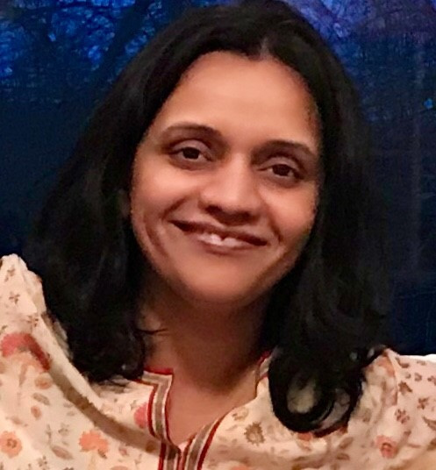
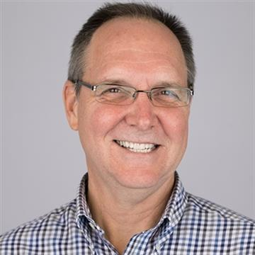
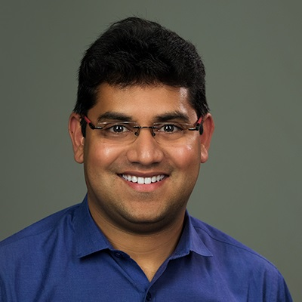
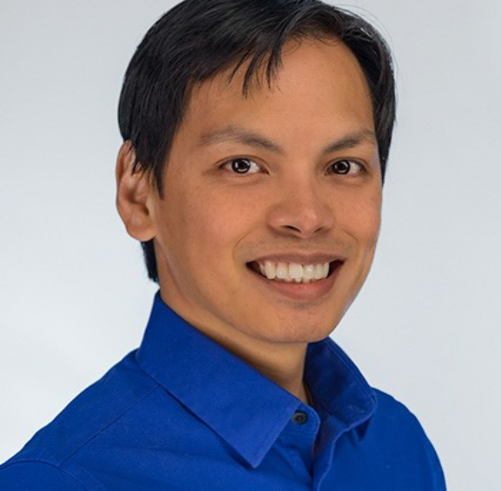
Team Access Crusaders
Radhika Brahmandam
Tom Hatz
Project Name: Focused Finance
Shriraj Parikh
Rannier Veloso

Slide 2
Why
What
How
Providing easy and familiar visual tools to deliver information and do the heavy-lifting for more complex analysis
Impaired person (with ADHD) is constantly overwhelmed with all the details in the layout he/she is presented with while using financial tools
A way to help the impaired person (with ADHD) to process all the information thrown at them to get what they need

Slide 3
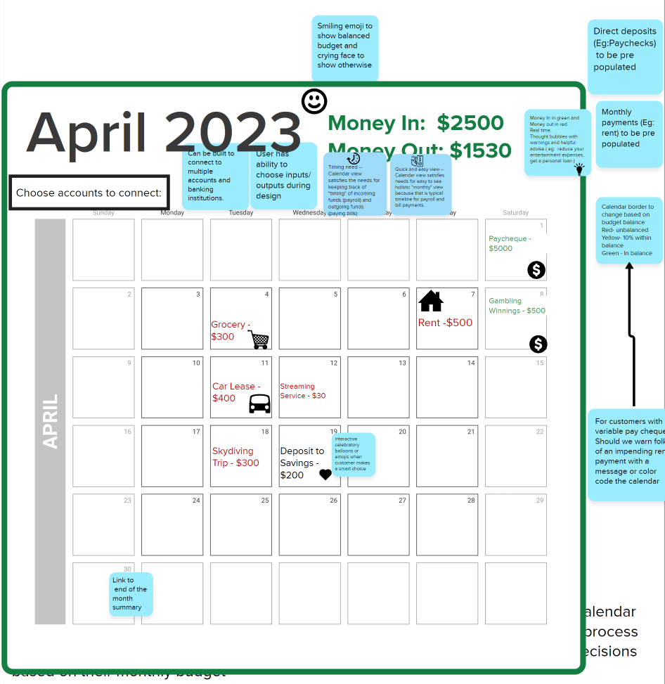
DEMO
Familiar and common layout
Color coded credits and debits
Regular credits/debits pre-populated
Ability to link multiple accounts/financial institutions
Rewarding good behavior
Financial services/solutions suggested

