Slide 1
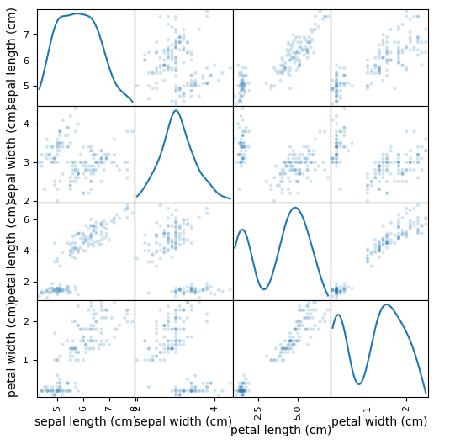
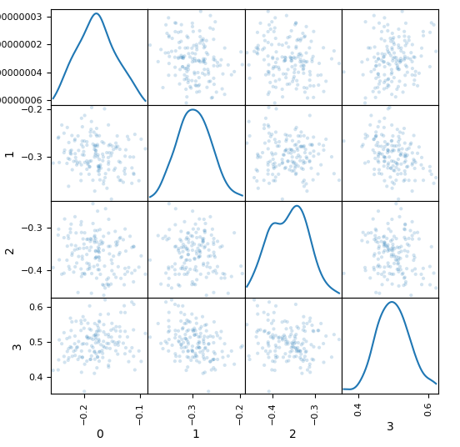
Simple GAN: iris
ver.1
Original Data
Generated Data

Slide 2
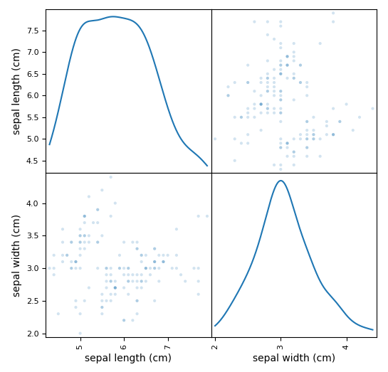
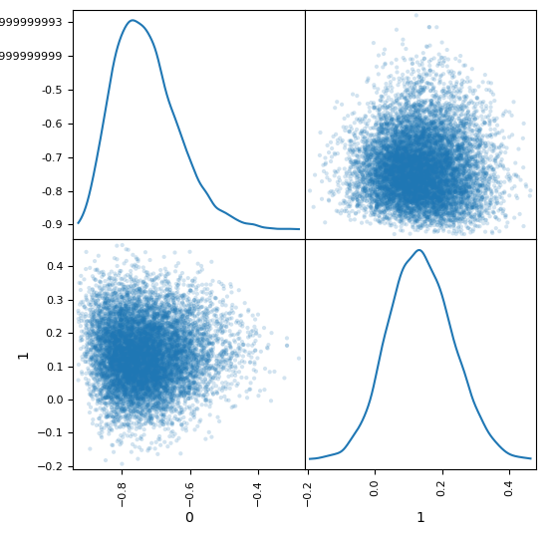
Simple GAN: iris
ver.2
Original Data
Generated Data

Slide 3
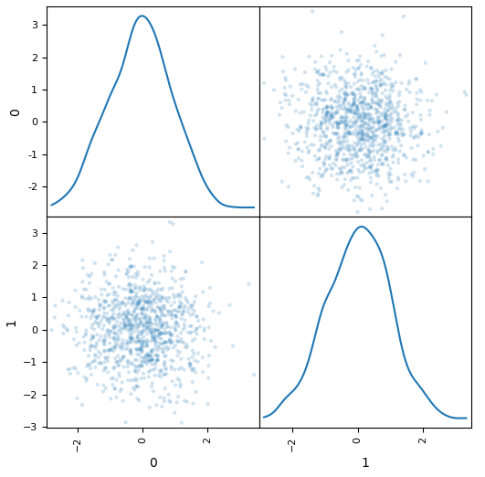
Simple GAN: normal
ver.3
Original Data
Generated Data

Slide 4
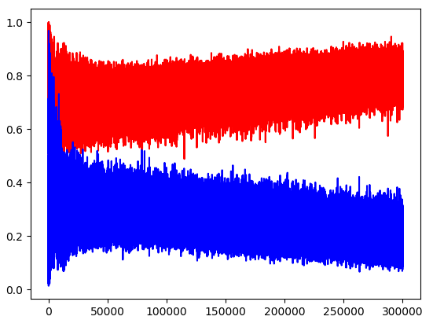
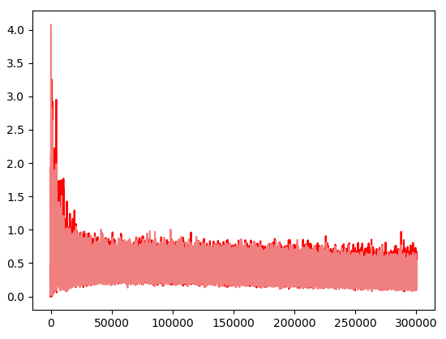
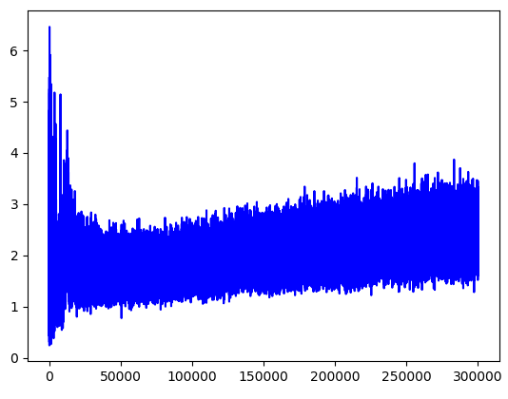
GAN: mnist (without conv net)
d_probs
g_probs
d_losses_real
g_losses 가 학습 안됨
d_losses_fake
g_losses

Slide 5
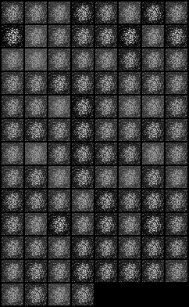
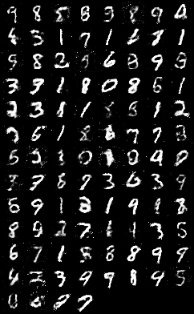
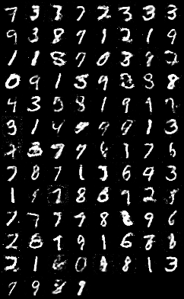
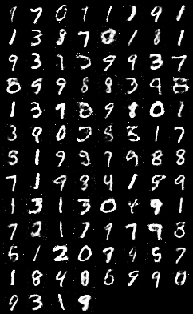
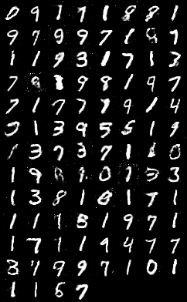
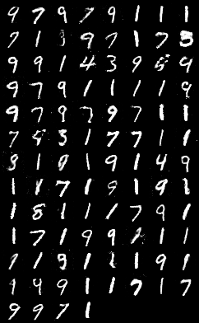
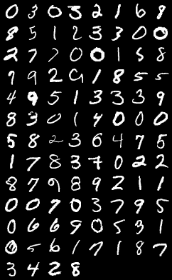
GAN: mnist (without conv net)
ep: 0
ep: 100
ep: 200
ep: 300
ep: 400
ep: 500
ep: 600

Slide 7
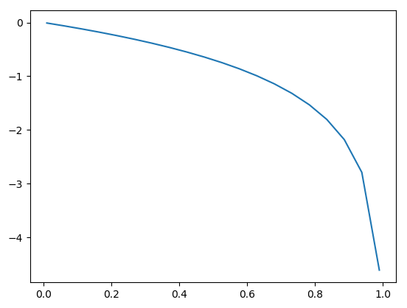
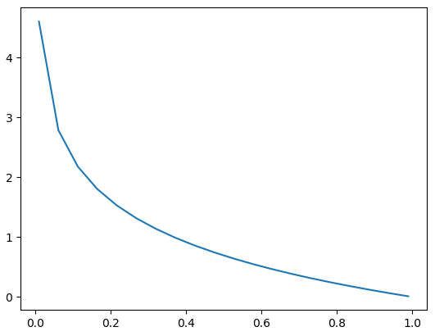


$$log⁡(1−x)$$
$$−log⁡(x)$$
when D(g(z)) < 0.4:
small gradient value
when D(g(z)) < 0.4:
large gradient value

Slide 9
Generator
output
act.
F.tanh(self.map2(x))
logit
linear
self.map2 = nn.Linear(hidden_size, output_size)
hidden
act.
x = F.elu(self.map1(x))
logit
linear
self.map1 = nn.Linear(input_size, hidden_size)
input

