Slide 1
GeoPlot.js

Slide 2
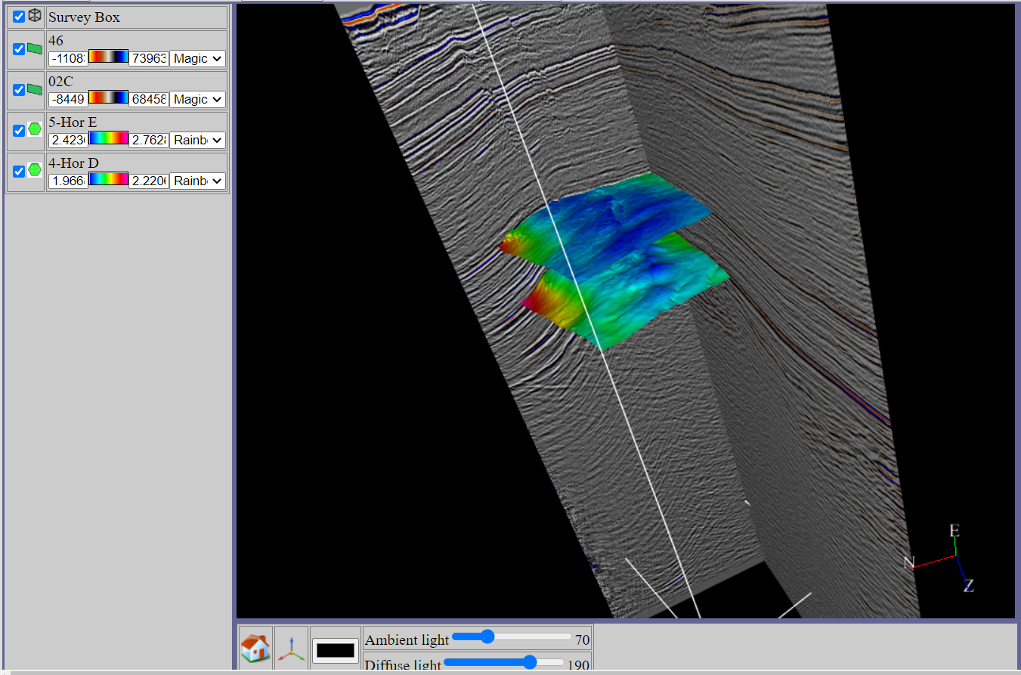
What is GeoPlot.js ?
It’s a JavaScript library to visualise subsurface data in 3D in any web browser
A single minified JavaScript file
No installation or plugins needed
Written in plain vanilla JavaScript not using any UI frameworks like jQuery, Angular, React etc
JSON files as arguments
Think of it as Google map for subsurface data
Front end only

Slide 3

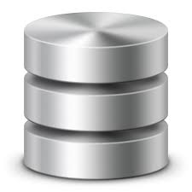

What’s the use of it ?
If your data is on a remote server, you should be able to visualise it without copying the data locally or installing expensive software on your desktop. Just login to the web portal and view them just the way you check emails
As more and more data starts residing in the cloud, there is a need to access and visualise them over the browser instead of any desktop environment
Could be used to make cloud native/SaaS application that runs on the browser without the need of any installation
Ideal for seismic data acquisition companies, national data repositories, oil companies etc.
Can even be used as an user interface for desktop apps as well.

Slide 4
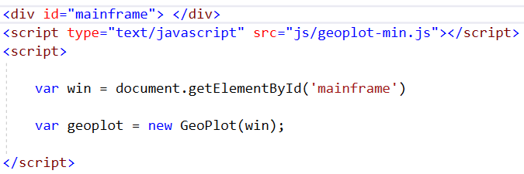
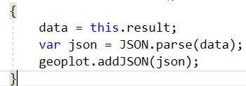
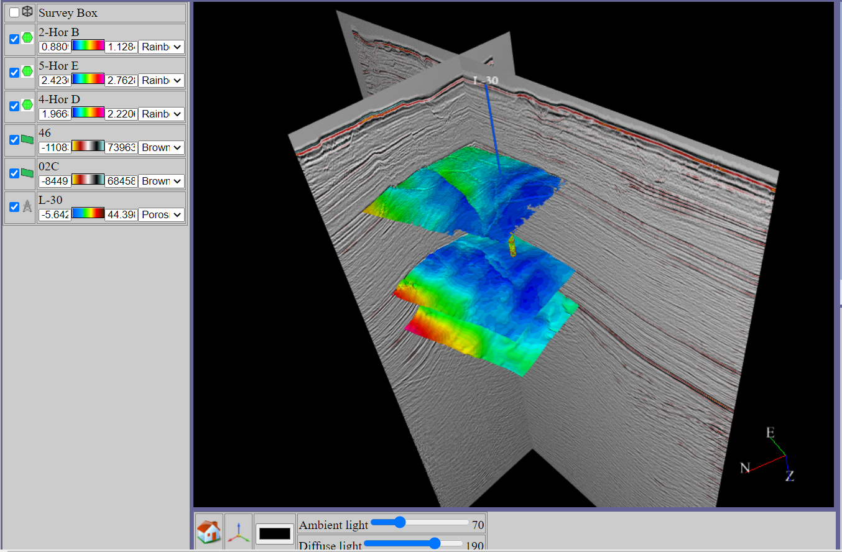
How does it work ?
Accepts JSON files as input, which can be exported from any data store by building appropriate plugins for them.
Currently it exports JSON files from a plugin loaded in OpendTect(open source seismic interpretation system).
It should work for any system which could export the JSON files in the specified format required by the system.
The HTML page creates the object of GeoPlot, just by passing a <div> element as parent, this will create its own window contained in that <div> element
The input data is parsed to form a JSON object which is then added to the plot. The plot then creates the visual object and adds it to the list
JSON

Slide 5
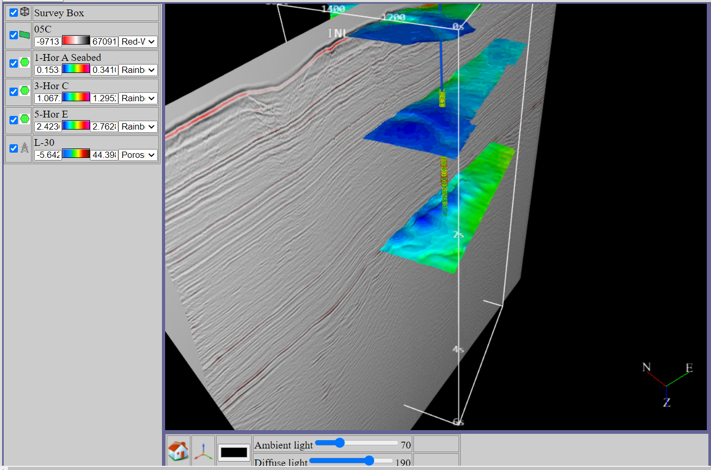
Features
Single minified JavaScript file
Supports seismic 2D/3D data
Surfaces
Wells

Slide 6
What’s the future ?
Nothing concrete has been decided yet, but there can be many ways in which this can be released
Could be released under GPL license
Could be released under any freemium business model, like a some functionalities can be free, whereas others can be paid features
Could be sold as just a front end library
Could also be sold as a complete web app.

Slide 7
Acknowledgements
The subsurface data(seismic, wells and surfaces) has been downloaded from
https://terranubis.com/
Exported to JSON from a plugin built for OpendTect (Open Source Seismic Interpretation system)
https://www.dgbes.com/

