Slide 1
Car Accident Severity Analysis
Applied Data Science Capstone
Final Report

Slide 2
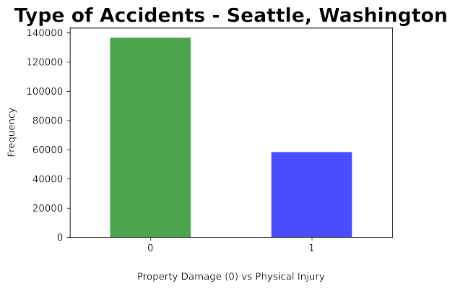
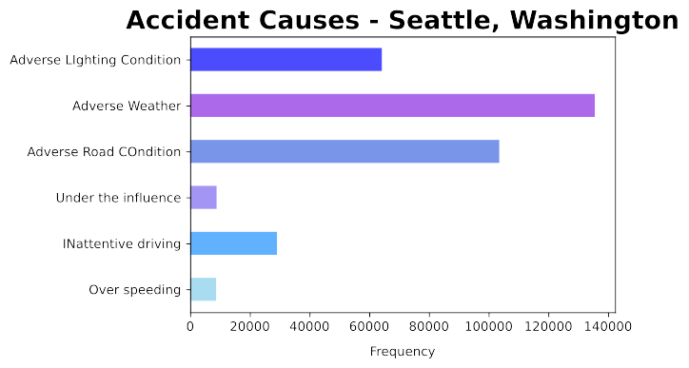
Accidents at Seattle

Slide 3
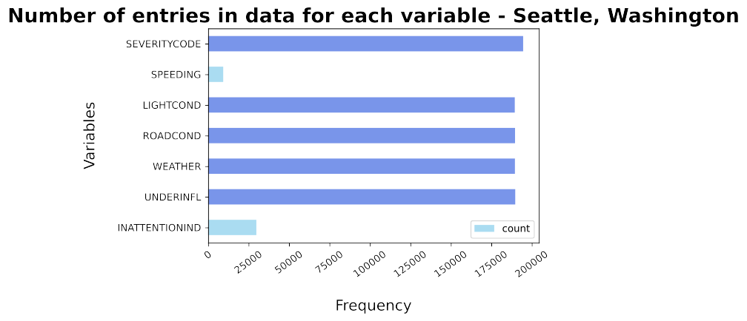
Data Understanding

Slide 4
Feature Selection
Feature Variables | Description
INATTENTIONIND | Whether or not the driver was inattentive (Y/N)
UNDERINFL | Whether or not the driver was under influence (Y/N)
WEATHER | Weather condition during the time of collision (Overcast/Rain/Clear)
ROADCOND | Road condition during the collision (Wet/Dry)
LIGHTCOND | Light conditions during the collision (Lights on/ Dark with light on)
SPEEDING | Whether the car wasabove the speed limit at the time of collision (Y/N)

Slide 5
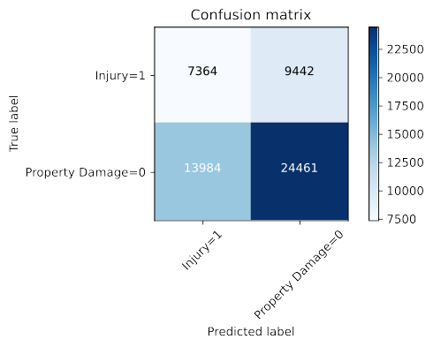
Logistic Regression
 | Precision | Recall | F1 - score
0 | 0.64 | 0.72 | 0.68
1 | 0.44 | 0.34 | 0.39
Accuracy | 0.58
Micro Avg | 0.54 | 0.53 | 0.53
Weighted Avg | 0.56 | 0.58 | 0.56

Slide 6
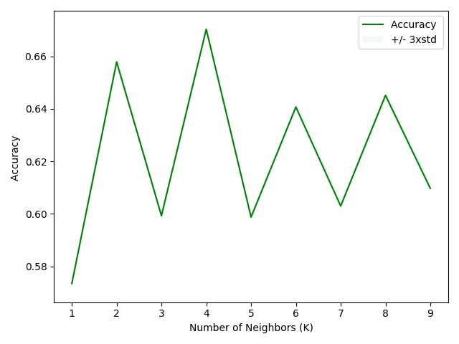
k-Nearest Neighbor
 | Precision | Recall | F1 - score
0 | 0.92 | 0.70 | 0.80
1 | 0.08 | 0.32 | 0.13
Accuracy | 0.67
Micro Avg | 0.50 | 0.51 | 0.46
Weighted Avg | 0.86 | 0.67 | 0.75

Slide 7
Comparison
Algorithm | Average F1 score | Property Damage (0) vs Injury (1) | Precision | Recall
Decision Tree | 0.56 | 0 | 0.64 | 0.72
 |  | 1 | 0.44 | 0.34
Logistic Regression | 0.60 | 0 | 0.72 | 0.67
 |  | 1 | 0.35 | 0.41
K-Nearest Neighbour | 0.75 | 0 | 0.93 | 0.70
 |  | 1 | 0.08 | 0.32

Slide 8
Thank You

