Slide 1
MIND BLOOM
A mental wellness companion app
Minor Project - Semester 5
Team Members:
Heer Ranpara
Jeel Ravrani
Vidhi Rathod
Jiya Shethiya
Dharmi Vasiyani

Slide 2
Introduction:
Mind Bloom is a mental wellness companion application designed to help users understand and manage their everyday mental well-being.
The application combines self-reflection, mental health assessments, meditation, exercise, journaling and conversational support in a single platform.
It uses KNN-based assessment scoring and personalized activity suggestions to provide a more user-specific wellness experience.
Scope:
Daily journaling and mood tracking
PHQ-9 and GAD-7 assessments
Daily mental wellness check-in
Meditation and mindfulness activities
AI-based chat companion
Personalized physical and mental exercise
Gratitude, sleep and habit tracking
Crisis / emergency support information and contact numbers
Video Companion as a future extension(currently working on it.)

Slide 3
Problems identified
Fragmented Wellness Tools
Users often need different applications for journaling, meditation, assessment, exercise and habit tracking.
2. Limited Personalization
Many existing wellness applications provide general suggestions instead of considering the user's recent activity and assessment results.
3. Lack of Continuity
Mood, assessment results, meditation and physical activity are often maintained separately.
4. Limited Immediate Support
Traditional wellness applications may not provide an interactive conversational companion whenever the user needs one.
5. Difficulty Tracking Progress
Users may not have a simple visual way to see consistency and improvement in their wellness activities.
Mind Bloom aims to bring these functions together in one integrated platform.

Slide 4
Advantages
DISADVANTAGES
Multiple wellness features available in one application
Personalized exercise suggestions
KNN-based assessment scoring
Interactive AI chat companion
Streaming responses for a more natural conversation
Crisis-keyword detection for safety-sensitive situations
Visual exercise streak and tree-growth system
Persistent crisis / emergency button
Supports different types of journal media
The application is not a replacement for professional medical care.
AI-generated responses may require further validation and monitoring.
Personalization depends on the accuracy of user-provided information.
Some advanced features are still under development.
Secure storage and privacy protection are required for sensitive user data.

Slide 5
Modules of mind bloom
Authentication
Username and password
User account management
Dashboard
Daily insight
Weather information
Notifications
Chat Companion — LIVE
Warm Companion persona
Calming Doctor persona
Male / female selection
Google Gemini API
Streaming responses
Crisis-keyword detection
Assessment
Full PHQ-9 and GAD-7
KNN-based scoring
Daily Check-in with 4 quick questions
Video Companion - PLANNED
Guided visual wellness sessions
Future interactive support features
Currently under development
Journal
Day-wise journal entries
Text, photo, video and audio
Live audio recording
Mood Checker
Meditation with stopwatch and countdown timer
Music support
Exercise & Movement — LIVE
Physical exercises
Mental wellness exercises
Personalized suggestions
Growing-tree streak visualization
Monthly exercise-minute tracking
End-of-month reward card
Animated human figures for exercises
Additional Wellness Tools
Gratitude Log
Sleep Tracker
Habit Tracker
Resource Library
Weekly Reflection
Crisis / Emergency
Persistent emergency button
Helpline information
Safety-focused support flow

Slide 6
Tools and technology used
Frontend
HTML
CSS
JavaScript
Backend
Python
Flask
Database
PostgreSQL / SQLite
Machine Learning
Scikit-learn
K-Nearest Neighbours (KNN)
Pandas
NumPy
Pickle
Artificial Intelligence
Google Gemini API
Streaming responses
Crisis-keyword detection
Storage & Media
Static file uploads
Text, image, video and audio data
Development
Web-based application architecture
Modular backend and frontend design

Slide 7
→ Authentication
→ Dashboard
→ Journal
→ Assessment
→ Chat Companion
→ Video Companion — Planned
→ Exercise & Movement
→ Additional Wellness Tools
→ Crisis / Emergency
Client / User Interface
↓
Flask Backend
↓
Database — PostgreSQL / SQLite
The backend also communicates with:
KNN Model → Assessment scoring
Google Gemini API → Chat Companion
Static Upload Storage → Journal media
Module Map
System Architecture
User → Flask Backend → Processing / Database / AI / ML → Response → User

Slide 8
Activity Status
FEATURE STATUS
Daily Check-in
↓
Collect User Responses
↓
Suggestion Engine
↓
Analyse Recent Assessment + Check-in + Meditation Activity
↓
Suggest Physical / Mental Exercise
↓
User Completes Exercise
↓
Update Exercise Minutes & Streak
↓
Tree Growth Visualization
↓
Monthly Reward Card
LIVE:
Chat Companion
Exercise & Movement
Assessment
Journal
Meditation
Daily Check-in
UNDER DEVELOPMENT:
Video Companion

Slide 9
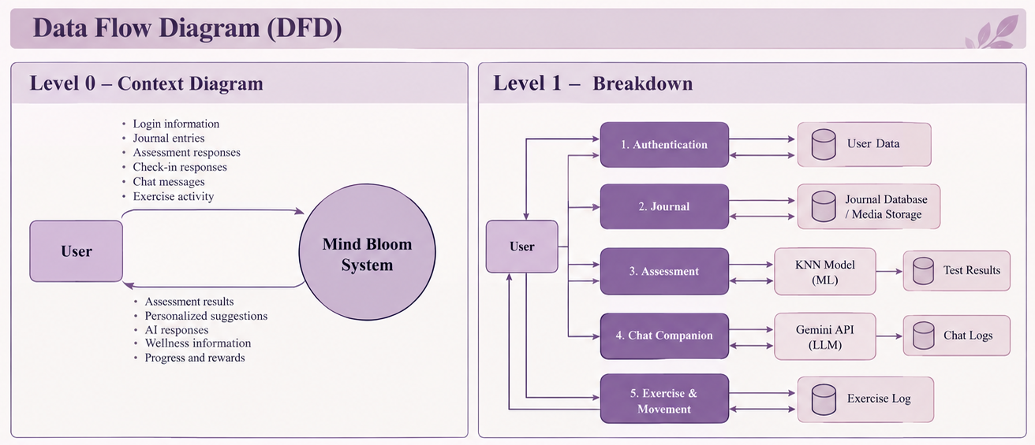

Slide 10
Conclusion
Mind Bloom provides a single platform for mental wellness and self-care.
Combines journaling, meditation, assessments, AI chat, exercise, and wellness tracking.
Uses PHQ-9, GAD-7 and KNN-based analysis for personalized suggestions.
Gemini-powered Chat Companion provides interactive AI support.
Exercise and wellness modules encourage healthy and consistent daily habits.
Crisis support features help promote safer user interaction.
The system focuses on personalization, accessibility, privacy, and continuous self-care.
FUTURE SCOPE:
Video Companion
Improved ML recommendations
More wellness features
Better personalization
Multilingual support

