Slide 1




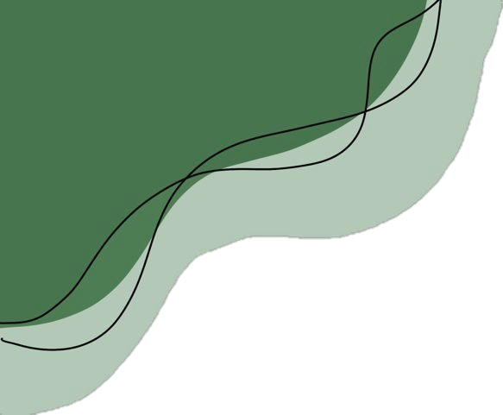

Bloom Within, Shine Beyond!

Slide 2
Mind Bloom is a mental wellness companion application designed to help users understand their emotions, monitor their mental well-being, and build healthier daily habits through mood assessment, journaling, meditation, and AI-powered support.

Slide 3
User Interaction & Form Validation:
The user interacts with Mind Bloom by clicking buttons or entering information. JavaScript checks whether the required form fields are filled in before submission.
Request Handling:
The browser sends the request or login credentials to the appropriate Flask route in app.py. Flask processes the request and uses authentication and authorization checks, such as @login_required, to protect restricted pages.
Authentication & Database Op:
Flask verifies login credentials against stored account information and uses SQLAlchemy to retrieve, insert, update, or delete data in the database. After successful login, the user is redirected to the dashboard.
Response Generation:
Flask processes the request and either renders a Jinja template into an HTML page or returns JSON data to the frontend.
Dashboard Display & Dynamic Updates:
The dashboard displays relevant user information and available features. JavaScript uses fetch() to communicate with Flask APIs and update parts of the page without reloading the entire page.
Application
Workflow
01
02
03
04
05

Slide 4
User Interaction & Form Validation:
The user interacts with Mind Bloom by clicking buttons or entering information. JavaScript checks whether the required form fields are filled in before submission.
Request Handling:
The browser sends the request or login credentials to the appropriate Flask route in app.py. Flask processes the request and uses authentication and authorization checks, such as @login_required, to protect restricted pages.
Authentication & Database Op:
Flask verifies login credentials against stored account information and uses SQLAlchemy to retrieve, insert, update, or delete data in the database. After successful login, the user is redirected to the dashboard.
Response Generation:
Flask processes the request and either renders a Jinja template into an HTML page or returns JSON data to the frontend.
Dashboard Display & Dynamic Updates:
The dashboard displays relevant user information and available features. JavaScript uses fetch() to communicate with Flask APIs and update parts of the page without reloading the entire page.
01
02
03
04
05

Slide 5
Technology Stack of Mind Bloom

Slide 6

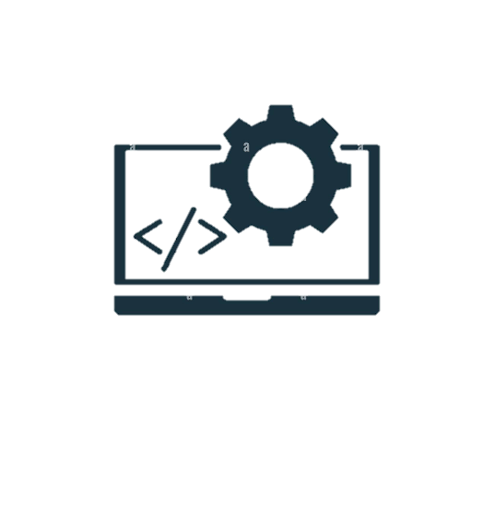
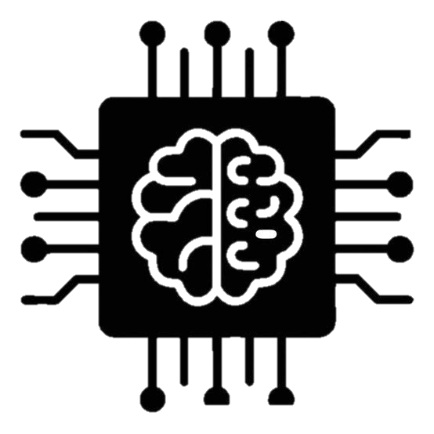
1. Frontend Technologies — HTML, CSS, JavaScript
HTML structures the web pages and their content.
CSS styles the interface, colours, layouts, and typography.
JavaScript adds interactive features and validates form inputs.
It helps users navigate different modules of Mind Bloom.
JavaScript's fetch() enables communication with the Flask backend without reloading the entire page.

Slide 7
2. Backend Technologies — Python, Flask, Jinja2
Python handles the application's main logic and processing.
Flask manages URL routes, requests, and responses.
It handles login functionality and communication between the frontend and database.
Jinja2 dynamically generates HTML pages using backend data.
Together, these technologies connect the user interface with the application's core functionality.

Slide 8
3. Database Technologies — SQL Database, SQLAlchemy
The SQL database stores structured application data.
It can store user accounts, assessment results, and other application records.
SQLAlchemy connects Python with the database using ORM operations.
It supports retrieving, inserting, updating, and deleting records.
This helps manage application data in an organized manner.

Slide 9
4. Machine Learning — Pandas, NumPy, Scikit-learn, Pickle
Pandas loads and processes survey datasets.
NumPy supports numerical operations and data manipulation.
Scikit-learn provides tools to implement the K-Nearest Neighbors (KNN) classification model.
The model uses survey responses to predict a mental health condition category based on learned patterns.
Pickle saves and loads the trained model for use in the application.

Slide 10
5. Deployment & Development Tools — GitHub, Render, Android Studio, Kotlin
GitHub stores the project's source code and tracks changes.
Render hosts the Flask web application online.
Android Studio provides the environment for Android app development.
Kotlin is used to write the Android application's code.
These tools support source-code management, web deployment, and access to the project through an Android application.

Slide 11
BEHIND
THE PREDICTIONS
6. Algorithm Selection:
1. Dataset Collection
3. Data Preprocessing
4. Feature Selection:
8. Nearest NeighboursŚŚŚŚ
10. Model Integration
2. Data Loading
7. Distance Calculation
9. Classification
11. Result Display
5. Dataset Splitting

Slide 12
6. Algorithm Selection:
1. Dataset Collection
7. Distance Calculation
2. Data Loading
BEHIND
THE PREDICTIONS
3. Data Preprocessing
8. Nearest NeighboursŚŚŚŚ
9. Classification
4. Feature Selection:
10. Model Integration
5. Dataset Splitting
11. Result Display

Slide 14
DATABASE

Slide 15
DATABASE
User Data Storage: Manages user account information for registration and login.
Authentication Support: Helps Flask verify user credentials during login.
Assessment Data: Supports storing and retrieving mental wellness assessment information.
Journal Management: Supports journal data management if journal entries are stored in the database.
Flask Integration: Connects the database with Flask routes in app.py.
SQLAlchemy ORM: Enables database operations through Python objects instead of writing every query manually.
CRUD Operations: Supports creating, reading, updating, and deleting database records.
Protected Access: Works with login protection, such as @login_required, to restrict access to authorized users.
Data Retrieval: Fetches relevant records when the application needs to display information.
Data Organization: Helps keep application information structured and manageable.

Slide 16

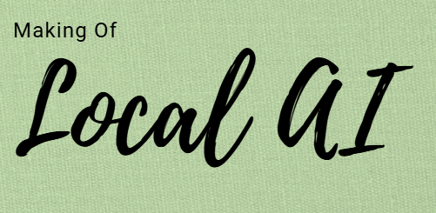


Slide 17
Mind Bloom uses Ollama to run the Qwen language model locally for AI-powered chatbot responses. The Flask backend connects the chatbot interface with the model to process user messages and generate replies. This approach reduces dependence on external AI APIs, helps avoid API quota limitations, and can improve privacy when processing remains on the local machine. Once the model is downloaded, it can work offline, depending on the application's configuration.

Slide 19
Deployment : From code to cloud

Slide 20

Deployment : From code to cloud
GitHub Repository: Stores the Mind Bloom source code and tracks project changes.
Render Hosting: Deploys the Flask web application and makes it accessible online.
Public URL: Allows users to access Mind Bloom through a web browser.
Automatic Deployment: Render can redeploy the website when configured changes are pushed to GitHub.
UptimeRobot Monitoring: Periodically checks the deployed website's availability.
Remote Accessibility: Users can access the hosted website without installing Python or running the Flask server locally.

Slide 21

Android Studio
MainActivity.kt
Application
AndroidManifest.xml
activity_main.xml
APK file

Slide 22
01. Android Studio
Android Studio
The IDE used to develop, test, and build the Mind Bloom Android application.

Slide 23
Android Studio
02. MainActivity.kt:
Contains the Kotlin code that controls the app's main screen and handles application behaviour.

Slide 24
Android Studio
03. AndroidManifest.xml:
Defines essential app information, including permissions, activities, and application configuration.

Slide 25
Android Studio
04. activity_main.xml:
Defines the layout and visual structure of the app's main screen.

Slide 26
Android Studio
05. APK File:
The final installation file generated to install and run Mind Bloom on compatible Android devices.

Slide 27

Presented By:
Heer Ranpara
Vidhi Rathod
Jeel Ravrani
Jiya Shethiya
Dharmi Vasiyani
Faculty Guide:
Darshita Madam
THANK YOU

