Slide 1


Slide 2
PROBLEM
A guy who is new to a place and admires to eat the best and the famous street food of the city will face problem in finding a shop that is famous and also have reasonable rates .
Secondly that guy may also find problem in finding a laundary that is the basic nesscaity of daily life.

Slide 3

Idea???
Lets join the street vendors and laundary services together so that who so enters a new city may not face such problems

Slide 4
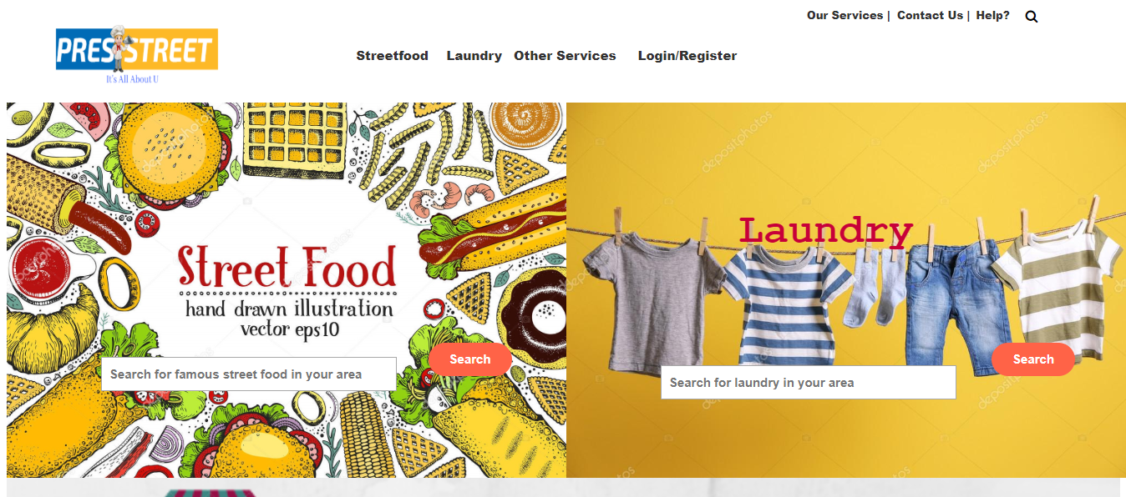
Home Page

Slide 5
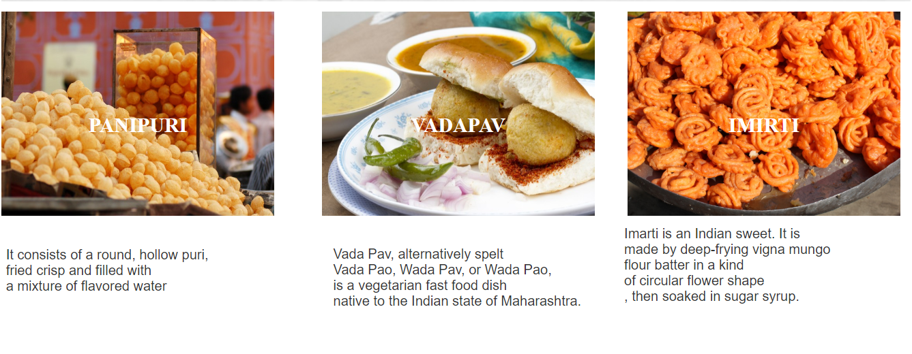

Slide 6


Slide 7
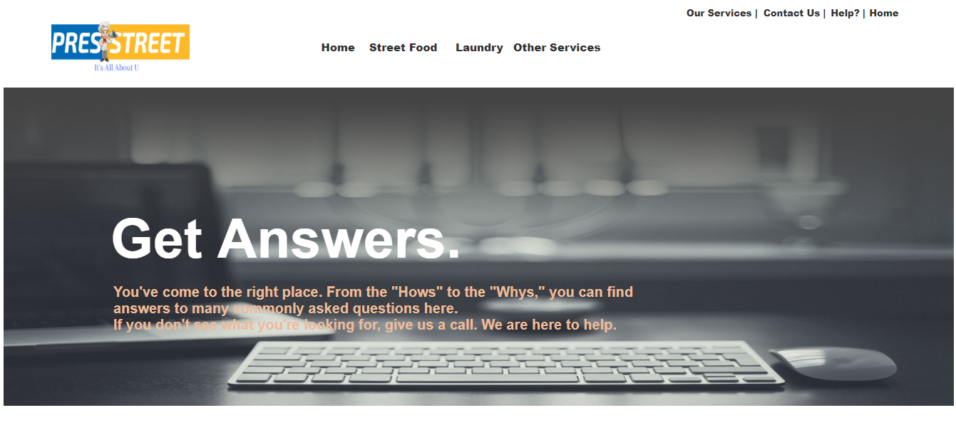

Slide 8
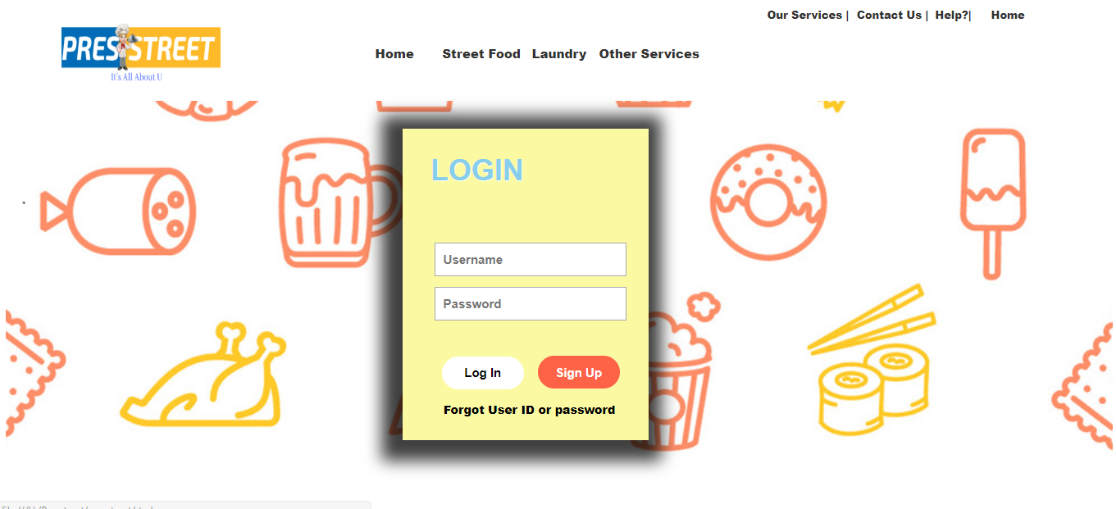

Slide 9
Thank-You!!

