Slide 1
Understanding bird behaviors from accelerometer data
Zhongqi Miao

Slide 2
Outline
Goal and tasks
Methods overview
Plans for the summer

Slide 3
Ultimate goal
We want to compare bird behaviors under different circumstances.
Geographical patterns
Life stage
Migration stage
Disease states
Through:
Foraging-resting patterns
Energy expenditure

Slide 4
Tasks
We want to classify bird behavioral modes (flying, resting, etc.) from collected acceleration signals
In supervised manner
In unsupervised manner
In semi-supervised manner
We want to transform the data into interpretable feature representation (energy expenditure)
Hand crafted features
In unsupervised manner
In self-supervised manner

Slide 5
Methods overview
We want to classify bird behavioral modes (flying, resting, etc.) from collected acceleration signals
In supervised manner
In unsupervised manner
In semi-supervised manner
All data – label methods
Support Vector Machine
Decision Trees
Nearest Neighbors
Neural Networks
Gaussian Mixture Model
Hidden Markov Model
…

Slide 6
Methods overview
This branch of method is the best choice for this task if we have enough labeled data.
It is expensive and sometimes impossible to collect ground truthed labels for training.
The more behavioral modes to be studied, the more labeled data are needed.
Vast amount of unlabeled data may be wasted.
We want to classify bird behavioral modes (flying, resting, etc.) from collected acceleration signals
In supervised manner
In unsupervised manner
In semi-supervised manner

Slide 7
Methods overview
We want to classify bird behavioral modes (flying, resting, etc.) from collected acceleration signals
In supervised manner
In unsupervised manner
In semi-supervised manner

Slide 8
Methods overview
We want to classify bird behavioral modes (flying, resting, etc.) from collected acceleration signals
In supervised manner
In unsupervised manner
In semi-supervised manner
Data similarity clustering methods
Nearest neighbor
Guassian Mixture model
…

Slide 9
Methods overview
Simple unsupervised approaches might not be very suitable for this task.
The clusters generated by the methods are not guaranteed to correspond to the target behavioral modes.
Depending on study scales, some behavioral modes like foraging usually consist of multiple sub-behavioral modes like walking, flying.
We want to classify bird behavioral modes (flying, resting, etc.) from collected acceleration signals
In supervised manner
In unsupervised manner
In semi-supervised manner

Slide 10
Methods overview
We want to classify bird behavioral modes (flying, resting, etc.) from collected acceleration signals
In supervised manner
In unsupervised manner
In semi-supervised manner
Notes:
Behavioral modes at different scale canonical activity modes and fundamental

Slide 11
Methods overview
We want to classify bird behavioral modes (flying, resting, etc.) from collected acceleration signals
In supervised manner
In unsupervised manner
In semi-supervised manner
Supervised classification with the help of unlabeled data
Gaussian Mixture Model
Hidden Markov Model
Bayes Model
Semi-Supervised Support Vector Machine
…

Slide 12
Methods overview
We want to classify bird behavioral modes (flying, resting, etc.) from collected acceleration signals
In supervised manner
In unsupervised manner
In semi-supervised manner
This branch of methods are the most feasible for this task
The classification models are trained on both labeled and unlabeled data.
Large amount of labeled data is not necessary under this circumstance.
Accuracy can be affected.

Slide 13
Methods overview
We want to classify bird behavioral modes (flying, resting, etc.) from collected acceleration signals
In supervised manner
In unsupervised manner
In semi-supervised manner

Slide 14
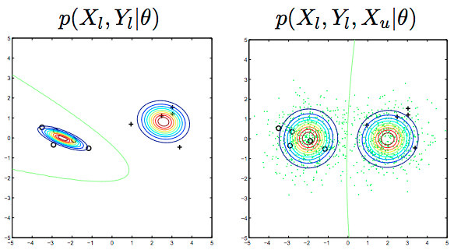
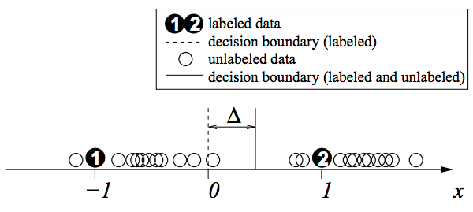
Brief intro to semi-supervised learning
Assuming each class is a coherent distribution (e.g. Gaussian)
With and without unlabeled data, the decision boundary can shift

Slide 15
Methods overview
We want to transform the data into interpretable feature representation (energy expenditure)
Hand crafted features
In unsupervised manner
In self-supervised manner
Conventional signal processing methods
Fourier transformation
Statistical features
…

Slide 16
Methods overview
We want to transform the data into interpretable feature representation (energy expenditure)
Hand crafted features
In unsupervised manner
In self-supervised manner
This branch of methods require prior knowledge of different animal to construct features.
Data of different animal species might need different design of features.

Slide 17
Methods overview
We want to transform the data into interpretable feature representation (energy expenditure)
Hand crafted features
In unsupervised manner
In self-supervised manner

Slide 18
Methods overview
We want to transform the data into interpretable feature representation (energy expenditure)
Hand crafted features
In unsupervised manner
In self-supervised manner
Unsupervised feature learning
Hidden Markov Mode
Auto-encoder
…

Slide 19
Methods overview
We want to transform the data into interpretable feature representation (energy expenditure)
Hand crafted features
In unsupervised manner
In self-supervised manner
Very feasible with out the constraints from focusing behavioral modes
This branch of methods captures important information and internal structures from the data without any supervision

Slide 20
Methods overview
We want to transform the data into interpretable feature representation (energy expenditure)
Hand crafted features
In unsupervised manner
In self-supervised manner

Slide 21
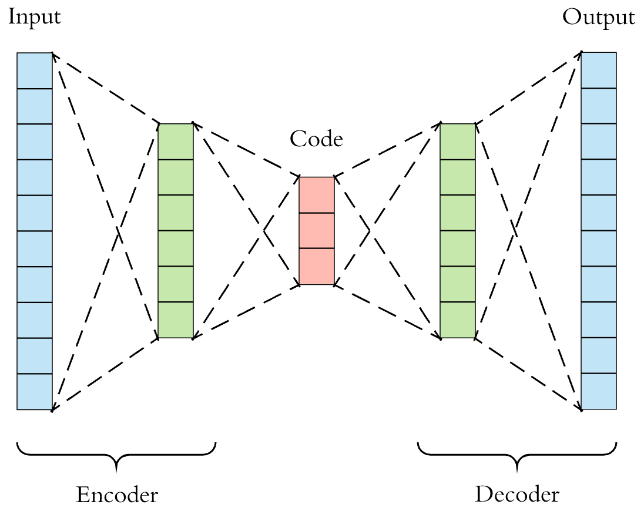
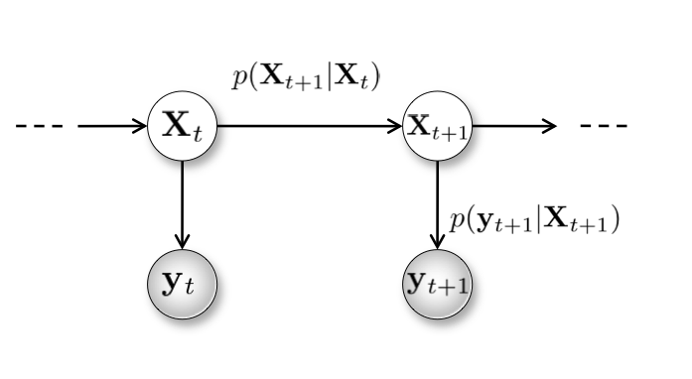
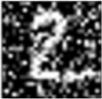

Brief intro to HMM and Auto-encoder
Hidden Markov Model
Auto-encoder

Slide 22
Methods overview
We want to transform the data into interpretable feature representation (energy expenditure)
Hand crafted features
In unsupervised manner
In self-supervised manner
Learning internal structures from data
Context learning
Non-parametric feature learning model
…

Slide 23
Methods overview
We want to transform the data into interpretable feature representation (energy expenditure)
Hand crafted features
In unsupervised manner
In self-supervised manner
Not constrained by focusing behavioral modes either.
This branch of methods learns internal structures with input data as the supervision.
Since there are supervision, the methods can learn more information than pure unsupervized methods.

Slide 24
Methods overview
We want to transform the data into interpretable feature representation (energy expenditure)
Hand crafted features
In unsupervised manner
In self-supervised manner

Slide 25
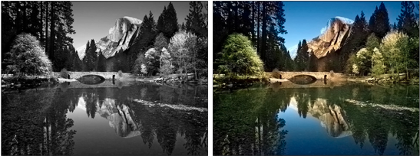
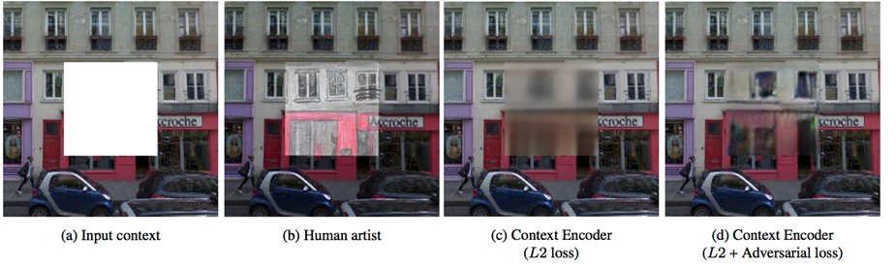
Brief intro to self-supervised methods
Context Learning:
input
output

Slide 26
Propositions
If we really want to study specific behaviors:
Semi-supervised learning + new data collection (at least a few)
Use unsupervised and self-supervised learning methods to learn feature representations of the data, and connect the results with bird energy expenditure or other more interpretable parameters for further studies.

Slide 27
Summer plan details
Transferring classification model trained on the labeled 10 hz data to the rest unlabeled 4 hz data to get a general sense of the whole dataset.
Extract statistical features as baselines.
Explore unsupervised feature representation using HMM and auto-encoder.
Explore self-supervised feature representation using one-channel to three-channel self-supervision, and non-parametric self-learning features.
Compare the three kinds of feature representations and explore their relationships with animal energy expenditures.

Slide 28
Expectations
Statistical features (e.g. frequency and phase changes from Fourier transformation) can provide basic information of animal energy expenditure.
The efficacy of other feature representations is not clear until I do the experiments.
If the experiments prove those feature representations can provide profound information of animal energy expenditure and other behavioral parameters, one paper on the methods will be produced.
Then future studies coupling multiple animal parameters will be extended.
If none of the feature representations can extract enough information of animal energy expenditure, I propose we collect more labeled data.

Slide 29
Thank you!

Slide 30
Notes
Study based on animal energy expenditure
Domain adaptation (model transfer across different animal species) and auto-encoder （Rahman et al. 2016)
This can be used for classification of the 40hz data using the 10hz model

Slide 31
What I will do
Use auto-encoder feature representations on the labeled data, and compare it with conventional statistical features and the features used by Hezi.
If it works, it is possible to encode input signals into interpretable representations
Then apply it to unlabeled data, and do unsupervised learninng
Try Hidden Markov Model with multiple kinds of feature representations
Taking phase of the signal into account
Mooney-face-like representations
Signal compression

