Slide 1
Understanding bird behaviors from accelerometer data
Zhongqi Miao

Slide 2
Outline
Goal and tasks
Methods overview
Plans for the summer

Slide 3
Ultimate goal
We want to compare bird behaviors under different circumstances.
Geographical patterns
Life stage
Migration stage
Disease states
Through:
Specific behavioral modes e.g. foraging-resting patterns
Low-level parameters e.g. energy expenditure

Slide 4
Tasks
We want to classify bird behavioral modes (flying, resting, etc.) from collected acceleration signals
We want to transform acceleration signals into interpretable feature representation (e.g. energy expenditure)

Slide 5
Methods
We want to classify bird behavioral modes (flying, resting, etc.) from collected acceleration signals
In supervised manner
In unsupervised manner
In semi-supervised manner
We want to transform acceleration signals into interpretable feature representation (e.g. energy expenditure)
Hand crafted features
In unsupervised manner
In self-supervised manner

Slide 6
Propositions
We want to classify bird behavioral modes (flying, resting, etc.) from collected acceleration signals
In supervised manner
In unsupervised manner
In semi-supervised manner
We want to transform acceleration signals into interpretable feature representation (e.g. energy expenditure)
Hand crafted features
In unsupervised manner
In self-supervised manner

Slide 7
Propositions
We want to classify bird behavioral modes (flying, resting, etc.) from collected acceleration signals
In supervised manner
In unsupervised manner
In semi-supervised manner
We want to transform acceleration signals into interpretable feature representation (e.g. energy expenditure)
Hand crafted features
In unsupervised manner
In self-supervised manner
EXPENSIVE
UNINTERPRETABLE
SPECIES SPECIFIC

Slide 8
Propositions
We want to classify bird behavioral modes (flying, resting, etc.) from collected acceleration signals
In supervised manner
In unsupervised manner
In semi-supervised manner
We want to transform acceleration signals into interpretable feature representation (e.g. energy expenditure)
Hand crafted features
In unsupervised manner
In self-supervised manner
EXPENSIVE
UNINTERPRETABLE
Use both labeled and unlabled data
SPECIES SPECIFIC
General and no supervision
General and uses data as supervision

Slide 9
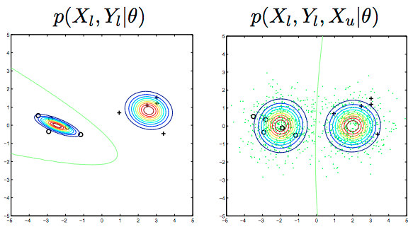
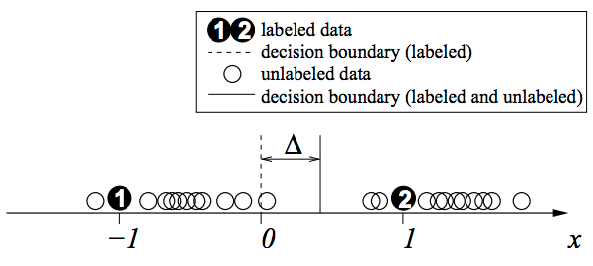
Brief intro to semi-supervised learning
Assuming each class is a coherent distribution (e.g. Gaussian)
With and without unlabeled data, the decision boundary can shift

Slide 10
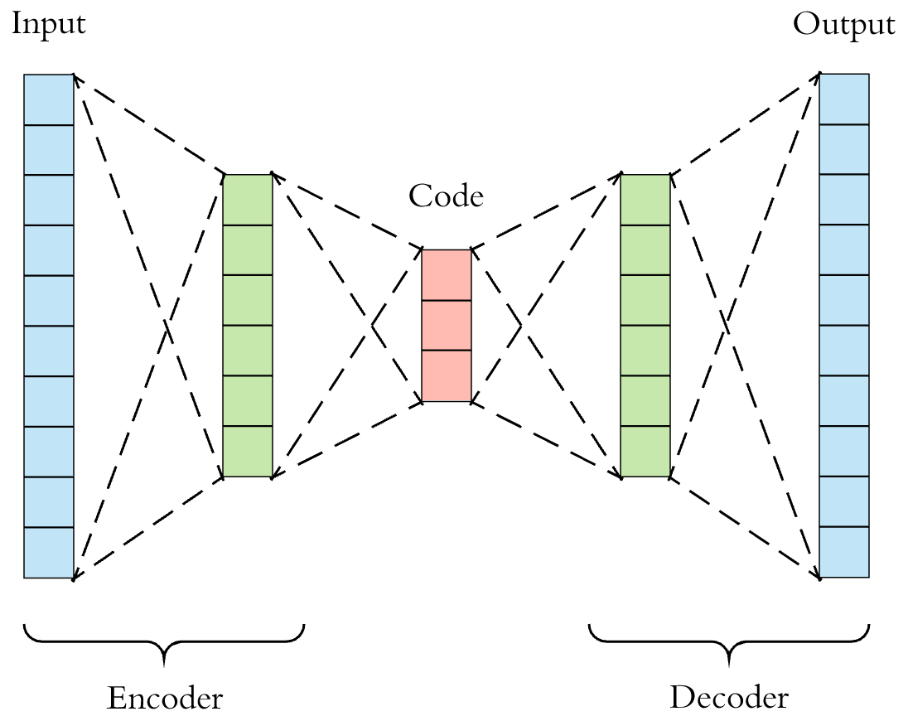
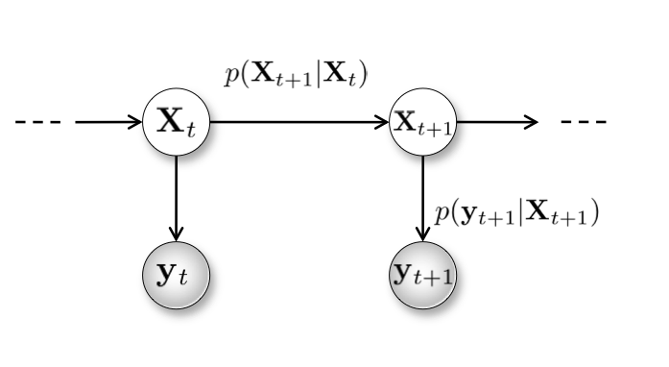
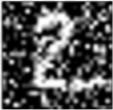

Brief intro to unsupervised features
Hidden Markov Model
Auto-encoder

Slide 11
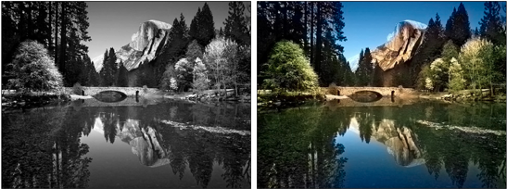
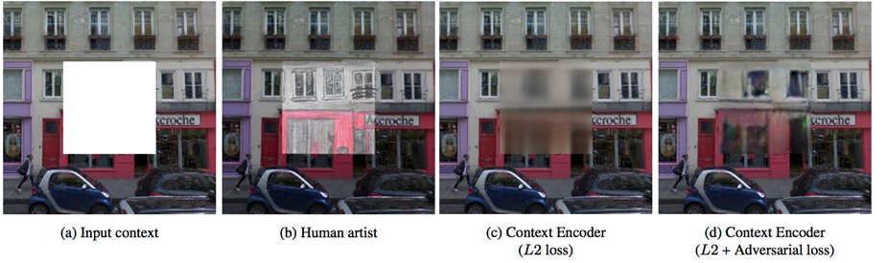
Brief intro to self-supervised methods
Colorization:
input
output
Content filling:

Slide 12
Summer plan details
Transferring classification model trained on the labeled 10 hz data to the rest unlabeled 4 hz data to get a general sense of the whole dataset.
Extract hand-crafted features (e.g. statistical features and energy expenditures) as baselines.
Explore unsupervised feature representation using HMM and auto-encoder.
Explore self-supervised feature representation using one-channel to three-channel self-supervision, and non-parametric self-learning features.
Explore self-supervised feature representation using one-channel to three-channel self-supervision, and non-parametric self-learning features.
Explore semi-supervised learning methods if we have more data.

Slide 13
Summer plan details
Transferring classification model trained on the labeled 10 hz data to the rest unlabeled 4 hz data to get a general sense of the whole dataset.
Extract hand-crafted features (e.g. statistical features and energy expenditures) as baselines.
Explore unsupervised feature representation using HMM and auto-encoder.
Explore self-supervised feature representation using one-channel to three-channel self-supervision, and non-parametric self-learning features.
Explore self-supervised feature representation using one-channel to three-channel self-supervision, and non-parametric self-learning features.
Explore semi-supervised learning methods if we have more data.

Slide 14
Summer plan details
Transferring classification model trained on the labeled 10 hz data to the rest unlabeled 4 hz data to get a general sense of the whole dataset.
Extract hand-crafted features (e.g. statistical features and energy expenditures) as baselines.
Explore unsupervised feature representation using HMM and auto-encoder.
Explore self-supervised feature representation using one-channel to three-channel self-supervision, and non-parametric self-learning features.
Explore self-supervised feature representation using one-channel to three-channel self-supervision, and non-parametric self-learning features.
Explore semi-supervised learning methods if we have more data.

Slide 15
Summer plan details
Transferring classification model trained on the labeled 10 hz data to the rest unlabeled 4 hz data to get a general sense of the whole dataset.
Extract hand-crafted features (e.g. statistical features and energy expenditures) as baselines.
Explore unsupervised feature representation using HMM and auto-encoder.
Explore self-supervised feature representation using one-channel to three-channel self-supervision, and non-parametric self-learning features.
Explore self-supervised feature representation using one-channel to three-channel self-supervision, and non-parametric self-learning features.
Explore semi-supervised learning methods if we have more data.

Slide 16
Summer plan details
Transferring classification model trained on the labeled 10 hz data to the rest unlabeled 4 hz data to get a general sense of the whole dataset.
Extract hand-crafted features (e.g. statistical features and energy expenditures) as baselines.
Explore unsupervised feature representation using HMM and auto-encoder.
Explore self-supervised feature representation using one-channel to three-channel self-supervision, and non-parametric self-learning features.
Explore self-supervised feature representation using one-channel to three-channel self-supervision, and non-parametric self-learning features.
Explore semi-supervised learning methods if we have more data.

Slide 17
Summer plan details
Transferring classification model trained on the labeled 10 hz data to the rest unlabeled 4 hz data to get a general sense of the whole dataset.
Extract hand-crafted features (e.g. statistical features and energy expenditures) as baselines.
Explore unsupervised feature representation using HMM and auto-encoder.
Explore self-supervised feature representation using one-channel to three-channel self-supervision, and non-parametric self-learning features.
Explore self-supervised feature representation using one-channel to three-channel self-supervision, and non-parametric self-learning features.
Explore semi-supervised learning methods if we have more data.

Slide 18
Summer plan details
Transferring classification model trained on the labeled 10 hz data to the rest unlabeled 4 hz data to get a general sense of the whole dataset.
Extract hand-crafted features (e.g. statistical features and energy expenditures) as baselines.
Explore unsupervised feature representation using HMM and auto-encoder.
Explore self-supervised feature representation using one-channel to three-channel self-supervision, and non-parametric self-learning features.
Explore self-supervised feature representation using one-channel to three-channel self-supervision, and non-parametric self-learning features.
Explore semi-supervised learning methods if we have more data.

Slide 19
Expectations
Statistical features (e.g. frequency and phase changes from Fourier transformation) can provide basic information of animal energy expenditure.
The efficacy of other feature representations is not clear until I do the experiments.
If the experiments prove those feature representations can provide profound information of animal energy expenditure and other behavioral parameters, one paper on the methods will be produced.
Then future studies coupling multiple animal parameters will be extended.
If none of the feature representations can extract enough information of animal energy expenditure, I propose we collect more labeled data, and I will then explore semi-supervised methods.

Slide 20
Thank you!

Slide 21
Notes
Study based on animal energy expenditure
Domain adaptation (model transfer across different animal species) and auto-encoder （Rahman et al. 2016)
This can be used for classification of the 40hz data using the 10hz model

Slide 22
What I will do
Use auto-encoder feature representations on the labeled data, and compare it with conventional statistical features and the features used by Hezi.
If it works, it is possible to encode input signals into interpretable representations
Then apply it to unlabeled data, and do unsupervised learninng
Try Hidden Markov Model with multiple kinds of feature representations
Taking phase of the signal into account
Mooney-face-like representations
Signal compression

