Slide 1
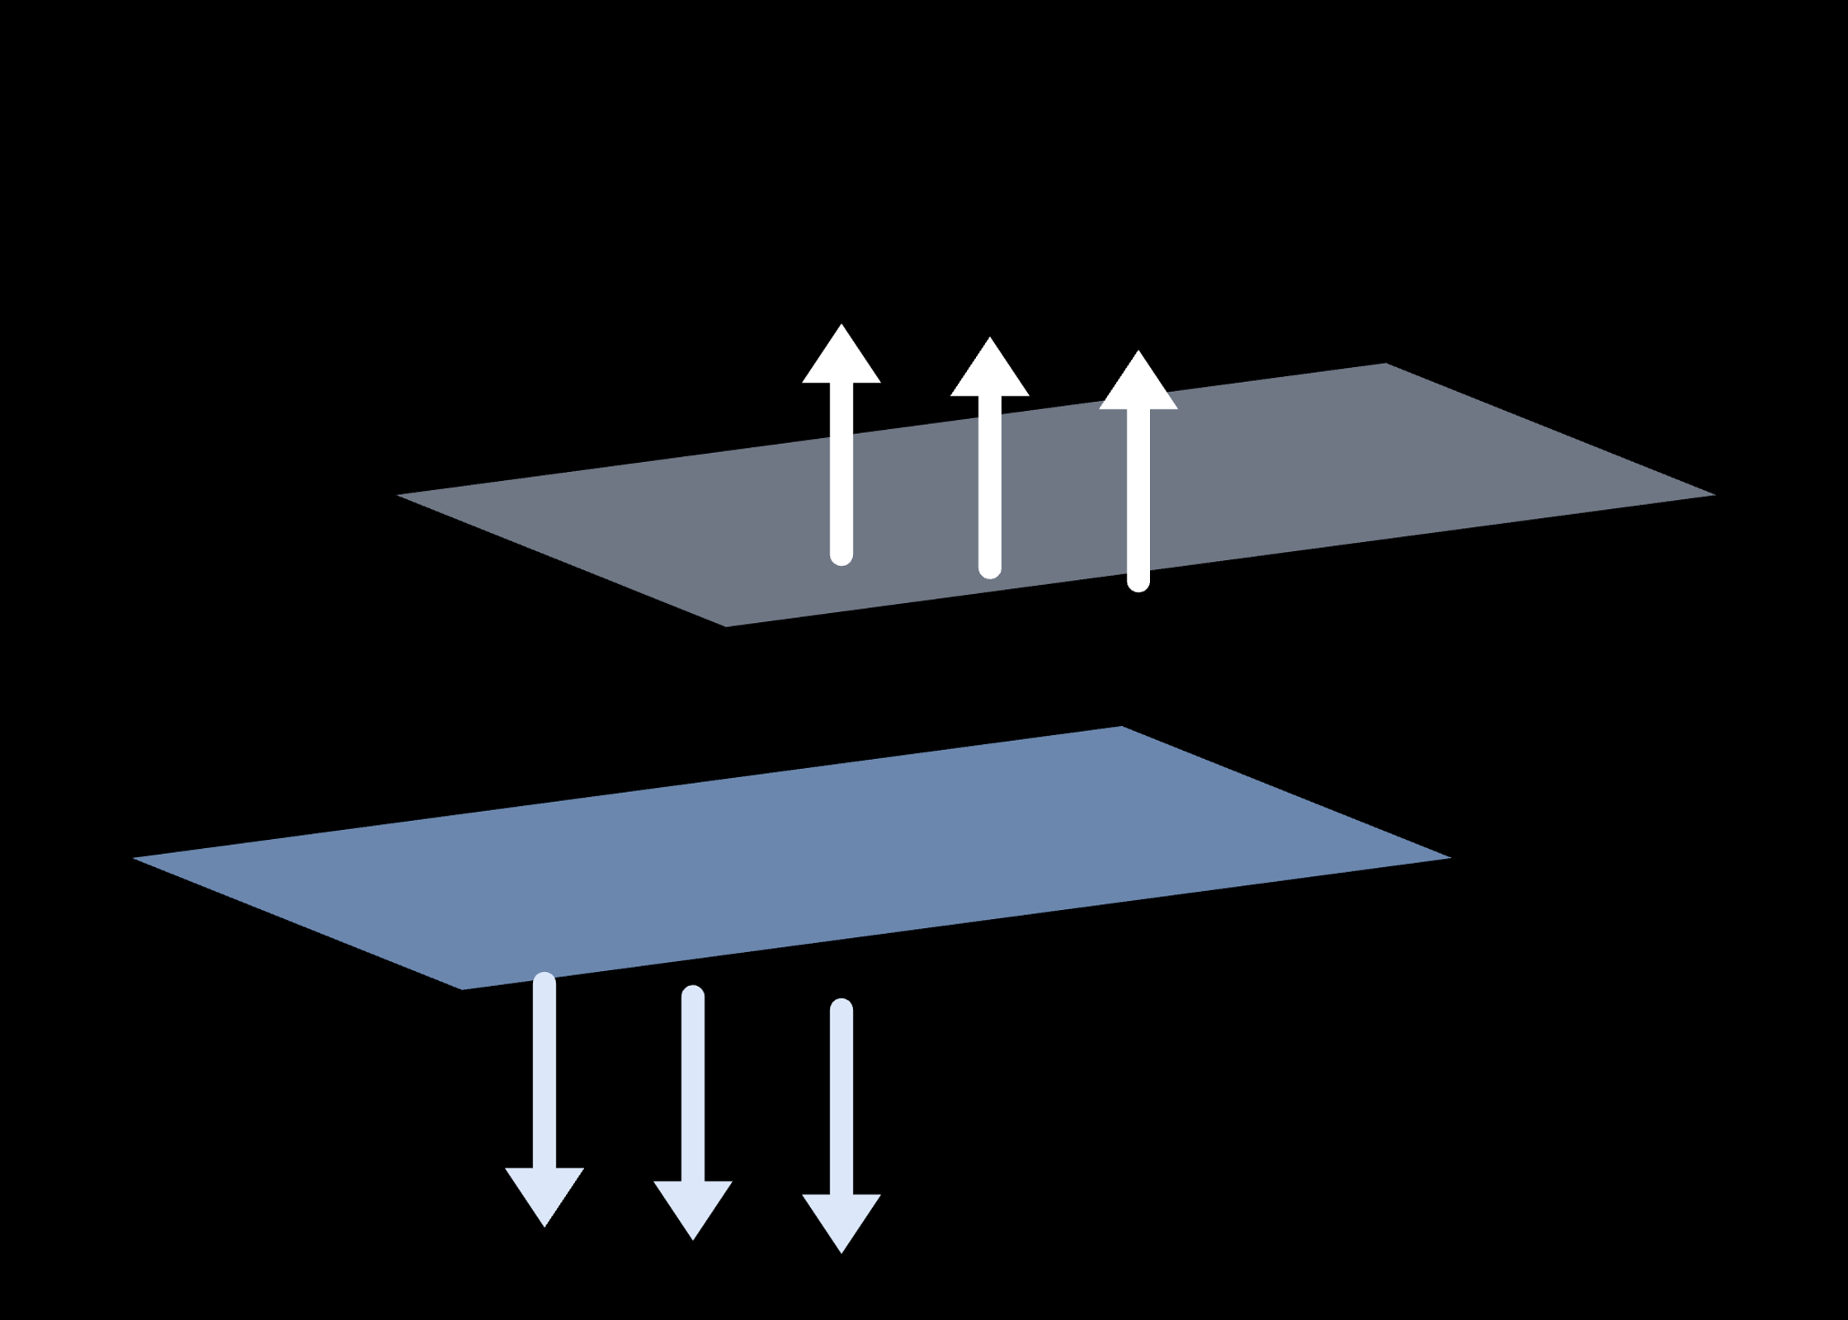
PHYSICAL REVIEW LETTERS 137, 076401 (2026)
DOI: 10.1103/qhvs-pfkq
Layer Edelstein Effect
Layer-resolved, current-induced spin magnetization in nonmagnetic bilayers —
electrically generated and switched by a perpendicular field
Binchang Zhou, Pan Zhou, Baoru Pan, Yuzhong Hu, Songmin Liu, Lizhong Sun
Xiangtan University · Hunan, China
Literature Presentation

Slide 2
Background: The Route to the LEE
Introduction
Edelstein effect — a current induces spin polarization
KNOWN EFFECT 1
• δS = χ · j in noncentrosymmetric systems — verified in Rashba interfaces & topological insulators
• Limitation: global response — all layers summed, no layer addressability
+
Layertronics — the layer index as a new degree of freedom
KNOWN EFFECT 2
• Top- and bottom-layer electrons deflect oppositely — the layer Hall effect
• Limitation: charge only — no current-induced spin magnetization
↓
OPEN QUESTION
A current-induced spin magnetization that is layer-resolved and switchable by an electric field?
This Letter answers yes — by proposing the Layer Edelstein Effect (next page)
Zhou et al., Phys. Rev. Lett. 137, 076401 (2026)
02 / 11

Slide 3
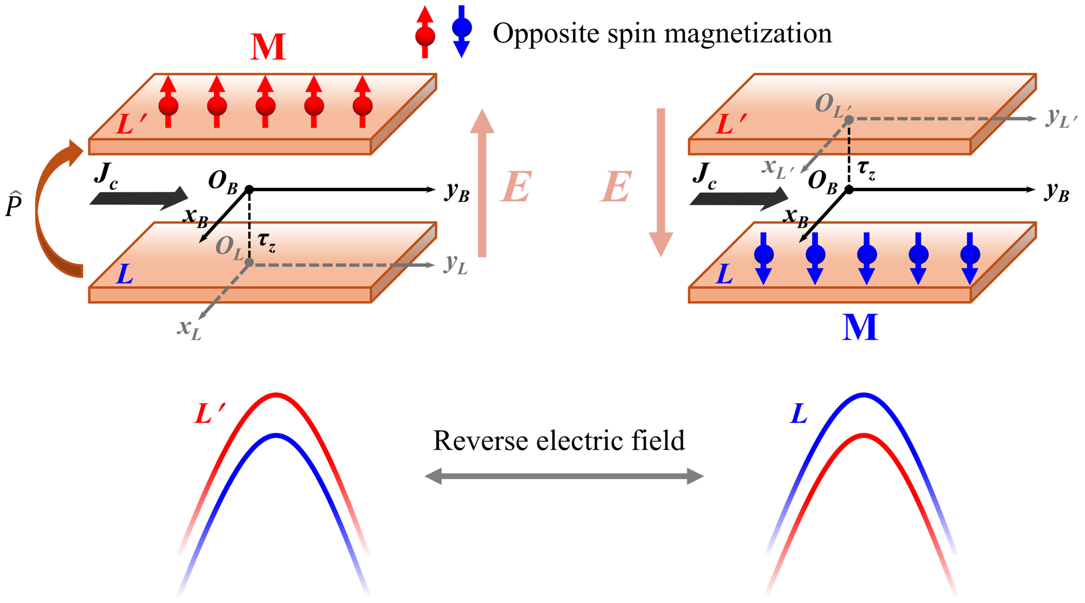
Core Proposal: The Layer Edelstein Effect (LEE)
Key concept
The LEE: a current drives opposite spin magnetizations on the two layers, and a perpendicular field selects which layer hosts them.
Layer-resolved counterpart of the Edelstein effect — the natural current-induced-spin member of the layer Hall effect family.
In-plane current jA induces layer-resolved spin magnetizations with opposite components.
A perpendicular field E selects which layer hosts the magnetism and sets its direction.
Allowed in both centrosymmetric and noncentrosymmetric bilayers.
Fig. 1 — Stacking operator P̂ builds L′ from L; reversing the vertical field E flips the layer hosting the spin magnetization M
E ↑ → spin-up M in the upper layer · E ↓ → spin-down M in the lower layer
Zhou et al., Phys. Rev. Lett. 137, 076401 (2026)
03 / 11

Slide 4
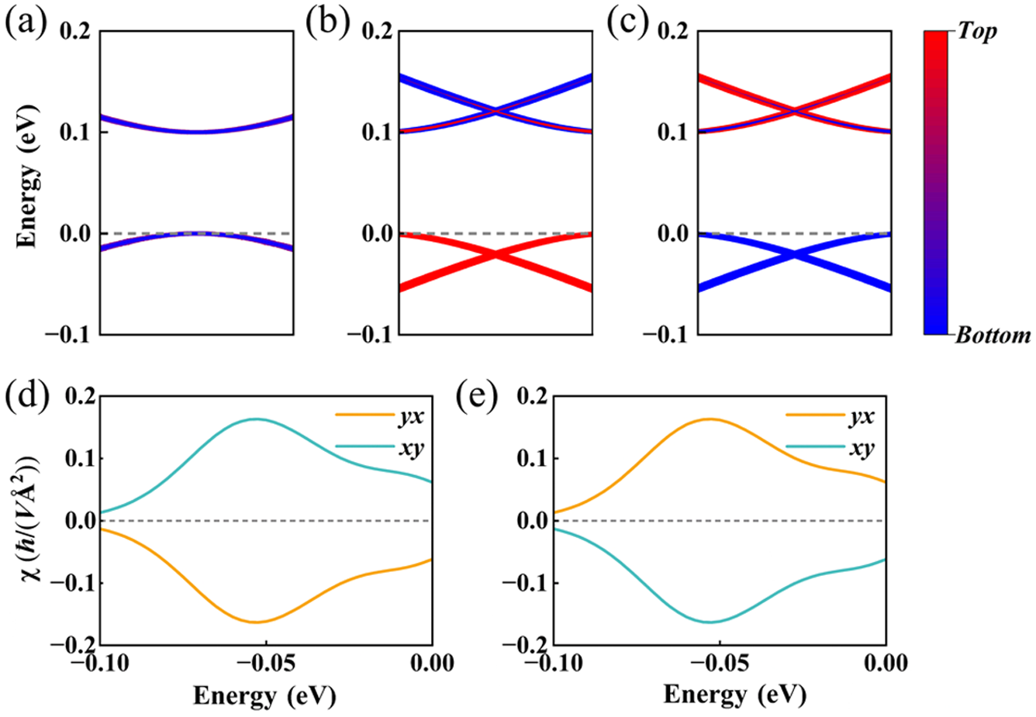
Minimal k·p Model: Demonstrating the LEE
Minimal model
WHY THIS MODEL SUFFICES
• Symmetry dictates the tensor form — the model needs only the essential ingredients
• Two layers · Rashba SOC of opposite sign (τz factor) · field-tunable Δ
• Warping & spin mixing: renormalize magnitude only, never the tensor form (SM V)
τ — layer · σ — spin · Δ tunable by the out-of-plane field E
RESULT: THE RESPONSE TENSOR
• Δ = 0: inversion kept → exact cancellation, zero net
• Δ ≠ 0: weight → one layer; jx (jy) → My (Mx)
• Sign reverses with Δ — the LEE, demonstrated
Fig. 2 — layer-selective bands under ±E and the induced response vs chemical potential
Zhou et al., Phys. Rev. Lett. 137, 076401 (2026)
04 / 11

Slide 5
Symmetry Rules: How the Classification Is Computed
Symmetry framework
2
Build the bilayer point group
1
Enumerate all stackings
• Unified coordinates: ops extended to 4×4 Q±
• Layer-keeping: LGBintra = LGL ∩ LGL′ · layer-exchanging: LGBinter = P̂LGL ∩ LGLP̂−1
• Total LGB = union of both subsets
• Fix the monolayer layer group LGL (80 types)
• Build every P̂ = Pτzτo from the quotient group LGlat / LGL, LGlat ∈ {C2h, D2h, D4h, D6h}
3
Impose the tensor constraints
4
Compare before vs after stacking
• Neumann's principle: (R|τ) constrains χij exactly like (R|0)
• Fractional translations never matter — allowed χij follows from the point group alone
• Allowed in L but newly forbidden in B → Type I
• All zero at zero field → redo under E, track LGBinter → Type II
✓
Model-free verdict: the LEE type follows from the bilayer point group alone — no microscopic model required.
Zhou et al., Phys. Rev. Lett. 137, 076401 (2026)
05 / 11

Slide 6

Two Manifestations of the LEE, Dictated by Symmetry
Classification
TYPE I
Layer-opposite, field-redistributed
TYPE II
Field-created response
① Monolayer L noncentrosymmetric → χijL allowed
② Stacking symmetry (inversion / mirror) forbids it in B: χijB = 0
① Stricter symmetry: χijB, χijL, χijL′ all vanish at zero field (I, or Mz + Cnz, n > 2)
③ Zero net → partner layer cancels L exactly:
② Under E every LGBinter op is broken — acting with one equals reversing E → components odd in E, layer-opposite
vs
③ Condition: ≥ 1 component unconstrained by LGBintra
E polarizes Fermi states onto one layer → sign & host layer flip with E
Typical: inversion/mirror stacking of noncentrosymmetric monolayers (Janus MoSSe → D3d / D3h)
E's dual role: creates then redistributes the response
Typical: direct stacking of centrosymmetric monolayers (MoTe2, P̂ = Ê)
→
Both types follow one point-group rule — quantified on the next slide: all 80 layer groups can host the LEE.
Zhou et al., Phys. Rev. Lett. 137, 076401 (2026)
06 / 11

Slide 7
A Model-Independent Symmetry Criterion
Universality
Applying the same rule to all 80 layer groups: at least one LGBinter op is essential — inversion does NOT forbid the LEE
CONSEQUENCE OF TYPE I + TYPE II
Ci
✓
C2h
✓
D2h
✓
C3i
✓
D3d
✓
C6h
✓
80
D4h
✓
D6h
✓
/80
Centrosymmetric bilayer point groups — LEE allowed (representative entries of Table I)
C1
✗
C2(z)
✗
C3
✗
C3v
✗
C6v
✗
Some noncentrosymmetric groups also forbid it — the verdict is point-group only
Every layer group reaches the LEE via an appropriate stacking — the effect is ubiquitous in nonmagnetic bilayers.
Meaning: a generic, symmetry-governed response — candidate bilayers can be screened by group theory alone, before any DFT.
Inversion stacking → noncentrosymmetric monolayers · direct translation stacking → centrosymmetric monolayers
Zhou et al., Phys. Rev. Lett. 137, 076401 (2026)
07 / 11

Slide 8
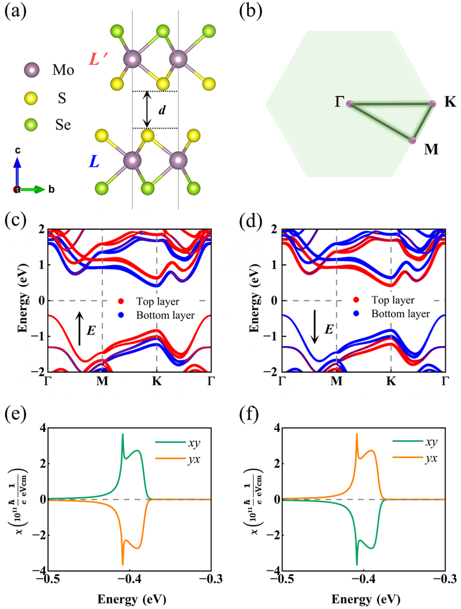
LEE in Realistic Materials: Semiconducting Janus MoSSe
Materials I — Type I
SETUP
• Semiconducting Janus MoSSe monolayer, inversion stacking P̂ = Î → Type-I bilayer (D3d)
RESULTS (DFT)
• Under ±E, Fermi-level states localize onto one single layer (+E top / −E bottom) — Fig. 3c–d
• In-plane current jx (jy) induces M along −y (x) on the selected layer — Fig. 3e–f
• Reversing E flips the host layer and reverses χxy = −χyx
CONCLUSION
• Type-I LEE confirmed — finite-temperature calculations show it is experimentally detectable in dual-gated van der Waals devices
Zhou et al., Phys. Rev. Lett. 137, 076401 (2026)
08 / 11

Slide 9
More Carriers: MoTe₂ and WTe₂ Bilayers
Materials II
Same criterion, more platforms
TYPE II
Bilayer MoTe₂ — LEE switched on by the field
The same symmetry criterion predicts a field-created LEE in centrosymmetric TMDs and extends unchanged to metallic systems.
• Monolayer P̄6m2 carries C3z + Mz → all Edelstein components vanish (Type II)
• Direct stacking (P̂ = Ê) preserves P̄6m2 — yet the field induces χxy = −χyx ≠ 0, opposite signs
• The field-created, field-controlled scenario in action
METALLIC
1T′-WTe₂ — a direct metallic platform
• Stacked 1T′-WTe2: a metallic realization of the LEE (SM Sec. X)
• No gate-defined carrier density required — closer to ambient transport measurements
Together with MoSSe, the predicted LEE spans semiconducting and metallic nonmagnetic bilayers — three concrete, synthesizable material candidates.
SM Sec. IX · Sec. X
Zhou et al., Phys. Rev. Lett. 137, 076401 (2026)
09 / 11

Slide 10
Device Perspectives
Outlook
1
2
3
Electrical probing
Spin-orbit logic
Magnetic memory
A dual-gated van der Waals device supplies the vertical field and tunes the carrier density — the layer-resolved spin polarization can be read out through spin-to-charge conversion, with magnitude and sign tracked versus gate voltage (SM Sec. IX, XI).
The stacking degree of freedom opens a wide configuration space for designing spin-magnetization-switchable bilayer spin-orbit logic — distinct from the layer-dependent spin Hall effect, which shares the spin-layer coupling origin but serves different functionalities (SM Sec. XII).
The LEE uniquely switches between two opposite spin-magnetization configurations under an electric field — enabling all-electric manipulation of the "0" and "1" states in magnetic memory devices, without magnetic fields or magnetic ordering.
MoSSe · MoTe₂ semiconducting platforms
Stacking as a design knob
E-field writes the bit
→
From fundamental symmetry to working devices — the remaining step is experimental confirmation in stacked 2D materials.
Zhou et al., Phys. Rev. Lett. 137, 076401 (2026)
10 / 11

Slide 11
CONCLUSIONS
Phys. Rev. Lett. 137, 076401 (2026)
1
The LEE — a new member of the Hall family
Layer-resolved, current-induced spin magnetization: the natural real-space counterpart of the layer Hall effect.
Universal and symmetry-governed
Thank You
2
A model-independent point-group criterion: at least one layer-exchange operation is essential — all 80 layer groups can realize it via proper stacking.
3
Two complementary manifestations
Zhou, Zhou, Pan, Hu, Liu, Sun,
Phys. Rev. Lett. 137, 076401 (2026)
DOI: 10.1103/qhvs-pfkq
Type-I explicit layer-opposite components and Type-II electric-field-induced components cover every nonmagnetic bilayer.
4
Confirmed in realistic materials
First-principles verification on MoSSe, MoTe₂ and 1T′-WTe₂ bilayers — detectable in dual-gated van der Waals devices.
11 / 11

