Slide 1
Racial disparities in police stops
STAT 5200 · REPLICATION
Replicating Pierson et al. (2020), Nature Human Behaviour
[Presenter 1] · [Presenter 2] · [Presenter 3] · [Presenter 4]
November 11, 2026
Notes:
Person 1. Today we replicate a study of nearly 100 million US traffic stops that asks whether police decisions about whom to stop and whom to search are racially biased.

Slide 2
Are stops and searches racially biased?
THE QUESTION
0.10
0.07
The benchmark problem
We don’t know who is at risk of a stop: how much each group drives, where, and how often they break traffic laws.
stops per Black resident per year (state patrols)
stops per white resident per year
The paper answers with three designs: one each for whom to stop, whom to search, and what a policy change does.
Per-capita stop rates: Pierson et al. (2020)
Notes:
Person 1. About 20 million Americans are stopped each year. Black drivers are stopped more per person, but that alone does not prove bias: the population is the wrong denominator because we don’t observe driving behaviour. This is the benchmark problem. The paper uses three designs to get around it, one per decision.

Slide 3
Stanford Open Policing Project
DATA
The paper
Our replication
95M stops
56M stops
21 state patrols and 35 city police departments, 2011–2018, gathered through public records requests in all 50 states.
14 statewide files, 2011–2015, for the DiD. Only TX, FL, OH and WA have usable stop times for the veil of darkness.
Data lesson: North Carolina’s highway patrol is missing the stop time in 96% of records.
openpolicing.stanford.edu · code: github.com/stanford-policylab/opp
Notes:
Person 1. The authors released raw data, cleaned data and code. We downloaded the 14 statewide files used in the marijuana analysis and re-ran their pipeline in R. Recording practices vary a lot by state, which limited which states we could use for the stop-decision test.

Slide 4
Officers can’t see race as easily after dark
WHOM TO STOP · VEIL OF DARKNESS
Same clock time
DST windows
Logit on counts
Compare 7 pm stops on days when 7 pm is light with days when it is dark.
Keep stops within 30 days of a daylight saving change, so driving patterns barely move.
Black share ~ dark + spline(clock time) + county + season × year
Key assumption: at a fixed clock time, who is on the road doesn’t change with daylight.
A negative coefficient on darkness means Black drivers are a smaller share of stops when race is hard to see.
Grogger and Ridgeway (2006); Pierson et al. (2020)
Notes:
Person 2. The test compares stops at the same clock time when it is light versus dark. Restricting to 30 days around DST changes keeps the comparison close in time, like an RD bandwidth. Stops between sunset and dusk are dropped. The spline absorbs how the driver mix changes through the evening.

Slide 5
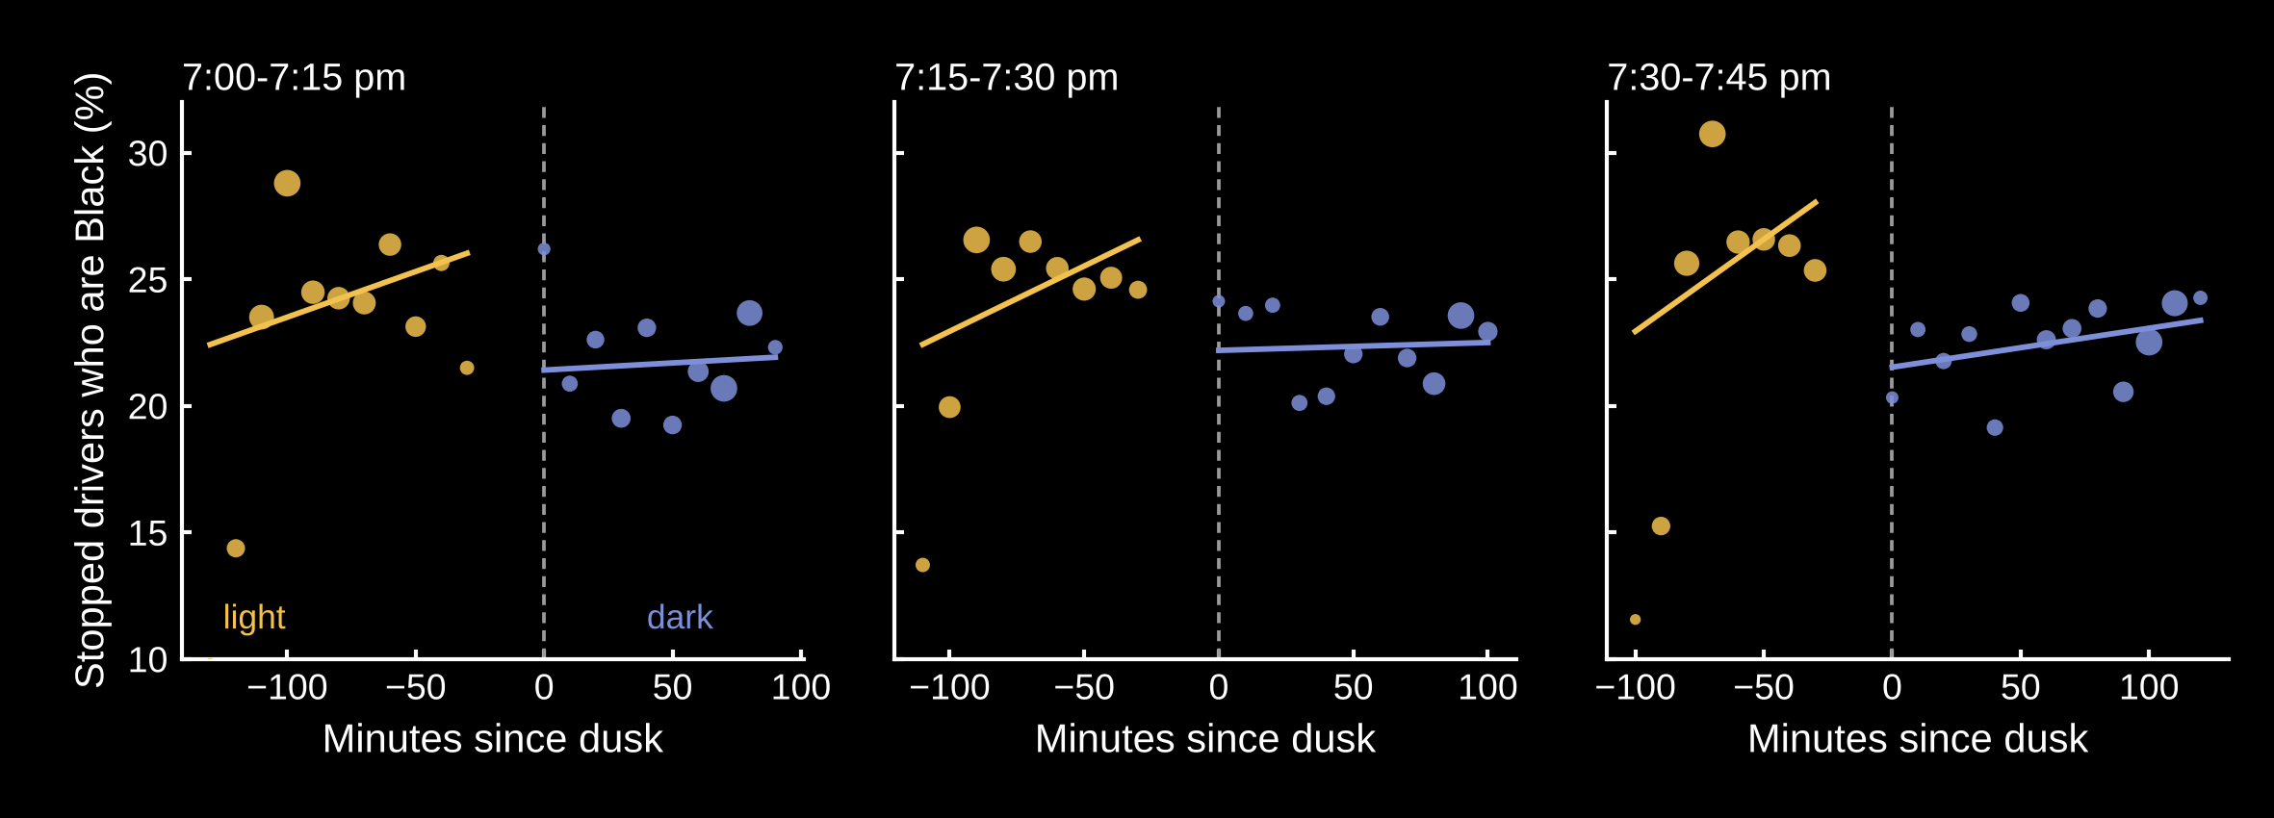
After dusk, fewer stopped drivers are Black
WHOM TO STOP · RESULTS
Darkness coefficient (log odds), state patrols: Paper −0.033 [−0.039, −0.027] Ours −0.053 [−0.081, −0.026]
Figure: Texas state patrol, 2011–2017, top 20 counties, all days. Coefficient: TX, FL, OH, WA in 30-day DST windows.
Notes:
Person 2. Our version of the paper’s Figure 2 for Texas. At the same clock time, the share of stopped drivers who are Black drops after dusk in every window: 24.2 to 21.7 percent, 24.4 to 22.5, and 25.8 to 22.7. The pooled model gives −0.053, same sign and similar size to the paper’s −0.033; e to the −0.053 is about 0.95, so roughly 5 percent lower odds after dark. Caveats: streetlights weaken the contrast, and some violations like broken tail lights are only visible at night. Our sample is smaller because only four of our states record stop times well enough.

Slide 6
Black and Hispanic drivers: a lower search bar
WHOM TO SEARCH
State patrols | Search rate | Hit rate | Threshold
White | 1.9% | 32.0% | 20.9%
Black | 4.3% | 29.4% | 16.0%
Hispanic | 4.1% | 24.3% | 13.9%
Outcome test: a lower hit rate means searches needed less evidence.
Infra-marginality: average hit rates can mislead, so the paper models the threshold directly.
Threshold test: Bayesian (Stan); we present it, not re-estimate it.
All numbers on this slide: Pierson et al. (2020). Threshold = inferred probability of contraband above which officers search.
Notes:
Person 3. Black and Hispanic drivers are searched about twice as often. Becker’s outcome test looks at hit rates instead: if searches of a group succeed less often, officers used a lower bar. But average hit rates suffer from infra-marginality, so the paper’s threshold test models the search bar directly. The inferred threshold is lower for Black and Hispanic drivers. This is the one part we did not re-estimate.

Slide 7
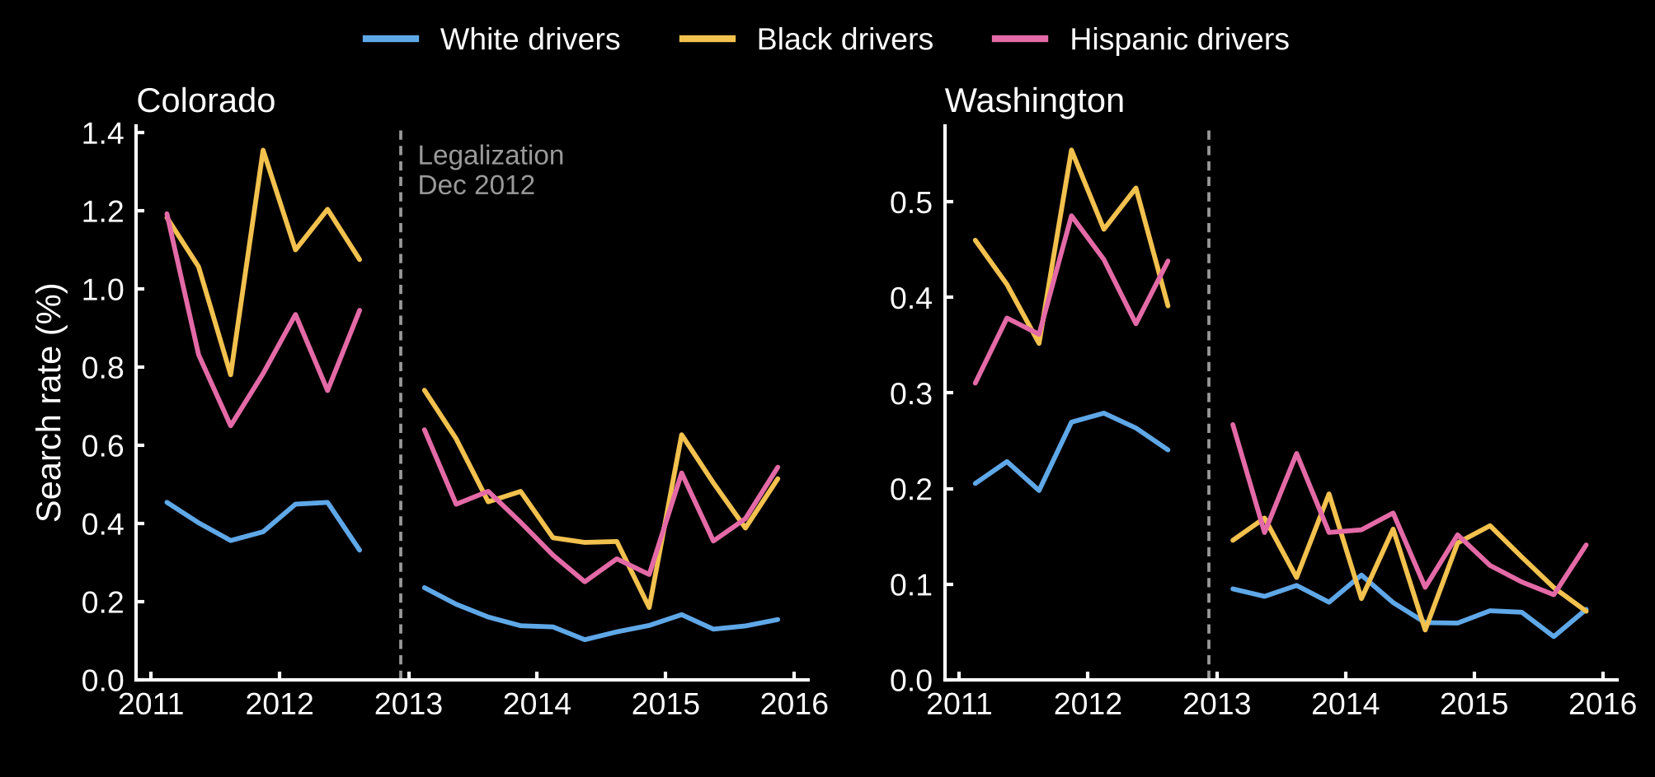
Searches fell after marijuana legalization
POLICY CHANGE · DIFFERENCE-IN-DIFFERENCES
Treated: Colorado and Washington, legal from Dec 2012.
Controls: 12 states that did not legalize.
Model: logit of search on state, race, a linear trend and race × treated-after.
Our figure from the replication data. Controls: AZ, CA, FL, MA, MT, NC, OH, RI, SC, TX, VT, WI.
Notes:
Person 3. Possession of small amounts stopped being a reason to search. In both treated states, search rates for every group drop sharply after December 2012. The controls, on the backup slide, show no comparable drop. The identifying assumption is parallel trends: without legalization, CO and WA search rates would have moved like the controls.

Slide 8
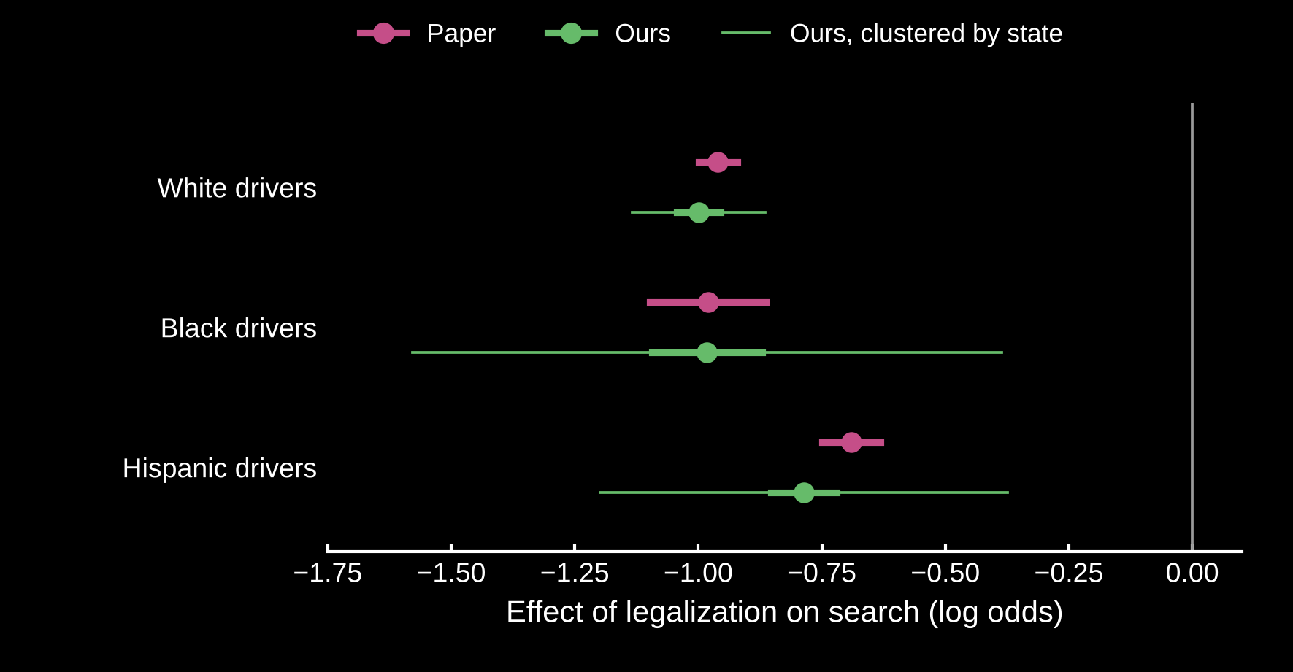
The DiD replicates closely
TABLE 1 · PAPER VS OURS
Drivers | Paper | Ours
White | −0.96 | −1.00
Black | −0.98 | −0.98
Hispanic | −0.69 | −0.79
A coefficient of −1 means the odds of a search fell by about 63%.
Logit on 74,404 state × day × race cells (56M stops). Paper: Table 1, Pierson et al. (2020).
Notes:
Person 3. This is the headline replication. Same 14 states, same specification. Black drivers match exactly; white and Hispanic are within about 0.1. Small differences likely come from the data release, since California and Montana come from a 2023 update, and from filters we simplified. exp(−1) is about 0.37, so the odds of being searched fell by roughly 63 percent. The thin green lines preview the next slide: standard errors clustered by state.

Slide 9
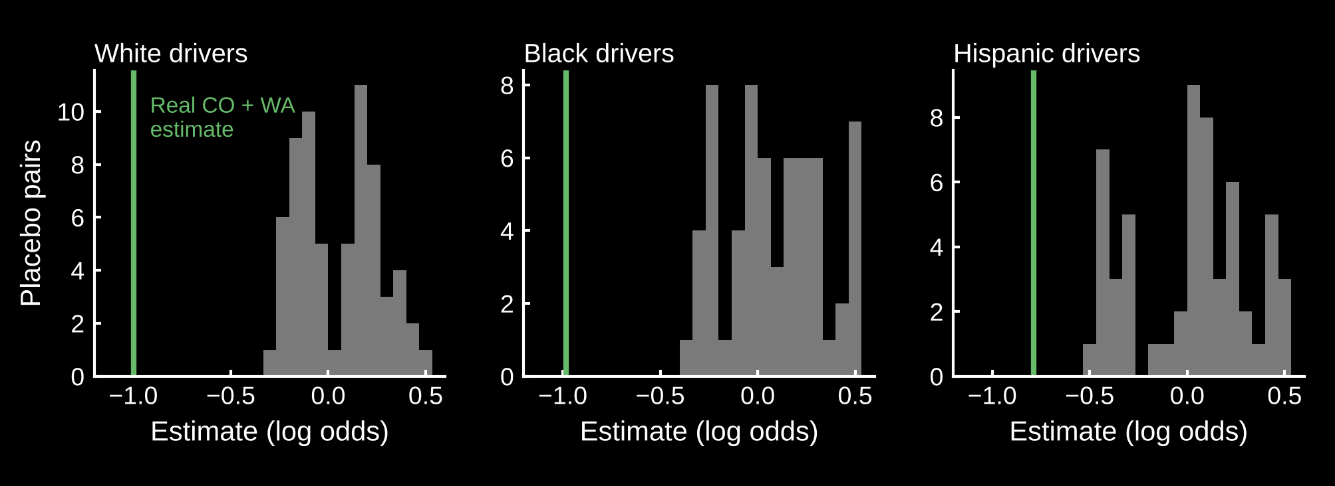
Only two states were treated
WHAT WE LEARNED · INFERENCE
Clustered by state
Placebo test
Standard errors grow 3–5×. For Black drivers: 0.06 → 0.30. All effects stay significant.
0 of 66 fake legalizations in control-state pairs match the real effect. p ≈ 1/67 ≈ 0.015.
Placebo: each pair of the 12 control states treated as if it legalized in Dec 2012, model re-estimated.
Notes:
Person 4. The paper treats 56 million stops as independent, but legalization varies only at the state level and only two states were treated. Clustering by state makes the standard errors three to five times larger, though with 14 clusters even that is unreliable. A placebo test is more convincing: we pretended each pair of control states legalized and re-ran the model. None of the 66 placebo estimates is as negative as the real one.

Slide 10
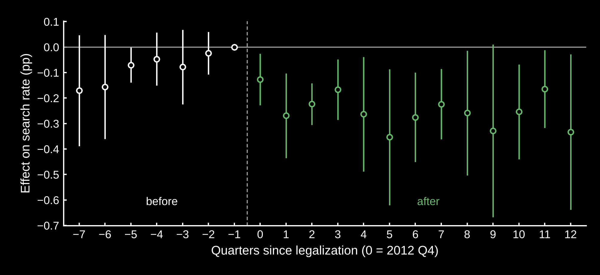
The drop starts at legalization and lasts
WHAT WE LEARNED · TRENDS AND SCALE
Pre-trends: roughly flat, so parallel trends looks plausible.
Scale matters: in a linear model, the effect for white drivers is only −0.08 pp, not significant.
Their base rate was about 0.3%: a big relative change on a tiny base.
Linear probability model with state, quarter and race effects; SE clustered by state. Reference quarter: 2012 Q3.
Notes:
Person 4. The paper uses one linear time trend, which can hide pre-trends, so we ran an event study. Coefficients before legalization are close to zero; afterwards they sit around −0.2 to −0.35 percentage points. One more lesson: parallel trends in log odds is not the same as in rates. The logit coefficient for white drivers is large, but in percentage points the effect is tiny because the base rate was already very low.

Slide 11
Both main findings replicate
TAKEAWAYS
Stops: fewer of the stopped drivers are Black after dark.
Policy: legalization cut searches for every group, but the gap in search thresholds remained.
Method: with two treated states, inference, not the point estimate, is the weak spot.
Next: veil of darkness for city police · synthetic control for Colorado · data after 2015
Notes:
Person 4. Summarize: the stop result and the DiD both replicate with the authors’ public data and code. The weakest part of the DiD is inference with only two treated states; the placebo test addresses that. Possible extensions: run the veil of darkness for cities, a synthetic control for Colorado, and newer years of data. Then take questions.

Slide 12
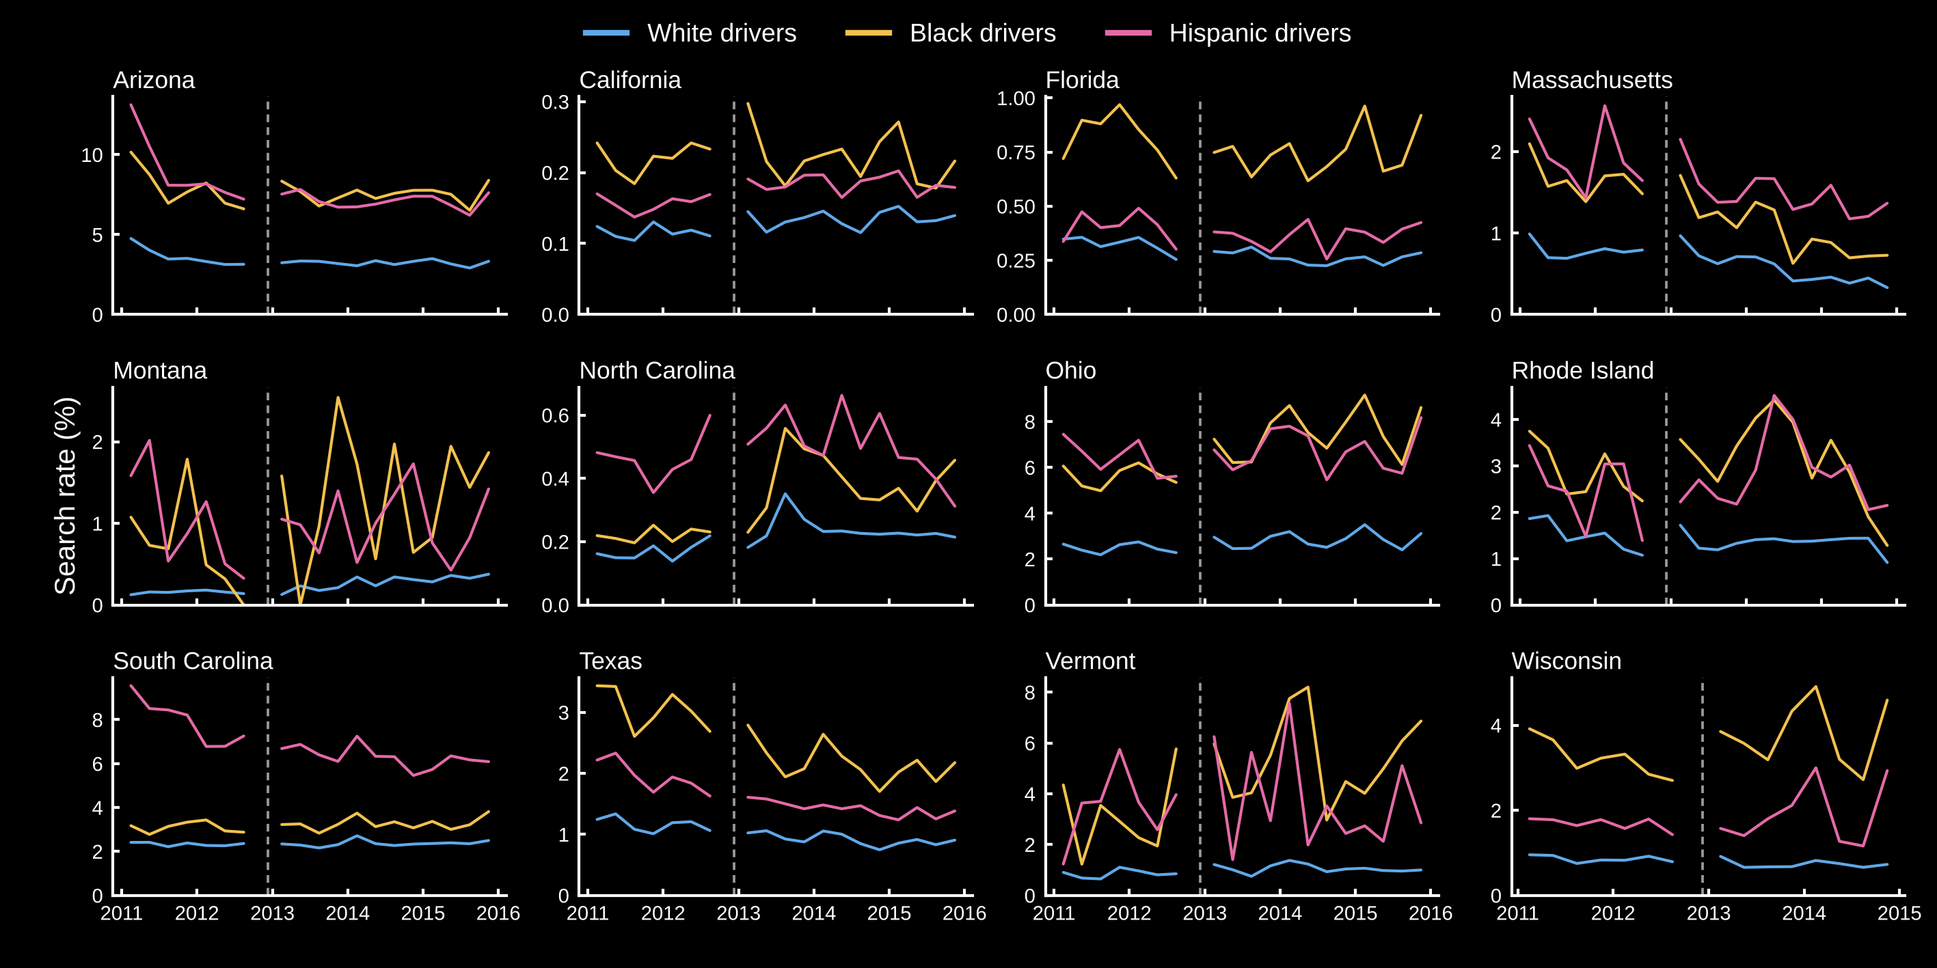
Control states show no drop at legalization
BACKUP
Our replication of the paper’s Fig. 5. Wisconsin data end in 2014.
Notes:
Backup for questions about parallel trends: the 12 control states. Search rates move around, but none shows a sharp break at December 2012 like Colorado and Washington.

