Slide 1

Used Car Pricing
Drexel DSCI 521: Final Project - Richard Anton - Winter 2022/2023
Notes:
Hello

Slide 2


Group 8 - Team
Full time software developer, part time student.
Proficient in Python and a number of other programming languages.
In Seattle area, work and time-zone makes group project collaboration challenging.
Completed ML, AI, deep learning, and computer vision courses at Drexel.
Minimal prior experience with exploratory data analysis and data cleaning or preparation.
Not much experience with tools and libraries like Pandas and Scikit-learn; prior courses usually required implementing algorithms “from scratch”, i.e. just using NumPy.
Richard Anton
rna63@drexel.edu
MS CS student
(will complete at end of Spring ’23)
Notes:
Intro
Final project
For CS 613 Machine learning

Slide 3
How do different variables influence used vehicle pricing?
Practical utility to multiple types of users
User car dealers
Private sellers
New car purchasers with a trade-in
Dealerships purchasing trade-ins
Automotive websites and data providers (KBB, Edmunds, etc).
Economists or scientists investigating used vehicle market dynamics
Team’s Personal Reasons
Explore a regression problem (more prior experience with classification)
Gain experience with visualization, data preparation, and relevant libraries, especially scikit-learn, Pandas, and XGBoost.
Interested in cars
COVID-19 supply chain problems highlighted vehicle pricing changes
Notes:
During COVID-19 supply problems, used car prices increased significantly when new car availability decreased which caused some of my curiosity in this area.

Slide 4
Project Overview (TODO: fix)

Slide 5
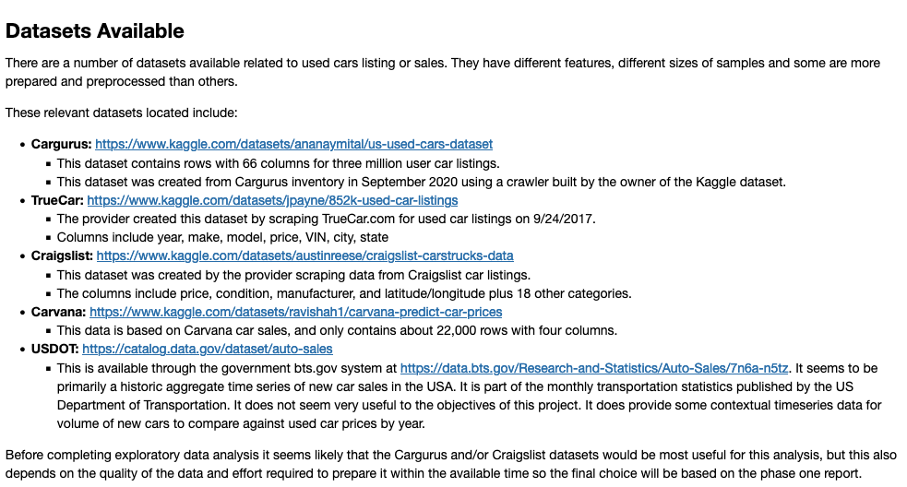
Dataset
TODO:
Replace
With
Txt

Slide 6
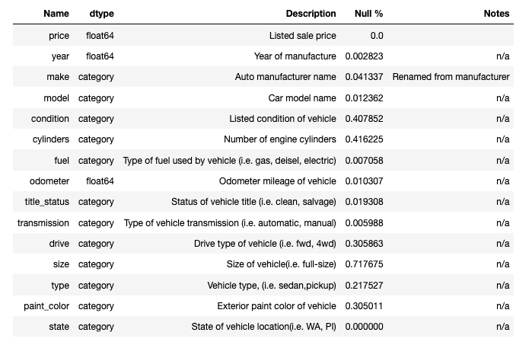
Data Dictionary
Columns we used from the Craigslist dataset.

Slide 7
Unused Columns
These columns we dropped after EDA before cleaning the data set.
id, url, VIN, image_url - unique to each listing
posting_date – only have data from limited period of time so not useful to determine seasonality
region, region_url, county, lat, and long - using state as a single column for the effect of the vehicle location on price.

Slide 8
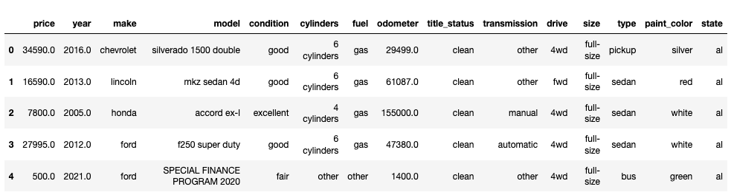
Data Samples

Slide 9
Exploratory Data Analysis
TODO: should be more than one slide

Slide 10
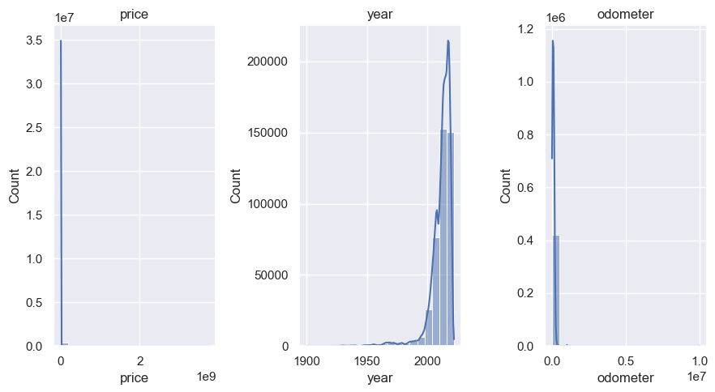
Numeric Features - Histogram

Slide 11
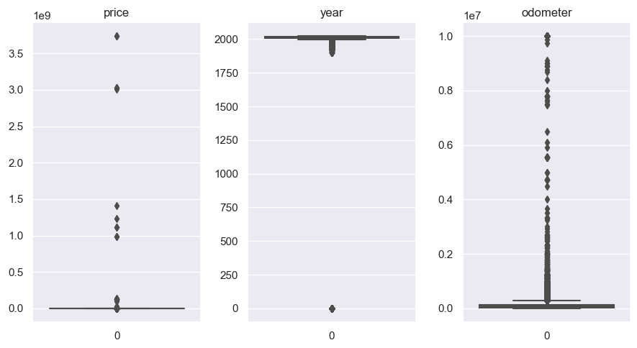
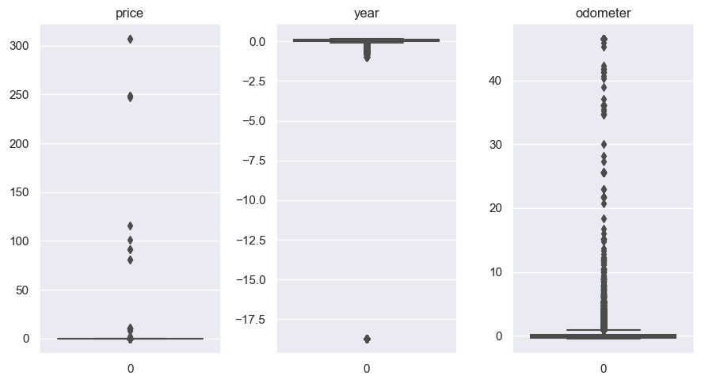
Numeric Features - Box Plots
Unnormalized
Normalized

Slide 12
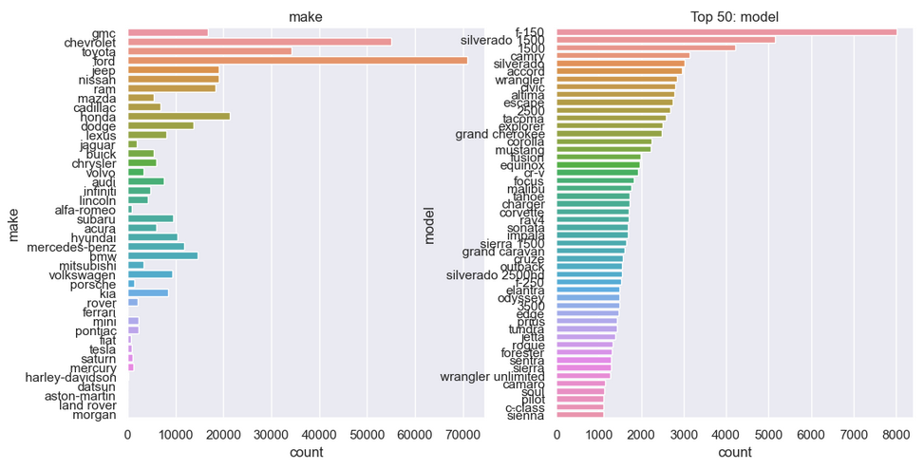
Categorical Features

Slide 13
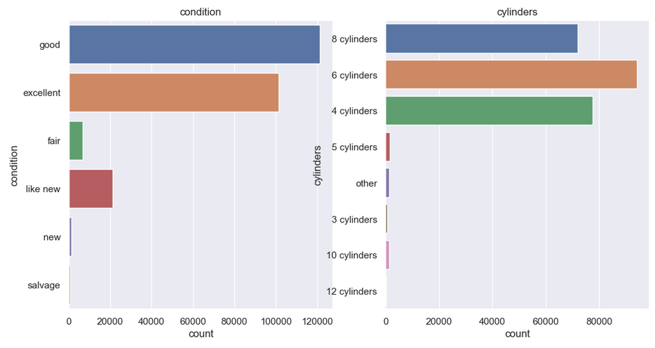
Categorical Features

Slide 14
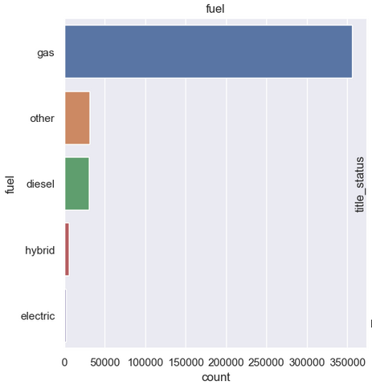
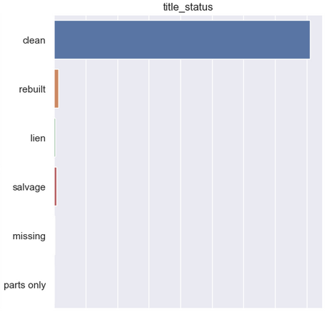
Categorical Features

Slide 15
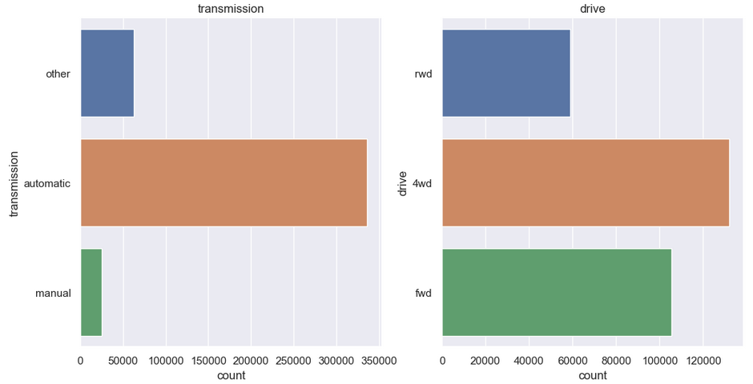
Categorical Features

Slide 16
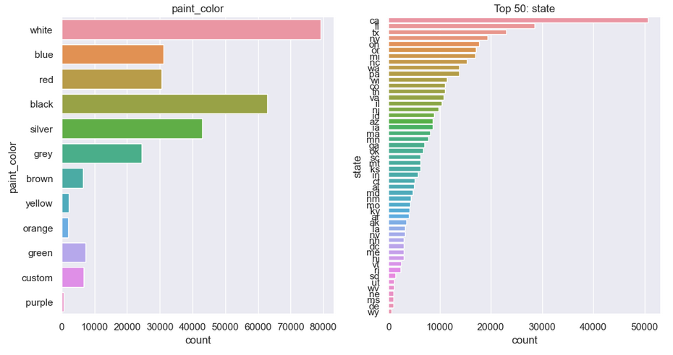
Categorical Features

Slide 17
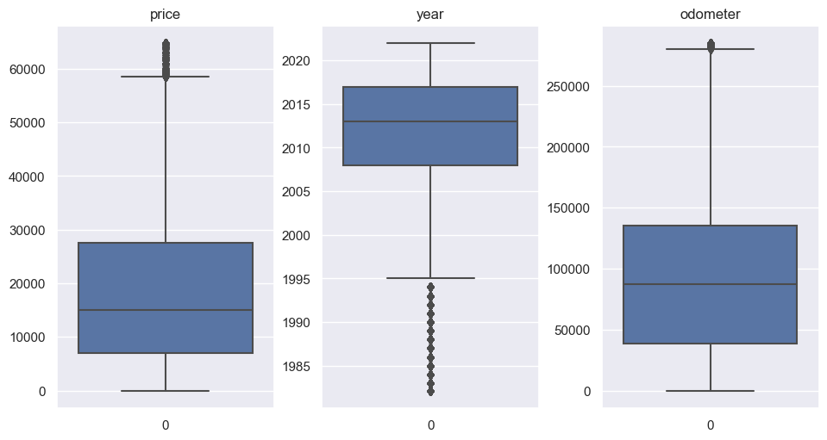
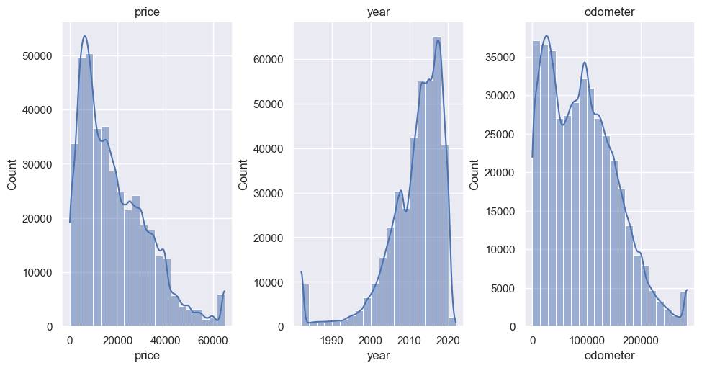
Data Preparation
Imputed missing values
Categorical mode
Numerical: mean
Drop rows missing price
Capped outliers
Price > 300,000 or < 1
Years > 2023
Odometer > 300,000
Anything > 3 stdev from mean

Slide 18
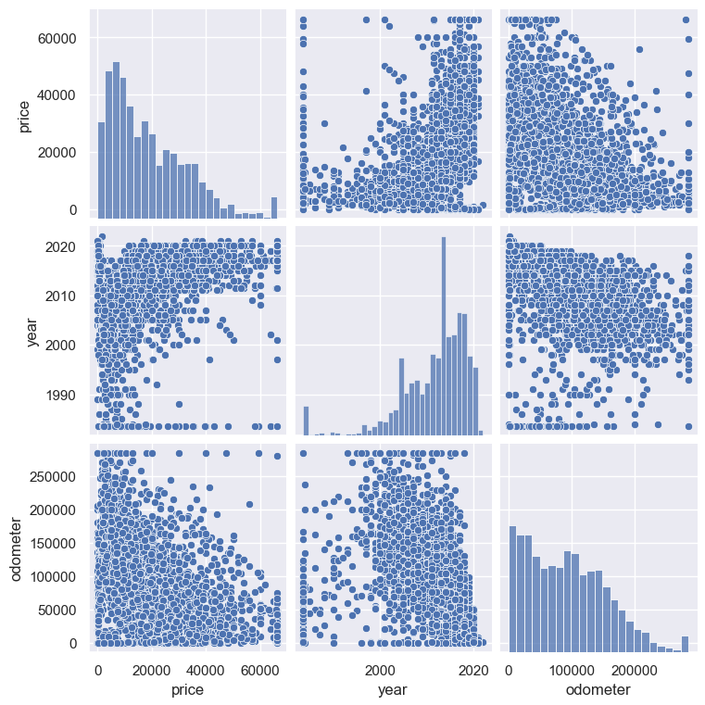
Pair Plots
On cleaned numerical features of sampled dataset.

Slide 19
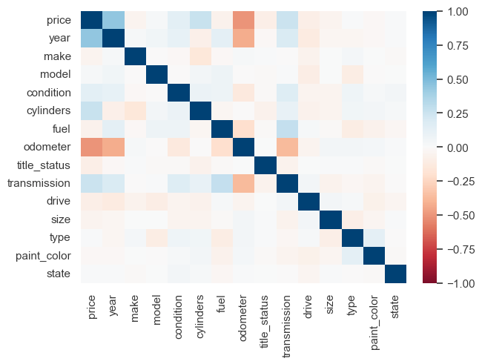
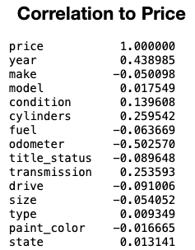
Correlation Matrix

Slide 20
Regression Models
TODO:

Slide 21
Challenges
EDA notebook for cleaning data kept crashing due to dataset size.
Visualizations made it crash, actually data cleaning pretty fast.
Had to disable pair plots for the full dataset.
Sparse categorical features
i.e. model
One hot encoding with decision trees has some drawbacks
Had to use leave one out encoding for getting feature importance for XGBoost so could map back to original columns, but LOO had worse regression performance.

Slide 22
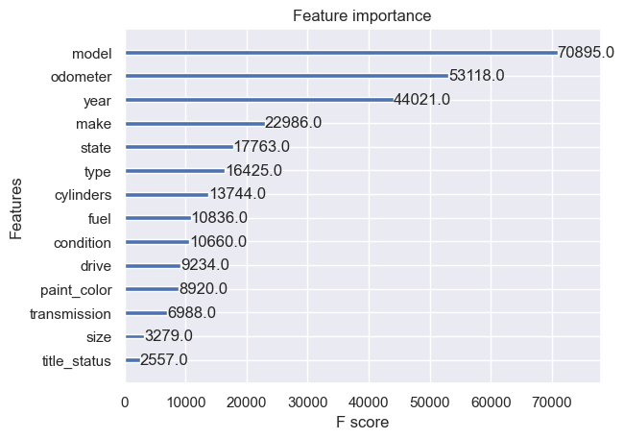
Feature Importance
Calculated by fitting XGBoost to cleaned data using LeaveOneOut encoding for categorical features.

Slide 23
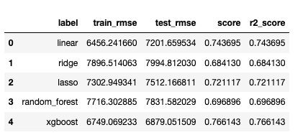
Regression Results - Baseline
TODO: describe this.

Slide 24
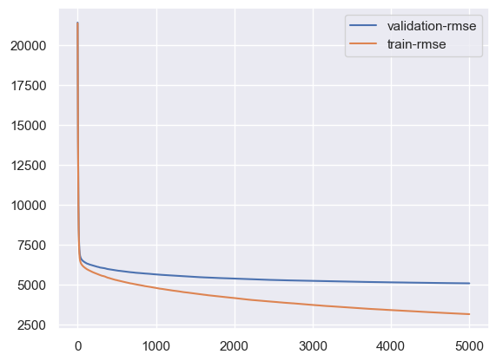
Regression Results – Tuned
Learning_rate = 0.1
RMSE of train data: 3148.63
RMSE of test data: 5077.03
R2 Score: 0.872617141105975
Notes:
NOTE: from run saved to model_xgboost_2023_03_12_18_03_47.pkl

Slide 25
Summary
TODO: write the summary.

Slide 26
Future Work

Slide 27
References

