Slide 1

Used Car Pricing
Drexel DSCI 521: Final Project - Richard Anton - Winter 2022/2023
Notes:
Hello

Slide 2


Group 8 - Team
Full time software developer, part time student.
Proficient in Python and a number of other programming languages.
In Seattle area, work and time-zone makes group project collaboration challenging.
Completed ML, AI, deep learning, and computer vision courses at Drexel.
Minimal prior experience with exploratory data analysis and data cleaning or preparation.
Not much experience with tools and libraries like Pandas and Scikit-learn; prior courses usually required implementing algorithms “from scratch”, i.e. just using NumPy.
Richard Anton
rna63@drexel.edu
MS CS student
(will complete at end of Spring ’23)
Notes:
Intro
Final project
For CS 613 Machine learning

Slide 3
Project Overview
The goals of this project are:
1) to explore the influence of different features on the listing price of used vehicles,
2) examine the efficacy of various machine learning models for predicting listing price from the available training data,
and 3) to enable users to predict a vehicle price via a web application based on the trained model.

Slide 4
How do different variables influence used vehicle pricing?
Practical utility to multiple types of users
User car dealers
Private sellers
Customers/dealers negotiating prices of trade-in vehicles
Automotive websites and data providers
Economists or scientists investigating market dynamics
Team’s Personal Reasons
Explore a regression problem (more prior experience with classification)
Gain experience with visualization, data preparation, Scikit-Learn, Pandas, and XGBoost
Always have been interested in cars
COVID-19 supply chain problems effect on vehicle prices
Notes:
During COVID-19 supply problems, used car prices increased significantly when new car availability decreased which caused some of my curiosity in this area.

Slide 5
Dataset
Five different datasets of used car price data were located.
These included datasets sourced from Carvana, CarGurus, Craigslist, TrueCar, and the US Department of Transportation.
After investigation into these datasets in phase one for data quality, dataset size, and features included, the Craigslist based dataset was selected
It includes a column for the state location, the same basic make, model, price, mileage and year information common to all the datasets
Plus a number of additional feature columns which may affect price.
The original dataset contains 426,880 rows.
Notes:
Selection of Dataset for Continued Analysis
The Carvana dataset provides very few columns(Name,Year,Miles,Price), and a much smaller set of samples than the other datasets.
The CarGurus dataset has the largest rows and the most feature columns avaiable(at 66). However, it only provides location data as zip code, longitude and latitude, which would make analyzing the effect on price from different areas more difficult since would prefer to just compare prices across US states.
Both the Craigslist and Carvana datasets have some data cleaning work required to remove outliers as well as signficiant numbers of null values.
The TrueCar dataset is by far the cleanest dataset, having no null values, and more columsn than the Carvana dataset. However, the columns available would only allow some of the investigations we have in mind. It provides Price,Year,Mileage,City,State,Vin,Make,Model. Vin is of little use without advanced preprocessing based on VIN coding, so the only advantage in features it providese to the Carvana dataset are from location based on City, State.
The Craigslist dataset is most amenable to the investigations planned in terms of the columns available. This is because it includes a column for the state location, the same basic make, model, price, mileage and year information common to all the datasets, but also has a number of additional feature columns which may affect price. The complete columns are: id,url,region,region_url,price,year,manufacturer,model,condition,cylinders, fuel,odometer,title_status,transmission,VIN,drive,size,type,paint_color,image_url, description,county,state,lat,long,posting_date
The rest of our discussion will focus on the Craigslist dataset specifically.

Slide 6
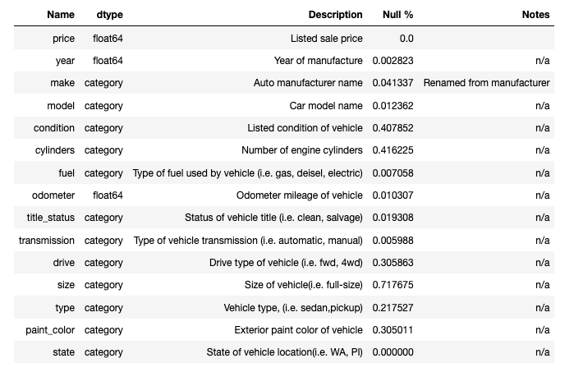
Data Dictionary
Columns used from the Craigslist dataset.

Slide 7
Unused Columns
These columns were dropped after EDA before cleaning the data set.
id, url, VIN, image_url - unique to each listing
posting_date – only have data from limited period of time so not useful to determine seasonality
region, region_url, county, lat, and long - using state as a single column for the effect of the vehicle location on price.
description – this would potentially useful if using an NLP model but not in the scope of this project.

Slide 8
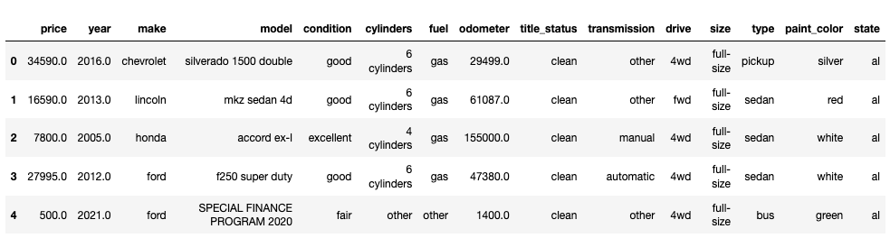
Data Samples

Slide 9
Exploratory Data Analysis
Useful columns in the dataset include:
Two numeric columns, not counting listing price
And a larger number of categorical columns
Examined the distribution of categorical features, histogram of numeric features, and correlation across all features.
Examined pair plots across numeric feature pairs.
Examined missing/null ratio of all columns, and removed outliers of the numeric features.

Slide 10
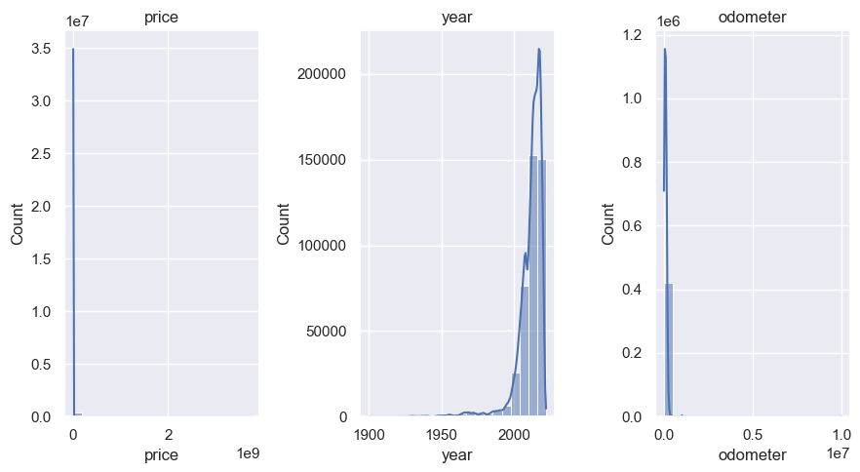
Numeric Features – Histogram (raw data)

Slide 11
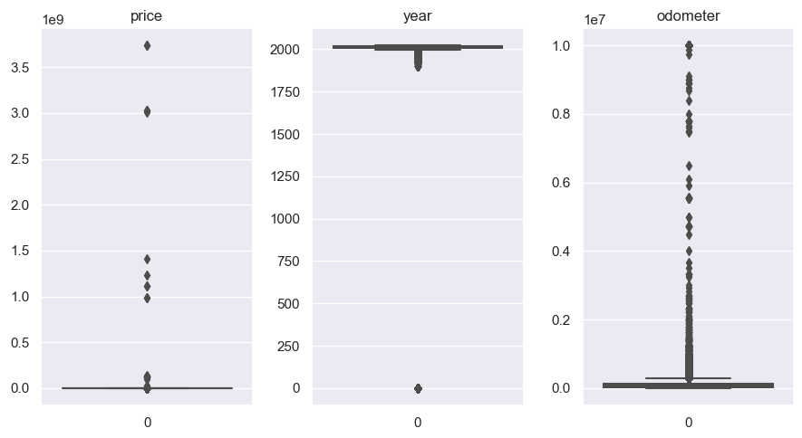
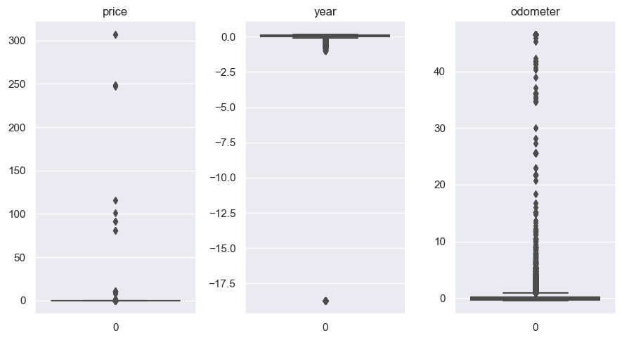
Numeric Features - Box Plots (raw data)
Unnormalized
Normalized

Slide 12
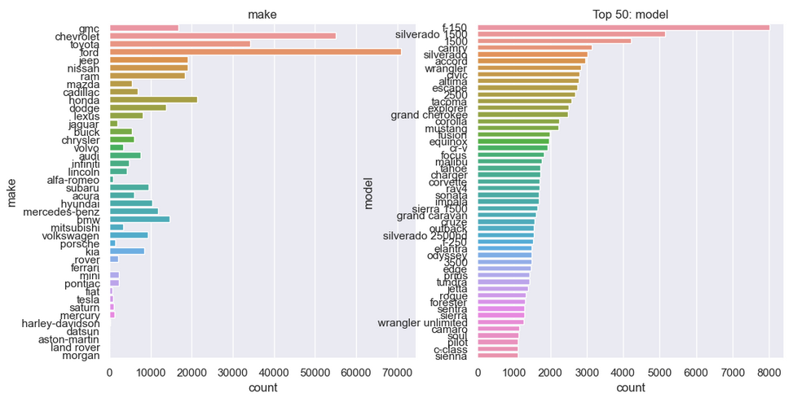
Categorical Features

Slide 13
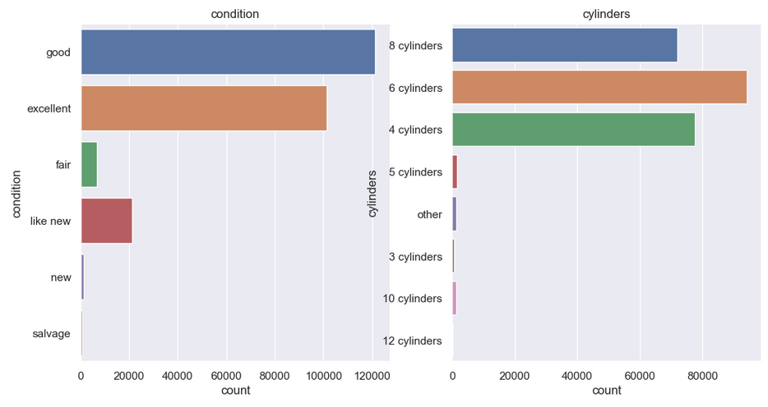
Categorical Features

Slide 14
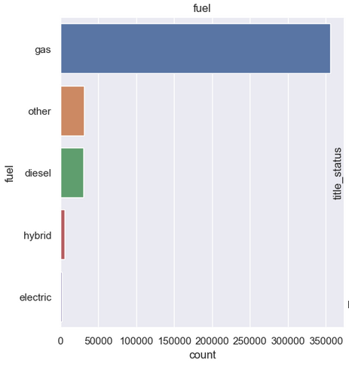
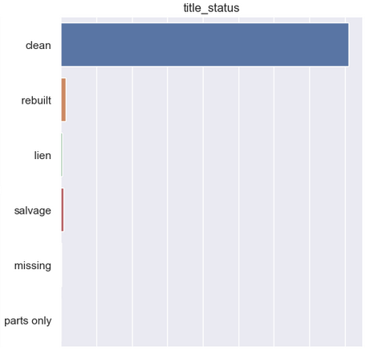
Categorical Features

Slide 15
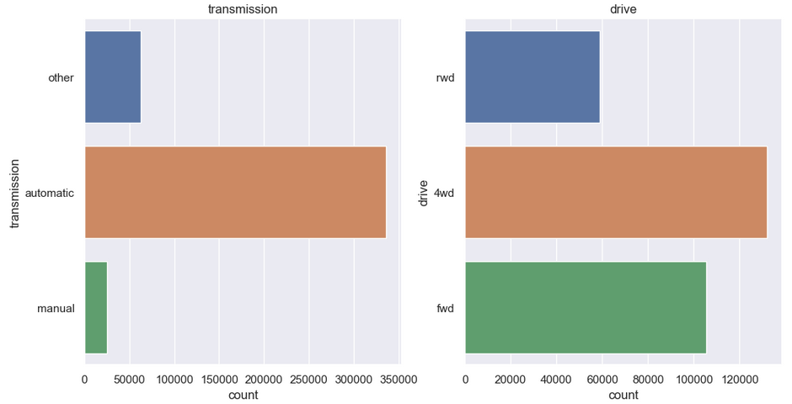
Categorical Features

Slide 16
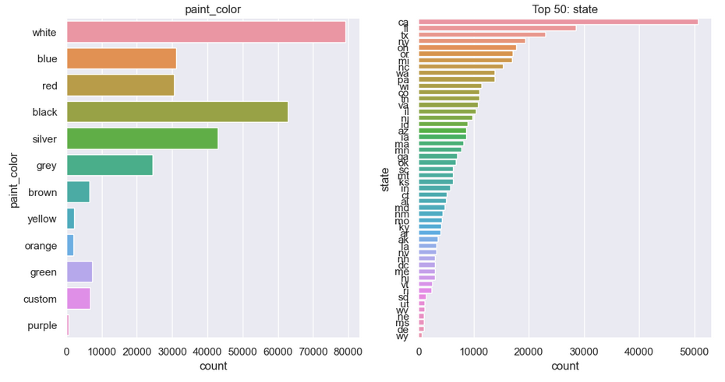
Categorical Features

Slide 17
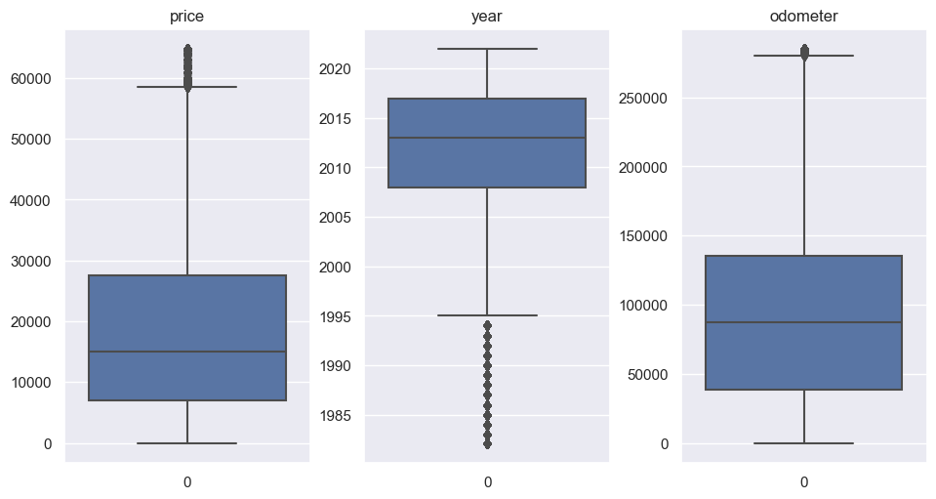
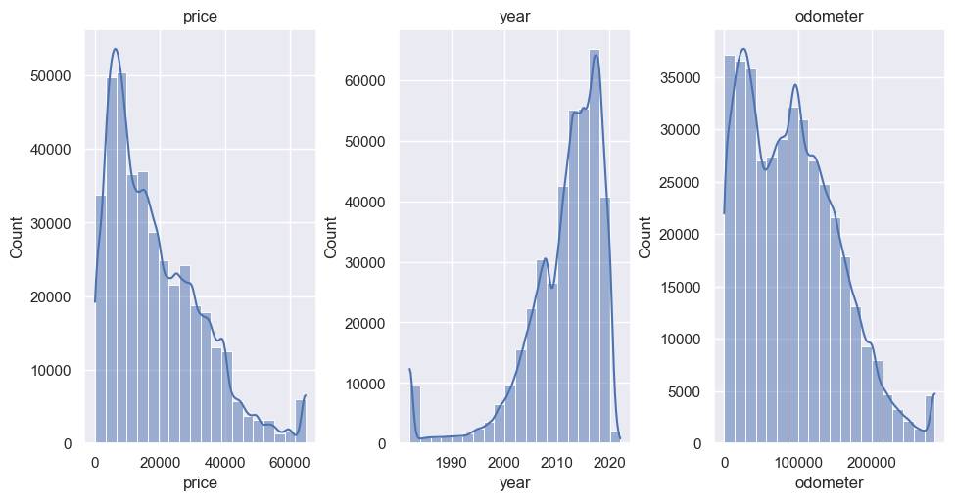
Data Preparation
Imputed missing values
Categorical mode
Numerical: mean
Drop rows missing price
Cleaned dataset contains 393, 909 rows (vs 426,880 original)
Capped outliers
Price > 300,000 or < 1
Years > 2023
Odometer > 300,000
Anything > 3 stdev from mean

Slide 18
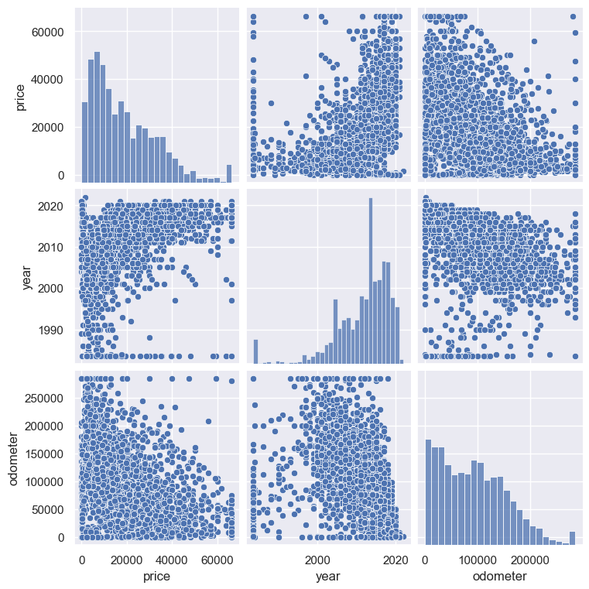
Pair Plots
On cleaned numerical features of sampled dataset.

Slide 19
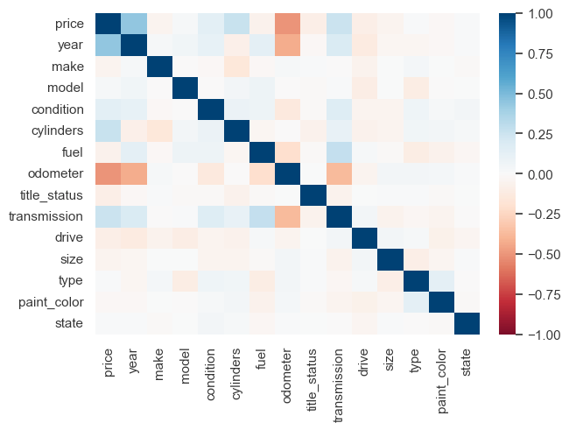
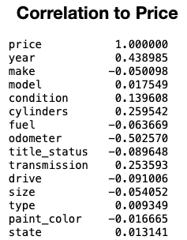
Correlation Matrix
Notes:
This is on the dataset after cleaning and imputing missing values.

Slide 20
Regression Models
Examined multiple types of regression models for predicting price.
Used linear, Ridge, and Lasso regression models for baseline
Also compared a random forest model.
Then an XGBoost model.
Also used a slightly different XGBoost model to evaluate feature importance.
For our baseline models
Minimal tuning of hyperparameters.
Normalized the scale of the numeric features(sklearn’s StandardScaler),
Used one-hot encoding for the categorical features.

Slide 21
Challenges
EDA notebook for cleaning data kept crashing due to dataset size.
Visualizations made it crash, actually data cleaning pretty fast.
Had to disable pair plots for the full dataset.
Sparse categorical features
i.e. vehicle model has 29,667 unique values in the dataset.
One hot encoding with decision trees has some drawbacks
Had to use leave one out encoding for getting feature importance for XGBoost so could map back to original columns, but LOO had slightly worse regression performance.

Slide 22
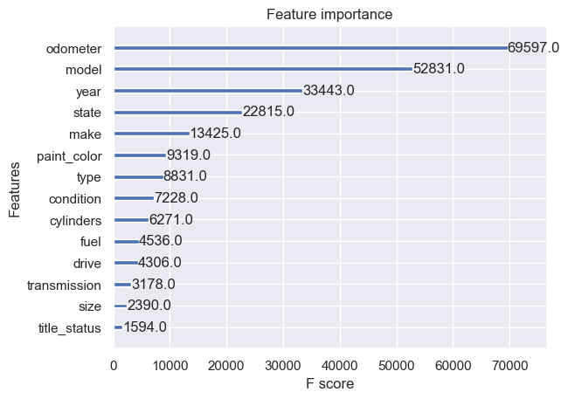
Feature Importance
Calculated by fitting XGBoost on cleaned data using LeaveOneOut encoding for categorical features.
Notes:
Model has a low correlation, but is very important according to Xgboost feature importance.
Probably due to very high number of values.

Slide 23
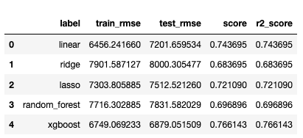
Regression Results - Baseline
To compare across the models we
Used RMSE as primary metric,
Along with R2 score, aka as the coefficient of determination
We used 20% of the
data used for test set, with training
of the models done on the other 80%.
Notes:
https://en.wikipedia.org/wiki/Coefficient_of_determination
Plain Linear is surprisingly good in comparison.

Slide 24
Regression Results – Tuned XGBoost
n_pca_comp = 10
# Using LeaveOneOut and PCA
cat_encoder = Pipeline([
('LOO', ce.LeaveOneOutEncoder(return_df=False)),
('PCA', PCA(n_components = n_pca_comp,random_state=193))
])
alt_pre_process = ColumnTransformer(remainder='passthrough',
transformers=[
("cat_encoder", cat_encoder, cat_cols),
('scale_data', StandardScaler(), numeric_cols),
])
Experimented with different encoding of columns and learning rates for XGBoost.
Best results so far are from changing the learning rate to 0.3, and using leave one out encoding, followed by PCA for for the categorical feature encoding.
Trained for 5000 rounds.
This also results is many fewer columns in the model which makes training much faster compared to one-hot encoding.

Slide 25
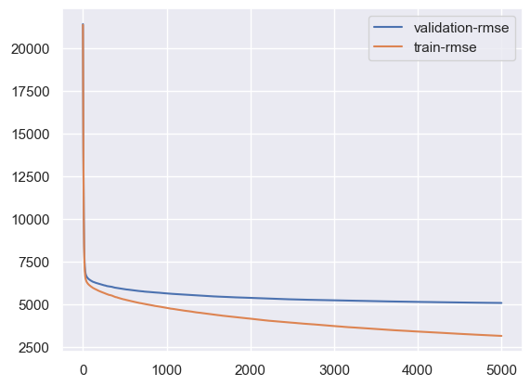
Regression Results – Tuned
RMSE of train data: 1771.48
RMSE of test data: 4944.28
R2 Score of test data: 0.879
Notes:
Saving model to model_xgboost_2023_03_13_16_35_43.pkl
The one hot encoding version performs a bit better than PCA + LeaveOneOut, but it uses much more memory and is slower.

Slide 26
Inference
To make the model practically useful, I saved the trained model and fitted preprocessor pipeline so they could be loaded and used in a separate notebook, used_car_price_predictor.ipynb, to verify I could duplicate test results from the saved model.

Slide 27
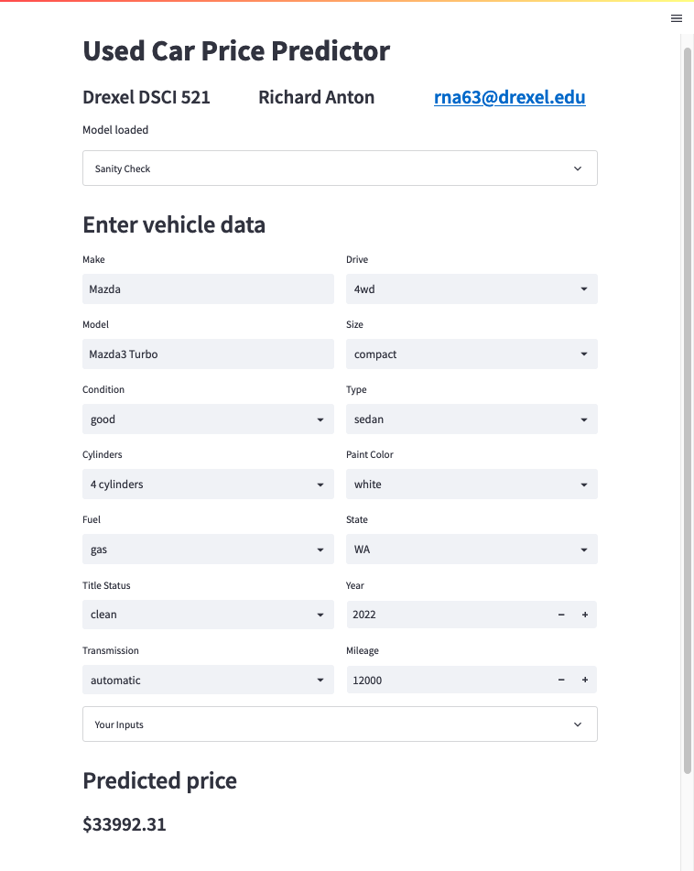
Streamlit App
Created a Streamlit web app
Uses the trained model to interactively predict price for a vehicle based on vehicle data entered by the user.
https://ranton256-used-car-sale-price--streamlit-price-predictor-tt183q.streamlit.app/

Slide 28
Summary
Imputation and cleaning of data took significant effort.
XGBoost performed the best, with random forest second.
But also required more preprocessing of features and tuning.
Most important features were odometer mileage, model, year, state, and make in that order.
The final trained model proposed reasonable results in most cases.
But there are edge cases where it outputs unreasonable values.

Slide 29
Future Work
More thorough search of best hyperparameters for XGBoost model
Plot map of states color-coded for high/low mean price
Faceted histograms of price across different values of each feature column to better visualize the relationship between each variable and price.
Experiment with MLP/neural network based regression model.
Use the CarGurus dataset with the same models and similar features to compare results.
Incorporate an NLP model of some kind to include information from the description text of each listing to improve the price prediction.

Slide 30
References
Coefficient of determination. (Mar 2023). In Wikipedia. https://en.wikipedia.org/wiki/Coefficient_of_determination
Chen, T., He, T., Benesty, M., Khotilovich, V., Tang, Y., Cho, H., ... & Zhou, T. (2015). Xgboost: extreme gradient boosting. R package version 0.4-2, 1(4), 1-4.
Ho, T. K. (1995, August). Random decision forests. In Proceedings of 3rd international conference on document analysis and recognition (Vol. 1, pp. 278-282). IEEE.
Hoerl, A. E., & Kennard, R. W. (1970). Ridge regression: Biased estimation for nonorthogonal problems. Technometrics, 12(1), 55-67.
Reese, A., (2021). Used Cars Dataset: Vehicles listings from Craigslist.org, v10. Retrieved Jan 28, 2023 from https://www.kaggle.com/datasets/austinreese/craigslist-carstrucks-data
Scikit-learn: Machine Learning in Python, Pedregosa et al., JMLR 12, pp. 2825-2830, 2011.
Tibshirani, R. (1996). Regression shrinkage and selection via the lasso. Journal of the Royal Statistical Society: Series B (Methodological), 58(1), 267-288.

