Slide 1

Used Car Pricing
Drexel DSCI 521: Final Project - Richard Anton - Winter 2022/2023
Notes:
Hello

Slide 2


Group 8 - Team
Full time software developer, part time student.
Proficient in Python and a number of other programming languages.
In Seattle area, work and time-zone makes group project collaboration challenging.
Completed ML, AI, deep learning, and computer vision courses at Drexel.
Minimal prior experience with exploratory data analysis and data cleaning or preparation.
Not much experience with tools and libraries like Pandas and Scikit-learn; prior courses usually required implementing algorithms “from scratch”, i.e. just using NumPy.
Richard Anton
rna63@drexel.edu
MSCS student
(will complete at end of Spring ’23)
Notes:
Intro
Final project
For CS 613 Machine learning

Slide 3
Project Overview
A number of the prior projects that I have worked on have been focused on classification, for example of images or sentiment analysis of textual data.
Since much of my experience with handling data sets for machine learning problems has been through graduate CS courses, I have implemented them typically without a dependency on anything but NumPy and matplotlib for visualizing results, which means I have limited experience with existing common tools like scikit-learn.
I am competent at using LaTex, but not an advanced user.
I have significant experience with NumPy and some experience using Pandas. I also have experience with matplotlib for visualizing aspects of data, but less with Seaborn.
The areas and skills I would like to grow through this project are:
More hands-on experience with scikit-learn and Pandas libraries.
More practice with visualization tools, such as matplotlib and Seaborn.
More practical experience with investigating a dataset, i.e. what data cleaning is needed and what relationships can be discovered in the data.
Experience with a practical machine learning regression problem.
Feature selection techniques to make machine learning problems more effective.

Slide 4
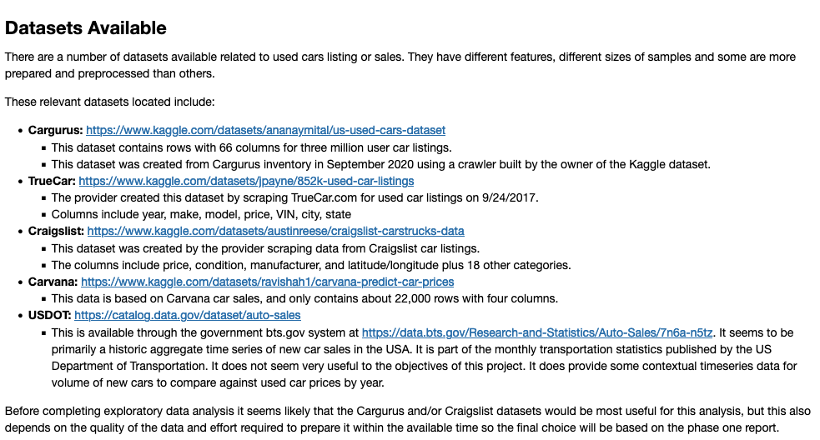
Dataset
TODO:
Replace
With
Txt

Slide 5
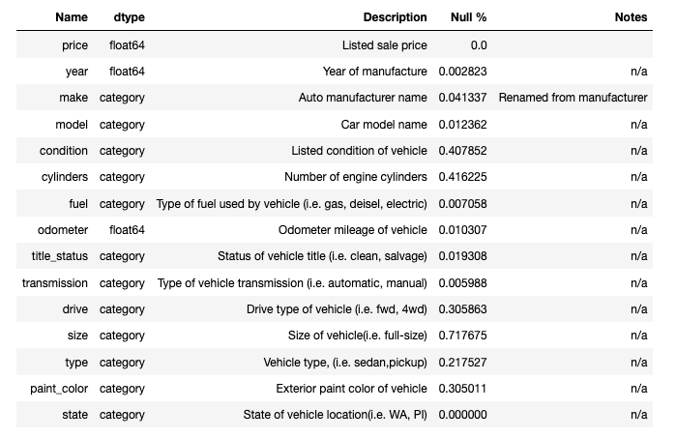
Data Dictionary
Columns we used from the Craigslist dataset.

Slide 6
Unused Columns
These columns we dropped after EDA before cleaning the data set.
id, url, VIN, image_url - unique to each listing
posting_date – only have data from limited period of time so not useful to determine seasonality
region, region_url, county, lat, and long - using state as a single column for the effect of the vehicle location on price.

Slide 7
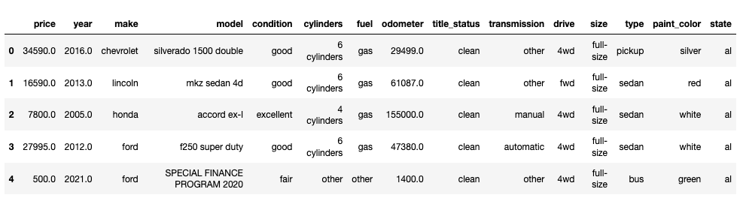
Data Samples

Slide 8
EDA 1
TODO: should be more than one slide

Slide 9
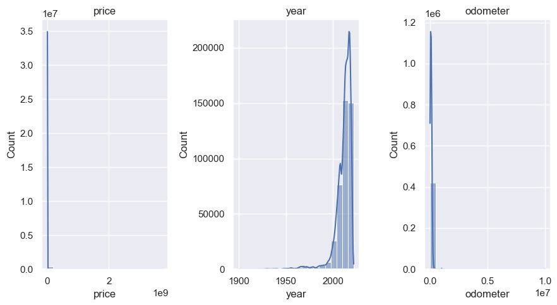
Numeric Features - Histogram

Slide 10
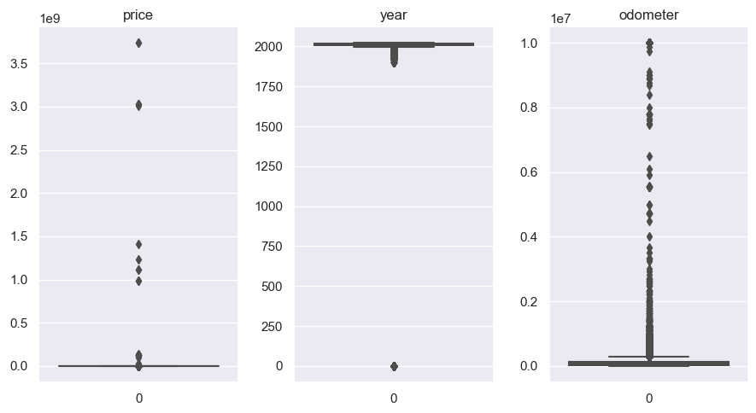
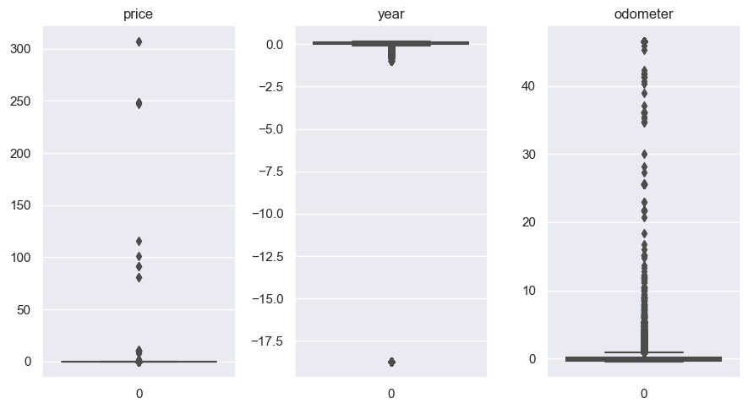
Numeric Features - Box Plots
Unnormalized
Normalized

Slide 11
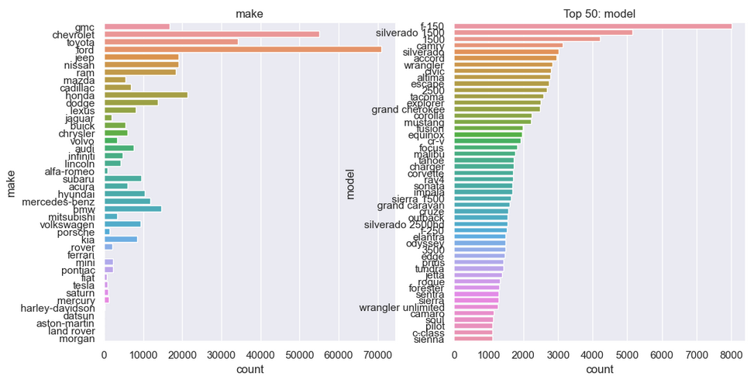
Categorical Features

Slide 12
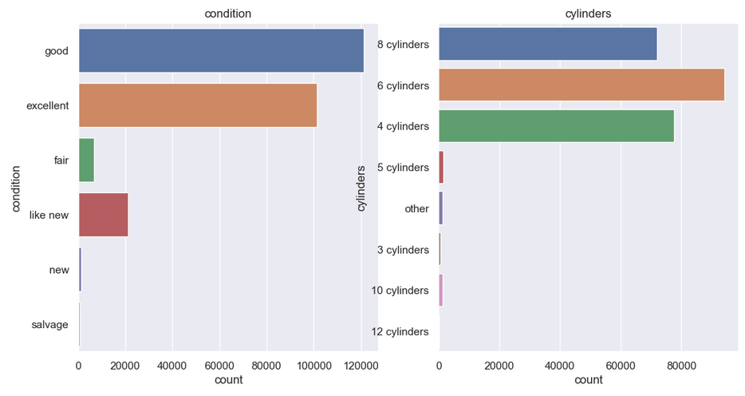
Categorical Features

Slide 13
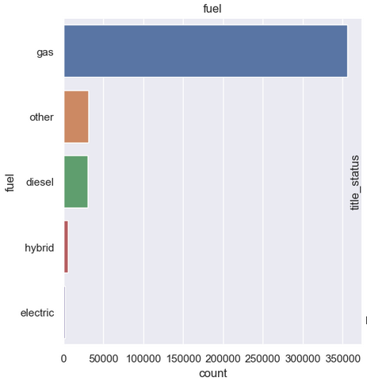
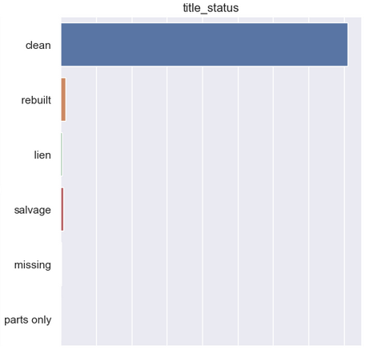
Categorical Features

Slide 14
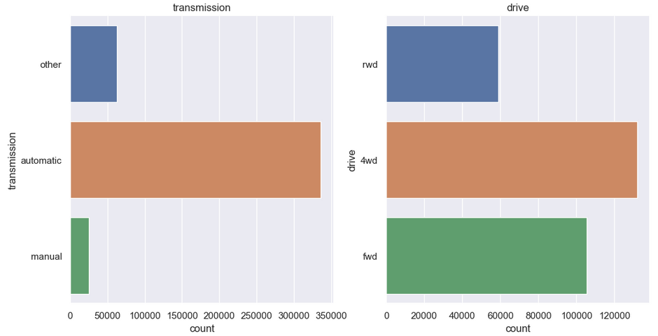
Categorical Features

Slide 15
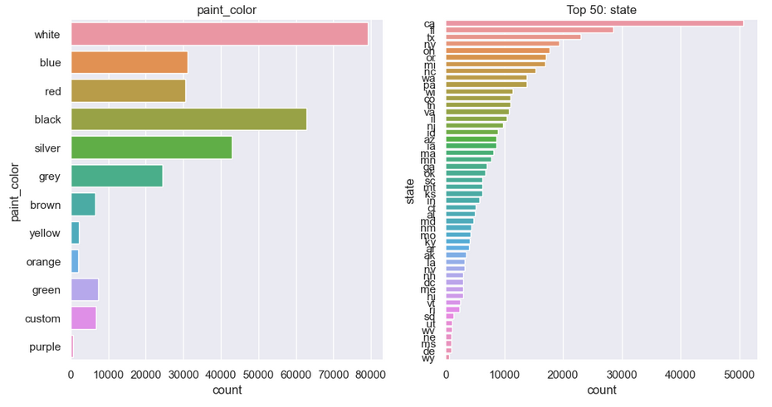
Categorical Features

Slide 16
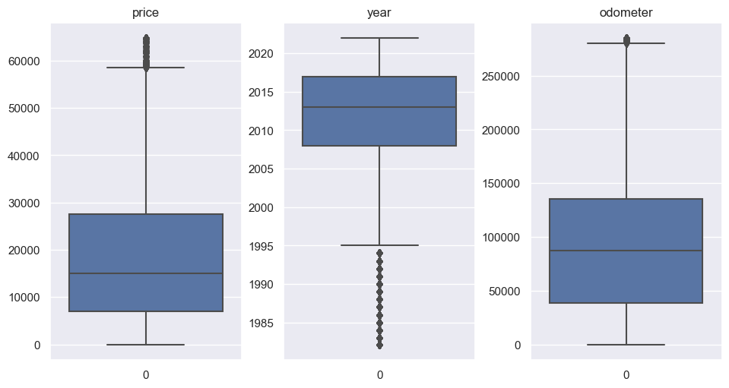
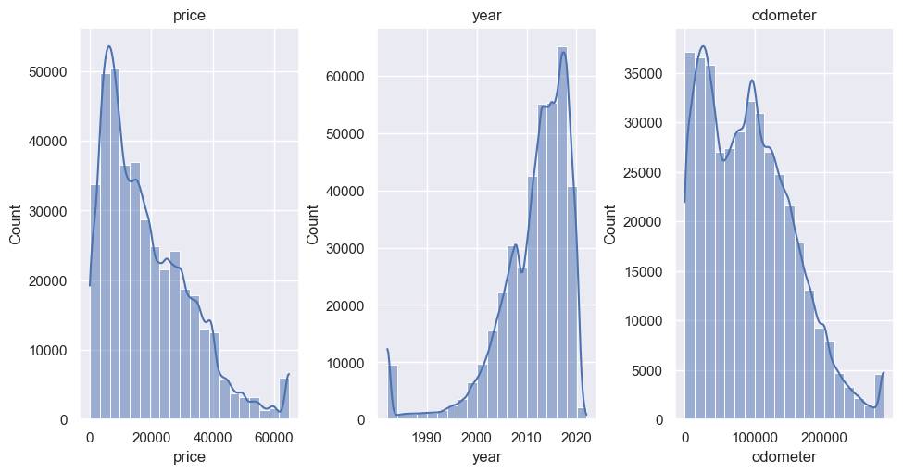
Data Preparation
Imputed missing values
Categorical mode
Numerical: mean
Drop rows missing price
Capped outliers
Price > 300,000 or < 1
Years > 2023
Odometer > 300,000
Anything > 3 stdev from mean

Slide 17
Regression Models
TODO:

Slide 18
Challenges
EDA notebook for cleaning data kept crashing due to dataset size.
Visualizations made it crash, actually data cleaning pretty fast.
Had to disable pair plots for the full dataset.
Sparse categorical features
i.e. model
One hot encoding with decision trees has some drawbacks
Had to use leave one out encoding for getting feature importance for XGBoost so could map back to original columns, but LOO had worse regression performance.

Slide 19
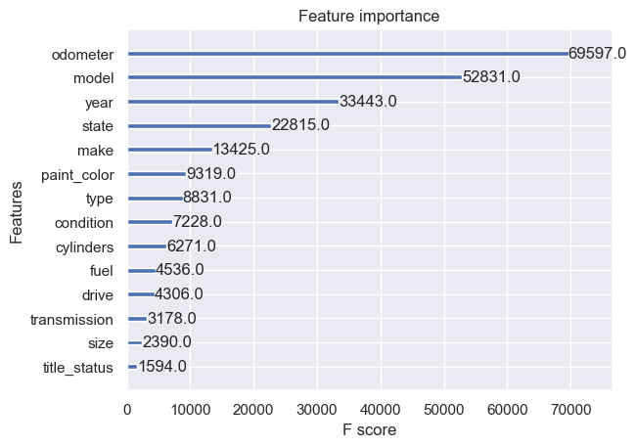
Feature Importance
Calculated by fitting XGBoost to cleaned data using LeaveOneOut encoding for categorical features.

Slide 20
Regression Results - Baseline

Slide 21
Regression Results – Tuned

Slide 22
Summary

Slide 23
Future Work

Slide 24
References

