Slide 1
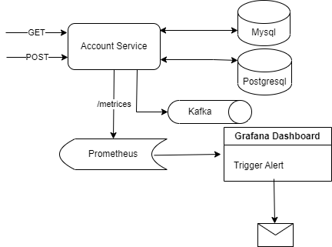
Advance monitoring & alerting in microservice
Advance alert & monitoring system helps to get the notification and solve the application problem before end user report that issue in production, it keeps checking multiple database connectivity, kafka connectivity and any API failures or slow response to notify the concern persons in advance. (Based on the input, data will be saved to different db tables)
Springboot microservice having REST apis(GET,POST) with different response code(200,400,500)
Microservice is having two different database connectivity( Mysql & PostgresSql ).
Microservice is having a kafka connection as a consumer.
Monitoring mechanism is needed to trigger an alert in case of either of the DB connectivity goes down or kafka connectivity goes down or any api returns 500 response code.
Technology used are – springboot actuator, Prometheus, Grafana.

Slide 2
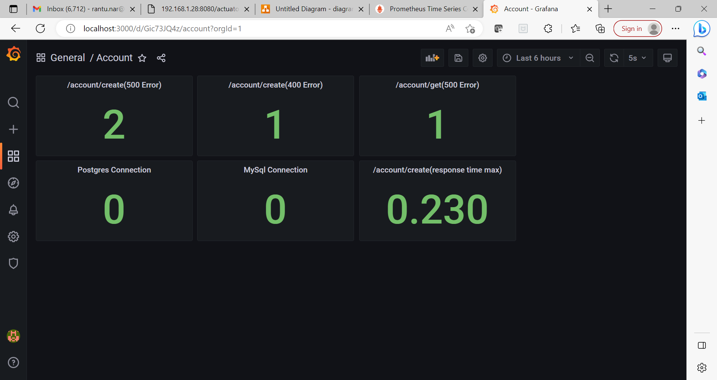
Grafana Dashboard & Alert
Dashboard is having 6 major panel (MySql Connection, PostgreSql Connection, GET api 500, POST api 500, POST 200 max response time, kafka connection)
MySql Connection & PostgreSql Connection value could be 0 or 1 where 0 means connection is ok and 1 means error.
Kafka connection value grater than 0 means it connected to brokers where 0 means no connection.
The alert will be trigger if either of MySql Connection/Postgres Connection value become 1 or Kafka Connection value become 0 or GET/POST(500) panel value becomes more than 0.
It’s also possible to monitor the max response time of /account/create api to determine if it’s more than expected average value or not then the alert can be sent for further investigation to identify the slowness of API.

