Slide 1

Impact of Mask MandateS on CoviD-19 A-Team Carolina Segovia Setordji Abotsi Andres Pulido Radhika Ansuri Chris Torkelson
Feb 12, 2022

Slide 2

Discussion Agenda
Discuss What we analyzed and Why
Discuss the Approach
Explain how we set up our Graphs
Describe our Results
State our Conclusion

Slide 3
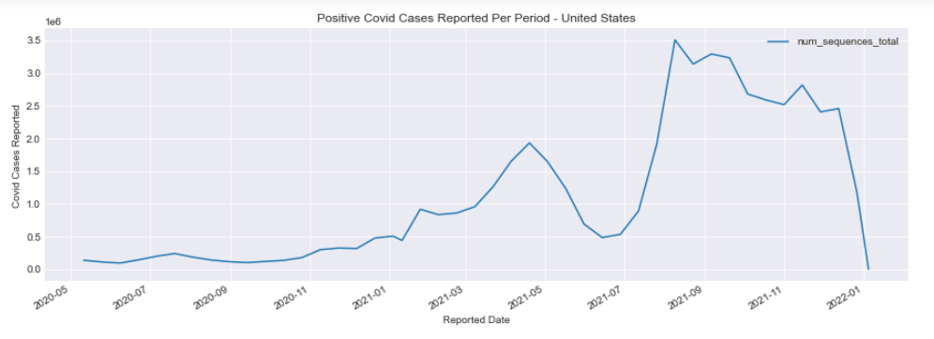
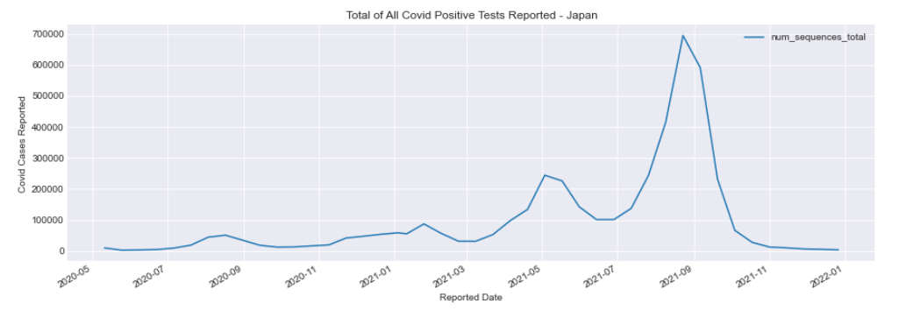
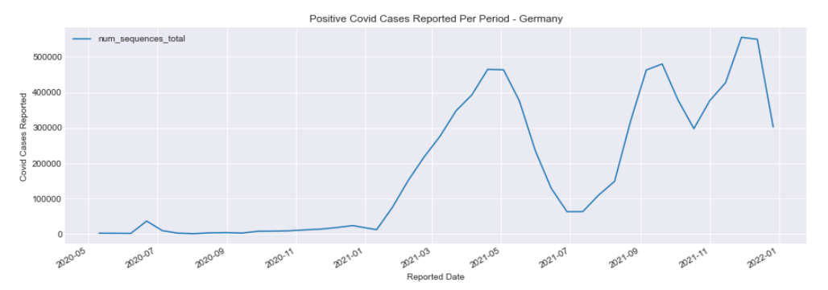
What we Analyzed and Why
There is a lot of controversy surrounding Covid Mask mandates and we wanted to see if we could determine if Mask Mandates actually impacted the spread of Covid across the globe to help policy makers understand the impact of masking and make more informed decisions about masking for future Covid-19 variants and future pandemics.
Discovery
Analyzed multiple Covid-19 Data Sets
Our World in Data – Face Covering Policies during the Covid-19 Pandemic
Kaggle - Omicron Daily Cases by Country
Our World in Data - Covid-cases#cumulative-confirmed-cases-per-million-people
Key discovery during preliminary data analysis was that there were two “waves” of Covid-19 that occurred between 2020 and 2022 that were apparent in each country we examined. See graph right.
Examined multiple options for how best to assess the impact of Masking
Comparing the total number of cases reported in different countries with respect to their overall masking policies.
Comparing the total number of cases reported in different countries while adjusting for, population size, population density, and testing rigor.
Analyzing how the timing of the mask mandates impacted the amplitude and duration of the two Covid-19 waves.
COVID-19 Cases Reported by Country
(May 2020 – Jan 2022)
United States
Wave 1
Wave 2
Japan
Wave 1
Wave 2
Germany
Wave 1
Wave 2
Source : www.kaggle.com/ashokkumarbibbab/covid-19-omicron-variant-and-daily-cases-analysis/data

Slide 4
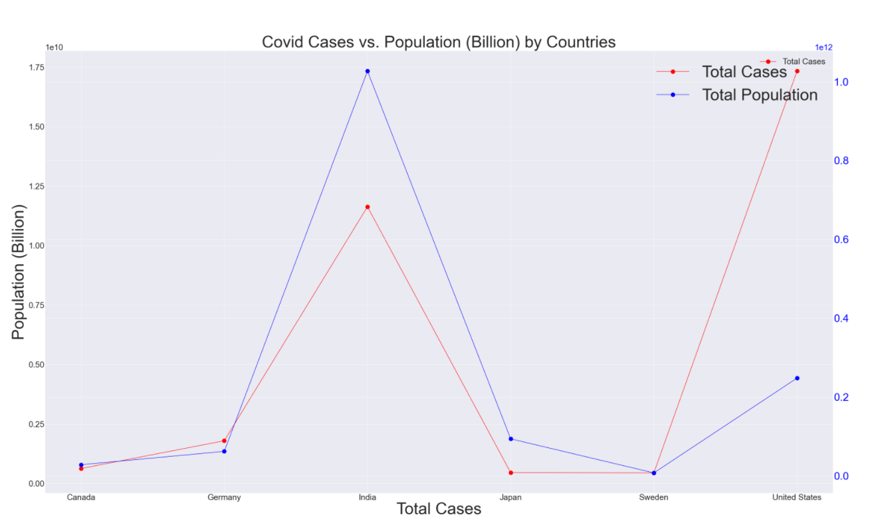
Approach
After analyzing the Covid cases by population graph, we determined that we can not attempt to compare case volumes between countries as there are too many variables such as population size, population density and Covid testing rigor that impact the total number of cases within each country.
The graph, upper right, compares the six countries we examined using the number of Covid cases reported versus country population. It documents that India with a population 5X the size of the US and 10X the population density, reported 68% of the cases that the US reported. If India was able to test at the same rigor as the US they would have
Analyze six countries ( two each) from three different continents to keep scope manageable. Chose US, Canada (NA), Sweden, Germany (EU) Japan, India (Asia) after examining our data to make sure they were countries that consistently and thoroughly reported their Covid numbers.
The primary data set used was the “Oxford Covid-19 Government Response Tracker”, Blavatnik School of Government, University of Oxford, England.
Approach Decision
Decided the best approach, given the data we found, was to analyze how the timing of the mask mandates impacted the amplitude and duration of the two Covid-19 waves comparing counties on three continents, US, Europe and Asia.
United States
Wave 1
Wave 2

Slide 5
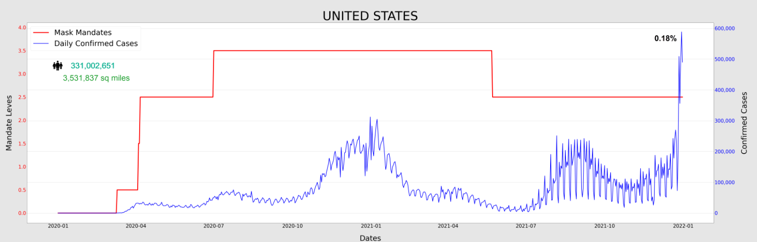
How to Read our Graphs
Covid Mask Mandates / Daily Confirmed Cases
Red Line / Left side scale
Blue Line / Right side sale
Daily Confirmed Covid Cases
Scale is in 100,000 increments
The US started with mask mandates in March of 2020 with masking “ .05 - Recommended” then aggressively increased mandates in “July of 2020 to a “3.5 – Required in all places outside the home.” They then reduced the mandate to “ 2.5 – Required in all public place” in July of 2021.

Slide 6
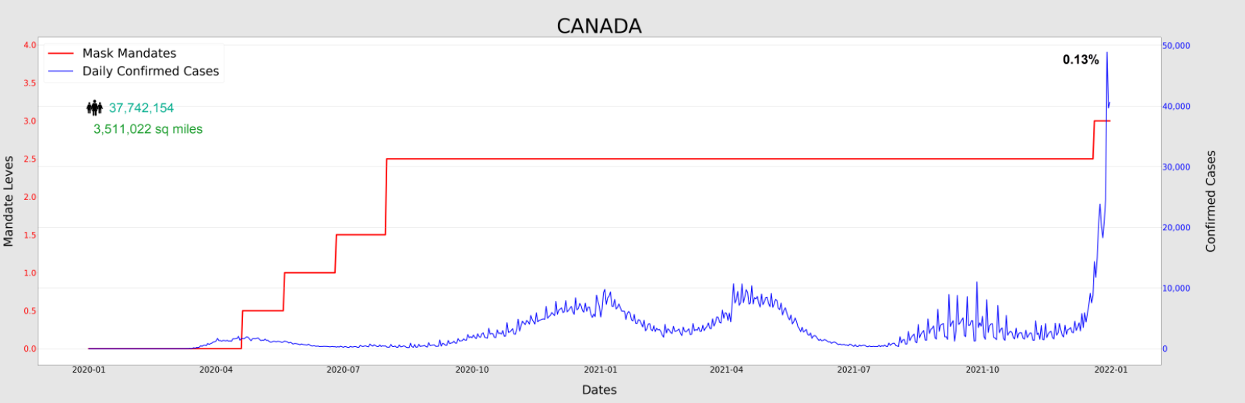
United States and Canada Analysis (NA)
Observations:
Both the US and Canada issued mask mandates in early 2020 before the first major Covid wave and continued mandates throughout the pandemic.
The US had slightly stronger mandates of a 3.5 vs 2.5 for Canada for the first wave between July of 2020 and March of 2021
Both countries experienced similar peaking of the initial two waves.
Despite masking policies both countries saw spikes at the start of 2022 with Omicron
Take Away:
The 2.5 level – “Masking required in all public places” that both countries had in place, did not prevent the end of year spike in cases that was due to Omicron.
Not enough evidence to conclude that masking impacted the number of Covid cases from this data analysis

Slide 7
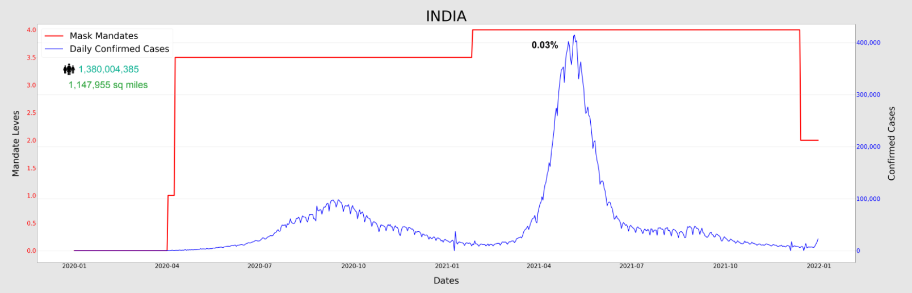
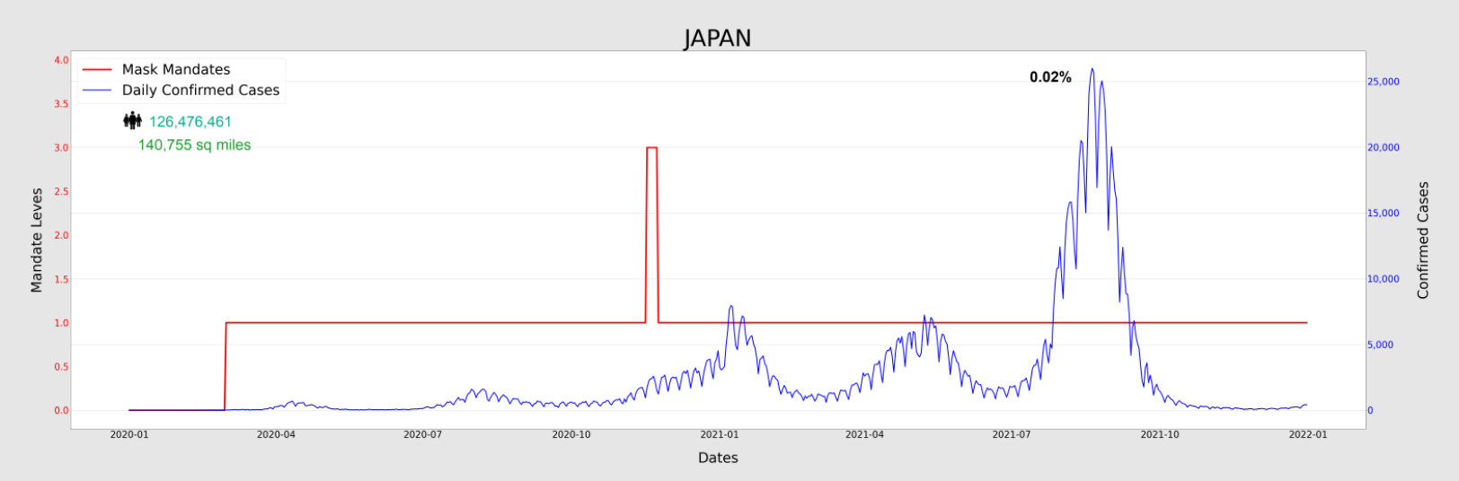
India and Japan (Asia)
Observations:
India and Japan had significantly different mask mandate policies, with India having the most aggressive policy of masks being required in all public places outside the home and Japan only recommending masks.
Of note is that Japan increased their mask mandate in June of 2021 then quickly reversed that decision and went back to recommended.
Despite these mask mandate differences, both countries experienced the two waves of Covid with the first wave peaking at a much lower level than the second. This may be due to the testing becoming more available after the first wave, but more analysis is required.
India has 10x the population of Japan with similar levels of population density, and reported 20x the number of Covid cases despite having much stronger masking, providing no evidence that masking reduced the number of Covid cases
Take Aways:
Despite significantly stronger Mask Mandate policies in India the relative amplitudes across the two waves of Covid are similar and India reported around 2X the number of Covid cases than Japan adjusting for population size and density
Not enough evidence to conclude that masking impacted the number of Covid cases from this data analysis.

Slide 8
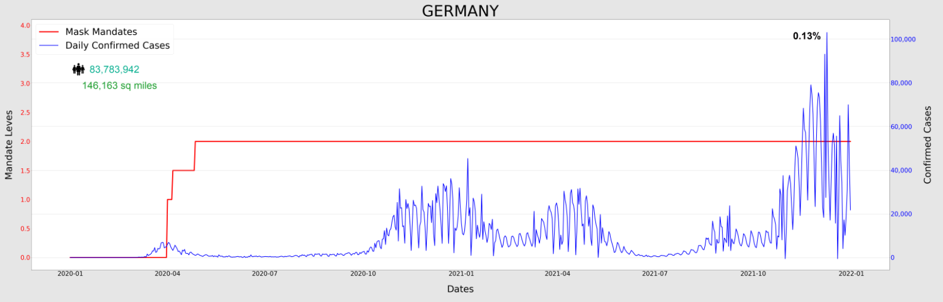
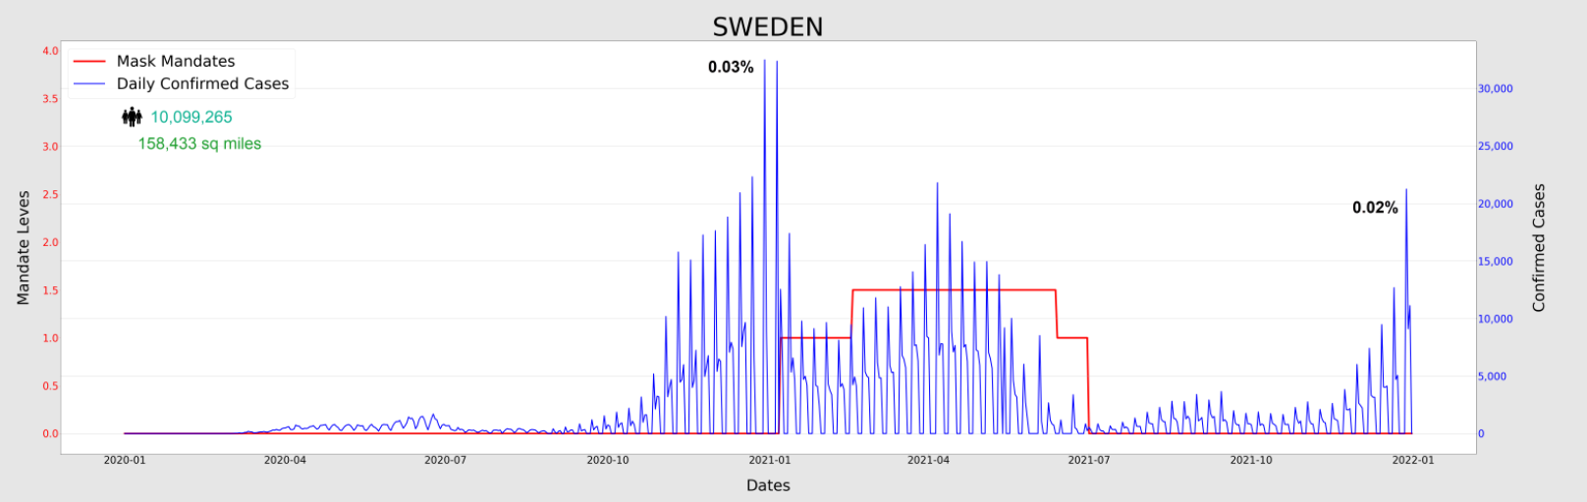
Germany and Sweden (EU)
Observations:
Germany and Sweden had significantly different mask mandating policies through 2020 with Germany issuing a 2.0 level “Masks required early in 2020 and Sweden having No Policy throughout 2020.
With no mask mandates throughout 2020 Sweden’s first wave of Covid shows a major spike in reported Covid cases in Q4. This spike is high when compared to the relative amplitudes of the first waves of Covid in the other five countries.
Sweden’s first wave spike is also much higher in total number of cases reported when compared with Germany. Sweden with a population of 1/8 of Germany peaked out at 35,000 cases per day compared to Germany’s peak of 45,000 per day and Germany’s population is 10X as dense as Sweden. Therefore, adjusting for population size and density we can estimate the Sweden reported around over 10x the number of Covid cases that Germany did.
The other major variable that could impact these numbers is a difference in testing rigor between Sweden and Germany. An analysis of the rigor of Corona Virus testing suggested that Sweden focused its Corona Virus testing on essential workers Germany had a broader testing policy that included opening up theaters and football (soccer) stadiums for free rapid testing. This suggest that Germany performed more rigorous testing than Sweden.
There also appears to be a significant drop in reported cases in Sweden in alignment with when they issued the Level 1 “Recommendation” to mask at the beginning of 2021.
1
2

Slide 9
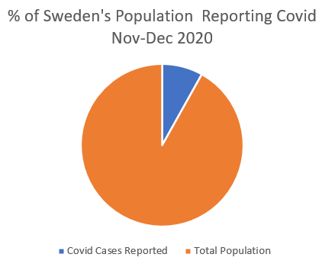
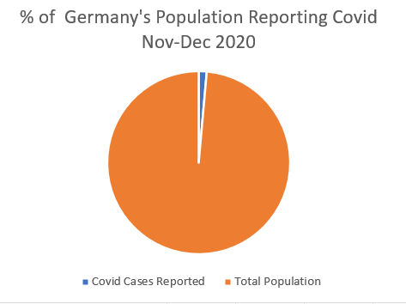
Conclusion
Sweden provided an excellent opportunity to analyze the impact of a Mask Mandates going from No Policy (Level 0) to Recommended (Level 1) in the middle of Wave 1 of Covid Pandemic.
Sweden’s data shows that not having any form of a mask mandate resulted in a 8X higher volume of Covid when compared to Germany that had a level 2 mask mandate.
Sweden’s data also shows that one week after the issuance of a Level 1 Mask Mandate, the Covid positive test volume decreased by over 2/3’s from 35,000 daily cases to fewer the 10,000 daily cases.
Mask Mandates Work and can significantly decrease the spread of Corona Virus in the short-term, and can decrease the amplitude of a Corona Virus Wave.
1
2
8.8%
1.4%

Slide 10
Extra Slides

Slide 11
Conclusion - “Mask Mandates Work”
There are a lot of variables involved that impact the number of positive Covid tests reported in a country. Availability of tests, access to testing sites, public sentiment on testing and other factors can greatly affect how number are reported.
The analysis of US and Canada, and India and Japan, who all had some level of mask mandates, did not provide evidence that mask mandates reduced the number of Covid cases.
The comparison between Sweden, with no mask mandate, and Germany with a level 2 mask mandate throughout most of 2020 through 2022, however, showed strong evidence that the lack of mask mandates increased the number of Covid Cases that Sweden would have seen when compared to Germany.
The evidence could lead to the idea that the level of Mask Mandates is not as important as the fact that some level of a mask mandate is put in place. That could help explain why the analysis between counties that had some form of Covid Mask Mandate did not yield any significant material differences in positive Covid testing volumes.
After looking at all the evidence, the final conclusion is that “Mask Mandates Work.” Sweden was one of the few countries that did not issue a mask mandate in 2020 prior to Covid Wave 1 and they experienced 10X the cases that would have been expected when compared to Germany.
Additionally, when Sweden decided to issue a Mask Manger during Covid Wave 1, their cases reported dropped by almost ½ the week after they issued the mandate.
The higher volumes of cases during that would have been expected when compared to Germany, along with the sharp reduction in cases the week after issues their first Mask Mandate, suggests that had a mask mandate been issues by Sweden in mid 2020 they would have experienced significantly fewer, potentially 10X fewer positive Covid cases.

Slide 12
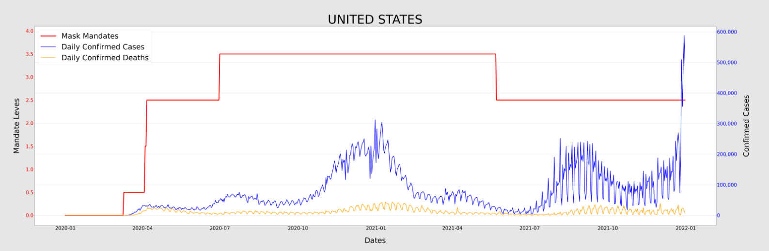
How to Read our Graphs
Covid Mask Mandates / Daily Confirmed Cases
Red Line / Left side scale
Blue Line / Right side sale
Daily Confirmed Covid Cases
Scale is in 100,000 increments
Yellow Line / Right side scale
Daily Confirmed Covid Deaths
Scale is in 100,000 increments
The US started with mask mandates in March of 2020 with masking “ .05 - Recommended” then aggressively increased mandates in “July of 2020 to a “3.5 – Required in all places outside the home.” They then reduced the mandate to “ 2.5 – Required in all public place” in July of 2021.
We examined both Covid Cases and Covid Deaths, and decided it was best to focus on Covid Deaths, because they remove the variable of the rigor of testing and make comparisons between countries more viable.

Slide 13
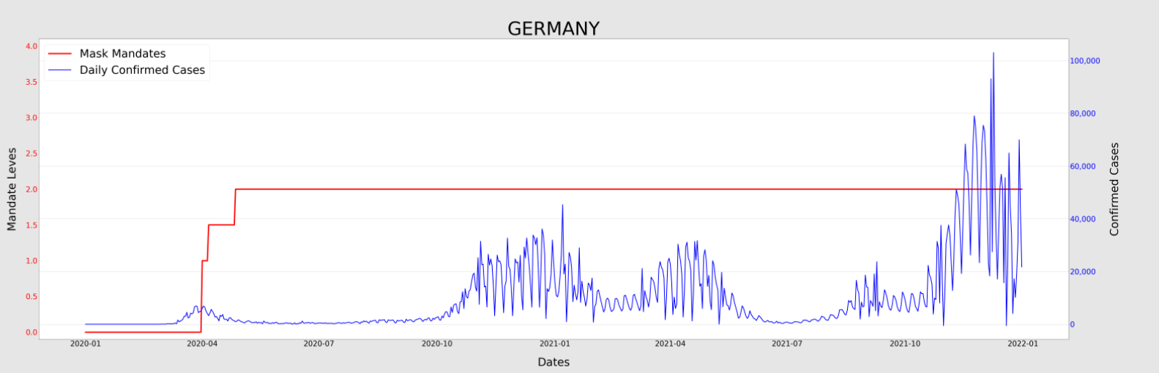
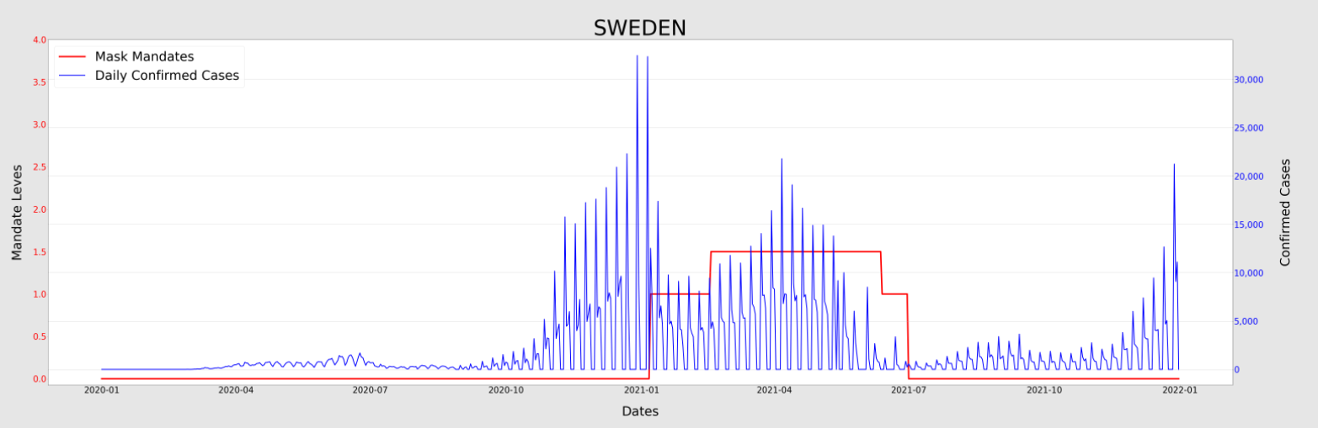
Germany and Sweden (EU)
Take Aways
The population adjusted 10X larger volume of cases for Sweden with no masking policy during the 1st Wave of Covid at the end of 2020 as compared with the level 2 masking policy of Germany provides strong evidence that not masking caused Sweden to have a much higher volume of Covid cases than they would have if they had masked.
Further supporting this claim is that when Sweden did issue their level 1 mask mandate, their Covid numbers immediately dropped to about ½ the number they had the previous week.
The fact that Sweden focused it Covid testing on essential workers and Germany had a more open, broad testing plan, and still reported similar numbers of Covid cases with 8X the population and 10X the density, further supports the assessment that masking decreased the number of Covid cases would have had without the Mask mandate.
1
2

