Slide 1
Enhanced data security in cloud transmission using aes algorithm and two-factor authentication
Presented by
Ranveer Sahu
es21btech11025@iith.ac.in

Slide 2
Why we need to secure data ?
Before receiver receive message from sender, there is a high probability that third party can access the data.
To make the privacy of user more secure we need to use a High Level Algorithm with some extra authentications.
Here we are using AES algorithm with 2– Step verification.

Slide 3
WhY AES ?
It is a symmetric key encryption algorithm.
It is more Powerful than 3-DES(data encryption standard).
Strong Security and High Performance.
AES is a Block cipher encrypt 128 bits(16 bytes) of data at a time.
It treats the 16 bytes as a grid of 4x4. Messages which are longer than 128 bits are broken into 128 bits.

Slide 4
Implementation of AES with 2-step authentication
Below are some steps in order to be followed during implementation:
REGISTRATION
AUTHENTICATION
COMMUNICATION

Slide 5
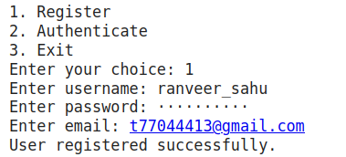
user registration
If user is already registered, they can directly go for authentication.
If user is new then user first must have to register on the platform with:
create a username
create user password
Email id

Slide 6
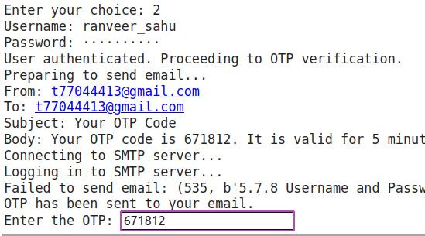
authentication
Now to authenticate the user, user must have to log-in with correct credentials which they have created during registration.
user will get OTP on their registered
email id to verify.
if above all are done then they will
get granted access for communication.

Slide 7
If access granted
Select (1) for “message” and (2) for “file path”
For messages, add a passphrase and then we get
Encrypted output:
Decrypted output:

Slide 8
Conclude:
When a sender transmits a message to a receiver, the plaintext is converted into ciphertext upon completion of the encryption process. This transformation renders the text unreadable without the corresponding decryption key. To enhance security, two-factor authentication is implemented.

Slide 9


