Slide 1
operators

Slide 2
Mathematical Operators
Addition +
Subtraction -
Multiplication *
Division /
Modulus %

Slide 3
Simple Arithmetic
public class Example {
public static void main(String[] args) {
int j, k, p, q, r, s, t;
j = 5;
k = 2;
p = j + k;
q = j - k;
r = j * k;
s = j / k;
t = j % k;
System.out.println("p = " + p);
System.out.println("q = " + q);
System.out.println("r = " + r);
System.out.println("s = " + s);
System.out.println("t = " + t);
}
}
> java Example
p = 7
q = 3
r = 10
s = 2
t = 1
>

Slide 4
Shorthand Operators +=, -=, *=, /=, %=
Common Shorthand
a = a + b; a += b;
a = a - b; a -= b;
a = a * b; a *= b;
a = a / b; a /= b;
a = a % b; a %= b;

Slide 5
Shorthand Operators
public class Example {
public static void main(String[] args) {
int j, p, q, r, s, t;
j = 5;
p = 1; q = 2; r = 3; s = 4; t = 5;
p += j;
q -= j;
r *= j;
s /= j;
t %= j;
System.out.println("p = " + p);
System.out.println("q = " + q);
System.out.println("r = " + r);
System.out.println("s = " + s);
System.out.println("t = " + t);
}
}
> java Example
p = 6
q = -3
r = 15
s = 0
t = 0
>

Slide 6
Shorthand Increment and Decrement ++ and --
Common Shorthand
a = a + 1; a++; or ++a;
a = a - 1; a--; or --a;

Slide 7
Increment and Decrement
public class Example {
public static void main(String[] args) {
int j, p, q, r, s;
j = 5;
p = ++j; // j = j + 1; p = j;
System.out.println("p = " + p);
q = j++; // q = j; j = j + 1;
System.out.println("q = " + q);
System.out.println("j = " + j);
r = --j; // j = j -1; r = j;
System.out.println("r = " + r);
s = j--; // s = j; j = j - 1;
System.out.println("s = " + s);
}
}
> java example
p = 6
q = 6
j = 7
r = 6
s = 6
>

Slide 8
Relational Operators > < >= <= == !=
Primitives
Greater Than >
Less Than <
Greater Than or Equal >=
Less Than or Equal <=
Primitives or Object References
Equal (Equivalent) ==
Not Equal !=
The Result is Always true or false

Slide 9
Relational Operator Examples
public class Example {
public static void main(String[] args) {
int p =2; int q = 2; int r = 3;
Integer i = new Integer(10);
Integer j = new Integer(10);
System.out.println("p < r " + (p < r));
System.out.println("p > r " + (p > r));
System.out.println("p == q " + (p == q));
System.out.println("p != q " + (p != q));
System.out.println("i == j " + (i == j));
System.out.println("i != j " + (i != j));
}
}
> java Example
p < r true
p > r false
p == q true
p != q false
i == j false
i != j true
>

Slide 10
Logical Operators (boolean) && || !
Logical AND &&
Logical OR ||
Logical NOT !

Slide 11
Logical (&&) Operator Examples
public class Example {
public static void main(String[] args) {
boolean t = true;
boolean f = false;
System.out.println("f && f " + (f && f));
System.out.println("f && t " + (f && t));
System.out.println("t && f " + (t && f));
System.out.println("t && t " + (t && t));
}
}
> java Example
f && f false
f && t false
t && f false
t && t true
>

Slide 12
Logical (||) Operator Examples
public class Example {
public static void main(String[] args) {
boolean t = true;
boolean f = false;
System.out.println("f || f " + (f || f));
System.out.println("f || t " + (f || t));
System.out.println("t || f " + (t || f));
System.out.println("t || t " + (t || t));
}
}
> java Example
f || f false
f || t true
t || f true
t || t true
>

Slide 13
Logical (!) Operator Examples
public class Example {
public static void main(String[] args) {
boolean t = true;
boolean f = false;
System.out.println("!f " + !f);
System.out.println("!t " + !t);
}
}
> java Example
!f true
!t false
>

Slide 14
Logical Operator Examples Short Circuiting with &&
public class Example {
public static void main(String[] args) {
boolean b;
int j, k;
j = 0; k = 0;
b = ( j++ == k ) && ( j == ++k );
System.out.println("b, j, k " + b + ", " + j + ", " + k);
j = 0; k = 0;
b = ( j++ != k ) && ( j == ++k );
System.out.println("b, j, k " + b + ", " + j + ", " + k);
}
}
> java Example
b, j, k true 1, 1
> java Example
b, j, k true 1, 1
b, j, k false 1, 0
>

Slide 15
Logical Operator Examples Short Circuiting with ||
public class Example {
public static void main(String[] args) {
boolean b;
int j, k;
j = 0; k = 0;
b = ( j++ == k ) || ( j == ++k );
System.out.println("b, j, k " + b + ", " + j + ", " + k);
j = 0; k = 0;
b = ( j++ != k ) || ( j == ++k );
System.out.println("b, j, k " + b + ", " + j + ", " + k);
}
}
> java Example
b, j, k true 1, 0
> java Example
b, j, k true 1, 0
b, j, k true 1, 1
>

Slide 16
Logical Operators (Bit Level) & | ^ ~
AND &
OR |
XOR ^
NOT ~

Slide 17
Twos Complement Numbers
Base 10 A byte of binary
+127 01111111
+4 00000100
+3 00000011
+2 00000010
+1 00000001
+0 00000000
-1 11111111
-2 11111110
-3 11111101
-4 11111100
-128 10000000

Slide 18
Adding Twos Complements
Base 10 Binary
+3 00000011
-2 11111110
+1 00000001
Base 10 Binary
+2 00000010
-3 11111101
-1 11111111

Slide 19
Logical Operators (Bit Level) & | ^ ~
int a = 10; // 00001010 = 10
int b = 12; // 00001100 = 12
a 00000000000000000000000000001010 10
b 00000000000000000000000000001100 12
a & b 00000000000000000000000000001000 8
&
AND
|
OR
a 00000000000000000000000000001010 10
b 00000000000000000000000000001100 12
a | b 00000000000000000000000000001110 14
^
XOR
a 00000000000000000000000000001010 10
b 00000000000000000000000000001100 12
a ^ b 00000000000000000000000000000110 6
~
NOT
a 00000000000000000000000000001010 10
~a 11111111111111111111111111110101 -11

Slide 20
Logical (bit) Operator Examples
public class Example {
public static void main(String[] args) {
int a = 10; // 00001010 = 10
int b = 12; // 00001100 = 12
int and, or, xor, na;
and = a & b; // 00001000 = 8
or = a | b; // 00001110 = 14
xor = a ^ b; // 00000110 = 6
na = ~a; // 11110101 = -11
System.out.println("and " + and);
System.out.println("or " + or);
System.out.println("xor " + xor);
System.out.println("na " + na);
}
}
> java Example
and 8
or 14
xor 6
na -11
>

Slide 21
Shift Operators (Bit Level) << >> >>>
Shift Left << Fill with Zeros
Shift Right >> Based on Sign
Shift Right >>> Fill with Zeros

Slide 22
Shift Operators << >>
int a = 3; // ...00000011 = 3
int b = -4; // ...11111100 = -4
a 00000000000000000000000000000011 3
a << 2 00000000000000000000000000001100 12
b 11111111111111111111111111111100 -4
b << 2 11111111111111111111111111110000 -16
<<
Left
a 00000000000000000000000000000011 3
a >> 2 00000000000000000000000000000000 0
b 11111111111111111111111111111100 -4
b >> 2 11111111111111111111111111111111 -1
>>
Right

Slide 23
Shift Operator >>>
int a = 3; // ...00000011 = 3
int b = -4; // ...11111100 = -4
a 00000000000000000000000000000011 3
a >>> 2 00000000000000000000000000000000 0
b 11111111111111111111111111111100 -4
b >>> 2 00111111111111111111111111111111 +big
>>>
Right 0

Slide 24
Shift Operator Examples
public class Example {
public static void main(String[] args) {
int a = 3; // ...00000011 = 3
int b = -4; // ...11111100 = -4
System.out.println("a<<2 = " + (a<<2));
System.out.println("b<<2 = " + (b<<2));
System.out.println("a>>2 = " + (a>>2));
System.out.println("b>>2 = " + (b>>2));
System.out.println("a>>>2 = " + (a>>>2));
System.out.println("b>>>2 = " + (b>>>2));
}
}
> java Example
a<<2 = 12
b<<2 = -16
a>>2 = 0
b>>2 = -1
a>>>2 = 0
b>>>2 = 1073741823
>

Slide 25
Shift Operator >>> and Automatic Arithmetic Promotion
byte a = 3; // 00000011 = 3
byte b = -4; // 11111100 = -4
byte c;
c = (byte) a >>> 2
c = (byte) b >>> 2
a 00000011 3
a >>> 2 00000000000000000000000000000000 0
c = (byte) 00000000 0
b 11111100 -4
b >>> 2 00111111111111111111111111111111 1073741823
c = (byte) Much to big for byte 11111111 -1
>>>
Right
Fill 0

Slide 26
Assignment Operator (=) and Classes
Date x = new Date();
Date y = new Date();
x = y;

Slide 27
Assignment Operator (=) and Classes
Date x = new Date();
Date y = new Date();
x = y;

Slide 28
Ternary Operator ? :
Any expression that evaluates
to a boolean value.
boolean_expression ? expression_1 : expression_2
If true this expression is
evaluated and becomes the
value entire expression.
If false this expression is
evaluated and becomes the
value entire expression.

Slide 29
Ternary ( ? : ) Operator Examples
public class Example {
public static void main(String[] args) {
boolean t = true;
boolean f = false;
System.out.println("t?true:false "+(t ? true : false ));
System.out.println("t?1:2 "+(t ? 1 : 2 ));
System.out.println("f?true:false "+(f ? true : false ));
System.out.println("f?1:2 "+(f ? 1 : 2 ));
}
}
> java Example
t?true:false true
t?1:2 1
f?true:false false
f?1:2 2
>

Slide 30
String (+) Operator String Concatenation
"Now is " + "the time."
"Now is the time."

Slide 31
String (+) Operator Automatic Conversion to a String
expression_1 + expression_2
If either expression_1
If either expression_1 or expression_2 evaluates
to a string the other will be converted to a string
if needed. The result will be their concatenation.

Slide 32
Operator Precedence
Unary
Arithmetic
Shift
Comparison
Logical Bit
Boolean
Ternary
Assignment
+ - ++ -- ! ~ ()
* / %
+ -
<< >> >>>
> < >= <= instanceof
== !=
& | ^
&& ||
?:
= (and += etc.)

Slide 33
Flow of Control
Flow of control is the order in which a program performs actions.
Up to this point, the order has been sequential.
A branching statement chooses between two or more possible actions.
A loop statement repeats an action until a stopping condition occurs.

Slide 34
The if-else Statement
A branching statement that chooses between two possible actions.
syntax
if (Boolean_Expression)
Statement_1
else
Statement_2

Slide 35
The if-else Statement, cont.
example
if (count < 3)
total = 0;
else
total = total + count;

Slide 36
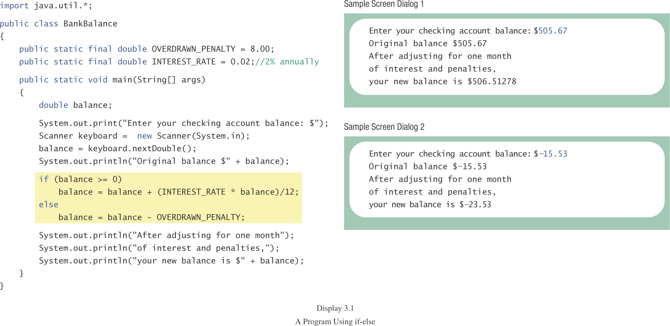
The if-else Statement, cont.
class BankBalance

Slide 37
Multibranch if-else Statements
syntax
if (Boolean_Expression_1)
Statement_1
else if (Boolean_Expression_2)
Statement_2
else if (Boolean_Expression_3)
Statement_3
else if …
else
Default_Statement

Slide 38
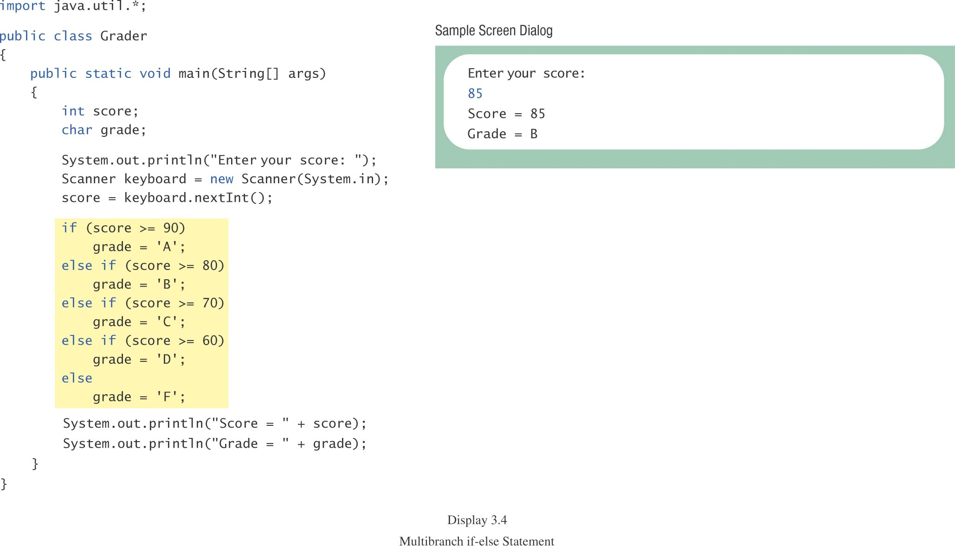
Multibranch if-else Statements, cont.
class Grader

Slide 39
Loop Statements
the while Statement
the do-while Statement
the for Statement

Slide 40
while Statement, cont.
syntax
while (Boolean_Expression)
Body_Statement
or
while (Boolean_Expression)
{
First_Statement
Second_Statement
…
}

Slide 41
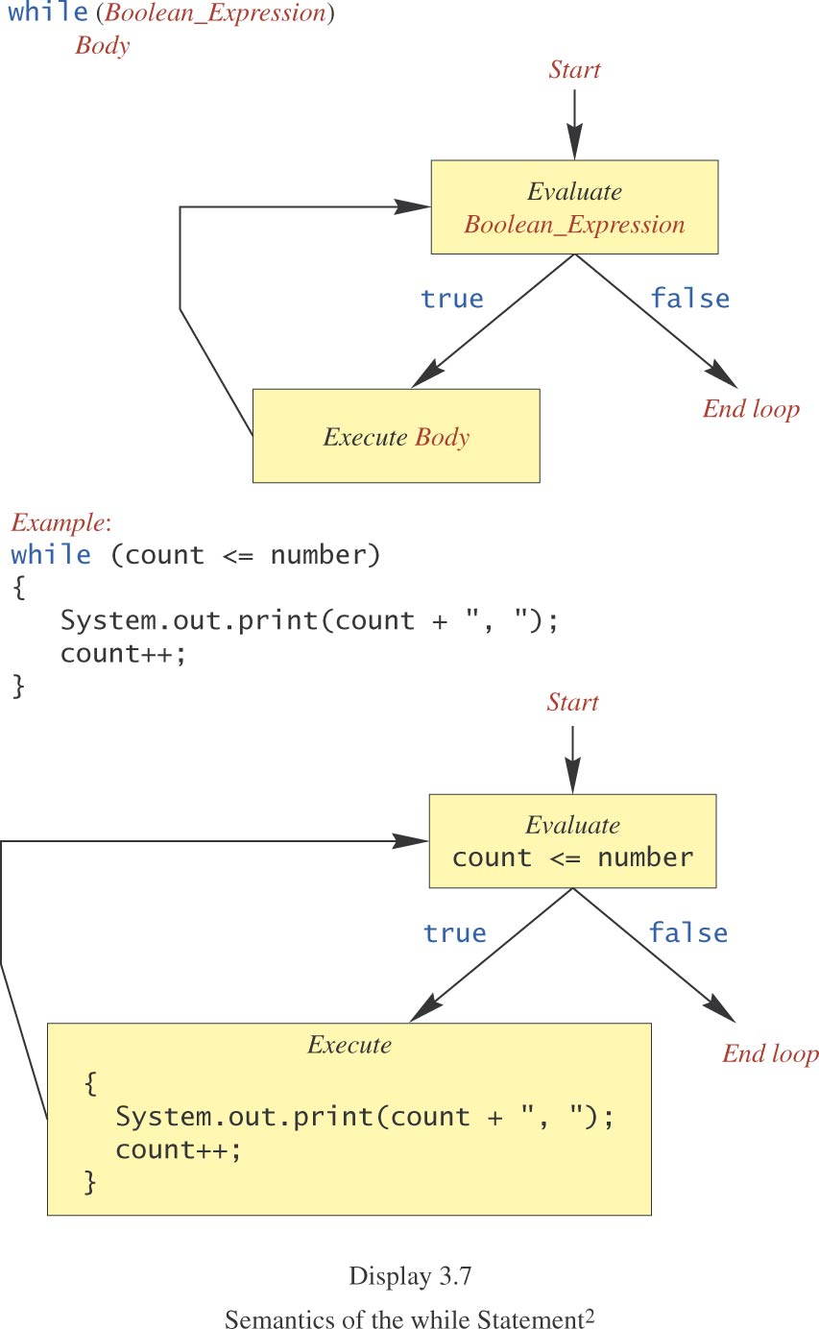
while Statement, cont.

Slide 42
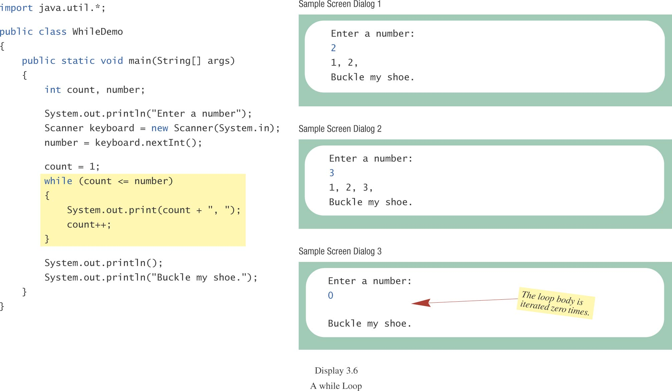
while Statement, cont.
class WhileDemo

Slide 43
do-while Statement
also called a do-while loop (repeat-until loop)
similar to a while statement
except that the loop body is executed at least once
syntax
do
Body_Statement
while (Boolean_Expression);
don’t forget the semicolon at the end!

Slide 44
do-while Statement, cont.
First, the loop body is executed.
Then the boolean expression is checked.
As long as it is true, the loop is executed again.
If it is false, the loop exits.
equivalent while statement
Statement(s)_S1
while (Boolean_Condition)
Statement(s)_S1

Slide 45
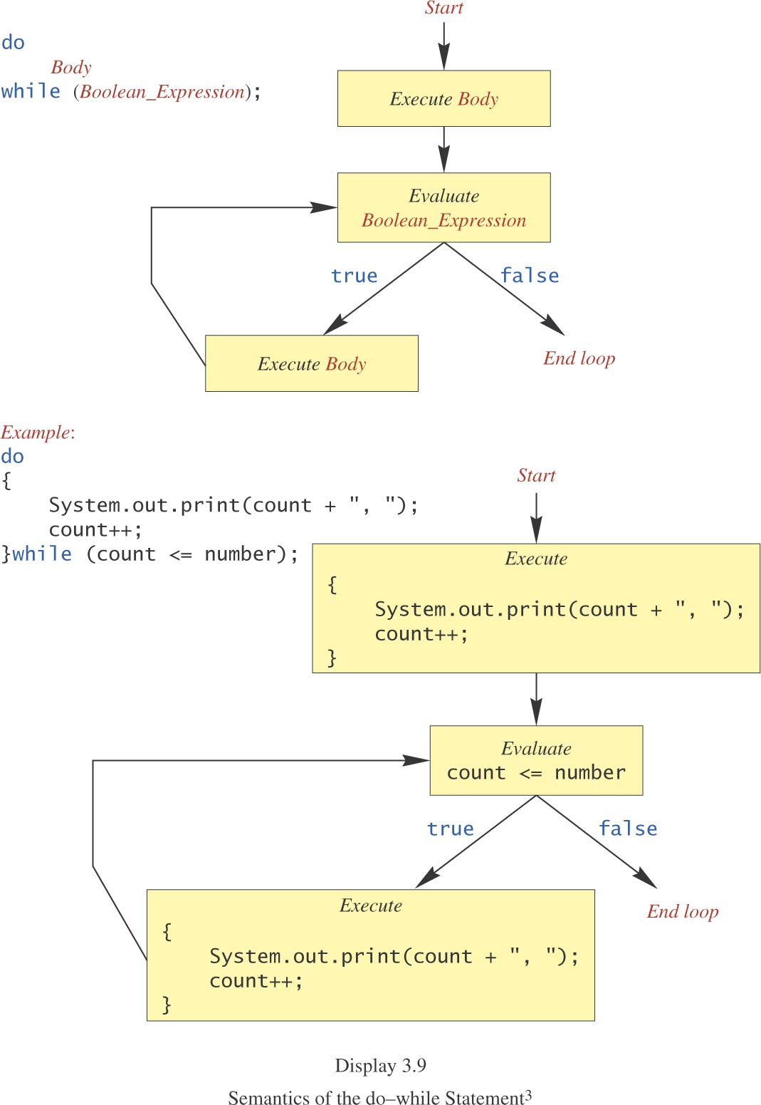
do-while Statement, cont.

Slide 46
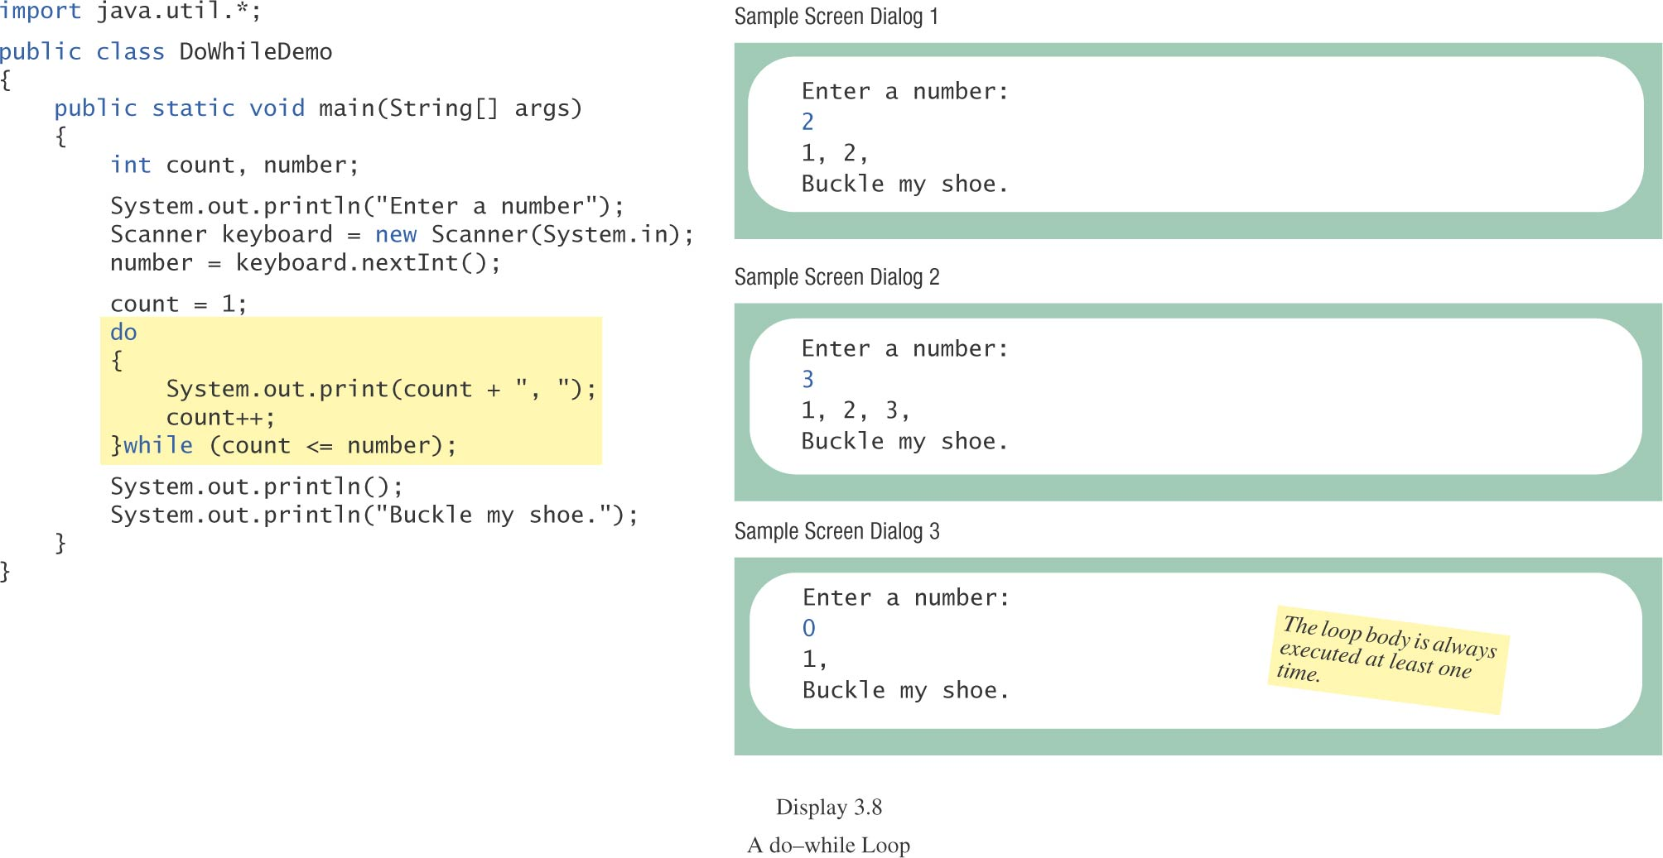
do-while Statement, cont.
class DoWhileDemo

Slide 47
Multibranch if-else Statements, cont.
equivalent logically
if (score >= 90)
grade = ‘A’;
if ((score >= 80) && (score < 90))
grade = ‘B’;
if ((score >= 70) && (score < 80))
grade = ‘C’;
if ((score >= 60) && (score < 70))
grade = ‘D’;
if (score < 60)
grade = ‘F’;

Slide 48
switch Statement
The switch statement is a multiway branch that makes a decision based on an integral (integer or character) expression.
The switch statement begins with the keyword switch followed by an integral expression in parentheses and called the controlling expression.

Slide 49
switch Statement, cont.
A list of cases follows, enclosed in braces.
Each case consists of the keyword case followed by
a constant called the case label
a colon
a list of statements.
The list is searched for a case label matching the controlling expression.

Slide 50
switch Statement, cont.
The action associated with a matching case label is executed.
If no match is found, the case labeled default is executed.
The default case is optional, but recommended, even if it simply prints a message.
Repeated case labels are not allowed.

Slide 51
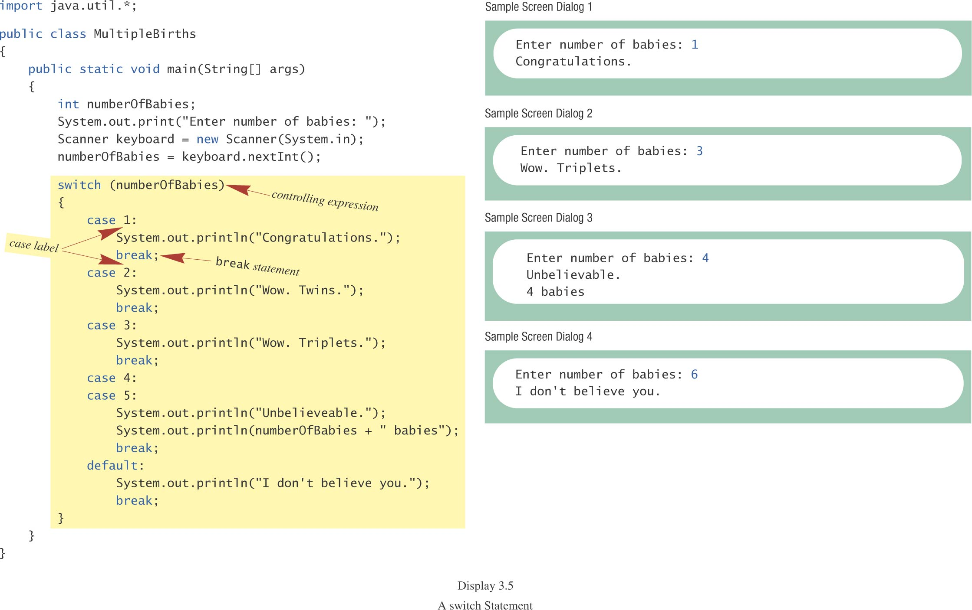
switch Statement, cont.
class MultipleBirths

Slide 52
switch Statement, cont.
The action for each case typically ends with the word break.
The optional break statement prevents the consideration of other cases.
The controlling expression can be anything that evaluates to an integral type (integer or character).

Slide 53
SWITCH CASE STATEMENT
A switch statement allows a variable to be tested for equality against a list of values. Each value is called a case, and the variable being switched on is checked for each case.

Slide 54
SWITCH CASE STATEMENT
Syntax
The syntax of enhanced for loop is −
switch(expression) { case value :
// Statements break; // optional
case value :
// Statements break; //optional
// You can have any number of case statements. default : // Optional
// Statements}

Slide 55
Jump Statement
Three jump statements
Break, continue and return

Slide 56
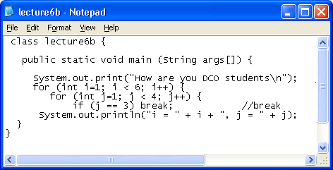
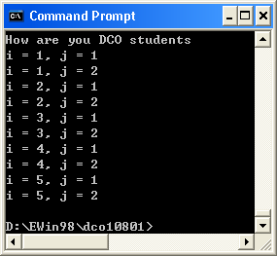
Break and Continue with the nested loop
result: j
1 and 2)
only
break

Slide 57
Break as a form goto
A break statement exits a loop before an entry condition fails.
The break statement can also be employed by itself to provide a form of “goto”. The format is:
break label:

Slide 58
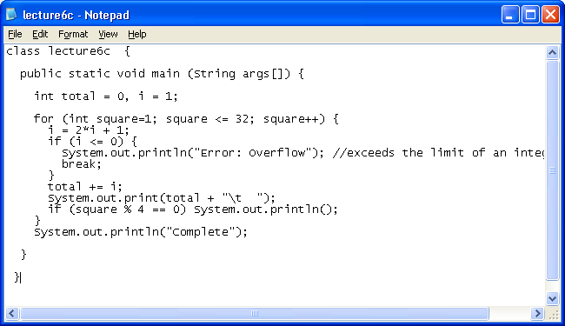
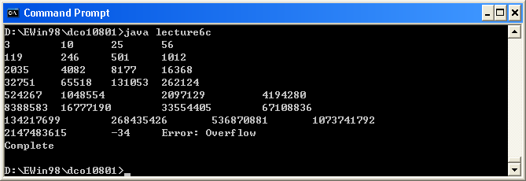
Example – use break to exit from loop
break once it
becomes negative

Slide 59
Continue - Explanation
Sometimes it is necessary to exit from the middle of a loop.
Sometimes we want to start over at the top of the loop.
Sometimes we want to leave the loop completely. For Example
for (int i = 0; i < length; i++) {
if (m[i] % 2 == 0) continue;
// process odd elements... }
it will process
the odd case

Slide 60
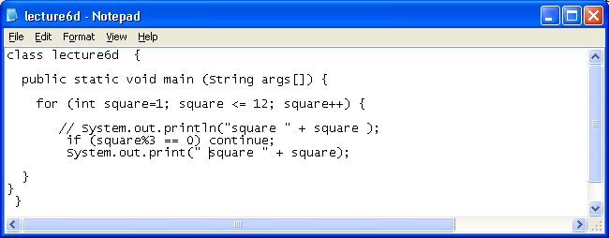
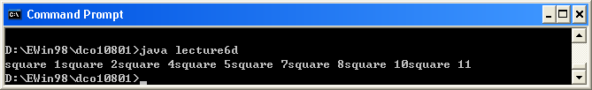
Example - continue
1, 3, 5, 7
are missing

Slide 61
Example - continue
1, 3, 5, 7
are missing

Slide 62
Return
It has purpose to exit from the current method
It jumps back to the statement within the calling method that follows the original method call.
Example
return expression

Slide 63
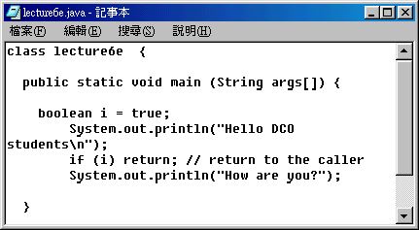
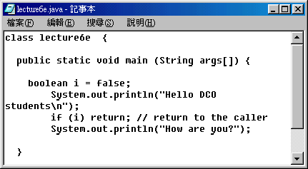


Example

Slide 64
Java String
In java, string is basically an object that represents sequence of char values. An array of characters works same as java string. For example:
char[] ch={'j','a','v','a','t','p','o','i','n','t'};
String s=new String(ch);
is same as:
String s="javatpoint";

Slide 65
Java String class provides a lot of methods to perform operations on string such as compare(), concat(), equals(), split(), length(), replace(), compareTo(), intern(), substring() etc.
The java.lang.String class implements Serializable, Comparable and CharSequence interfaces.

Slide 66
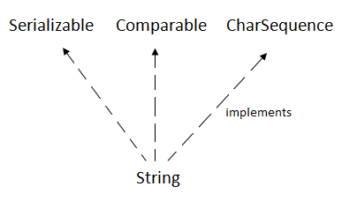

Slide 67
Char Sequence Interface
The CharSequence interface is used to represent sequence of characters. It is implemented by String, StringBuffer and StringBuilder classes. It means, we can create string in java by using these 3 classes.

Slide 68
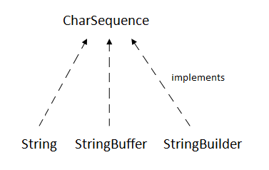

Slide 69
The java String is immutable i.e. it cannot be changed. Whenever we change any string, a new instance is created. For mutable string, you can use StringBuffer and StringBuilder classes.
We will discuss about immutable string later. Let's first understand what is string in java and how to create the string object.

Slide 70
What is String in java
Generally, string is a sequence of characters. But in java, string is an object that represents a sequence of characters. The java.lang.String class is used to create string object.
How to create String object?
There are two ways to create String object:
By string literal
By new keyword

Slide 71
1) String Literal
Java String literal is created by using double quotes. For Example:
String s="welcome";
Each time you create a string literal, the JVM checks the string constant pool first. If the string already exists in the pool, a reference to the pooled instance is returned. If string doesn't exist in the pool, a new string instance is created and placed in the pool. For example:
String s1="Welcome";
String s2="Welcome";//will not create new instance

Slide 72
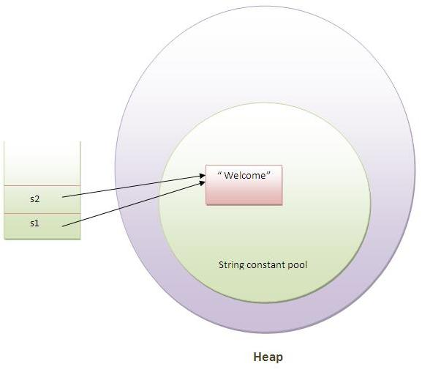

Slide 73
In the above example only one object will be created. Firstly JVM will not find any string object with the value "Welcome" in string constant pool, so it will create a new object. After that it will find the string with the value "Welcome" in the pool, it will not create new object but will return the reference to the same instance.
Note: String objects are stored in a special memory area known as string constant pool.
Why java uses concept of string literal?
To make Java more memory efficient (because no new objects are created if it exists already in string constant pool).

Slide 74
2) By new keyword
String s=new String("Welcome");
In such case, JVM will create a new string object in normal(non pool) heap memory and the literal "Welcome" will be placed in the string constant pool. The variable s will refer to the object in heap(non pool).
Java String Example
public class StringExample{
public static void main(String args[]){
String s1="java";//creating string by java string literal
char ch[]={'s','t','r','i','n','g','s'};
String s2=new String(ch);//converting char array to string
String s3=new String("example");//creating java string by new keyword
System.out.println(s1);
System.out.println(s2);
System.out.println(s3);
}}
javastrings

Slide 75
The switch Statement, cont.
syntax
switch (Controlling_Expression)
{
case Case_Label:
Statement(s);
break;
case Case_Label:
…
default:
…
}

Slide 76
Switch with char Type
char grade = 'A';
switch(grade)
{
case 'A':
case 'B':
case 'C':
case 'D':
System.out.println("Pass");
break;
case 'W':
System.out.println("Withdraw");
break;
case 'I':
System.out.println("Incomplete");
break;
default:
System.out.println("Fail");
}

Slide 77
for Statement
A for statement executes the body of a loop a fixed number of times.
example
for (count = 1; count < 3; count++)
System.out.println(count);
System.out.println(“Done”);

Slide 78
for Statement, cont.
syntax
for (Initialization; Condition; Update)
Body_Statement
Body_Statement
a simple statement or
a compound statement in {}.
corresponding while statement
Initialization
while (Condition)
Body_Statement_Including_Update

Slide 79
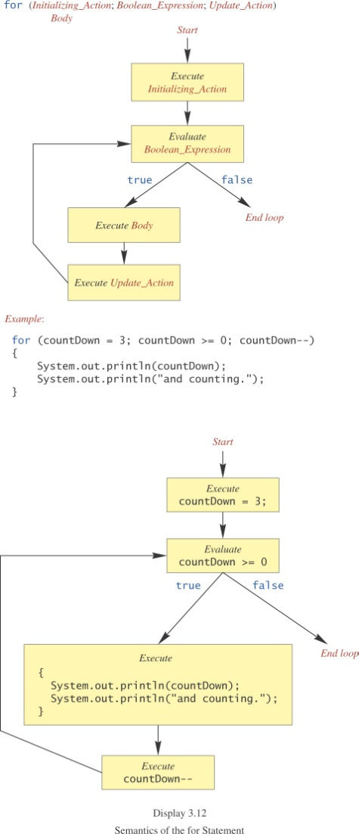
for Statement, cont.

Slide 80
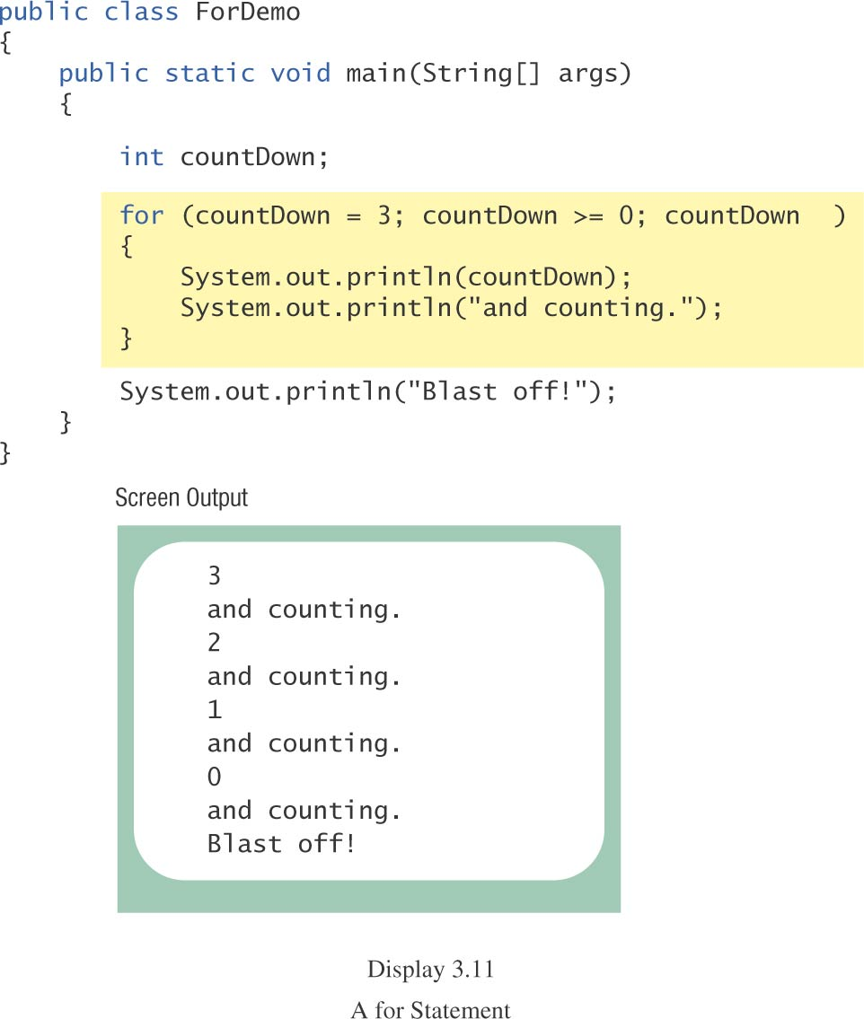
for Statement, cont.
class ForDemo

Slide 81
Multiple Initialization, etc.
example
for (n = 1, p = 1; n < 10; n++)
p = p * n
Only one boolean expression is allowed, but it can consist of &&s, ||s, and !s.
Multiple update actions are allowed, too.
for (n = 1, p = 100; n < p; n++, p -= n)
rarely used

Slide 82
Choosing a Loop Statement
If you know how many times the loop will be iterated, use a for loop.
If you don’t know how many times the loop will be iterated, but
it could be zero, use a while loop
it will be at least once, use a do-while loop.
Generally, a while loop is a safe choice.

Slide 83
Nested Loops
The body of a loop can contain any kind of statements, including another loop.
In the previous example
the average score was computed using a while loop.
This while loop was placed inside a do-while loop so the process could be repeated for other sets of exam scores.

Slide 84
Nested Loops
The body of a loop can have any kind of statements, including another loop.
Each time the outer loop body is executed, the inner loop body will execute 5 times.
20 times total
for (line = 0; line < 4; line++)
{
for (star = 0; star < 5; star++)
System.out.print('*');
System.out.println();
}
body of outer loop
body of inner loop
*****
*****
*****
*****
Output:

Slide 85
Enhanced for loop
Enhanced for loop is useful when scanning the array instead of using for loop.
Syntax of enhanced for loop is: for (data_type variable: array_name)
Here array_name is the name of array.
class EnhancedForLoop {
public static void main(String[] args) {
int primes[] = { 2, 3, 5, 7, 11, 13, 17, 19, 23, 29};
for (int t: primes) {
System.out.println(t);
}
}
}

Slide 86
For-each loop (Advanced/Enhanced For loop)
The for-each loop introduced in Java5. It is mainly used to traverse array or collection elements. The advantage of for-each loop is that it eliminates the possibility of bugs and makes the code more readable.
Advantage of for-each loop:
It makes the code more readable.
It eliminates the possibility of programming errors.
Syntax of for-each loop:
for(data_type variable : array | collection){}

Slide 87
New features from Java 5 to Java 7
JAVA 5 Features
The important features of J2SE 5 are generics and assertions. Others are auto-boxing, enum, var-args, static import, for-each loop (enhanced for loop etc.
For-each loop (Java 5)
Varargs (Java 5)
Static Import (Java 5)
Auto boxing and Unboxing (Java 5)
Enum (Java 5)
Covariant Return Type (Java 5)
Annotation (Java 5)
Generics (Java 5)

Slide 88
JavaSE 6 Features
The important feature of JavaSE 6 is premain method (also known as instrumentation).
Instrumentation

Slide 89
JavaSE 7 Features
The important features of JavaSE 7 are try with resource, catching multiple exceptions etc.
String in switch statement (Java 7)
Binary Literals (Java 7)
The try-with-resources (Java 7)
Caching Multiple Exceptions by single catch (Java 7)
Underscores in Numeric Literals (Java 7)

