Slide 1
Software Engineering
Surendran Velath

Slide 2
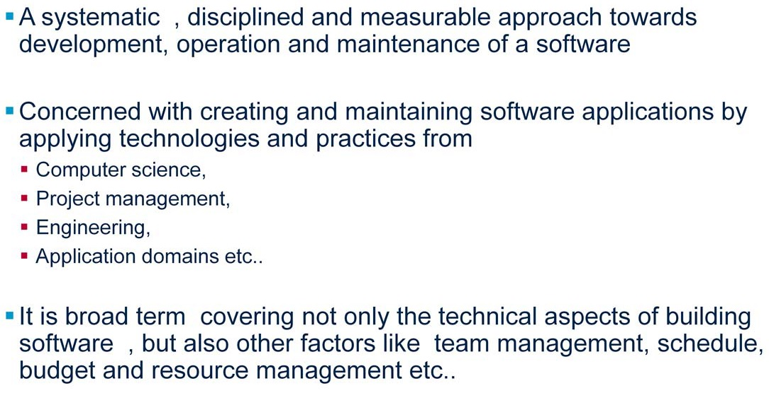
Software Engineering

Slide 3
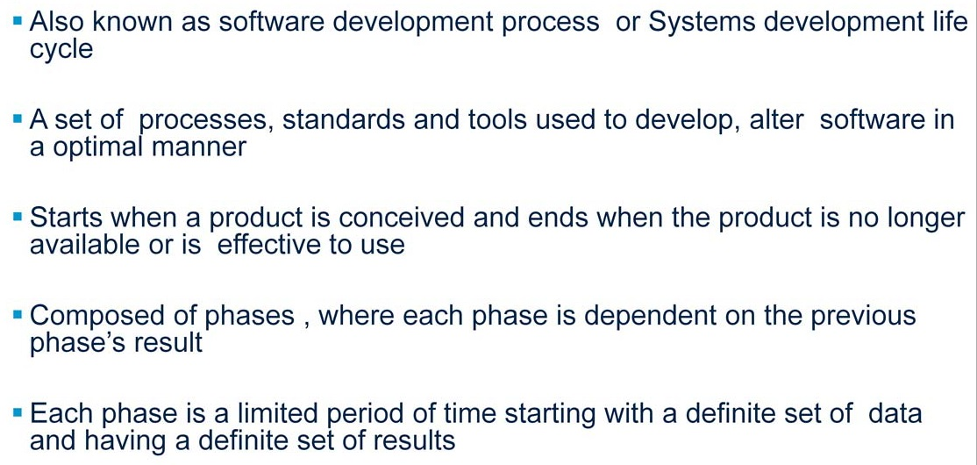
Software Development Life Cycle

Slide 4
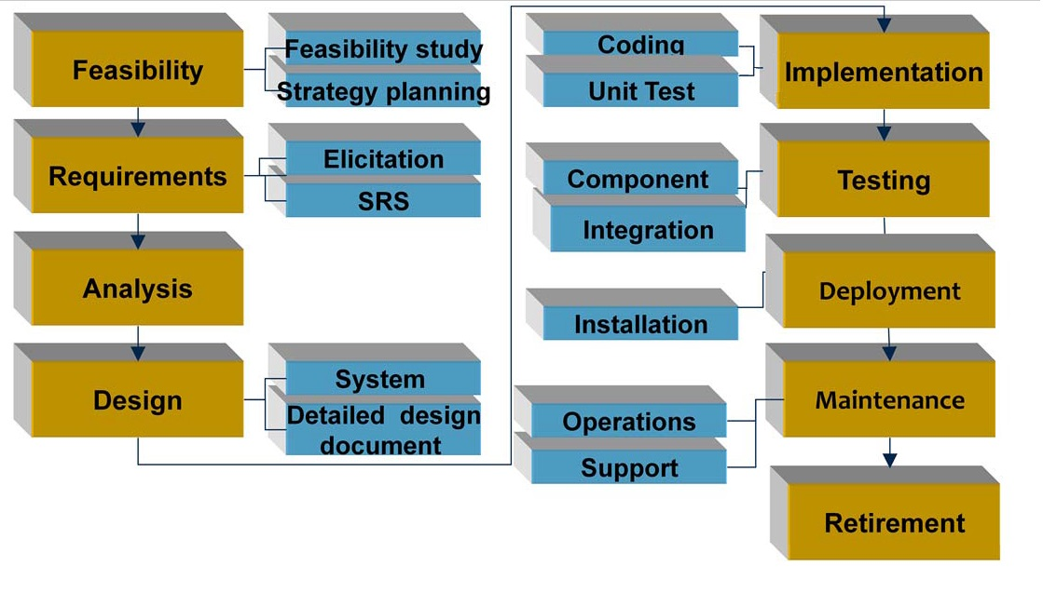
Software Development Phases

Slide 5
Initiation Phase
Begins when a business need or opportunity is identified
Project Manager is appointed to manage the project.
Business need is documented in a Concept Proposal.
System Concept Development Phase begins

Slide 6
System Concept Development Phase
The approaches for accomplishing the concept are reviewed for feasibility and appropriateness.
The Systems Boundary Document identifies the scope of the system
Senior Official approval and funding is obtained

Slide 7
Planning Phase
Describes how the business will operate once the system is implemented
Assess how the system will impact employee and customer privacy.
Ensure the products and/or services provide the required capability on-time and within budget, project resources, activities, schedules, tools, and reviews are defined.
Security certification and accreditation activities begin with the identification of system security requirements

Slide 8
Requirements Analysis Phase
Functional user requirements are formally defined and delineate the requirements in terms of data, system performance, security, and maintainability requirements for the system.
All requirements are defined to a level of detail sufficient for systems design to proceed.
All requirements need to be measurable and testable and relate to the business need or opportunity identified in the Initiation Phase

Slide 9
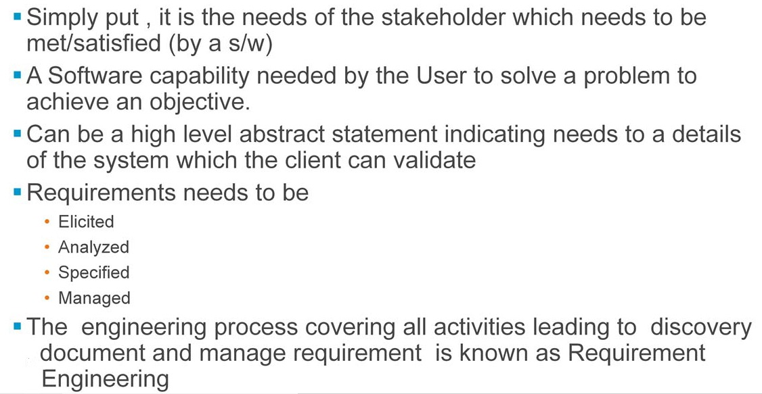
Software Requirement

Slide 10
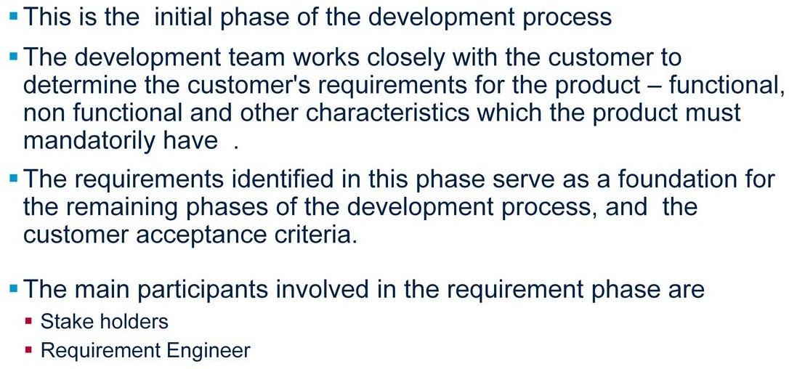
Requirement Phase

Slide 11
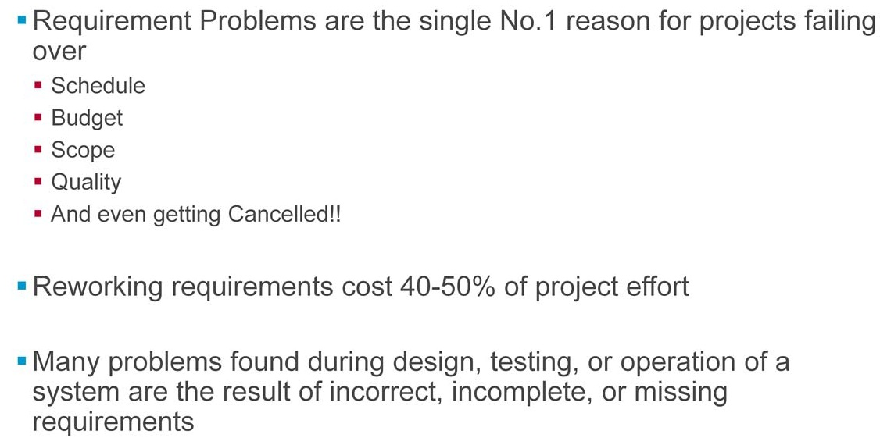
Need for Requirement

Slide 12
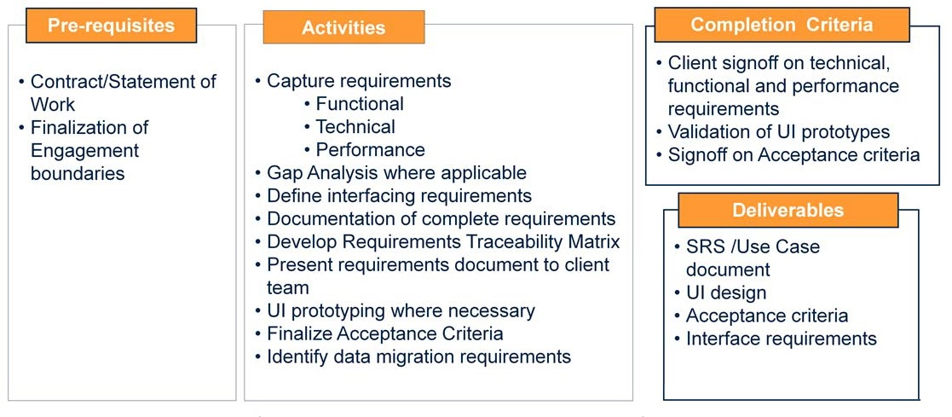
Requirement Phase Key Points

Slide 13
Design Phase
The physical characteristics of the system are designed.
The operating environment is established, major subsystems and their inputs and outputs are defined, and processes are allocated to resources.
Everything requiring user input or approval must be documented and reviewed by the user.
The physical characteristics of the system are specified and a detailed design is prepared.
Subsystems identified during design are used to create a detailed structure of the system.
Each subsystem is partitioned into one or more design units or modules.
Detailed logic specifications are prepared for each software module

Slide 14
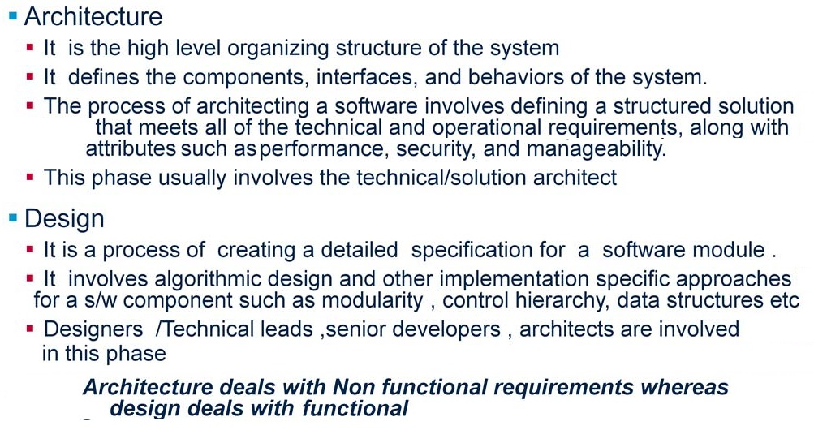
Architecture and Design

Slide 15
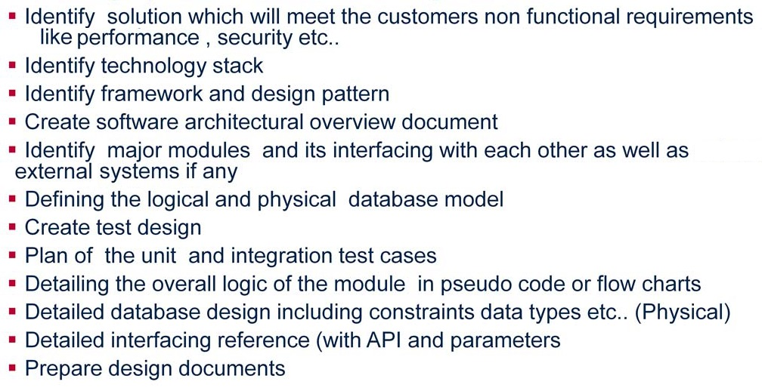
Design: key activities

Slide 16
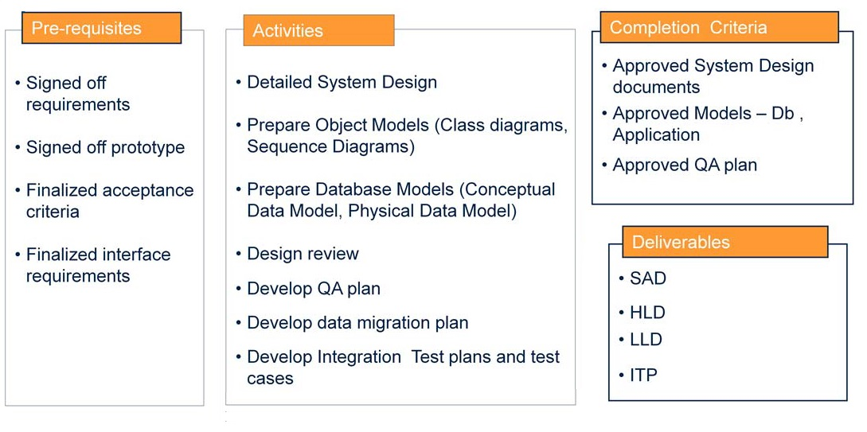
Design: key activities

Slide 17
Development Phase
The detailed specifications produced during the design phase are translated into hardware, communications, and executable software.
Software shall be unit tested, integrated, and re-tested in a systematic manner.
Hardware is assembled and tested

Slide 18
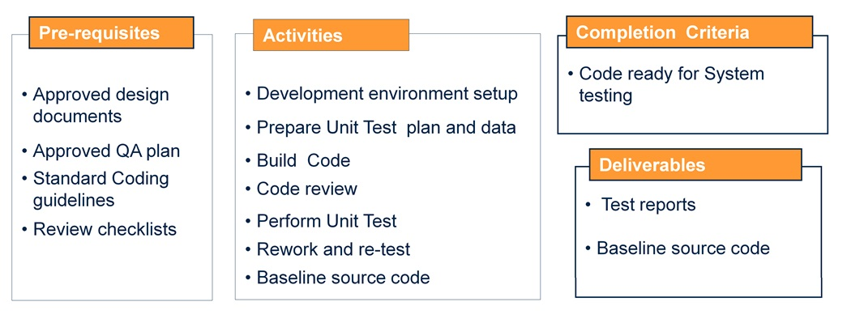
Development: Key activities

Slide 19
Integration and Test Phase
The various components of the system are integrated and systematically tested.
The user tests the system to ensure that the functional requirements, as defined in the functional requirements document, are satisfied by the developed or modified system.
Prior to installing and operating the system in a production environment, the system must undergo certification and accreditation activities

Slide 20
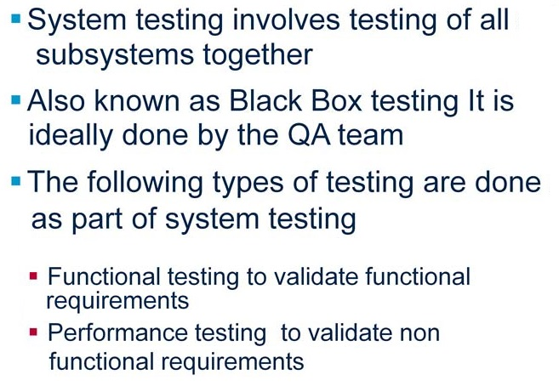
System Testing

Slide 21
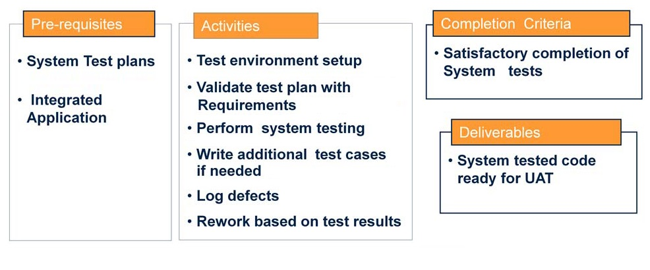
System Testing Key Activities

Slide 22
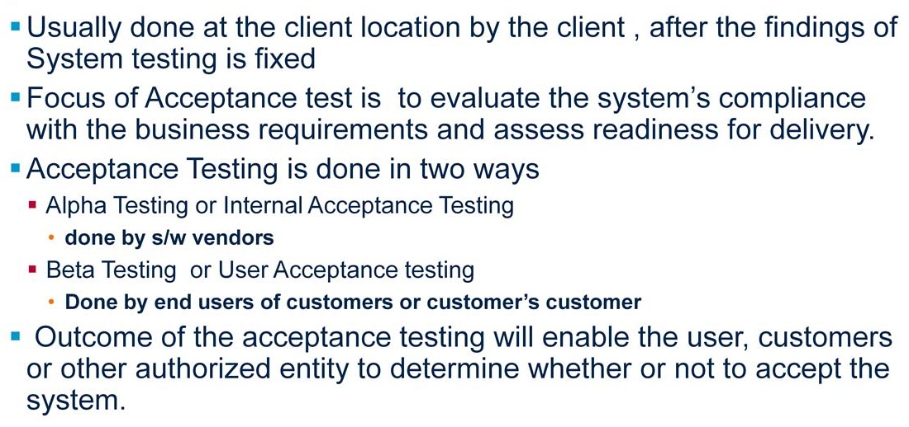
Acceptance Testing

Slide 23
Implementation Phase
The system or system modifications are installed and made operational in a production environment.
The phase is initiated after the system has been tested and accepted by the user.
This phase continues until the system is operating in production in accordance with the defined user requirements

Slide 24
Operations and Maintenance Phase
The system operation is ongoing.
The system is monitored for continued performance in accordance with user requirements, and needed system modifications are incorporated.
The operational system is periodically assessed through In-Process Reviews to determine how the system can be made more efficient and effective.
Operations continue as long as the system can be effectively adapted to respond to an organization’s needs.
When modifications or changes are identified as necessary, the system may re-enter the planning phase

Slide 25
Agile Methodology

Slide 26
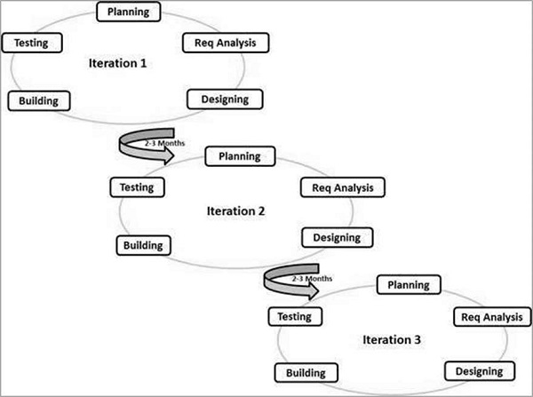
Agile Model

Slide 27
Agile vs Waterfall model
Agile is based on the adaptive software development methods, whereas the waterfall model is based on a predictive approach
Customer Interaction is backbone of Agile methodology
Open communication with minimum documentation are the typical features of Agile development environment.
Functionality can be developed rapidly and demonstrated
Suitable for fixed or changing requirements
Enables concurrent development and delivery within an overall planned context
Gives flexibility to developers

Slide 28
Scrum Process
Scrum is an agile process that allows us to focus on delivering the business value in the shortest time.
It rapidly and repeatedly inspects actual working software.
It emphasizes accountability, teamwork, and iterative progress toward a well-defined goal.
The Scrum Framework usually deals with the fact that the requirements are likely to change or most of the time.
Scrum is its flexible and quickly reacts to changes
Collaboration is achieved in daily stand up meeting with a fixed role assigned to scrum master, product owner, and team members
Scrum team focus to deliver maximum business value, from beginning early in the project and continuing throughout.

Slide 29
Scrum Principles
Self-organization: This results in healthier shared ownership among the team members. It is also an innovative and creative environment which is conducive to growth.
Collaboration: Collaboration is another essential principle which focuses collaborative work. 1. awareness 2. articulation, and 3. appropriation. It also considers project management as a shared value-creation process with teams working together to offer the highest value.
Time-boxing: This principle defines how time is a limiting constraint in Scrum method. An important element of time-boxed elements are Daily Sprint planning and Review Meetings.
Iterative Development: This principle emphasizes how to manage changes better and build products which satisfy customer needs. It also defines the organization's responsibilities regarding iterative development.

