Slide 1
Machine learning
*Mini Project
Name – Ranvijay Patel Amarnath
Roll No. – 1901156
Email - ranvijay.amarnath@iiitg.ac.in
Litrature Survey

Slide 2
Research Paper Survey :
http://www.columbia.edu/~jc4133/ADA-Project.pdf
In this article it uses the following Machine learning model to predict the model.
logistic regression
neural network
random forest
KNN model
After training the datasets using these model, these are the following results has been recorded.

Slide 3
Logistic regression :
We practiced 10-fold cross validation to tune parameters for logistic classifier. After we got a tuned model, we tested its performance on the testing set and the accuracy achieved 0.9132.
Resampling results:
AUC Sens Spec Accuracy Kappa
0.936 0.973 0.424 0.912 0.471
2. Neural Network (MLP)
A 5-fold cross-validation uses to select best parameters for neural network
AUC values are 0.9516 and 0.9423 for training set and test set.
3. Random forest :
AUC for training data is 0.991, for test data is it is 0.9427.

Slide 4
4. KNN :
AUC score for K- NN is 0.8531.
Comparison :
 | Random Forest | Neural Network | k-NN | Logistic Regression
AUC | 0.9427* | 0.9423 | 0.8531 | 0.9364
Test accuracy | 0.9136 | 0.9145* | 0.9018 | 0.9137
FPR at TPR=0.99 | 0.2642 | 0.2566* | 0.3054 | 0.3809
(* means this algorithm is the best in the given measurement)

Slide 5
Conclusion :
MLP is performing best among all these.
Neural network dominates in two measurements and ranked 2nd in AUC, so it’s the most powerful model.
In the light of overall test accuracy and AUC, and FPR at TPR=0.99, the best model is neural network. It has the most powerful prediction ability

Slide 6
2. https://research.ijcaonline.org/volume85/number7/pxc3893218.pdf
In this article, it uses the following machine learning model to train our model and predict the accuracy that how well the model is performing.
multilayer perception neural network (MLPNN)
tree augmented Naïve Bayes (TAN)
logistic regression (LR)
decision tree model (C5.0)

Slide 7
Table measurement of MLPNN, TAN, LR AND C5.0
Model | Partition | Accuracy | Sensitivity | Specificity
MLPNN | Training | 90.92% | 65.66% | 93.28%
MLPNN | Testing | 90.49% | 62.20% | 93.12%
TAN | Training | 89.16% | 55.87% | 91.97%
TAN | Testing | 88.75% | 52.19% | 91.73%
LR | Training | 90.09% | 64.83% | 91.76%
LR | Testing | 90.43% | 65.53% | 92.16%
C5.0 | Training | 93.23% | 76.75% | 94.92%
C5.0 | Testing | 93.23% | 59.06% | 93.23%

Slide 8
Conclusion :
the specificity measure has C5.0 with the highest values in training samples 94.92% and 93.23% for testing samples. From the previews, C5.0 is the best in accuracy, sensitivity, and specificity analysis of training sample.
However, the MLPNN is the best for accuracy; LR takes the best percentage for sensitivity, and C5.0 return to be the best in specificity analysis of testing samples.

Slide 9
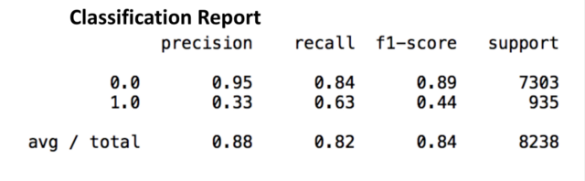
3. https://medium.com/analytics-vidhya/term-deposit-opening-decision-f57776b88453
In this article it uses thee model to train our model.
Logistic regression
K-NN
Random forest
1. Logistic Regression
Accuracy score : 0.815

Slide 10
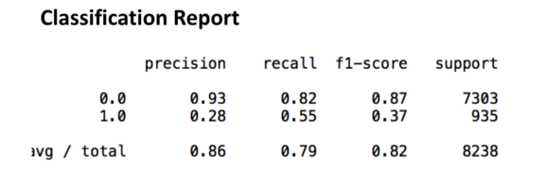
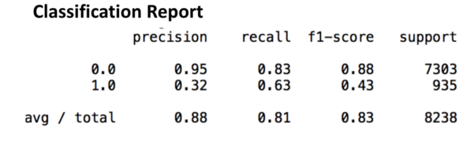
2. K-NN :
Accuracy Score = 0.789
3. Random forest :
Accuracy Score : 0.807

Slide 11
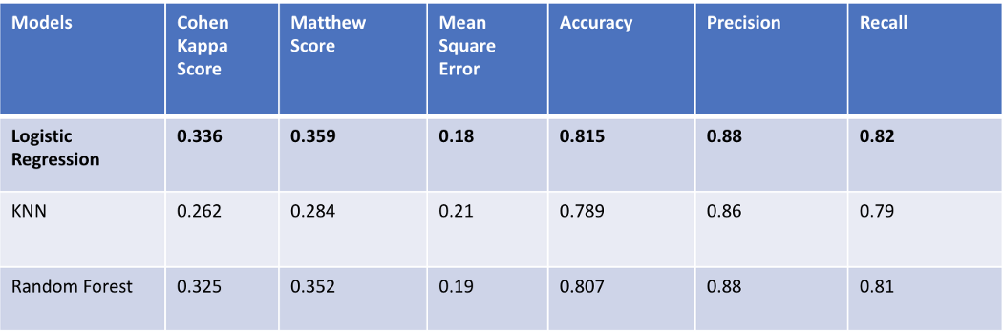
Summery :
After according to the table we can say that the Logistic regression model is the best fit model among all three model.

Slide 12
Final Conclusion :
After Analysing all three articals
In first article MLP is performing the best out of all.
According to second article the random forest is best.
According to 3rd the MLP is the best predictor.

